Slide 1
HamCon Colorado 2025
Grand Junction Colorado

Slide 2

Some DX History
OR

Slide 3
The Good, The Bad, and The Skilled
The Path to DX

Slide 4
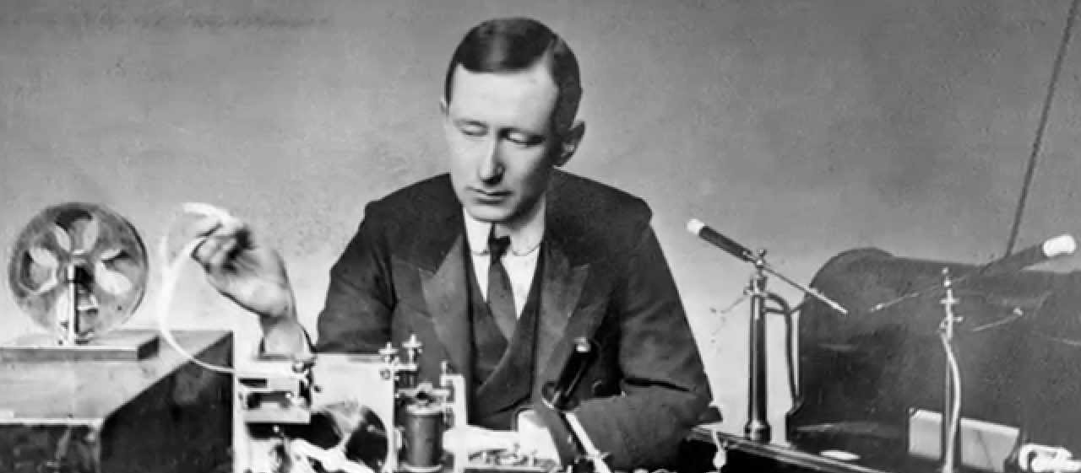
Wireless
Marconi, 22 years old, 1896, 2 miles across English countryside

Slide 5
Wireless
Then 4 miles
Then 10 miles ship to ship
Then 32 miles across the English Channel
1901, December 12th, 3rd attempt, transmitted an “S” 2,000 miles, from Newfoundland to England, “wireless” everywhere but a lot of skepticism and disbelief

Slide 6
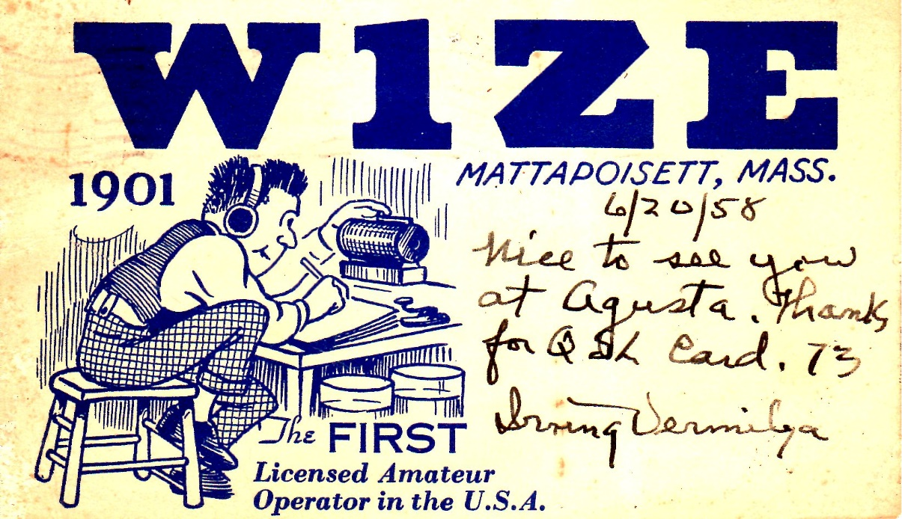
Irving Vermila
11-year-old
Simple park coil transmitter (squeak box)
Reverend C H Tyndall, closely followed Marconi’s work, spiritual similitudes
Got documents
Irving Invited all of his neighbors

Slide 7
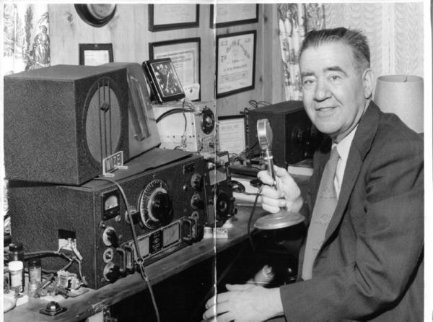
Irving Vermila
Private telegraph lines
Friendly competition
War with Brooklyn Navy Yard/United Wireless

Slide 8
Navy
Considered too radical
Senior officers were appalled, orders from land, where was their autonomy
But in 1901 dropped pigeons, adopted wireless
100 kw station at Arlington in 1913

Slide 9
Wireless Clubs
Clubs first appeared in 1909 and became quite popular in 1910
Not all was harmonious…..Chicago
The result was the “Chicago Plan”, and the Smith Cup

Slide 10
Crossing the Atlantic
Had to be at 200 meters
ARRL was asked to take on the project
Many in the scientific community were skeptical of doing this on such a short wavelength as 200 meters
Significant prizes offered by manufacturers

Slide 11
Crossing the Atlantic
Feb, 1921, 24 American amateurs transmitted and 250 British amateurs listened
zero success
British blocked each other
Send a U.S. operator!

Slide 12
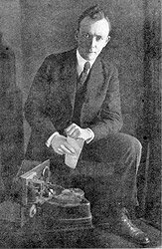
A bet…..
“We would bet our new spring hat that if a good U.S. amateur with a more modern set and an Armstrong unit could be sent to England, reception of U.S. amateurs would straight way become commonplace” ARRL secretary Kenneth Warner
Taken and doubled

Slide 13
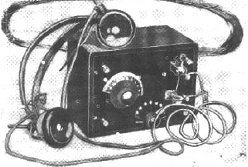
Paul Godley
An American, Paul Godley, considered a reception expert, was sent to England with the best American gear

Slide 14
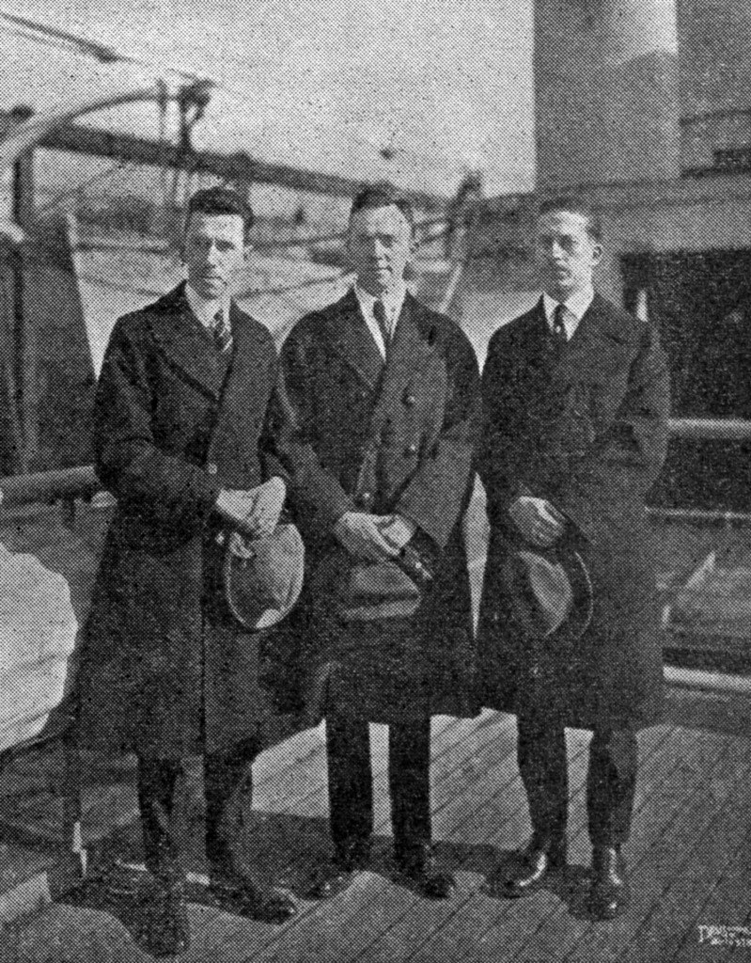
Crossing the Atlantic-Paul Godley
At a meeting with British hams there was a lack of belief that it could happen
In a conversation with the chief engineer for the British government of their wireless department, he said that American ham radio could not work in Britain due to the small size of the island, radios were too close
Most of the British radio, commercial and private was below 275 meters, at one-point Paul counted 39 harmonics from one commercial station

Slide 15
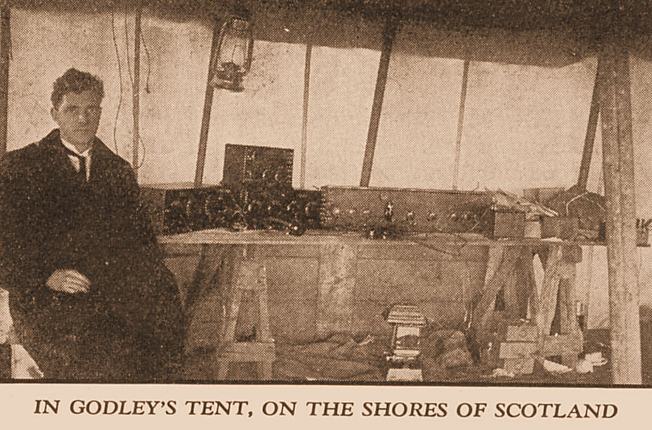
Crossing the Atlantic-Paul Godley
They arranged their equipment so that they could crouch down near the little oil heater and began listening
Visitors, Swank, Yacht at sea

Slide 16
Crossing the Atlantic
Sealed envelopes
Phonetics
1:42 am success, 1921, 1AAW
Headlines in QST- “Oh, Mr. Printer, how many exclamation points have you got? Trot’em all out, as we’re going to need them badly, because WE GOT ACROSS!!!!!
And incredibly it was done on 200 meters

Slide 17
Transpacific And More
December 14, Hawaii heard amateurs from California to Wisconsin on 375 meters
April 13-first transpacific two-way communication
April 13 and 14- Pacific and Atlantic coasts of US had a two-way communication
And then the next 12 months were filled with new record distances and countries talking to each other. One article called it the most hectic in the history of ham radio.
The record for 9000 miles stood for 6 days, longer than most records

Slide 18
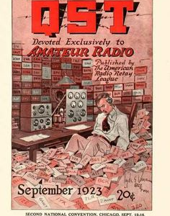
Transpacific And More
QST, 1923 stated “This poor magazine has recorded so many dazzling accomplishments in recent issues that its supply of exclamation points and bold-faced type is in danger of exhaustion”

Slide 19
200 Meters
1912 , the “Alexander Law” gave amateurs privileges below 200 meters and up to one kilowatt
1914 Amateur Radio Relay League was organized
Scientific experiments and results led to the longer the wavelength the greater the distance it would travel
Many interesting events in legislation, military, WWI, commercial broadcasting, spark vs CW, etc.
Ham radio played a crucial role in the knowledge and discoveries of the ionosphere

Slide 20
High Frequency
And soon special permission was being given to go to 80 meters, unheard of a few years ago
One radio scientist speaking of going to shorter wavelengths than 200 meters, was quoted in QST- “It can’t be done”.
Another said “One hundred meters is useless”
And then to the wonder of all, much of the DX was being done on the high frequencies of 108 to 118 meters

Slide 21
Daylight????
Soon 40 meters was experimented with, and with each surprising success, amateurs began to talk about doing international DX during daylight hours
One theory held that the moon was responsible for the distance that radio signals would go
Another that air conducted radio signals

Slide 22
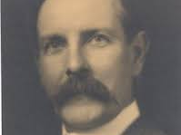
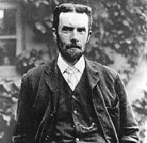
DAYLIGHT????
Then the Kennelly-Heaviside layer was discovered in the atmosphere
We know it as the “E” layer
Then 20 meters was authorized for experimentation

Slide 23
QSL cards
First one in 1916 from 3TQ
Carl Huffman, 8UX, an artist and ham radio operator further developed the idea, and soon QST was printing articles on how they should be sent and what should be on them

Slide 24
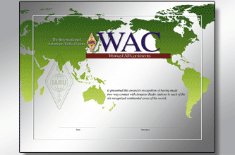
Worked All Continents
The oldest award and certificate
In 1926 the first one was awarded to Brandon Wentworth, 6OI

Slide 25
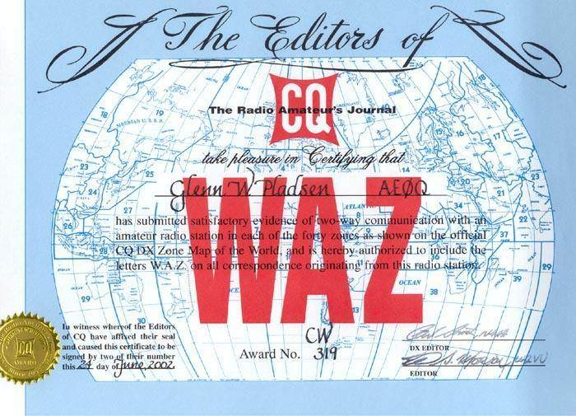
Worked All Continents
Began in 1934 by K.V. R. Lansingh, W6QX, editor of R/9 magazine
In 1940 CQ magazine sponsored it

Slide 26
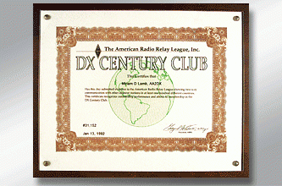
DX Century Club (DXCC) Started in 1935, first Awarded in 1937

Slide 27
Variable Directional Electric Wave Generating Device
1926
Paper written by two Japanese college professors
1932
Patent granted in 1932

Slide 28
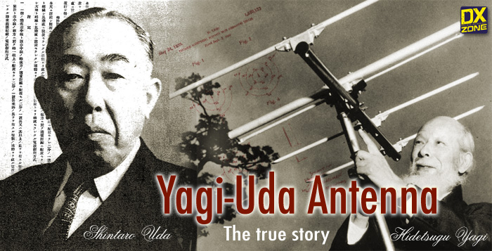
Yagi Antenna

Slide 29

Ernst Krenkel RAEM
Due to hard times after WWI he could not finish school
Was able to attend a free night class in radio operation
Final exam he had the highest CW speed
Wanted to be a ship radio operator and travel the world but there was no work

Slide 30
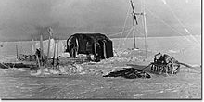
Ernst Krenkel RAEM
He heard of an urgent need for an Arctic expedition, applied and was accepted, because no one else wanted the poor pay, gone for a year, and terrible living conditions

Slide 31
Ernst Krenkel RAEM
After that year he wanted to return and use shortwave ham radio equipment
Was given an emphatic NO
Russian Radio Laboratory, Navy wanted him to test it, they gave him the equipment, then Navy, radio laboratory wanted him to test the gear

Slide 32
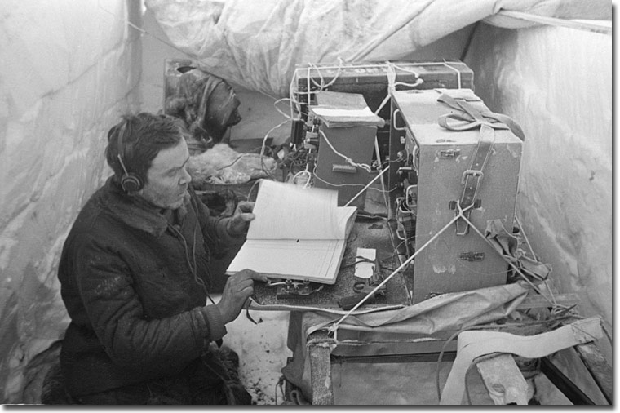
Ernst Krenkel RAEM
To the amazement of everyone he very successfully made contacts in the very harsh conditions.

Slide 33
Ernst Krenkel RAEM
He became well known to the public, particularly in Russia, being the operator on blimps and ships, making many DX contacts

Slide 34
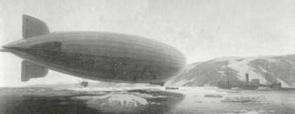
Ernst Krenkel RAEM

Slide 35
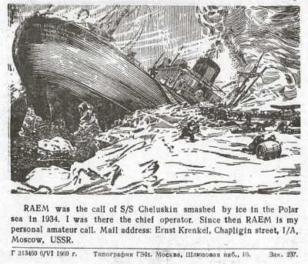
Ernst Krenkel RAEM
Adventure on “Cheyuskin”
Ended up on an ice flow and drifted until they came close to Greenland, all the while making contacts
His actions made him a hero

Slide 36
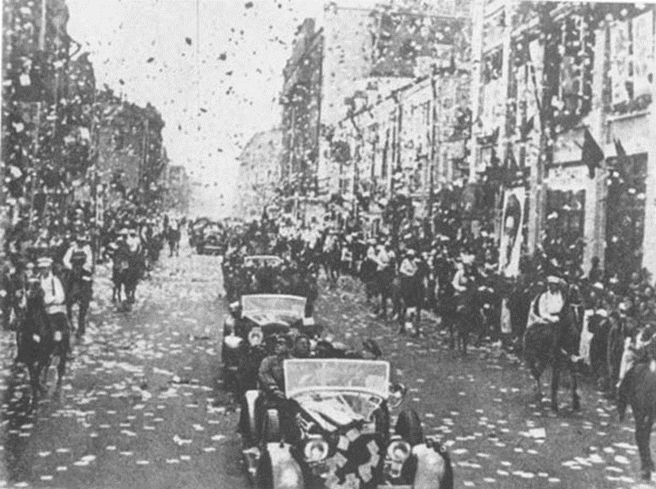
Ernst Krenkel RAEM
His actions made him a hero

Slide 37
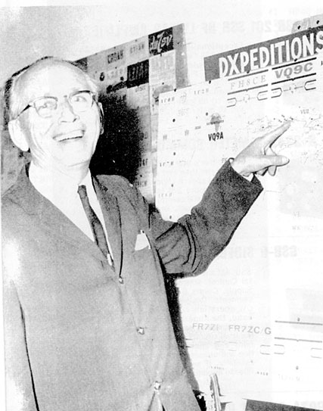
Gus Browning W4BPD
TV technician turned full time ham

Slide 38
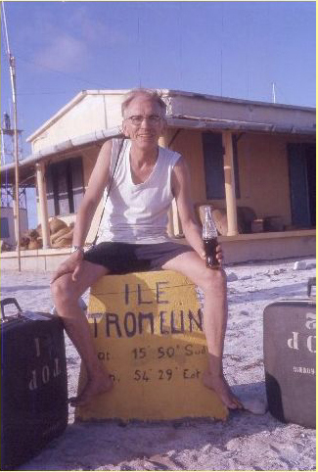
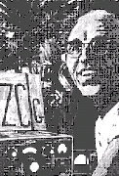
Gus Browning-W4BPD

Slide 39

Gus Browning W4BPD
The first DXer elected to the DX Hall of Fame
Well known for always having Coca-Cola on hand when working pile ups
Was right-handed but taught himself to write with his left hand so he could operate two handed CW
Always even tempered, smooth, but always controlled the pile up
If the natives ate it, he would eat it

Slide 40
Gus Browning W4BPD
Rarely had money
Joined fishermen, caravans, because they were going in the right direction
Showed natives how radio worked for a place to stay
Developed a taste for yak butter

Slide 41
Gus Browning W4BPD
Sometimes was not quite sure where he was, would ask, and then make up a call sign, had some strange call signs
Operated from over 100 countries

Slide 42
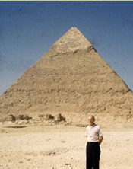
Gus Browning W4BPD
Great sense of humor
Always in control with his pileups
Up ten! Up ten!
QRT now, my feet are wet, need to get back in boat

Slide 43
Gus Browning and Bouvet Island

Slide 44
“It took about two hours of hard work for us to go the 1,000 feet or so from where the ship was anchored to where we wanted to land.
I had on the following clothing: regular undershorts and shirt, then two pair of those red, long, insulated underwear, a flannel shirt with long tails, two pairs of woolen pants, one pair of regular socks, and then a pair of woolen socks coming about six inches above my knees, then a very heavy turtleneck sweater. I also had a wool headpiece covering all but my eyes, and a big heavy overcoat, and last but not least, a pair of fur-lined gloves coming almost to my elbows. And I was still cold!

Slide 45
This glacier was making all kinds of noise all day long and all night long; cracking, popping, and snapping. Then there was a tremendous splash when a big chunk of this frozen snow dropped off to the ocean below.
I sure wish I could have stayed longer. I operated practically around the clock while down there— total number of QSOs at the end of that time was almost 5,000, and still the pile-up sounded larger than the first day there. It was great, fellows! The thrill is still with me when I sit or lie back and think of it all!”

Slide 46
Danny Weil
Nine years of sailing his boat, mostly alone, covering over 20,000 miles
Three boats, YASME I, II and III
Number 5 on the CQ all time list
Would do everything possible to give out countries and make contacts
John Arraway, K4IIF, in CQ magazine said “ He had more narrow escapes from death than 100 average men, was the pioneer of world wide Dxpedition.”

Slide 47
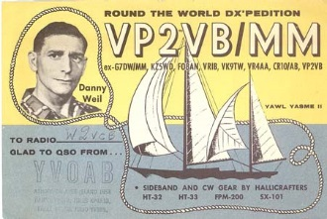
Danny Weil

Slide 48
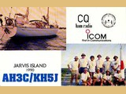


Slide 49
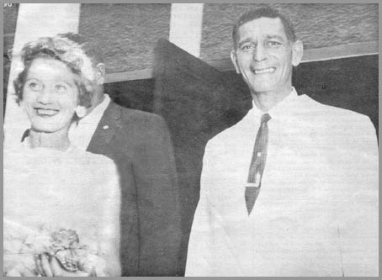
Danny Weil

Slide 50

Danny Weil
40 foot pole
Typhon
Wreck

Slide 51
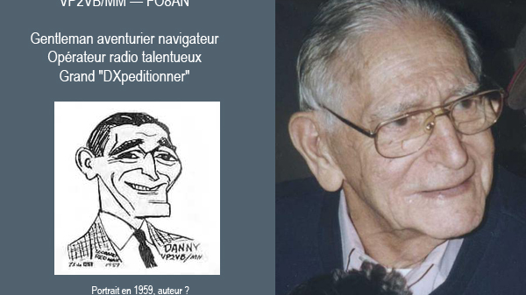

Slide 52
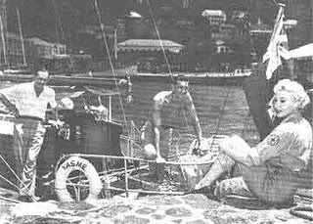
Iris & Lloyd Colvin

Slide 53
Iris and Lloyd Colvin
Retired military
Land developer
First licensed at age 12

Slide 54
Iris & Lloyd Colvin
One of the largest collections of QSL cards weighing over a ton
Generated over one million QSO’s
Traveled to 221 DXCC countries and operated from two thirds of them
Known for his generosity, kindness, passion and absolute integrity
Donated a life insurance policy over 150,000$ to ARRL

Slide 55
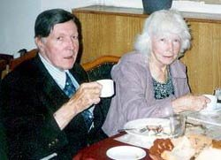
Iris and Lloyd Colvin
“If you don’t have it, it’s rare”
Could do cw at 40 wpm, but used 25 wpm to help those that were new or slower
Stories from their travels

Slide 56

Solar Eclipse QSO Party 2023/2024 Planning Kickoff
The Solar Eclipse QSO Party (SEQP) is coming back! Two solar eclipses will be traversing the continental United States over the next two years: an annular solar eclipse on October 14, 2023 and a total solar eclipse on April 8, 2024. These eclipses are going to be the last solar eclipse traversing the continental United States until 2044, and therefore this is our chance to both have some fun on the radio and study these amazing events! During a solar eclipse, the shadow of the moon creates temporary night-like conditions on Earth. This causes the ionosphere to weaken and the atmosphere to cool, therefore causing changes in ionospheric radio propagation. HamSCI is planning on have two more SEQPs, one for each of the upcoming solar eclipses.

Slide 57
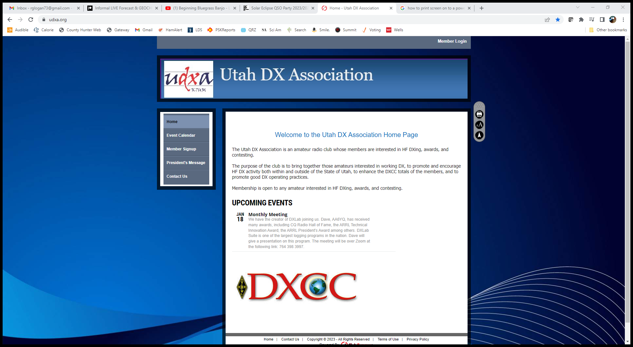

Slide 58
Sources:
http://w2pa.net/HRH/
RAOTA, autumn 2009, OT News
www.raota.org
https://en.wikipedia.org/wiki/Hidetsugu_Yagi
http://www.zl2al.com/2779/gus-browning-w4bpd/
Cain, James D., (2003), “The Danny Weil and Colvin radio Expeditions”, ARRL

