Slide 1
Critical comms for planned events
Clear, complete, concise
Steve Schroder Ki0KY
Notes:
Test test test

Slide 2
introduction
This presentation presents practices that enable clear, concise, and complete communications for emergencies at planned events.

Slide 3
TOPICS
PURPOSE
DUTCH CREEK INCIDENT
PLANS
DOCUMENTATION
TEMPLATES
COMPETENCY
COMMUNICATION SKILLS
REVIEW
REFERENCES

Slide 4
Purpose to support planned events
Emergency Communications, usually a medical emergency.
Routine traffic
Participant numbers,
Logistics
Administration

Slide 5
Planned Events
Major activity for amateur radio operators. Training for Emergencies
Wide range in size and scope.
From an hour or so to several days.
Car rallies, bicycle races, marathons, endurance races, horse races.

Slide 6
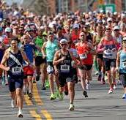

Slide 7
Boston Marathon:
26 miles, few hours
Relatively flat terrain
Many repeaters,
Thousands of runners
Large crowds
Hundreds of staff
Terrorism target
Mass Casualty Incident

Slide 8
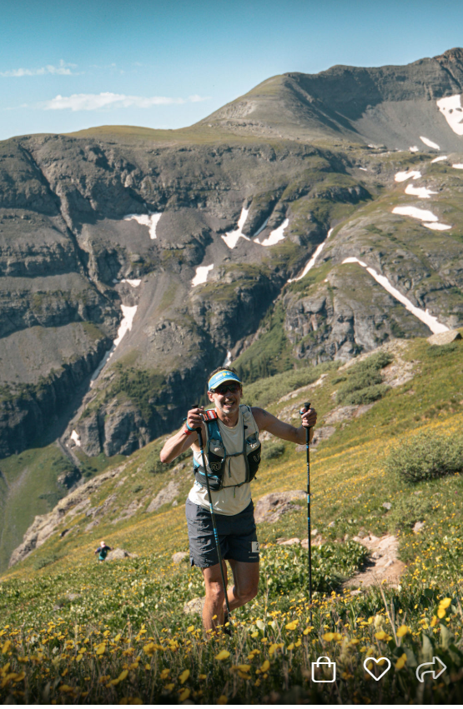

Slide 9
Hard Rock One Hundred
100 runners, 48 hours,
High mountains
Poor repeater coverage,
No standing EMS support,
One runner died in July’s race.

Slide 10
Dutch creek incident July 25, 2008
Eighteen-year-old on a saw team died two hours after injury from femoral artery bleed.
Several policies and procedures were not followed.
Confusion:
How serious is the injury?
Which EMT is in charge?
How to transport?

Slide 11
DUTCH CREEK INVESTIGATION
Finding 04:There was insufficient pre-planning to integrate incident personnel and resources into the local emergency management system
Finding 06 - The incident was operating with inaccurate or incomplete IAPs.

Slide 12
Dutch creek investigation Recommendations
1. Plans for Medical Emergency Procedures
2. Standardized Communication Center Protocols
3. Review Emergency Medical Procedures at each operational Period.

Slide 13


Slide 14
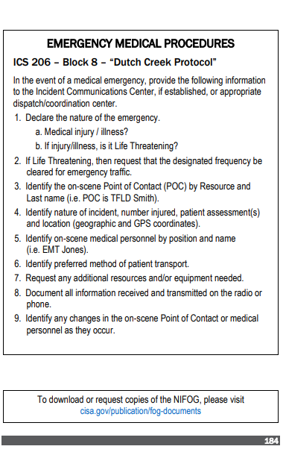

Slide 15


Slide 16
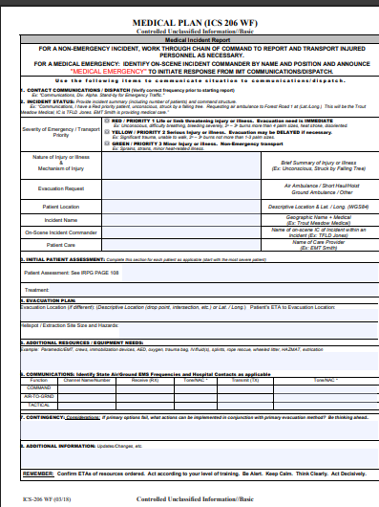
Ics 206 wf / medical incident report

Slide 17
Plans
Event Plan (registration thru finish, may include emergency procedures)
Communications Plan (Communication Protocols)
Team (Intra-team Communications)

Slide 18
ADMIN: Who says what to whom when “orders from headquarters”
Approved by event organizers.
Written plan that defines:
Policies and Procedures
Decision Maker: Who decides about EMS/911.
Expected Traffic:
Distributed to all communication personnel.

Slide 19
Example
Experienced club members knew from past races the race director makes the decision to call 911/SAR.
A unbriefed ham from a different club called 911 to dispatch an ambulance 30 plus minutes away for a runner.
The director arrived and the runner recovered to continue before the ambulance was “on scene.”

Slide 20
COMMUNICATIONS PLANs
Part of or separate from other instructions
ICS 205 INCIDENT COMMUNICATIONS PLAN
Incident Command System- Incident Management Teams
Part of the Incident Action Plan (IAP)
Limitations for non-ICS Events
Communication and organization information on separate pages

Slide 21
Signals Operating Instructions ( SOI)
Military
Adaptable for different situations, size units
Information might be on one page:
Frequencies,
Call signs,
Phone numbers,
Encryption,
Codes,
Challenges,
etc.

Slide 22
Xyz race communications plan
Primary: “Big Top Repeater “ 147.195 + 107.2
Alternate: “Simplex” 147.525
Directed Net, Wolf Pass NCS
Stations/Tactical Call Signs: Start, Low Ridge, Wolf Pass, High Creek, Finish, Sweep

Slide 23
XYZ RACE COMMUNICATIONS PLAN
Race Director: John Doe ph. 999-222-4444 (At Finish)
Medical Director: EMT-P Strange ph. 888-555-9999 (At Wolf Pass)
Report injuries to Medical Director.
Use the ICS-206 Block Eight “Dutch Creek Protocol”
Medial Director makes calls to 911.
Race Director makes calls for SAR.

Slide 24
Documentation write everything down
Unit Log (ICS-214)
Personnel and significant activities at each station,
Communications Log (ICS 309)
List messages to and from each station
General Message (ICS-213)
Admin. and third-party messages

Slide 25
Documentation is important!
Your personal records
Club/team Archive
Legal record: investigation, evidence, deposition, trial
After Action Review and Improvement Plan

Slide 26
ICS 214 Unit Log
Time Activity Log
0630 Leave home
0800 Arrive at Low Ridge Aid Station 67 miles
0810 Briefing with Low Ridge Aid Station Captain
1300 Nr 999 injured ref msg 1322
1533 Sweep passed, station shut down
1723 Arrived home 67 miles
AAR notes: Have 2 ops at each station.

Slide 27
EXAMPLE ICS 309, COMMUNICATONS LOG ENTRY
Time From To Message
(24:00) Call Sign/ID Call Sign/ID
1101 SUMMIT FINISH 1ST MALE IN OUT 1100
_1323_ SUMMIT FINISH MSG 1322 NR 999 INJURY
_______ ____________ __________ _________________________

Slide 28
GENERAL MESSAGE (ICS 213)
1. INCIDENT NAME XYZ RACE
2. TO: NAME, POSITION John Doe Director, Finish
3. FROM: NAME, POSITION Ben Franklin Low Ridge
4. SUBJECT: Lunch Count
5. DATE: 8 Nov.
6.TIME: 0820
7. MESSAGE: Low Ridge Lunch Count is 14
8. APPROVED BY: SIGNATURE, POSITION, TITLE Ben Franklin Low Ridge Aid Station Capt.
Notes:
The reply section was deleted to fit the text into the slide.

Slide 29
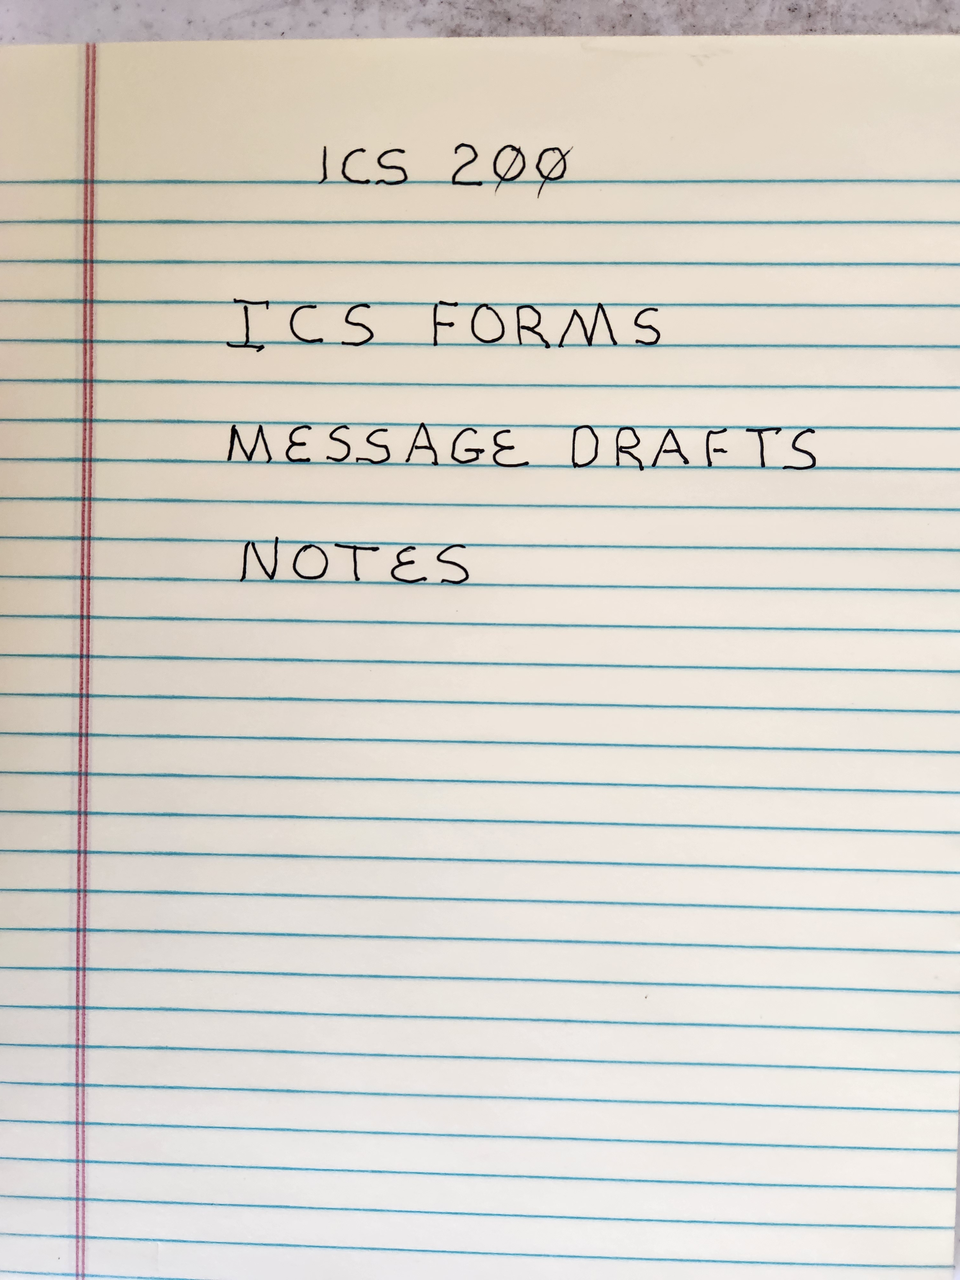

Slide 30
Team Communication Responsibilities
Brief.
Debrief.
Communicate hazards to others
Acknowledge and understand messages.
Ask if you don’t know.

Slide 31
Briefing
Tasks: Send, receive, document messages.
Purpose: Provide Clear, Concise, Complete Communications
End State: All messages passed with 100 percent accuracy

Slide 32
Debrief, HOT WASH, after action report
Timely
Everyone
Successes
Challenges
Collect, archive documents
Improvement Plan

Slide 33
Templates: clear, concise, complete
Reduce time and effort.
Only the critical words, not sentences
Checklist of required information

Slide 34
Templates
PSAP 911 Centers
US Military 9-Line Medivac
Taught in the Basic Combat Training.
Incident management teams : Dutch Creek Protocol /ICS 206WF / MEDICAL INCIDENT REPORT
NWCG IRPG
NWCG and ALL HAZARD IMT IAPs
NIFOG (back cover)

Slide 35
ICS 206 WF-Block 8 Dutch creek protocol
1. Declare the nature of the emergency
Medical injury / illness
If injury/illness, is it Life Threatening
2. If Life Threatening, then request the designated frequency be cleared for emergency traffic.
3. Identify the on-scene Point of Contact (POC) by Resource (title) and last name. (i.e. Radio Operator Smith)
4. Identify nature of incident, numbered injured, patient assessment(s),and location (geographic and GPS coordinates)

Slide 36
ICS 206-Block 8 Dutch creek protocol
5. Identify on-scene medical personnel by position and name
(i.e. EMT Jones)
6. Identify preferred method of patient transport
7. (All operators )Document all information received and transmitted on the radio or phone.**
8. Identify and changes in the on-scene POC or medical personnel

Slide 37
EXAMPLE DUTCH CREEK PROTOCOL ON ICS 213
2. TO: JOHN DOE DIRECTOR FINISH
3. FROM: EMT-P STRANGE SUMMIT
4. SUBJECT: NR 999 INJURY
5. DATE: _________
6.TIME: 1322
Notes:
The reply section was deleted to fit the text into the slide.

Slide 38
MESSAGE DUTCH CREEK PROTOCOL
LINE 1. MEDICAL INJURY NOT LIFE THREATENING
LINE 3. JONES KZ0ZZZ
LINE 4. NR 999 INJURED KNEE UNABLE TO WALK LOW RIDGE AID STATION
LINE 6. SAR UTV
8. EMT-P STRANGE

Slide 39
COMMUNICATION SKILLS
Write, edit, get approval before transmitting.
Print legible upper-case letters.
Speak slowly. Trace each letter as you speak.
Reading, speaking slowly, lowers vocal stress.
Read back each line for 100 percent accuracy.

Slide 40

Acknowledge each line
Summit this is Low Ridge Medical Emergency Dutch Creek Protocol How copy?
Low Ridge: I copy medical emergency Dutch Creek Protocol
Summit: Good copy, line 1 medical injury not life threatening How copy?
Low Ridge: I copy line 1 medical injury not life threatening
Summit: Good copy line 3 Joe Jones KZ0ZZZ how copy
Low Ridge: I copy line 3 Joe Jones KZ0ZZZ
Summit: Good copy line 4 number 999 injured knee unable to walk Low Ridge Aid Station How Copy

Slide 41
Acknowledge each line
Summit: I copy line 4 number 999 injured knee unable to walk Low Ridge Aid Station
Low Ridge good copy line 6 SAR UTV how copy
Summit: I copy line 6 SAR UTV
Low Ridge: Good copy line 8 EMTP Strange end of message how copy
Summit I copy line 6 EMTP Strange end of message
Low Ridge Good copy KZ0ZZZ

Slide 42
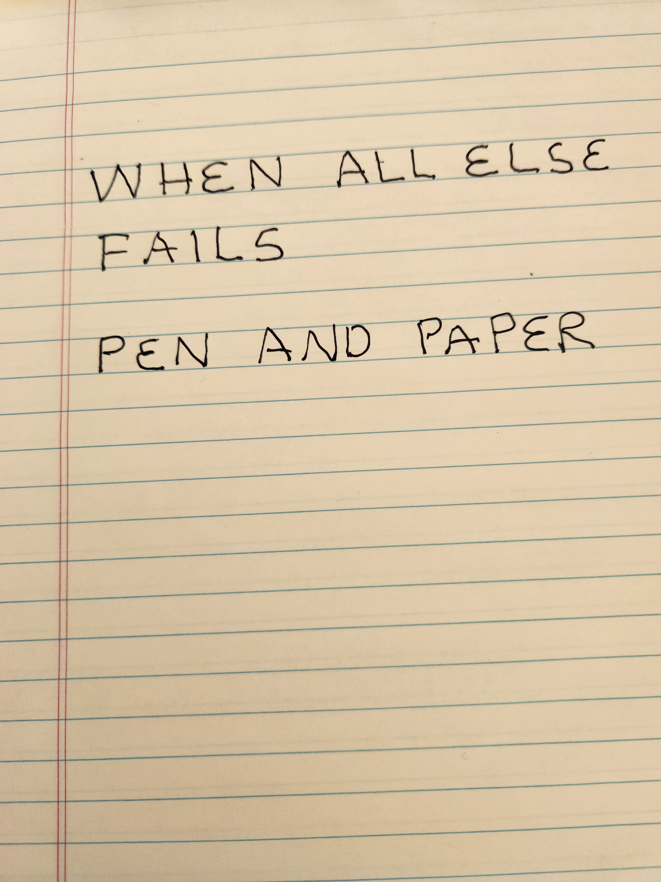

Slide 43
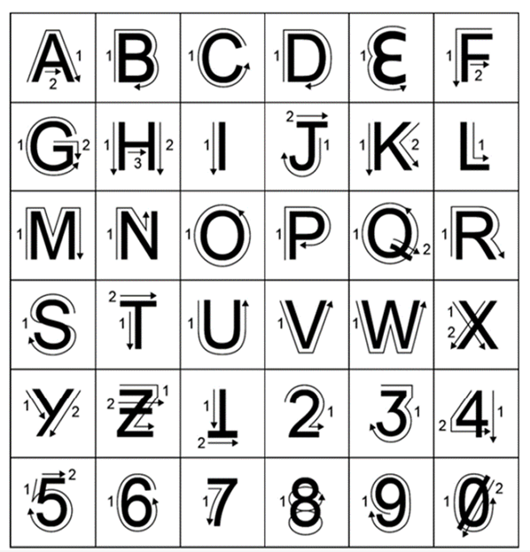

Slide 44
demonstrate competency before the incident
Conduct team training before the event.
Conduct briefing and drills before the start.
Repeat briefing and drills each operational period.

Slide 45
REVIEW
PURPOSE: Clear, complete, concise communications for emergencies at planned events.
DUTCH CREEK INCIDENT: Planning, Protocols, Briefings
PLANS: Policy, Communication (i.e. SOI), Team Briefings
DOCUMENTATION: Unit Logs, Communication Logs, Message Forms, ICS-200!
TEMPLATES: ICS 206-WF Dutch Creek Protocol
COMPETENCY. Briefings, Demonstrate Procedures
COMMUNICATION SKILLS: Write Everything, Print Clearly, Speak Slowly, Read Back.

Slide 46
INDEX OF KNOWLEDGE AKA FINAL EXAM
You are the leader for your club’s support of a planned event. A new ham from another, distant club will be part of your team.
List the topics you will have in your emailed instructions.
What documents will you have your team use?
Complete this sentence:
“Amateur” radio operators ______________________ “professional” communicators.

Slide 47
Do Your research (Google. YOUTUBE)
Dutch Creek Incident, Protocol
Signals Operating Instructions
FM 6-99 U.S. ARMY REPORT AND MESSAGE FORMATS
NIFOG App: https://www.cisa.gov › safecom › public-safety-library-... or cisa.gov/publication/fog-documents
INCIDENT RESPONSE POCKET GUIDE
GUERILLAS GUIDE TO THE BAOFENG RADIO!! , NC Scout (Amazon paperback)

Slide 48
QUESTIONS?
Steve Schroder KI0KY
KI0KY_at_ARRL.NET

Slide 50
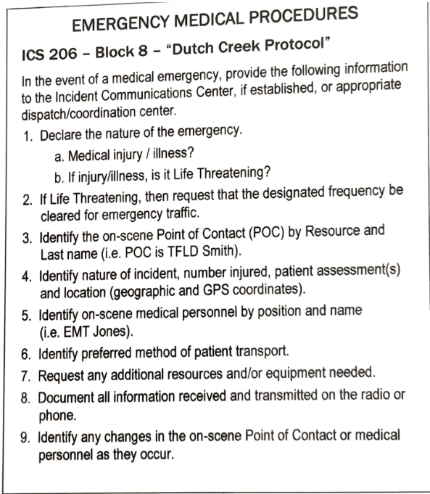

Slide 51

ICS -- 200

