Slide 1
Women in Amateur Radio - Connect, Learn, and Inspire!
Amanda Alden, K1DDN

Slide 2
ABOUT ME
Licensed since 2009
  General in 2011, Extra 2013
Own a print shop
Camping and Hunting
Love dogs and gardening
  Can and preserve everything

Slide 3
ABOUT ME
Colorado Section Manager
  Coordinated Volunteers on the Air
  Planning for Colorado 150/USA 250 events
  Visit with clubs
  Advocate
  Educate
  Head cheerleader

Slide 4
ABOUT ME
ARES involvement
  Responded to numerous fires
  Coordinated public service events
    Too many to list

Slide 5
ABOUT ME
Love all things HF
  Nets
  Ragchewing
  Contesting
Repeaters
  By default I’ve been taught more than I need about them

Slide 6
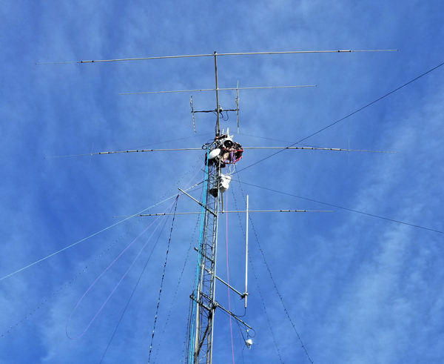

Slide 7
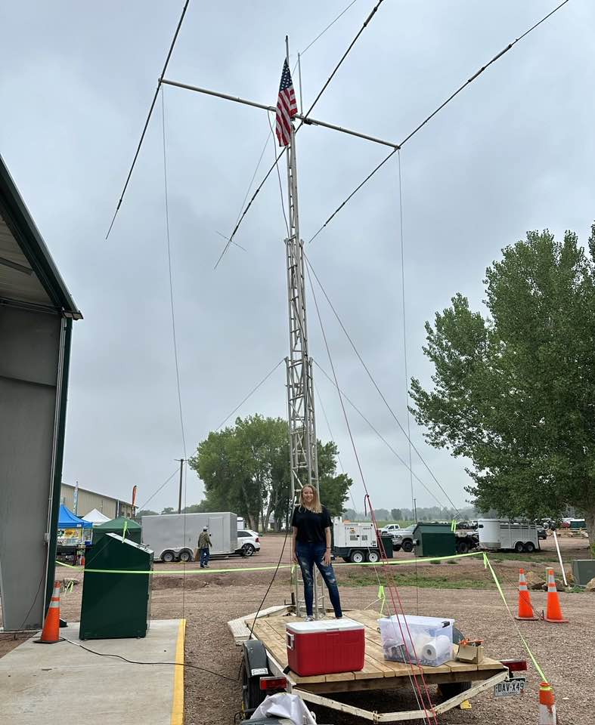
PORTABLE – POTA SETUP

Slide 8
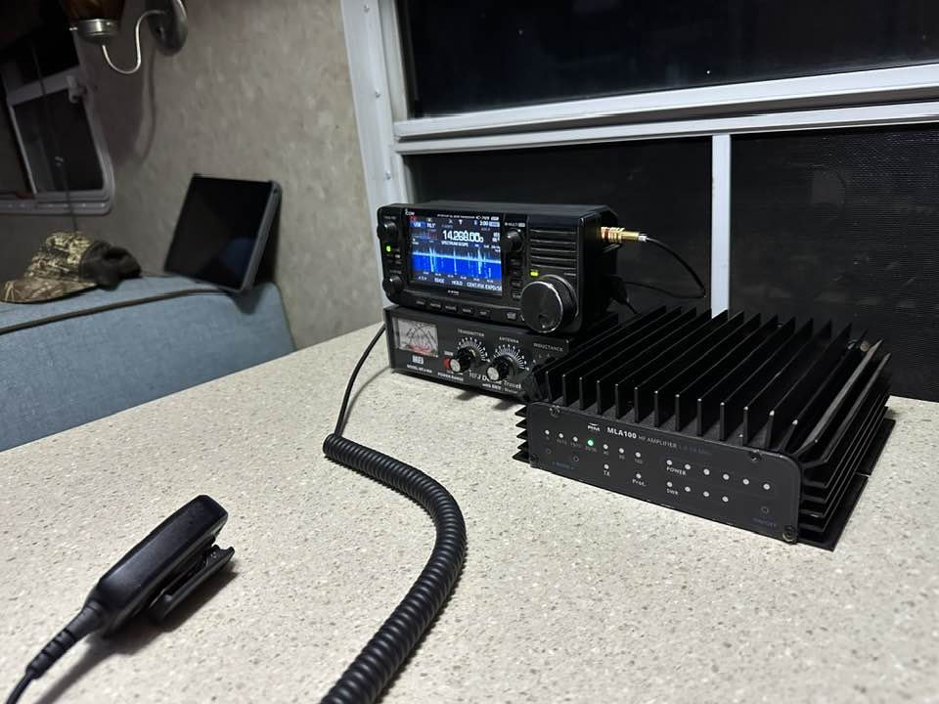
PORTABLE – POTA SETUP

Slide 9
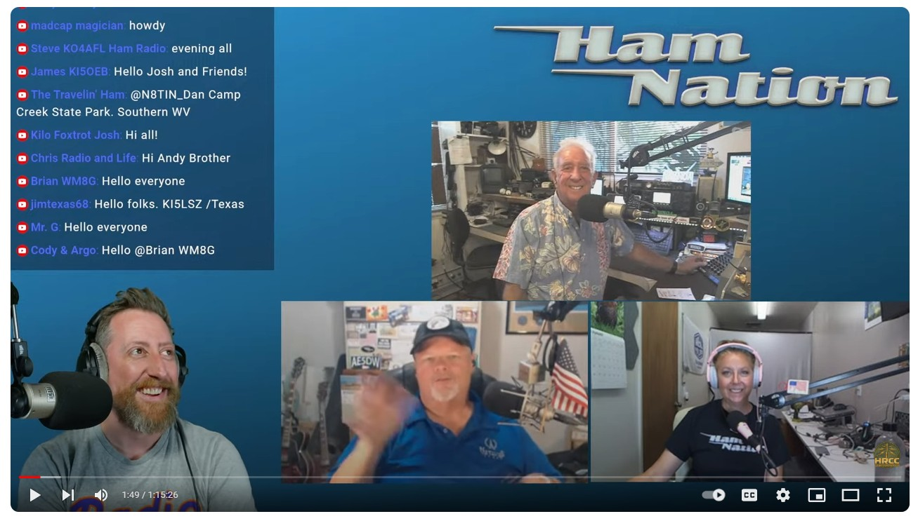
HAM NATION
HAM NATION PODCAST

Slide 10
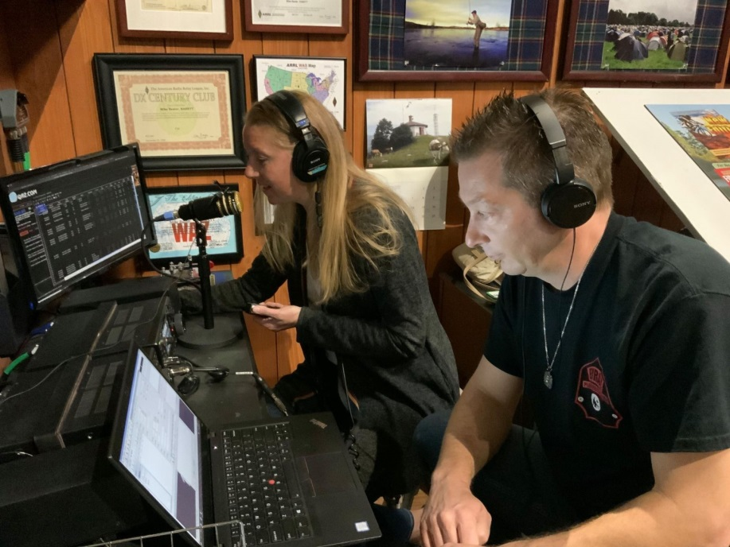
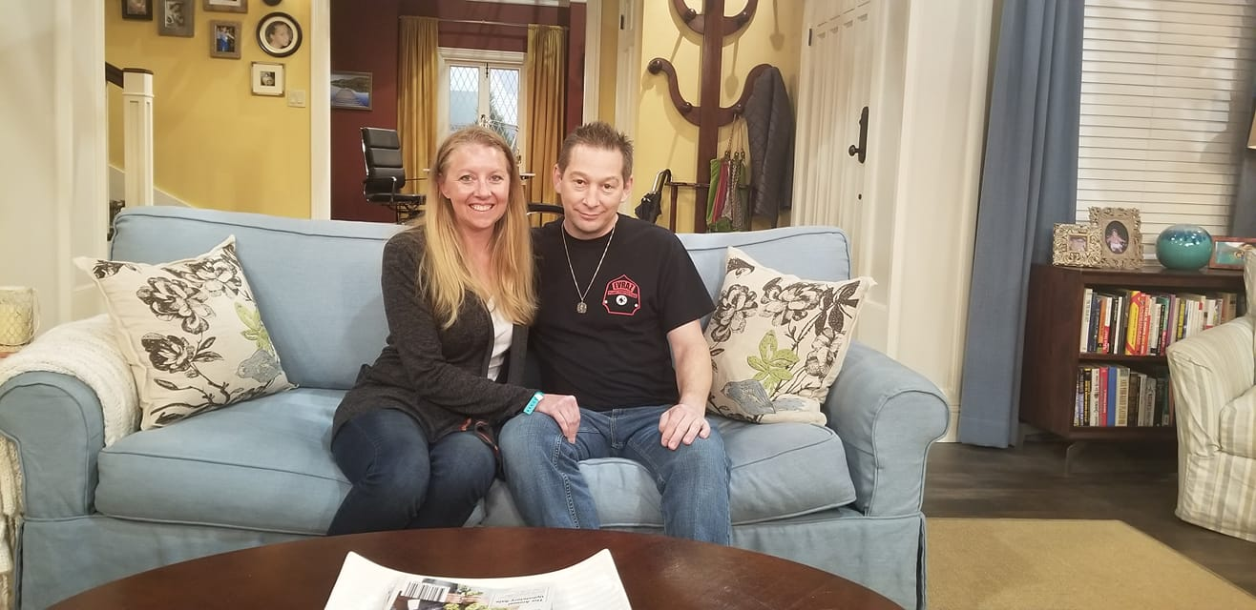
LAST MAN STANDING SET

Slide 11
LET’S HAVE SOME FUN!

