Slide 1

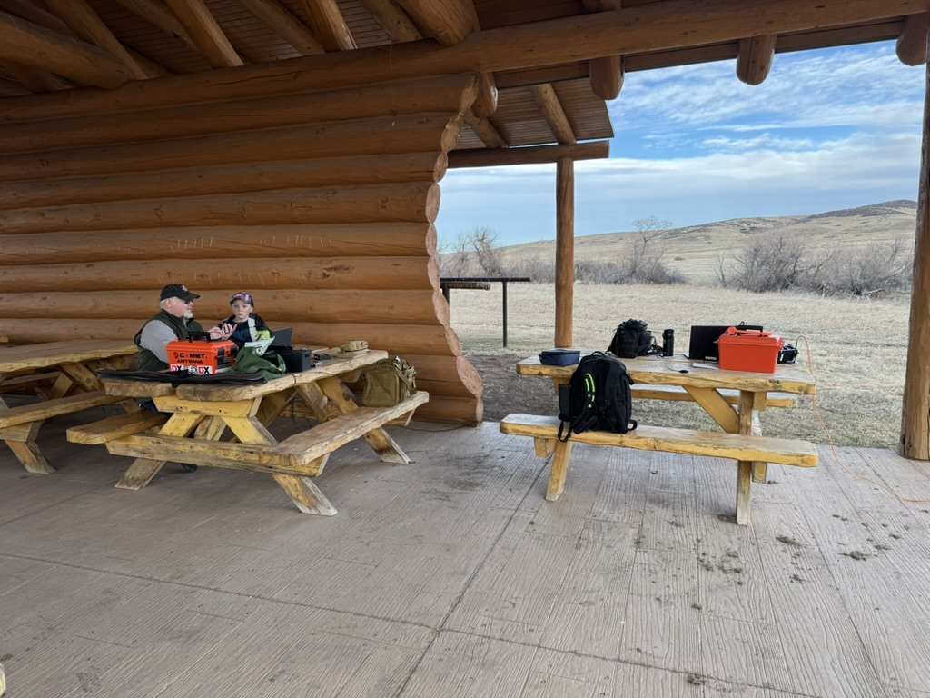
Planning Your Next Parks on the Air Activation
By Perry Lundquist (W6AUN) & Brad Tombaugh (W0BDT)

Slide 2
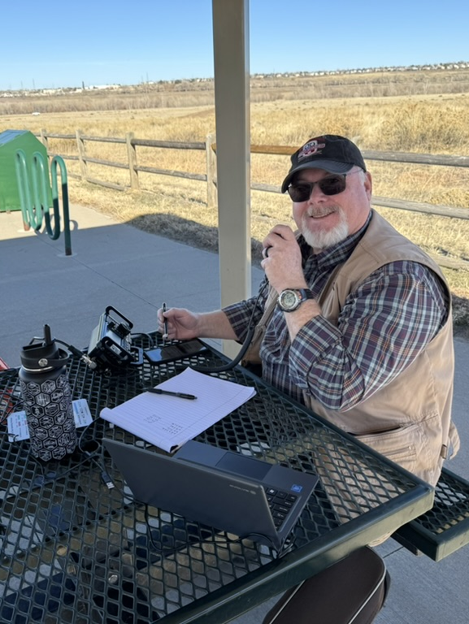
Presenters
Perry Lundquist, W6AUN
First licensed in 1978, Perry enjoys many amateur radio activities including POTA activating and hunting. He also serves his local ARES District as a Plans Section Chief and is the Liaison to the Douglas County Sheriff's Office in Colorado. Perry is a Reserve Deputy Sheriff with Douglas County, and is the manager of the 911 Communications Authority for Elbert County. Additionally, Perry is a Colorado AuxComm member. Professionally, he is a Senior Project Manager for a national telecom company.

Slide 3
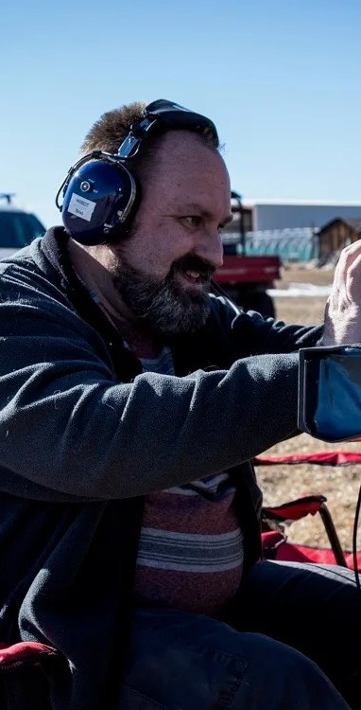
Presenters
Brad Tombaugh, W0BDT
After building a crystal radio set as a kid, Brad has had a lifelong interest in radio and electronics. After doing CB, FRS and GMRS, was licensed as an amateur in 2019. Brad is active with several area radio clubs and serves as IT staff and PIO for the local ARES district. Brad is an Advisory Consultant for a global IT firm.

Slide 4
Introduction
We’re not experts—just POTA enthusiasts!
Purpose: Share lessons learned and encourage others to try POTA.
Motto: 'Every day is Field Day!'
Notes:
We are not experts in anything, but are portable operations and Parks on the Air enthusiasts. I’m sure that there are people here today that have been licensed longer, done more activations, and made more contacts. Our purpose here is to share what we have learned, and to encourage others to try Parks on the Air.

Slide 5
History
Parks on the Air (POTA) began as a continuation of the American Radio Relay League's (ARRL) National Parks on the Air (NPOTA) event in 2016, which celebrated the National Park Service's centennial.
After NPOTA's immense popularity, many amateur radio operators desired to continue the activity.
Now an international program with year-round opportunities

Slide 6
Why Try POTA?
Fun to get outside and setup like Field Day, any day!
POTA is a perfect opportunity to get out of the house, visit a state or national park or forest, and practicing setting up portable gear
Great for those who live in apartments, condos, or HOA restricted neighborhoods where setting up an antenna is difficult
Flexible: HF, VHF/UHF, CW, SSB, Digital, Satellite
Notes:
POTA is a perfect opportunity to get out of the house, visit a state or national park or forest, and practicing setting up portable gear
Great for those who live in apartments, condos, or HOA restricted neighborhoods where setting up an antenna is difficult

Slide 7
Getting Started with POTA
Visit parksontheair.com, pota.app
Two roles: Activator, or Hunter
Not a contest – QSOs on any band/mode (except repeaters)
Activators must have all their equipment inside park boundaries
Notes:
POTA is not a contest; POTA QSOs may take place on any amateur band, including the WARC bands (30m/17m/12m) and vhf/uhf
You do earn points for activations and contacts, and get award certificates
“It’s Field Day every day!” or “Every day is field day!”
Can be a hunter from anywhere, or an activator in a park
Activators and all their equipment must be completely inside the boundaries of a designated park
Includes national parks, state parks, national monuments, state wildlife areas, trails, etc.

Slide 8
Getting Started
First step is to create an account on the https://ParksOnTheAir.org website.
Secondary website is https://pota.app
Independent site https://potamap.us shows areas, can click to see what entity a location is within
Being a hunter is easy, as all the logging is done by the activator.
Can hunt from anywhere, including from home
Notes:
Quick Demo:
Open Parks on the Air
Open POTA.app
Open POTAmap.us

Slide 9
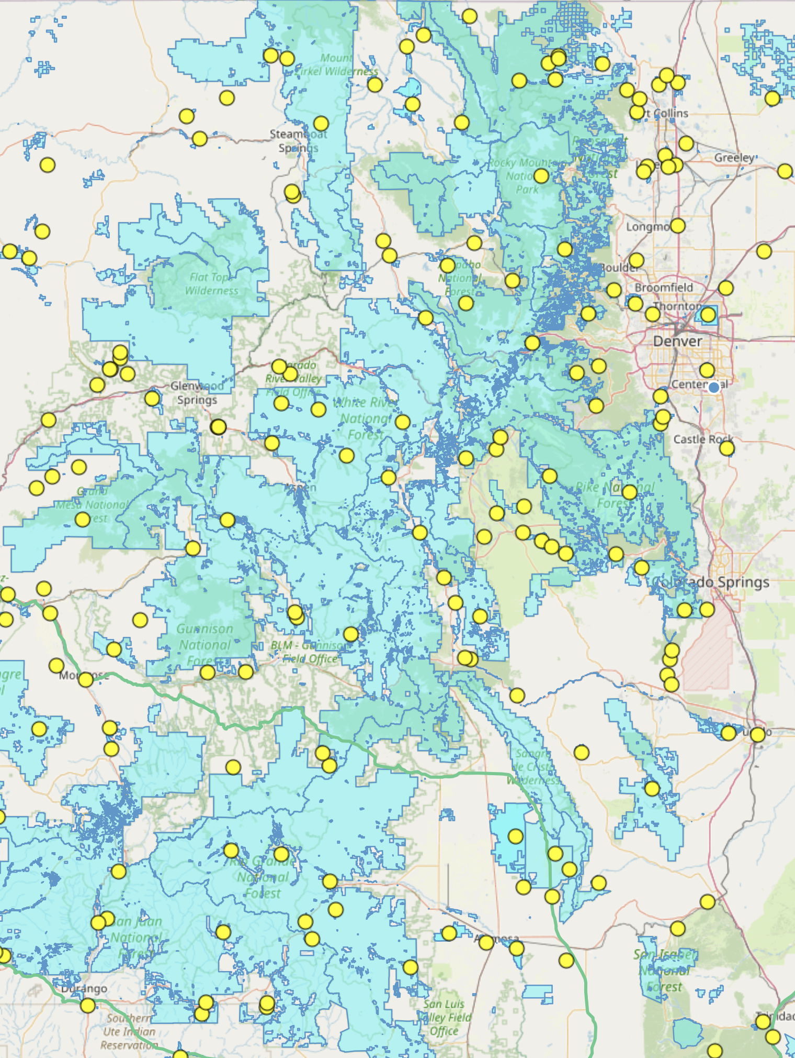
Registered Parks
Includes national parks, state parks, national monuments, state wildlife areas, trails, etc.
12,438 U.S. POTA entities (as of Oct 2025)
1,320 POTA Entities by state in the ARRL Rocky Mountain Division:
  Colorado (258)
  New Mexico (114)
  Utah (672)
  Wyoming (278)

Slide 10
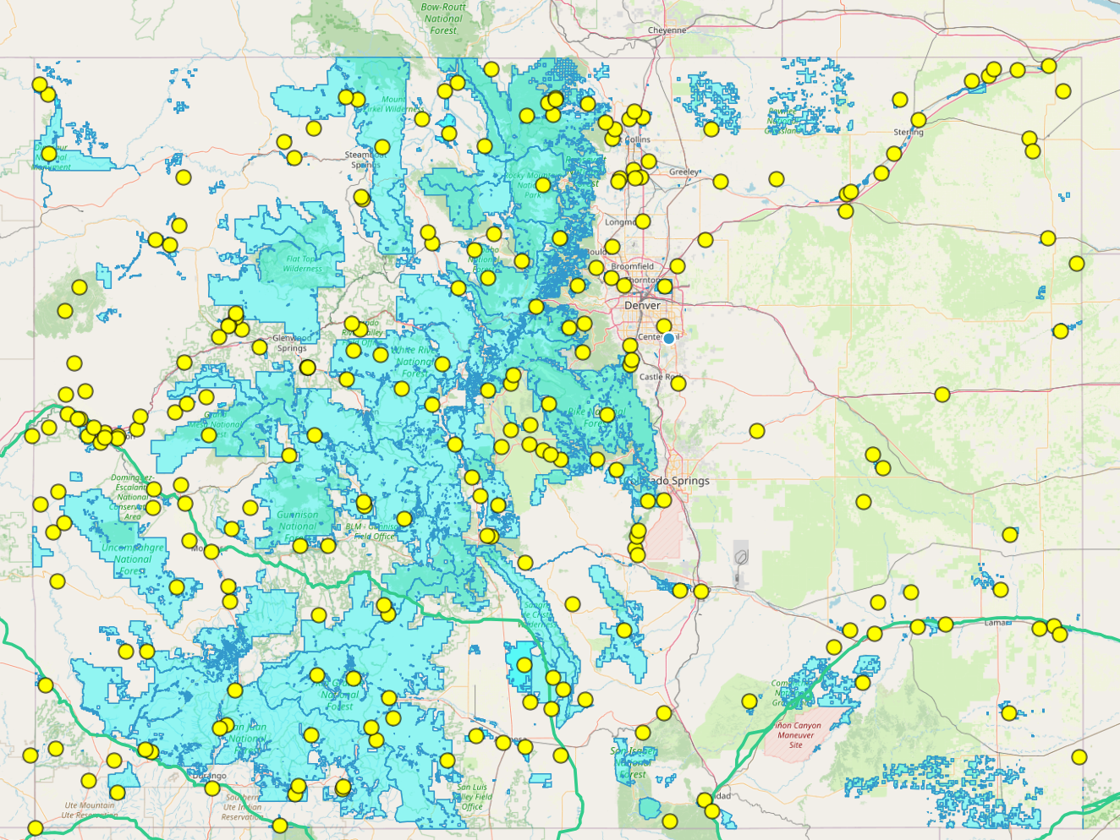
Colorado
Colorado's four national parks—Rocky Mountain, Black Canyon of the Gunnison, Great Sand Dunes, and Mesa Verde—cover a combined area of about 456,464 acres as of 2025.
Area Breakdown
  Rocky Mountain National Park: approximately 265,848 acres.
  Great Sand Dunes National Park: about 107,346 acres.
  Mesa Verde National Park: about 52,485 acres.
  Black Canyon of the Gunnison National Park: about 30,780 acres.
About 30% of Colorado's total land area is designated as national forest, representing approximately 14 million acres spread across 11 national forests within the state.
Colorado State Parks System
  Colorado currently has 43 state parks and over 350 wildlife areas.
  The combined land managed by Colorado Parks and Wildlife for parks and wildlife areas totals about 900,000 acres.
This acreage makes Colorado’s state parks and wildlife areas among the largest in the western US, exemplifying the state’s commitment to outdoor recreation and nature conservation.
The aggregate area of all SWAs in Colorado is about 684,000 acres, roughly 1,068 square miles.

Slide 11
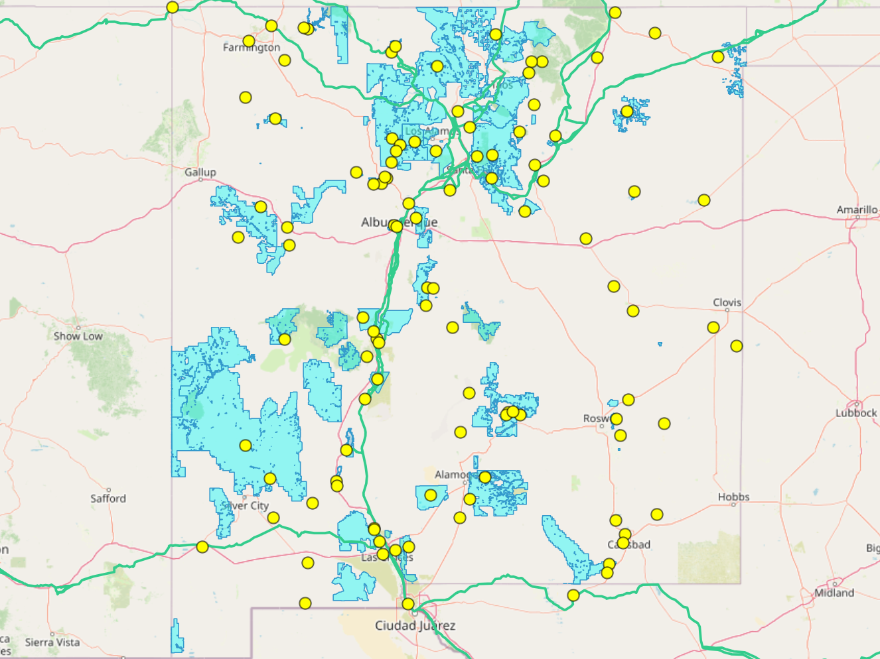
New Mexico
New Mexico’s national parks cover about 146,344 acres, while its national forests total approximately 9.1 million acres
New Mexico’s 35 state parks cover about 192,000 acres of land and water as of 2025. The state also maintains a network of wildlife management areas, with the latest estimate placing their total area at about 421,000 acres.
Area Details
  State Parks: 35 parks totaling 192,000 acres of land and water.
  State Wildlife Management Areas: Approximately 421,000 acres managed for wildlife conservation and public recreation, including recent additions like Bartlett Mesa.
Total area in state parks and wildlife areas: Circa 613,000 acres as of 2025.

Slide 12
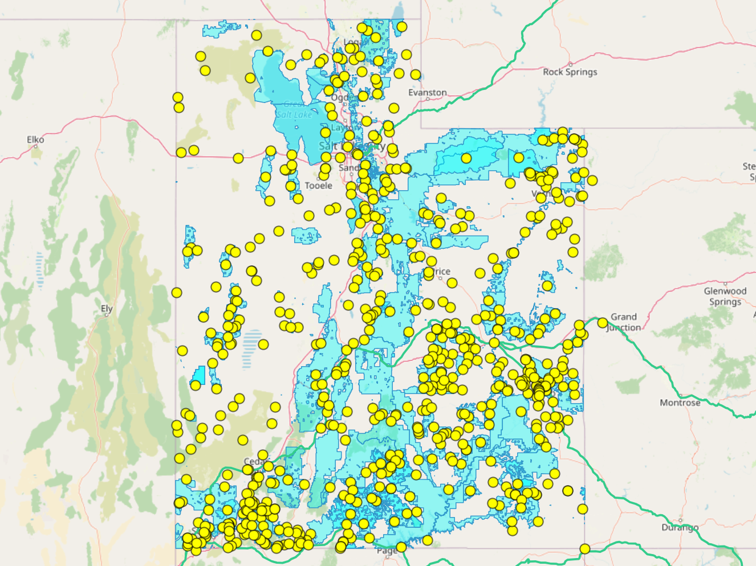
Utah
The total area of Utah’s national parks and national park-managed sites is roughly 5.6 million acres.
  The National Park Service manages the majority of these lands, though some national monuments and recreation areas are managed by other federal agencies.
These parks represent about 10% of Utah’s entire land area (Utah’s total land area is approximately 54.3 million acres)
Utah's national forests cover approximately 5.1 million acres as of 2025. The state is home to several national forests, with the largest being Dixie National Forest, which alone covers about 1.9 million acres.
Utah state parks cover over 95,000 acres of land and more than one million surface acres of water as of 2025.

Slide 13
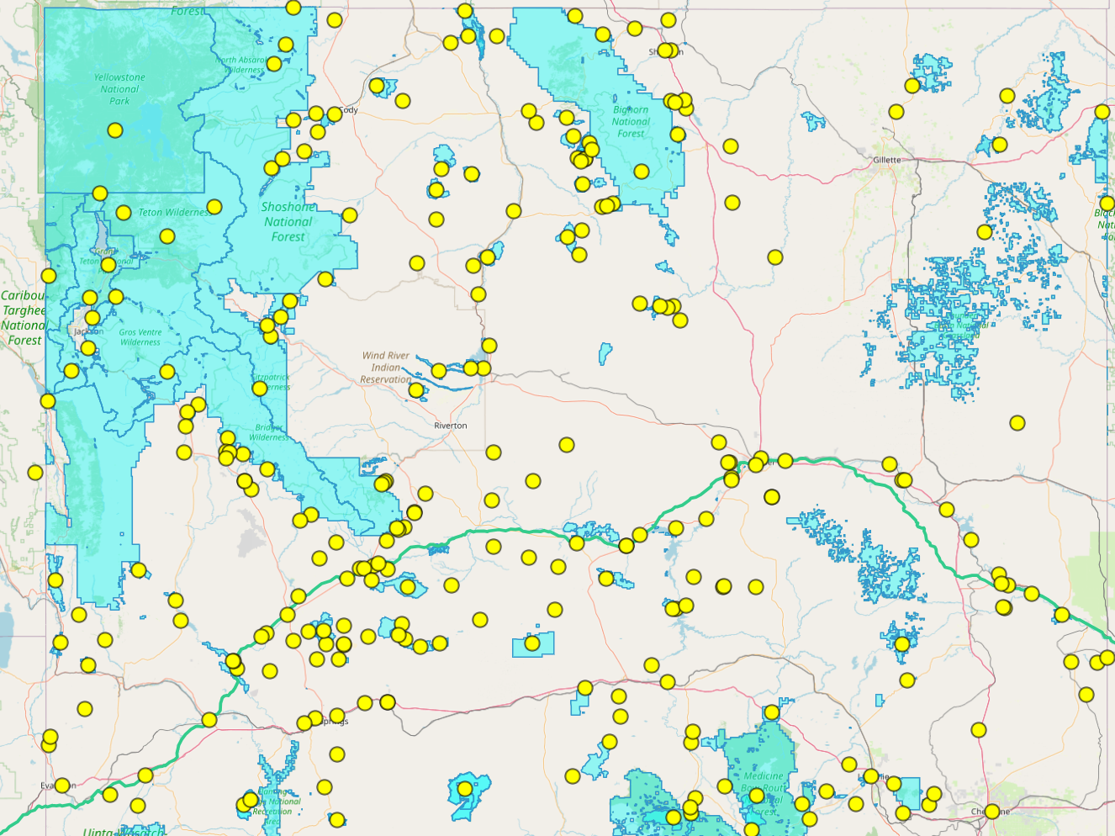
Wyoming
Wyoming's national parks and national forests together cover more than 10 million acres as of 2025. The state is home to massive protected public lands, including some of the largest and most iconic parks and forests in the United States.
National Parks in Wyoming
  Yellowstone National Park: Approximately 2.2 million acres (majority located in Wyoming).
  Grand Teton National Park: About 310,044 acres.
National Forests in Wyoming
  Bridger-Teton National Forest: 3.4 million acres.
  Other national forests (including Shoshone, Medicine Bow-Routt, Bighorn, and Black Hills): bring the total national forest acreage in the state to roughly 9 million acres.
Combined Area
  Total land area in Wyoming national parks: Over 2.5 million acres.
  Total national forest land area: Roughly 9 million acres.
  Combined total: More than 11.5 million acres of Wyoming are managed as national parks or national forests as of 2025
Wyoming’s state parks span over 100,000 acres, and the state wildlife habitat management areas cover more than 500,000 acres

Slide 14
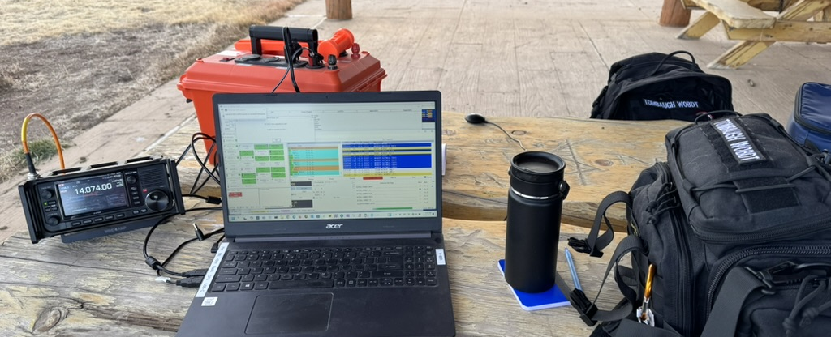
Gear: Start Simple
Radio: Any HF/VHF/UHF rig (QRP or full power)
Power: Vehicle, LiFePO4 battery, optional solar
Antennas: Wire (EFHW, dipole), vertical, mag-mount, loop, screwdriver
Accessories: Coax, connectors, throw line, tuner, mic or headset
Notes:
Many activators work entirely out of their vehicle, or use mag mount or drive on mounts for antennas. You don’t have to be in the wilderness, as long as you are inside the park boundary.

Slide 15
Radio
You really don’t need to have specialized equipment. Start with what you already have. Can use about any kind of transceiver, even if not designed as a portable unit, just be careful with it.
UHF/VHF HT, mobile, or HF rig?
QRP or full-power?
CW, digital, or SSB Voice?
Examples of popular portable radios:
  Yaesu FT-891 or FT-857
  Yaesu FT-817ND or FT-818ND
  ICOM IC-705
  Elecraft KX2 or KX3
  Xiegu 5105, G90, G106, X6100 or X6200
  Yaesu FT-991a or FT-710 Field
  Lab599 Discovery TX-500
  Yaesu FTX-1F
  QRP Labs QMX
Notes:
You really don’t need to have specialized equipment. Start with what you already have.
Can use about any kind of transceiver, even if not designed as a portable unit, just be careful with it.
After you have tried a few activations, you can decide what you would like to change.
There are many more radio options, include some that are CW only

Slide 16
Power Planning
100W rig: ~1A RX, 16–20A TX
QRP: ~0.3A RX, ~2.5A TX at 10W
LiFePO4: lightweight, long life
Solar extends battery time
(needs charge controller)
Notes:
Will need a battery big enough to power your rig, for long enough to make your contacts.
Starting out, might be able to power from your vehicle, depending on where you setup?

Slide 17
Battery Capacity
How much? How big, how heavy? What Modes?
Bigger radio means you need a bigger battery
LiFePO4 is lightweight, long life, despite higher cost
Lead acid (SLA or AGM) is only about half of the rated capacity before voltage too low
Full size 100w rig may be 1a on receive, 16-20a on transmit at full power
QRP might be under .3a on receive, under 2.5a on transmit at 10w
Notes:
What power you use to transmit determines how much battery power you need. A 100w radio will need a much bigger battery than a QRP rig.
The mode also affect battery consumption. CW uses very little, SSB uses more than CW but less than Digital modes like FT8
LiFePO4 batteries have become very affordable, weigh a fraction of lead acid batteries, and run for much longer.

Slide 18
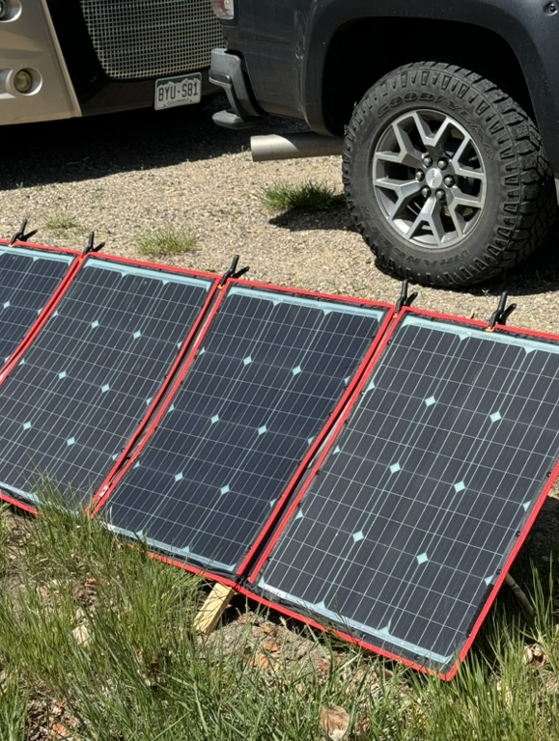
Solar Panels
Can extend your time or recharge spare battery
Need a solar charge controller for your battery type
PowerFilm LightSaver
West Mountain Radio EPIC PwrGate
BuddiPole PowerMini 2
Victron, Genasun, others
Many solar panels available
Rigid, Folding, Flexible
Notes:
If you plan to operate for a longer period or over several days you might consider a solar panel to keep your batteries charged
You’ll need a solar charge controller, like BuddiPole PowerMini2, West Mountain Radio Epic PWRgate, or Genesun, Victron
PowerFilm makes several panels with integrated batteries

Slide 19
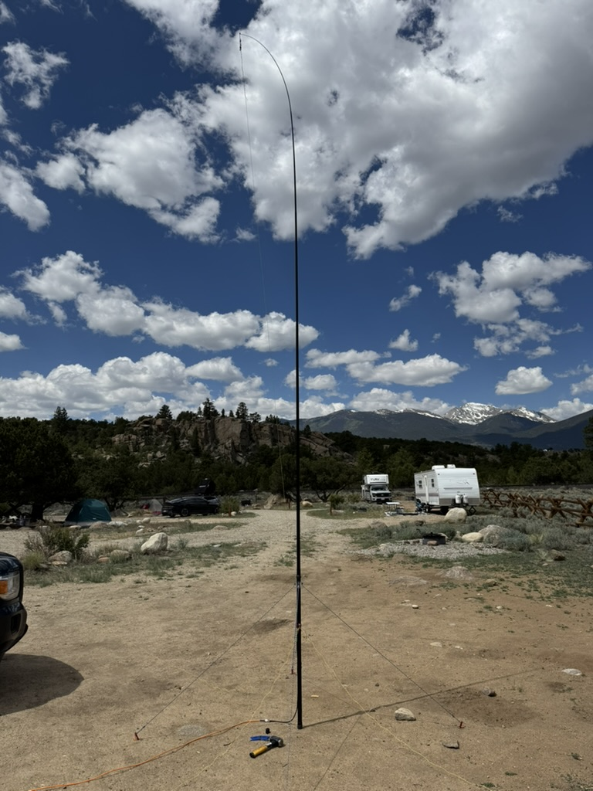
Antenna Considerations
Resonant frequencies
Bandwidth
Power handling
Gain/Efficiency/Q factor
Size and weight
Cost
Ease of deployment
Notes:
Will need an antenna for the bands that you want to work.
Can be a simple wire antenna, a telescoping whip or a ham stick with a mount.

Slide 20
Power Handling
Some portable antennae may not handle much power
QRP for 5-10w, maybe up to 20
If using 100w or an amp check the power handling limit
Notes:
Many portable antennae like the ones from K6ARK and QRPGuys EFHW have a small coil and will only handle up to 20w.

Slide 21
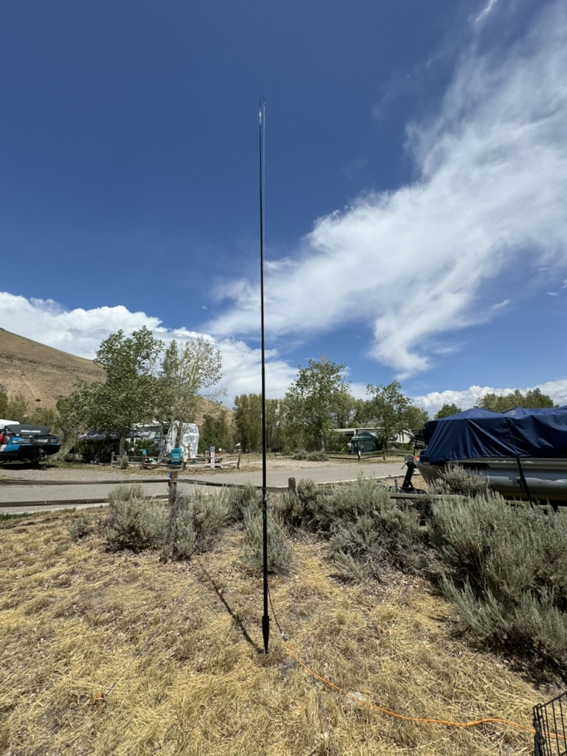
Wire Antenna
Simple wire dipole
End-fed half wave (may require a tuner)
K6ARK, KM4ACK, QRPGuys, CaHR, Packtenna
Random length wire with a tuner
Vertical on a mast
Silicone wire doesn’t tangle
Small plastic S-biner clips work well
J-Pole for VHF/UHF
Notes:
Could be hung from trees? (If there are trees, and only if not prohibited)
If you can’t use trees, may need a mast, which could be as simple as a fiberglass fishing pole or a painter’s pole

Slide 22
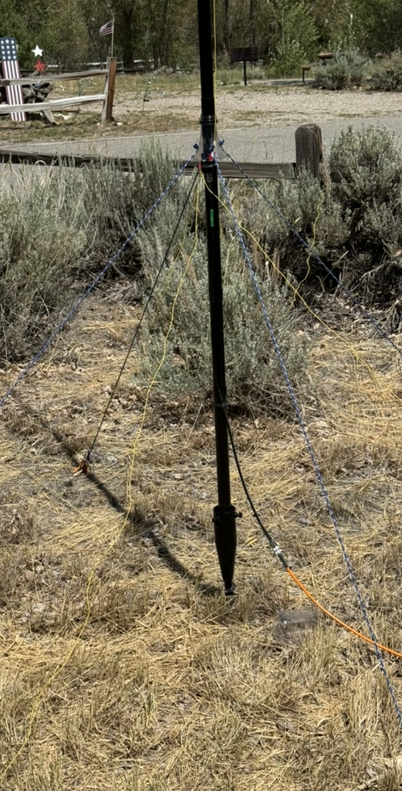
Free-standing Vertical or Dipole on Tripod/Stand
Wire antenna with mast
Telescoping stainless steel whip
Ham sticks (Vertical, dipole, octopus)
Wolf River Coil with a whip
POTA Performer
Chameleon CHA Basic Vertical or MPAS
Notes:
With a small mast, you can put up a wire antenna like a dipole, inverted-V, or EFHW, etc.
Stainless steel whips can be adjusted to cover multiple bands, can be combined with a coil to cover lower bands like the Wolf River Coil
Ham sticks have a high Q but are simple to setup and can be quite effective. Can be used to make a dipole, as a vertical with a ground mount, on a mag mount on your vehicle
The POTA Performer or Portable Elevated Resonant antenna is a vertical antenna for 40 through 6 meters sitting on an elevated tripod or support with feed point about five feet off the ground and two elevated tuned radials.
Chameleon makes several high-quality antenna kits with a variety of wire antenna and telescoping whips with coils

Slide 23
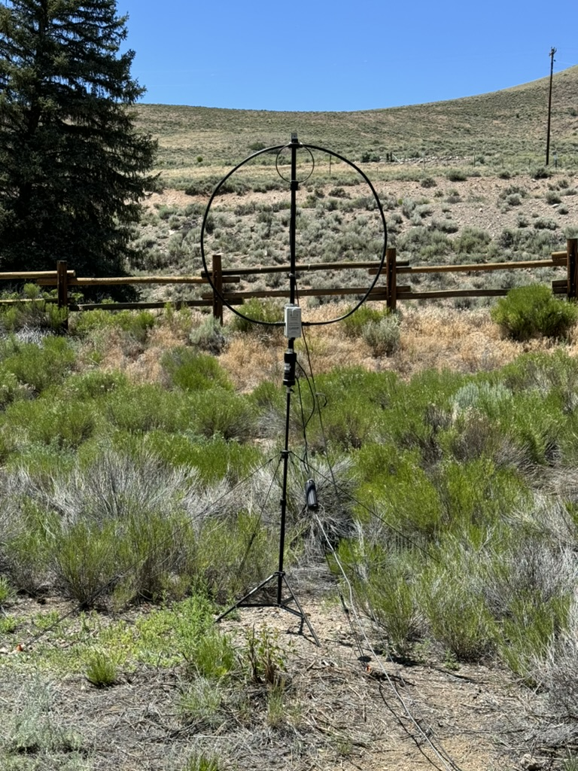
Magnetic Loop
Small, lightweight
Doesn’t need height
Doesn’t need ground plane or radials
  AlexLoop
  Alpha
  Chameleon
  ICOM
  PreciseRF
Notes:
Small Transmitting Loops, or Magnetic loop antenna are often made from a section of coax that can be rolled up and stored in a small bag
They can be mounted on a tripod, don’t need more that 1m above ground, doesn’t require ground plane or radials
Have high Q, narrow bandwidth, and have to be retuned when changing frequencies, but are perfect for digital modes on a preset frequency

Slide 24
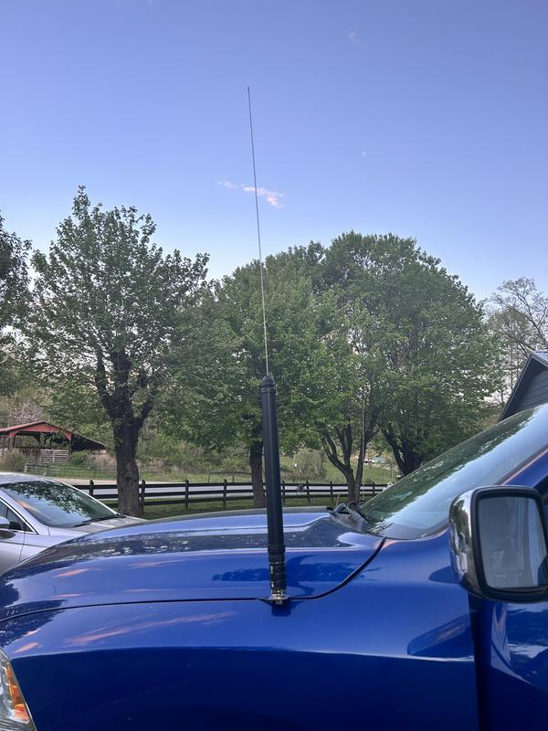
Screwdriver Antenna
Can cover multiple bands with one antenna
Tarheel
Yaesu ATAS-120
Notes:
Typically mounted to a vehicle, these multiband antenna use a motorized coil to tune to different bands.
Many Yaesu HF radios have built-in tuners to drive the ATAS

Slide 25
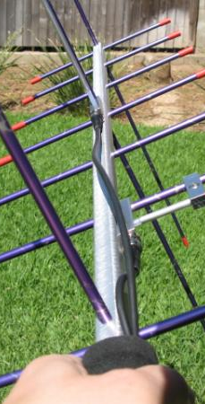
Specialty
2m/70cm handheld yagi or log periodic for satellite or directional gain
Arrow Antenna
Elk Log Periodic
homemade tape measure yagi
Notes:
If you know that you are going to direct your signal to a nearby city, a directional antenna like a Yagi or log periodic can provide gain in one direction
Dual band Yagi are often used for satellite cross-band repeaters like the ISS
Can build your own Yagi with a PVC pipe frame and steel tape measure elements

Slide 26
Radials vs. Screen or Faraday Cloth
Many antennae require ground radials of some sort
Laying on the ground doesn’t require tuning, but may not be as effective
Elevated radials may be more efficient, but must be tuned for the band
Wire screen or Faraday Cloth can be used in place of wire radials

Slide 27
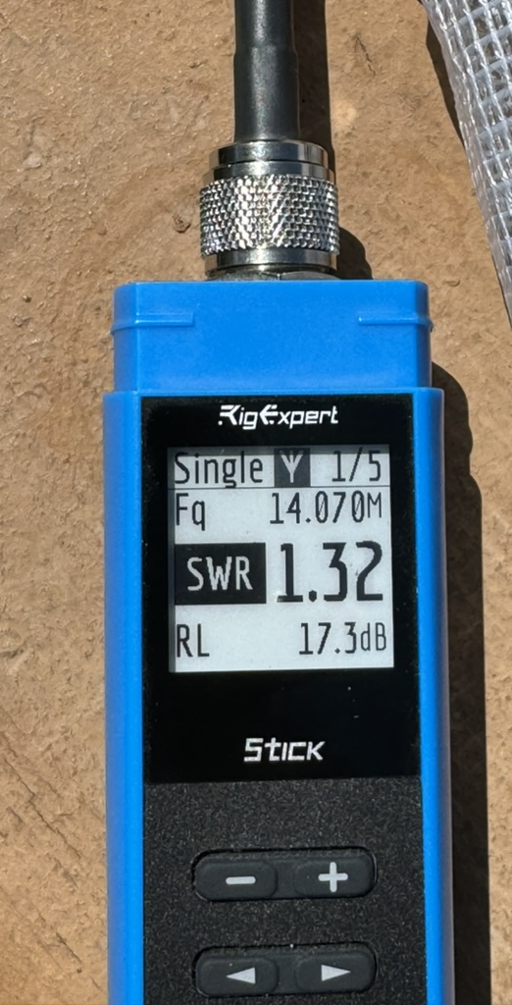
Other Gear
Mic/headset
Coax, power cables, USB cables
  Some like RG-316 for lightweight, others prefer RG-8X for durability
  New ABR-174 that is more flexible
  Some coax now available in high visibility colors
Arborist Throw Line for wire antenna
Antenna analyzer? Useful if you need to tune antenna
  Rig Expert Stick series is small and portable
12v watt meter to monitor battery level/usage or solar generation, or use a shunt
common mode choke, can be a coil of coax to make an “ugly balun” or string of ferrites
coax adapters, barrel connectors
Notes:
Using a headset may be easier to hear and less obtrusive to those around you
Many choices for coax, probably need 25-50’
Smaller coax like 174 or 316 is lighter weight and compact, may not be as durable
Some coax is now available in high visibility colors
Pay attention to what connectors your gear uses, many portable units use BNC vs. UHF
Handy to have a set of adapters and barrel connectors

Slide 28
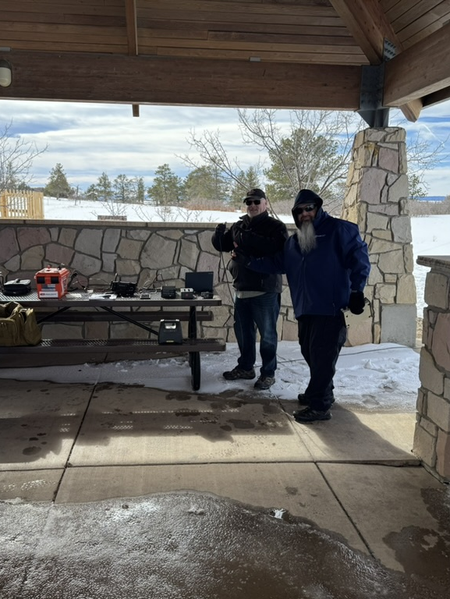
Do you need:
Shelter
  Umbrella
  push-up canopy
  Tarp
  Tent
Seating
Table/workspace
Sunglasses, eyeglasses, reading glasses
Sunscreen, insect repellent
Notes:
Depending on where you are going to setup and operate from you may need some other things.
If you operate out of your vehicle, you are probably all set.
Are there picnic tables or a pavilion at the park? You may need a small folding table and a chair
Do you need glasses or sunglasses?
Depending on the season and region, might need sunscreen or insect repellent

Slide 29
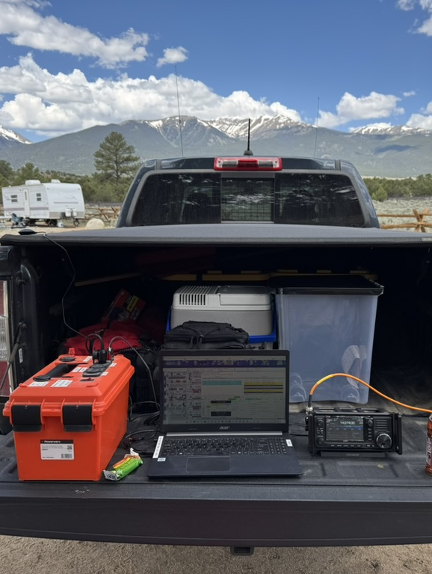
Setting Up at the Park
Check: entry fees, permits, staking/tree restrictions
Stay safe: distance from trails, facilities, overhead power lines
Locations: picnic tables, pavilions, campsites, vehicles
Antennas: tripod, fishing pole, drive-on mount, mag mount, trees (if allowed)
Notes:
Safety first! Scan the area for any overhead power lines and stay a safe distance away
Portable mast or fishing pole
Ground-mounted vertical
Tripod (photo or surveyor, may need mount or adapter)
Weighted base or stand
Ground spike or umbrella stand, like Chameleon Spike
Guy lines/stakes
“Feather Flag” base (https://www.amazon.com/SignWorld-Cross-Base-Feather-Flags/dp/B006R9IRP8)
Hang from trees, etc. if allowed
Clamp-on mount like Chameleon Jawmount or photographic clamps
Attach a ham stick mount attached to a quick clamp (a la KM9G)
Mag mount on your vehicle
Drive on mount for a mast

Slide 30
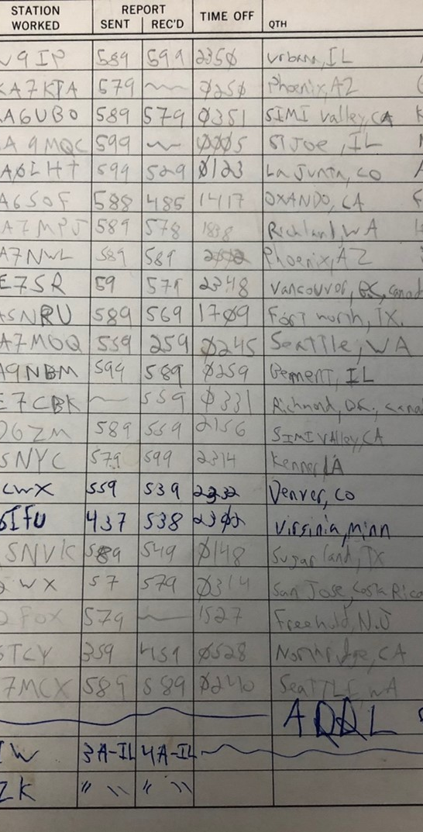
Logging
Only activators upload logs (ADI format)
Can use pen and paper, phone or computer
Can create directly on the POTA website
Apps: HAMRS, Ham2k PoLo, HRD, N3FJP, World Radio League, MacLoggerDX
Log must include: Callsign, Park #, Band, Mode, Date/Time
Need 10 contacts per UTC day for valid activation
Notes:
Filename requirements for uploading your log to the POTA website
Only need to record the band, not the frequency
Can record by hand with paper and pen
Many logging apps on smart phones or tables, or a small notebook computer
ADIF Master on Windows can easily filter and edit your logs if needed.

Slide 31
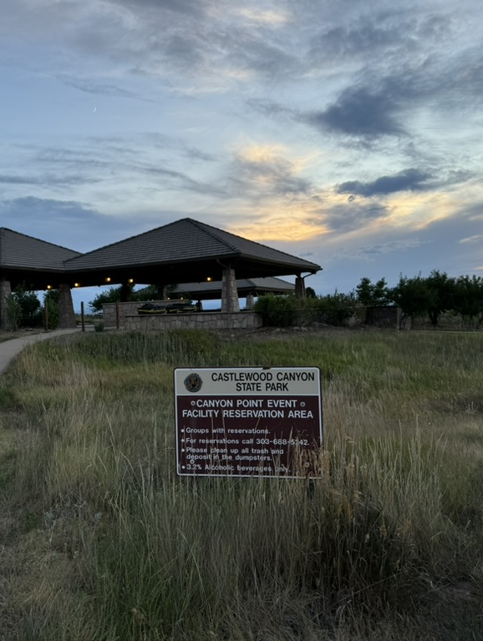
When & Where
Anywhere inside a designated park (confirm boundaries)
Multi-park activations possible (two-fer, four-fer)
Activation windows: Early Shift & Late Shift
Plan around weather and propagation conditions
Notes:
Anywhere inside of a designated park is fair game
Picnic table, bench
Parking lot (can work from vehicle)
Picnic pavilion
Trail head or trail (within 100’ so you don’t block access)
Campground or campsite
Some areas like National Forests cover a lot of area
Some areas span state boundaries
Look at other states in Rocky Mountain region for examples
Might find where multiple parks/trails overlap for a two-fer (or more!)
E.g. Elephant Rock Campground near Buena Vista is in Arkansas Headwaters and San Isabel National Forest
Are there SOTA summits in park boundaries? Could do both SOTA and POTA together.
Look at POTA map on website https://pota.app
Confirm boundaries with other maps like state park or national forest service maps, or with the https://POTAMAP.us website
https://newparks.m0trt.radio
Activations are based on UTC day
might be able to work in the evening before the end of the day
and continue later into the beginning of the next UTC day
much have 10 contacts for each day
Early Shift/Late Shift awards
Early Shift is the 6-hour period beginning at 02:00 UTC, +/- 1 hour for each 15 degrees of longitude that the park pin is offset from 0 degrees.
Late Shift is the 8-hour period beginning at 18:00 UTC, +/- 1 hour for each 15 degrees of longitude that the park pin is offset from 0 degrees.
During Standard Time (MST): The Mountain Time Zone is UTC-7. The early shift is from 7 p.m. to 1 a.m. MST.
During Daylight Saving Time (MDT): The Mountain Time Zone is UTC-6. The early shift is from 8 p.m. to 2 a.m. MDT.
POTA late shift times in Mountain Time (MT)
Start: 5:00 PM MT, End: 1:00 AM MT (the next day)? (double check this)

Slide 32
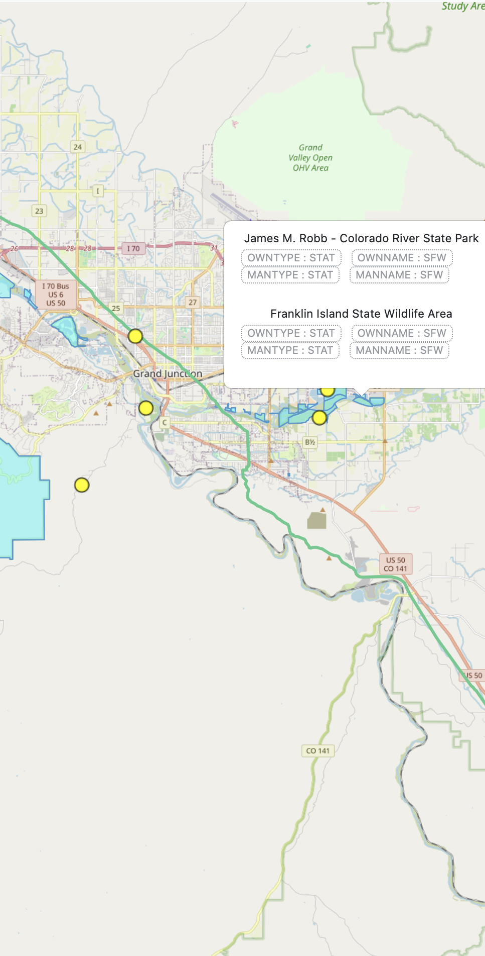
Resources
Web: parksontheair.com, pota.app, potamap.us
YouTube/Blogs:
  POTA YouTube Channel
  Ham Radio Crash Course KI6NAZ Josh Nass
  KB9VBR Michael Martens
  K0NR Bob Witte
  QRPer.com K4SWL Thomas Witherspoon
  Ham Radio Tube K8MRD Mike
  Costal Waves & Wires, K4OGO Salty Walt
  Temporarily Offline KM9G Steve
  Survival Tech Nord Julian OH8STN
  K6ARK
  QRP Guys
  Coffee and Ham Radio
Books: ARRL POTA Guide, Portable Operating for Amateur Radio
Communities: POTA Facebook, Discord
Notes:
See our POTA Resources list for links to these and more!

Slide 33
Awards & Events
Awards: Activator, Hunter, Park-to-Park, Repeat Offender, Rover, Kilo
Support Your Parks seasonal events: Jan, Apr, Jul, Oct
Notes:
For each activation and worked contacts, you accumulate “points” toward a multitude of award certificates
See the POTA website for a listing

Slide 34
Final Tips
Practice in your backyard first
Make a checklist of essential gear
Plan for weather, weak cell coverage, long pileups
Above all: have fun and get on the air!

Slide 35
Q&A
Questions about getting started, gear, or activation planning?

