Slide 1
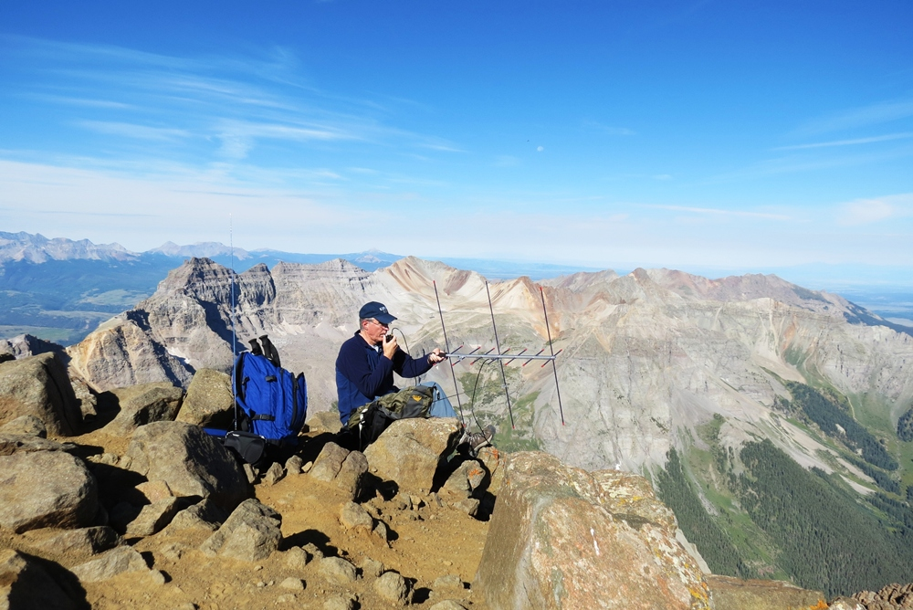

Having Fun with Mountaintop VHF
Bob Witte, KØNR
bob@k0nr.com
Hartsel, CO

Slide 2

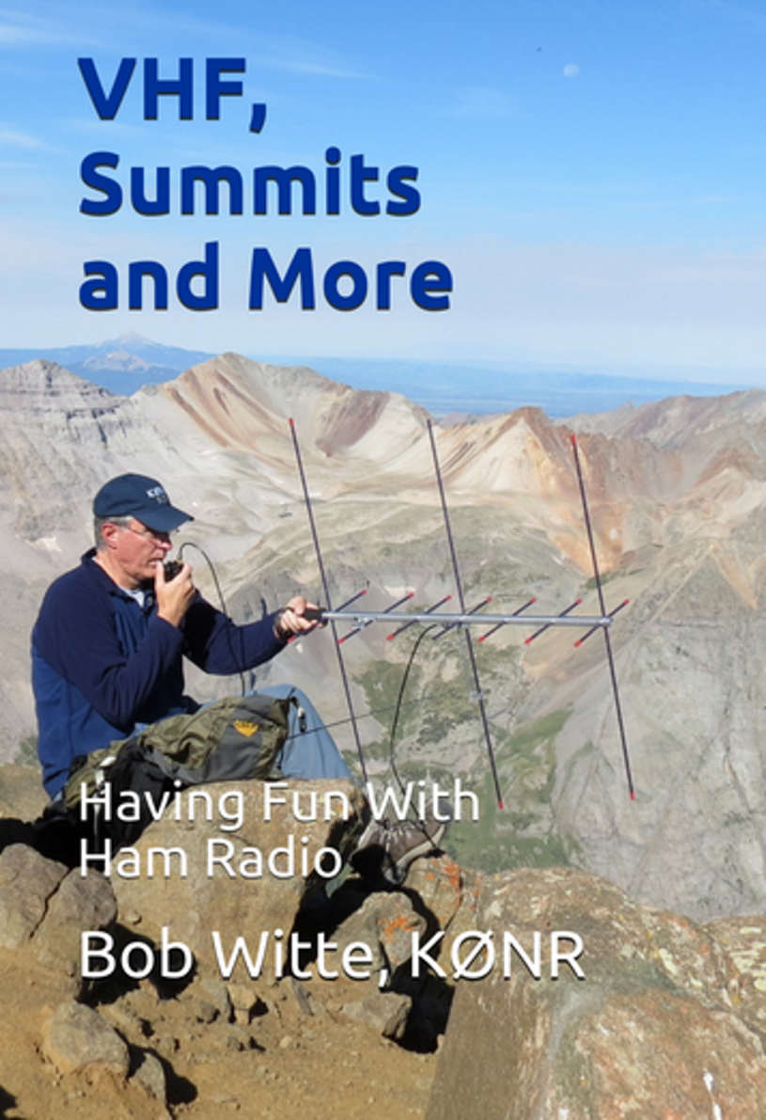
Speaking Today
Bob Witte KØNR
Hartsel, CO USA DM78
bob@k0nr.com www.k0nr.com
I was first licensed in 1977 after taking a ham radio license class at Purdue University
My technical background is Electrical Engineering and I have worked for decades in the electronic test and measurement industry.
Ham radio interest: the confluence of VHF ham radio, mountains and exploring.
And I like to write stuff.

Slide 3
Topics Today
General VHF/UHF operating
Summits On The Air (SOTA)
VHF Contests
How far can you go on VHF/UHF?
Parks On The Air (POTA)

Slide 4
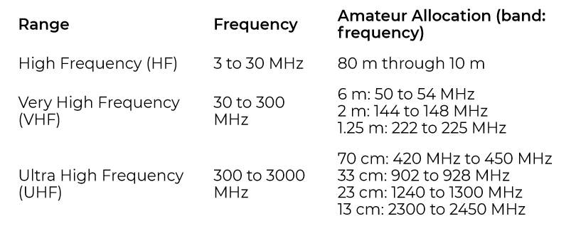
What is VHF/UHF?
VHF
UHF

Slide 5

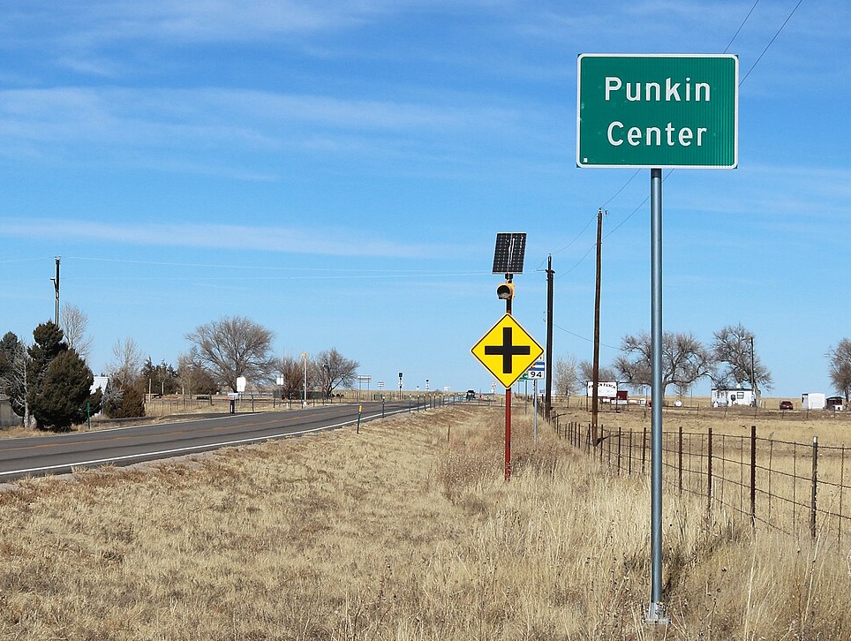
Height Above Average Terrain (HAAT)
Pikes Peak Elevation: 14,115 feet
HAAT: 9669 feet
VHF handheld range: >100 miles
Big Difference
Punkin Center, CO Elevation: 5364 feet
HAAT: ~0 feet
VHF handheld range: ~4 miles

Slide 6
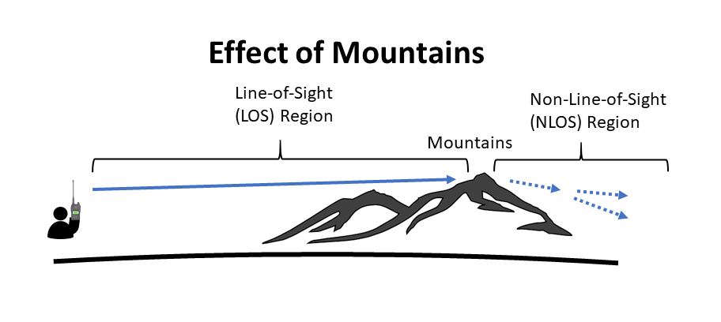
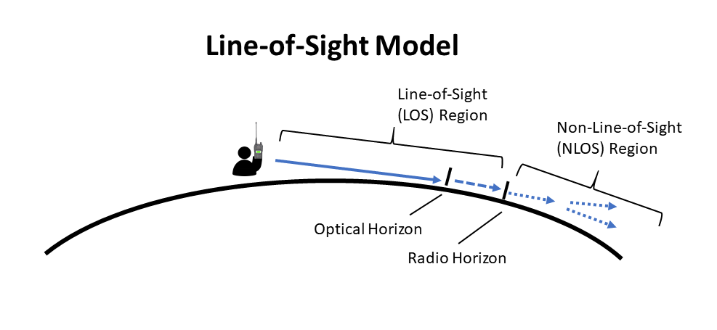
The Myth of VHF Line of Sight
We often refer to VHF propagation as being Line-of-Sight. This is a useful model but it is not correct.
VHF signals routinely go beyond the radio horizon.

Slide 7
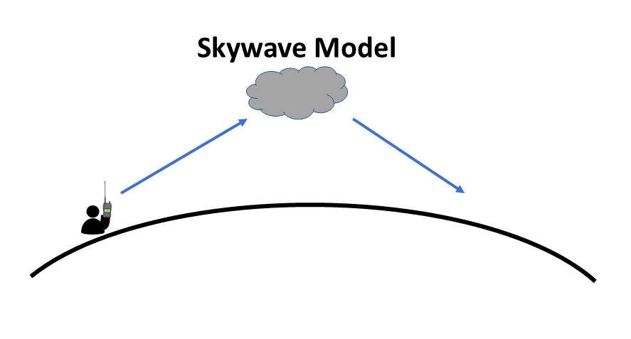
VHF Skywave Propagation
Sporadic-e Propagation
Seasonal: most common during the summer months
Occurs frequently on 6 meters
Occurs less frequently on 2 meters
F-Layer Propagation
Common propagation mode for HF bands
Occurs on 6 meters with intense sunspot activity
Trans Equatorial Propagation (TEP)
Rare propagation concentrated on stations 30 to 50 degrees latitude apart, spanning the equator
Most common on 6 meters, but possible on 2 meters.

Slide 8
6 Meters – The Magic Band
Propagation is normally similar to 2 meters
When sporadic-e (“e skip”) occurs, the band comes alive
Sporadic-e openings allow contacts across North America (and more)
Sporadic-e is very common in June and July
Calling frequency: 50.125 MHz USB
Move up in frequency as the band gets busy
50.110 to 50.125 MHz is the DX Window, use it only for contacts to other countries
FT8 Digital Mode is very popular on 6 meters
Works very well with weak signals and can compensate for poor propagation

Slide 9

Summits On The Air

Slide 10
Summits On The Air (SOTA)
Two ways to participate
Activator
Chaser
Worldwide program
Points and Award System
More points for higher summits
Over 1800 SOTA summits in Colorado (WØC)
SOTA activation requirements:
summit must be on the SOTA list
equipment must be carried
(no minimum distance, not attached to vehicle)
portable power (no fossil fuel generators)
See https://www.sota.org.uk/

Slide 11
A Few SOTA Rules
Activation Zone: within 25m vertical of the actual summit
Main qualification to be a SOTA summit: 150m of prominence
An Activator must complete 4 QSOs to earn SOTA points (must be with 4 different stations, changing to a new band does not count)
No repeater contacts (satellites OK)
Activators and Chasers submit their logs to the worldwide SOTA database
No QSL cards required, SOTA is on the honor system
Lots of awards and certificates

Slide 12
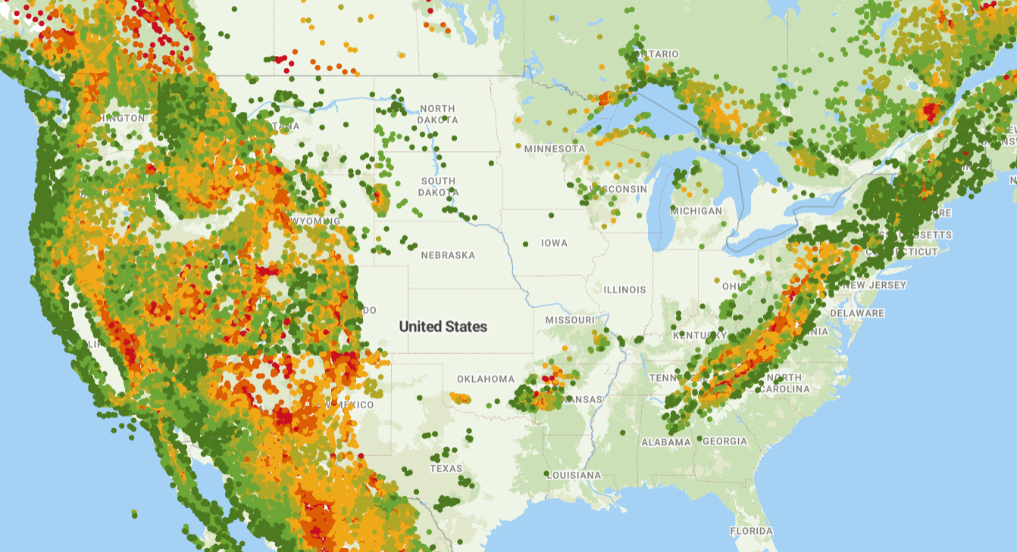
Source:
SOTA Atlas
http://sotl.as

Slide 13
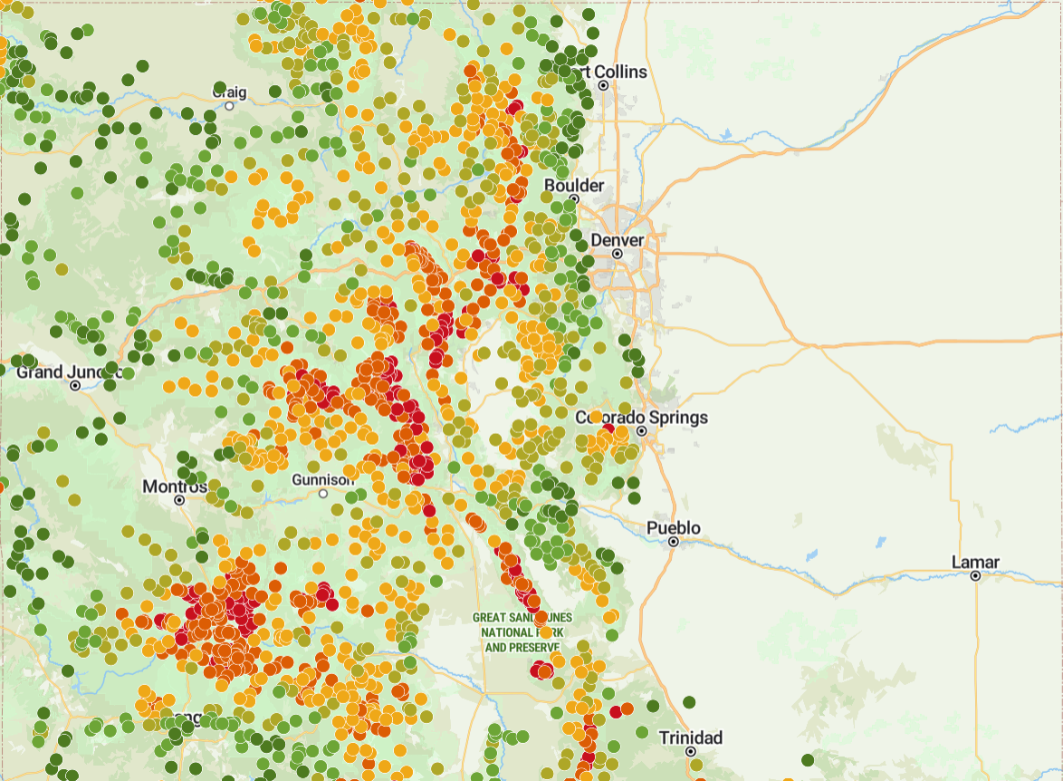
Colorado SOTA
Summits
Source:
SOTA Atlas
http://sotl.as

Slide 14
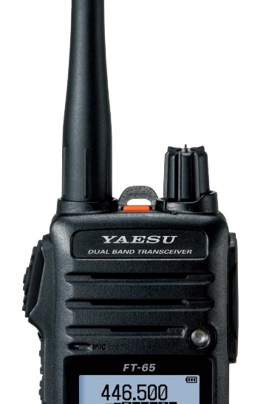
How Popular is VHF/UHF for SOTA?
80% of the SOTA QSOs logged are below 50 MHz
20% of the SOTA QSOs logged are above 50 MHz
Above 50 MHz, 2m FM is the dominant band/mode
90% of the QSOs are on the 2-meter band
85% of the >50 MHz QSOs are FM

Slide 15

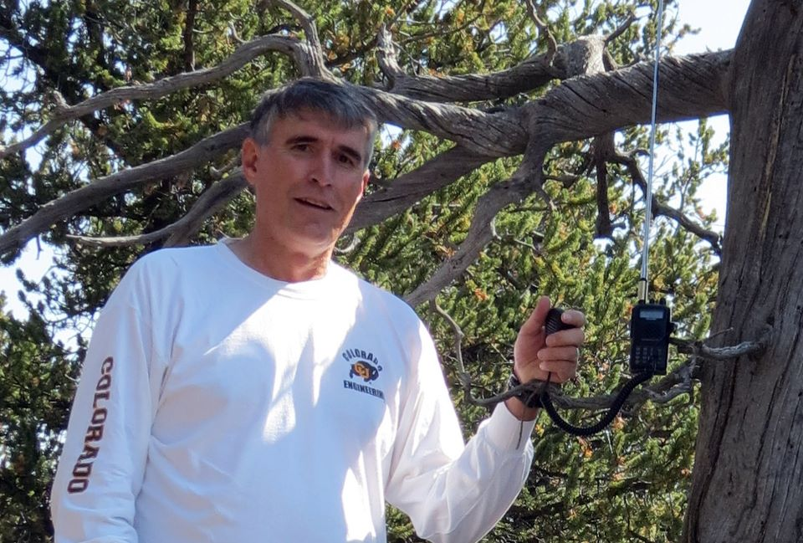
Easy VHF SOTA Activation
Also known as “take along a 2m handheld on a hike”
Kaufman Ridge HP
(WØ/SP-081)
10,765 feet elevation

Slide 16
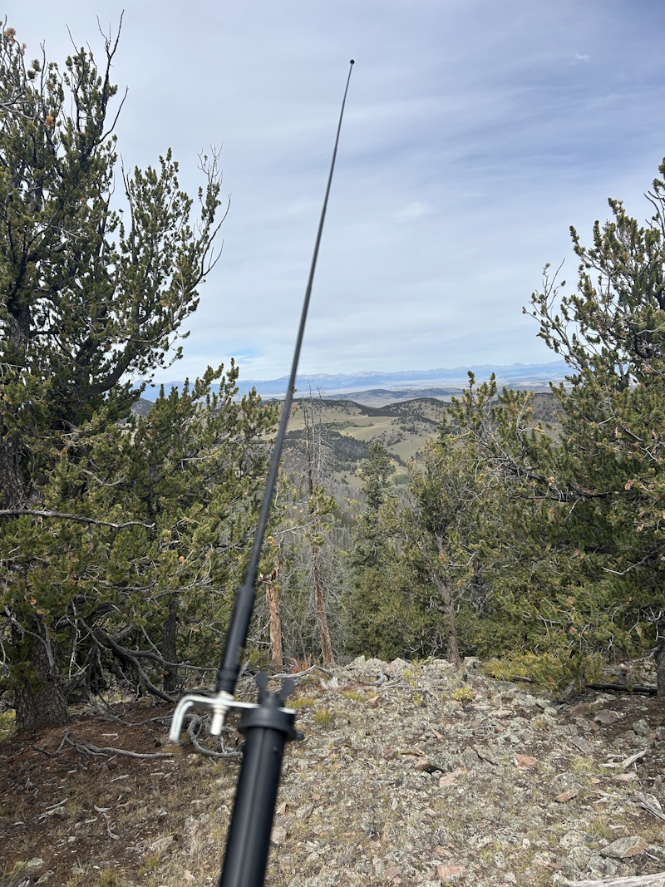
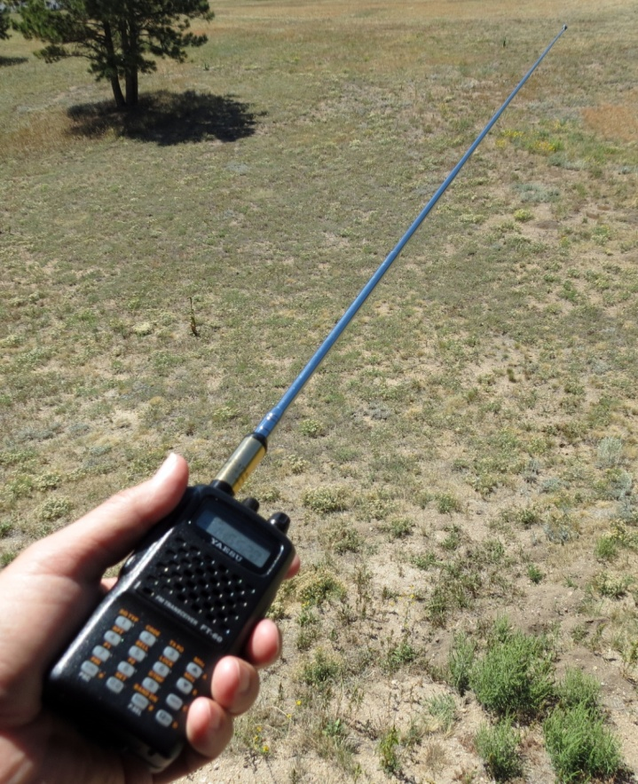
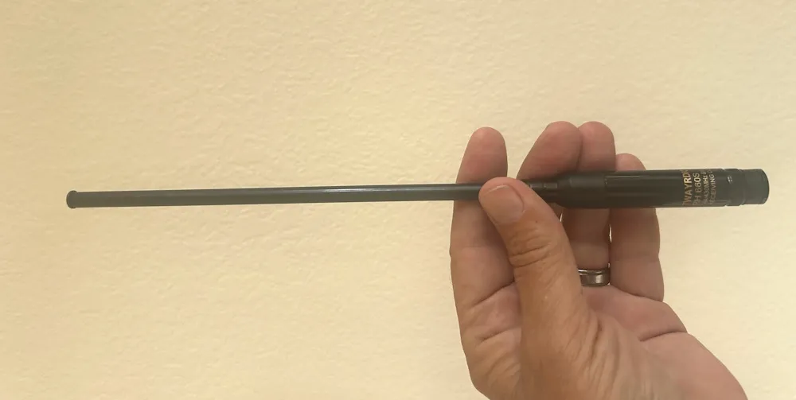
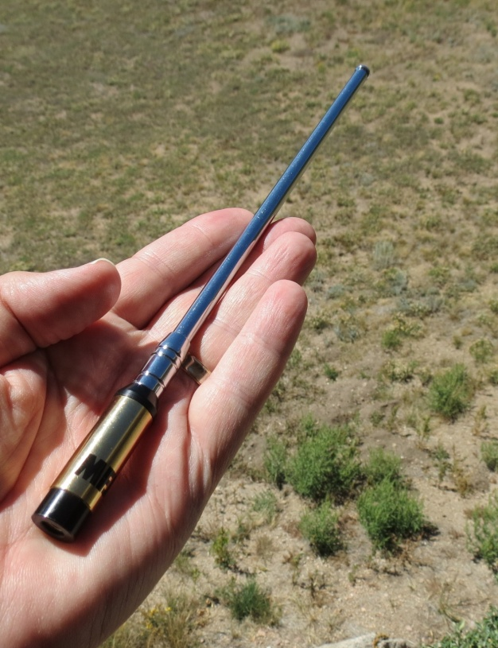
The ½-wave Vertical Antenna
Dualband 2m/70cm halfwave antenna
Search Amazon for
TWAYRDIO RH660
SMA (male or female)
BNC
$19 delivered
MFJ-1714 – SMA or BNC connector

Slide 17
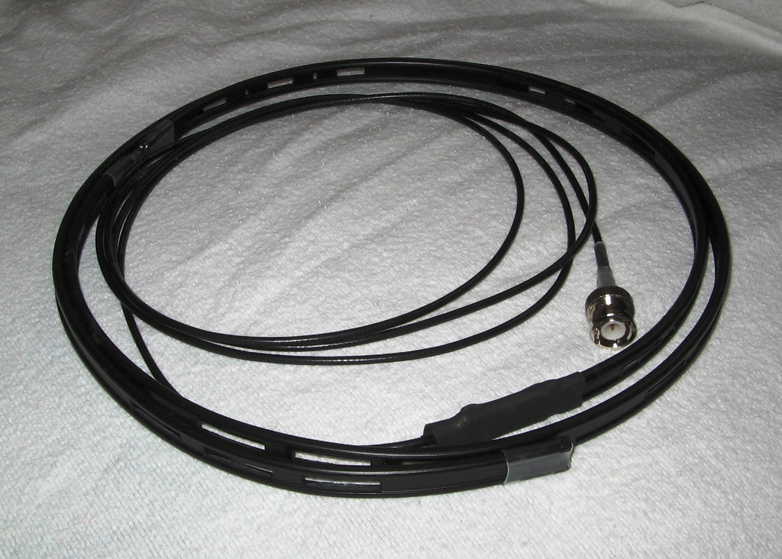
Roll Up J-pole Antenna for 2 meters
About 54 inches long
Hang it in a tree or on a fishing pole
Half-wave radiator with a quarter-wave matching section
Also dualband versions for 2m/70cm
Photo: kb3kai.com

Slide 18
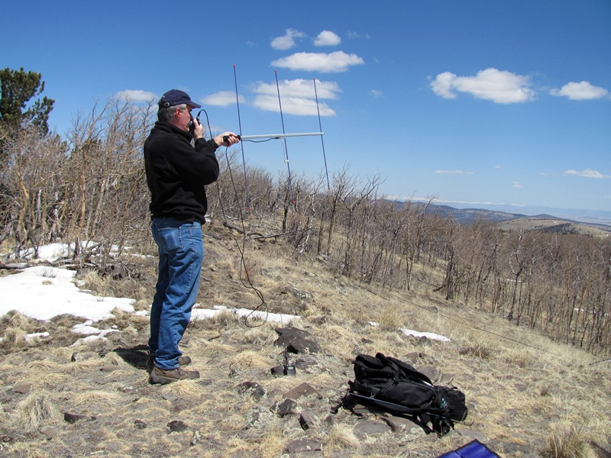
Improved VHF SOTA Activation
Also known as “bring along a small 2-meter Yagi antenna”
Aspen Ridge
(WØC/SP-084)
10,740 feet elevation
Arrow 3-element Yagi for 2m

Slide 19
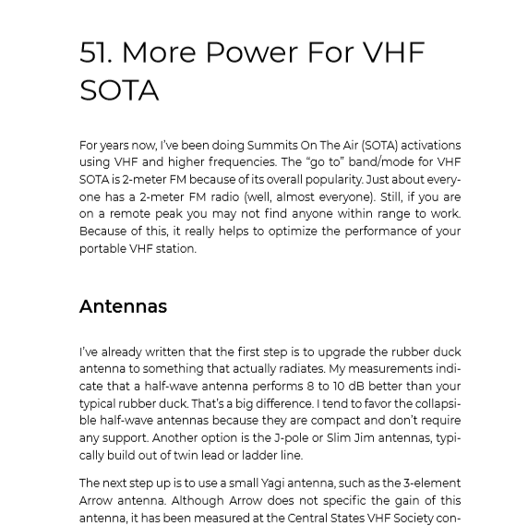
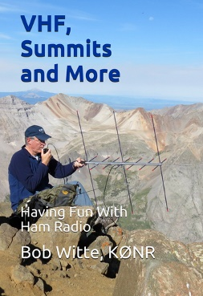
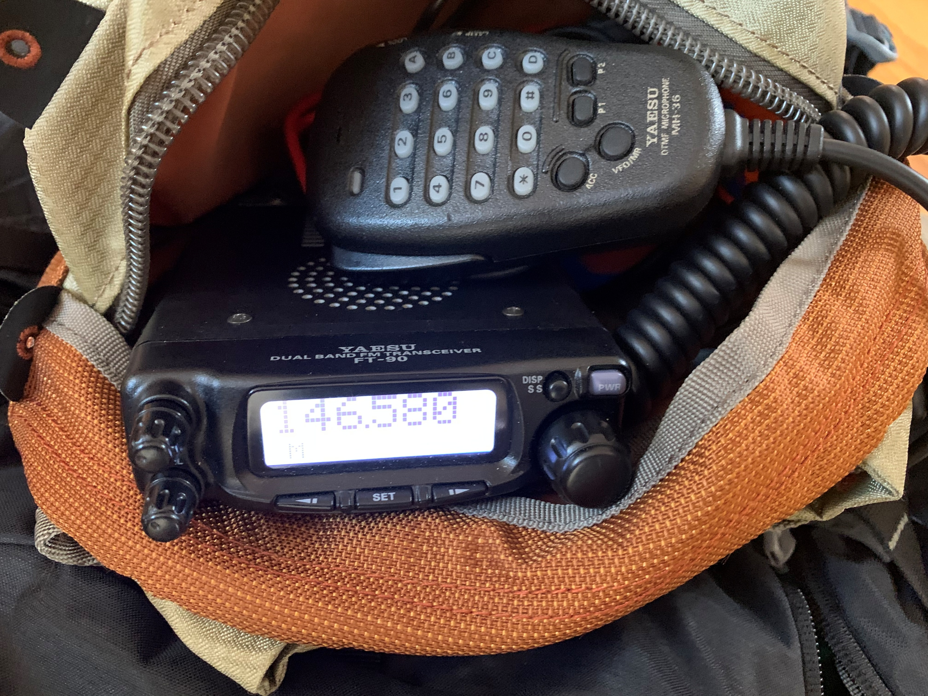
More punch for the NLOS region
Improve antenna first
Increase transmit power

Slide 20
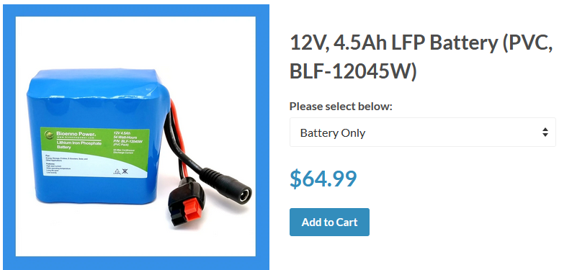
Bioenno LiFePO4 (LFP) Lithium Iron Phosphate Battery www.bioennopower.com
Voltage: 12V
Capacity: 4.5 Ah
Maximum Continuous Discharge Current: 9A (Make sure your load consumes less than 9A)
Maximum Peak Pulse Current: 18A (2 sec.)
Max Power Delivered to Load at 12V: 108 Watts (12v x 9A = 108 Watts)
Dimensions:(L x W x H) 2.9 in. x 2.3 in. x 2.8 in. (76 mm x 57 mm x 71 mm)
Weight: 1.0 lbs. (0.5 kg.)

Slide 21
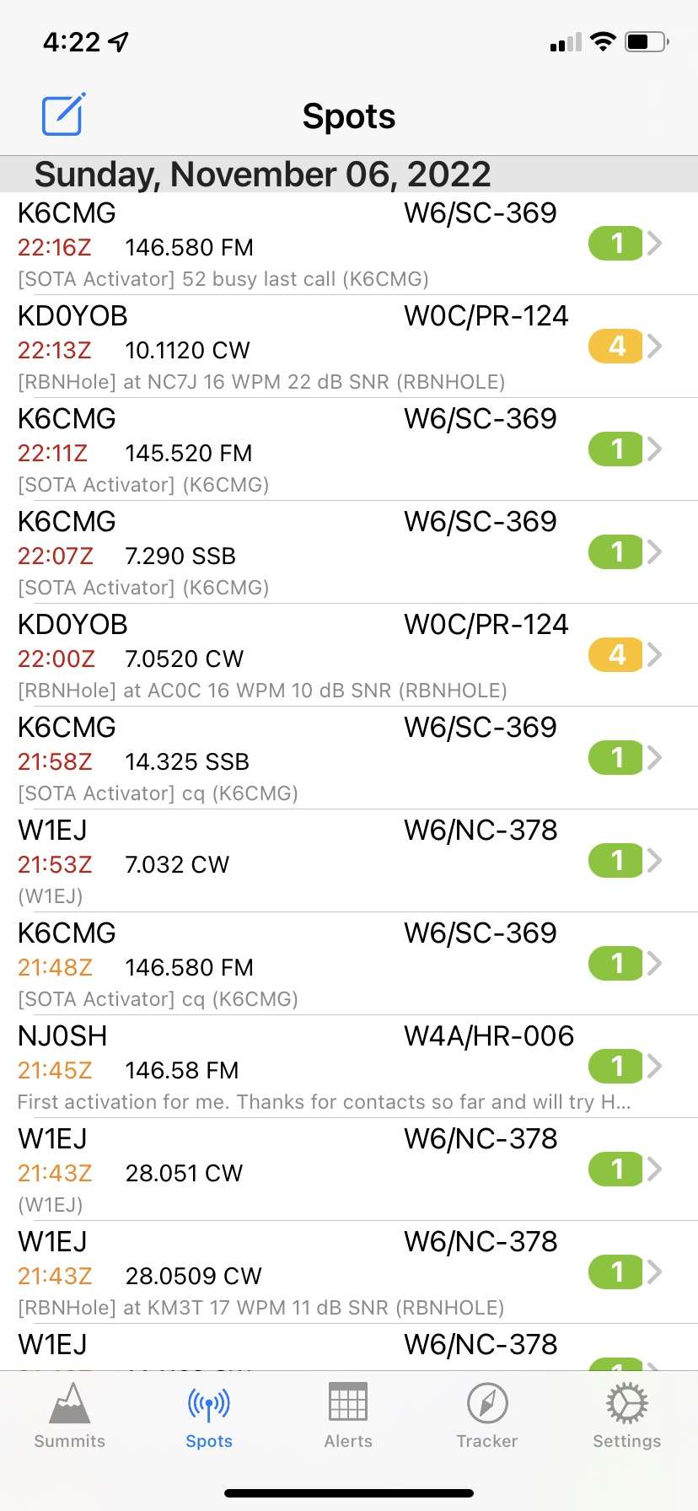
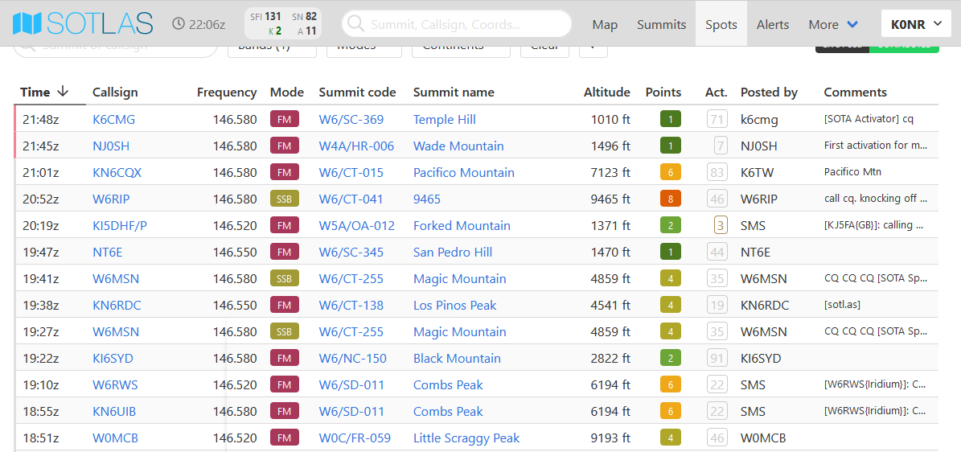
SOTAwatch
SOTA Goat app

Slide 22
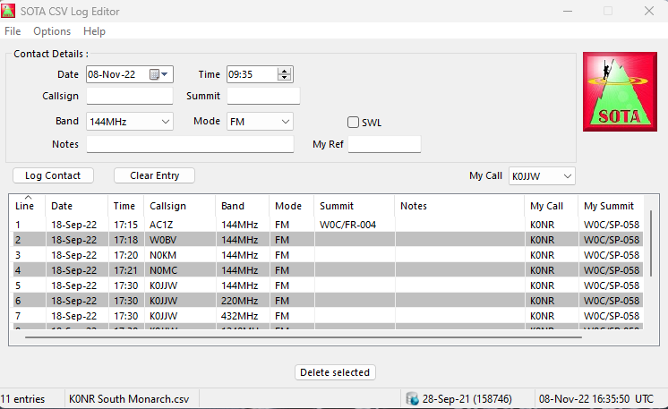
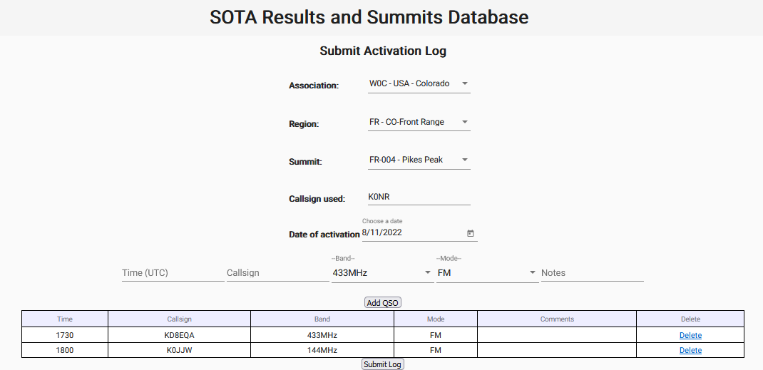
SOTA Logging
By Stewart/G0LGS Windows only

Slide 23
What’s With All the FM Gear?
It is well-known that FM performs poorly at weak signal levels
(compared to SSB, CW, WSJT modes)
The dualband FM HT is almost universal among radio hams.
Affordable, Compact & Portable
2m FM = Utility Mode
This has carried over to 1.2 GHz (Alinco HT)
I use SSB, CW, FT8 when I know there will be compatible stations on the air:
VHF Contest
Make a sked
WSJT modes are still lightly used for SOTA
(compact & convenient gear?)

Slide 24

The Big Weekend in Colorado for Summits On The Air (SOTA) See ham14er.org
Held the first full weekend in August.
2026 Main days are Saturday and Sunday (Aug 8 & 9)
2026 Bonus days are Thursday and Friday (Aug 6 and 7)
Activate and Chase ALL SOTA Summits, not just the Colorado 14ers

Slide 25
Bob KØNR on Mt Sneffels (14,150 Feet)

Slide 26
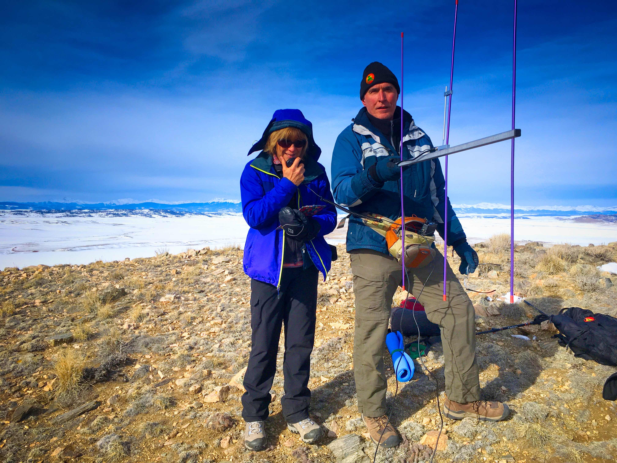
Joyce/KØJJW
and
Bob/KØNR
on
Spinney
Mountain
9524 feet

Slide 27
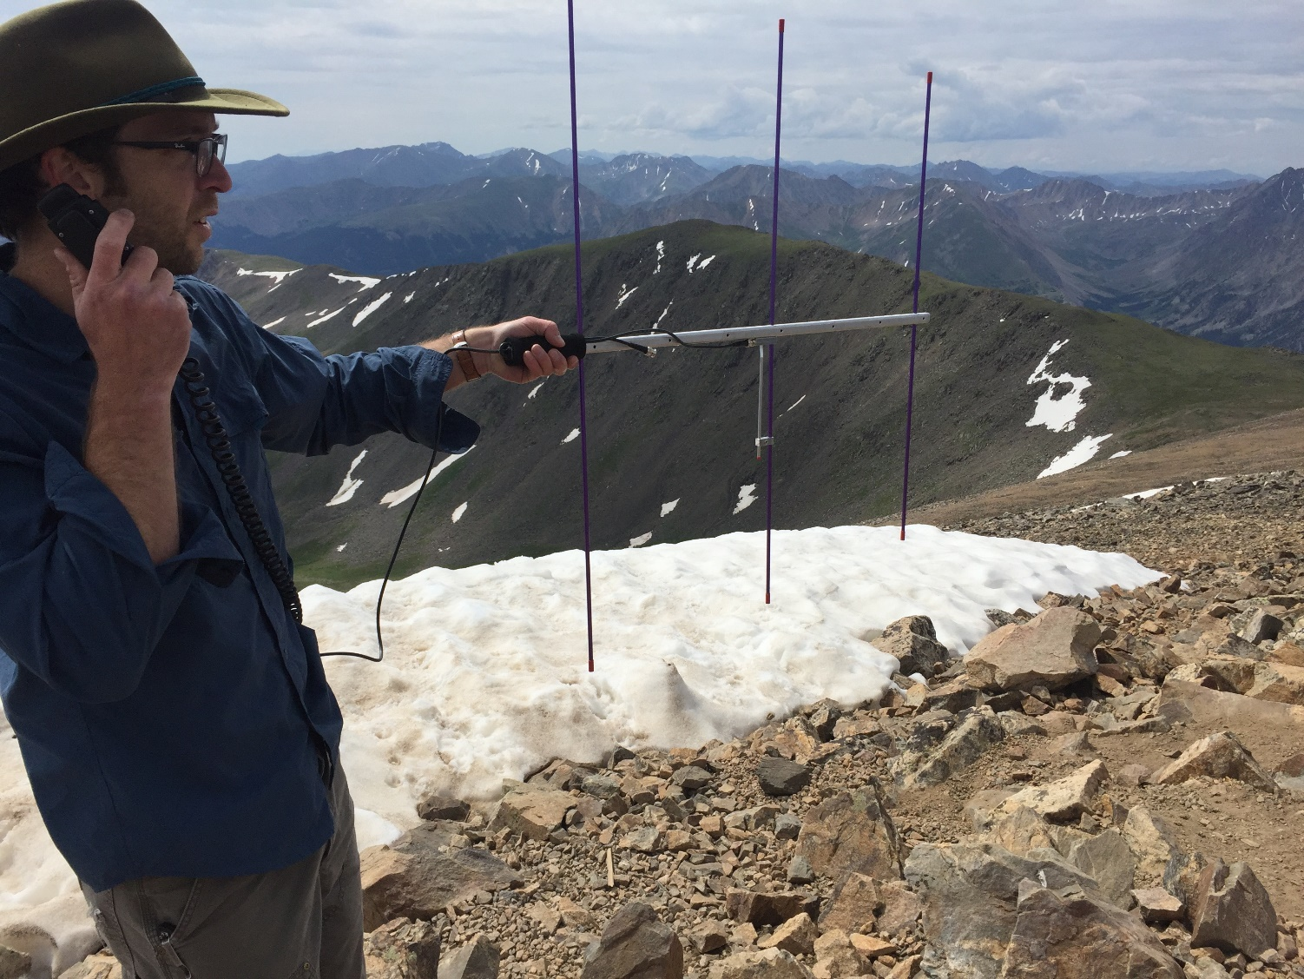
David WØADV on Mt Elbert 2015

Slide 28
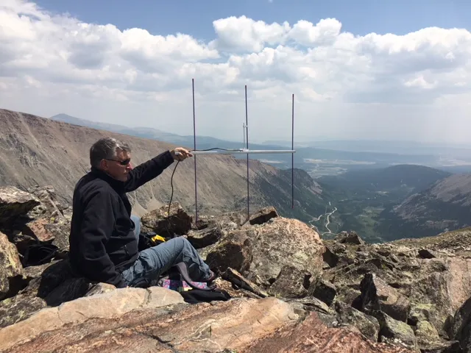
London Mountain Bob/KØNR

Slide 29
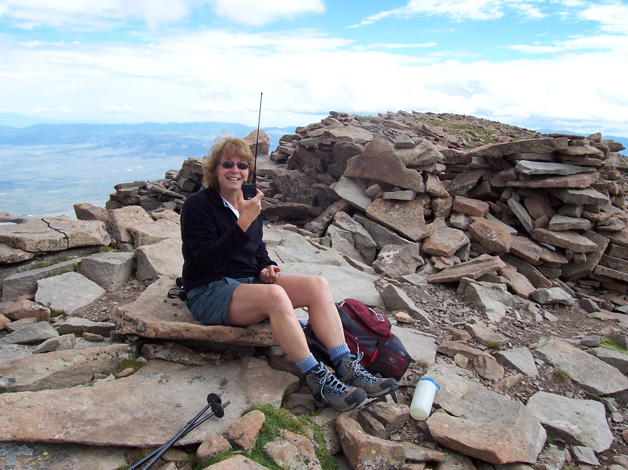

Joyce KØJJW Humbolt Peak

Slide 30
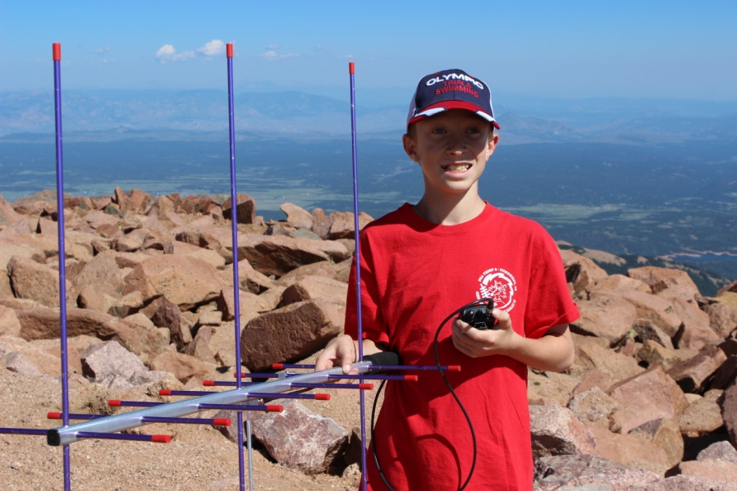
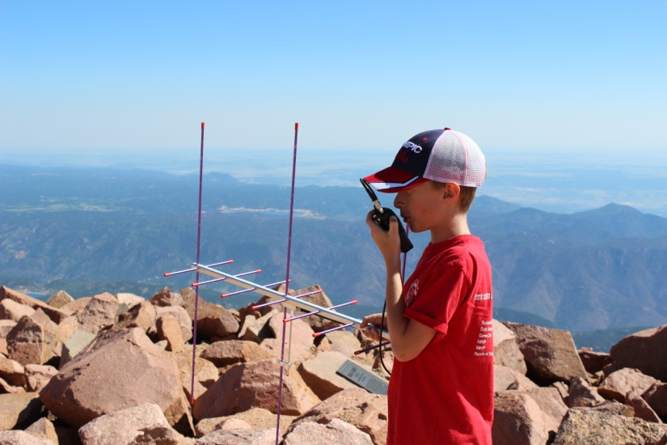
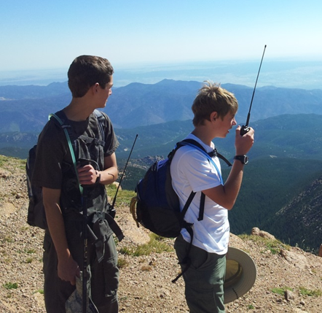
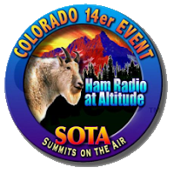
Boy Scouts On Pikes Peak

Slide 31
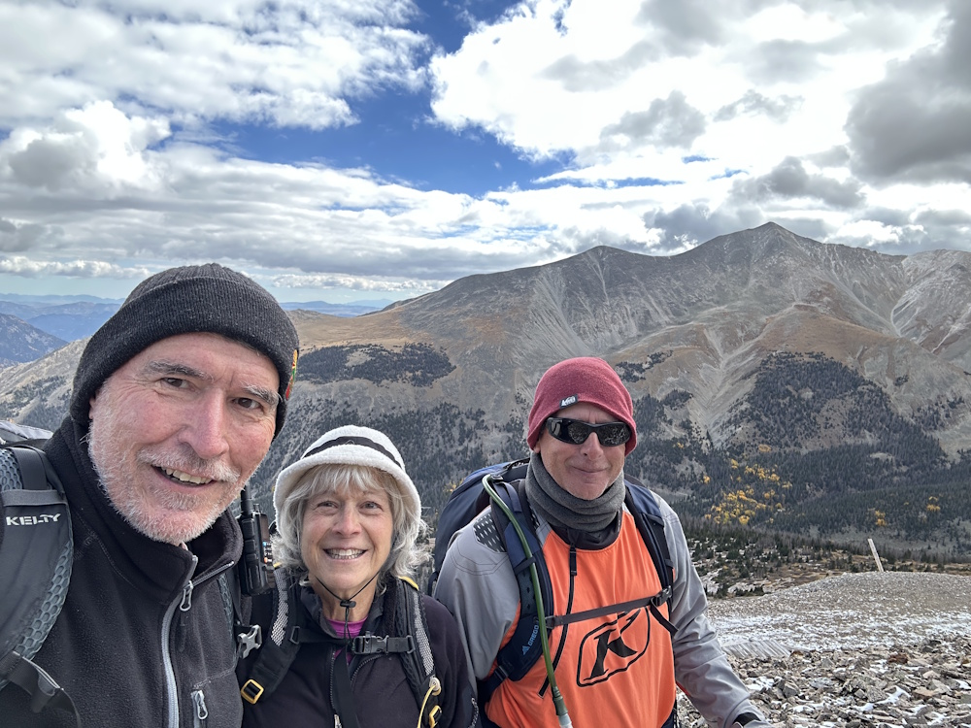
Boulder Mountain (WØC/SR-027) Bob/KØNR Joyce/KØJJW Steve/K5SJC Mt Antero in background

Slide 32
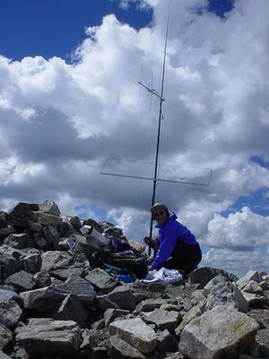
Peter K3OG Grays Peak
Mast mounted antennas
Yagi for 2m and 70 cm
Maxon for 6m

Slide 33
The Truth About VHF SOTA
VHF SOTA is easy to do, except when it’s not
You must have chasers within range to contact
Every decibel of signal strength matters

Slide 34
Some Operating Tips For VHF SOTA
Make some noise on 2m FM
National Simplex Calling Frequency: 146.52 MHz
North America Adventure Frequency: 146.58 MHz
Make long calls on 2m to drum up activity
Leave your squelch open
Let people know when you will be on the air
Operate close enough to population centers
Set schedules with specific operators
Operate during VHF contests (SSB, CW, FT8) Colorado 14er & Mountaintop Event

Slide 35

VHF Contests

Slide 36
VHF Contests!!!
VHF activity weekend
This brings out well-equipped VHF stations and operators
Scoring is based number of contacts and grids worked
Most contest activity is on SSB, also CW, FM, FT8
FT8 (and FT4) are popular, especially on 6 meters

Slide 37

Contest Format
Use all amateur bands above 50 MHz
50 MHz, 144 MHz and 432 MHz are most popular
Work everyone you can on every band
Score = QSO points x Total Grids Worked
Band | Points per QSO
50 MHz | 1
144 MHz | 1
222 MHz | 2
432 MHz | 2
902 MHz | 3
1296 MHz | 3
ARRL
June
VHF
Contest

Slide 38
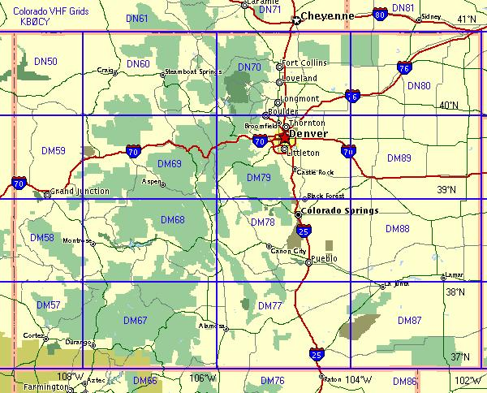
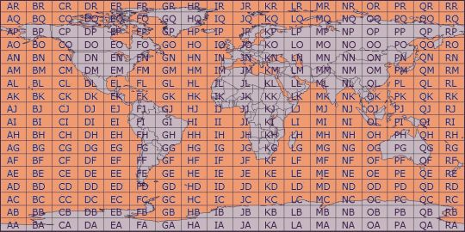
To make a contact, you need to exchange call sign and grid locator with the other station
Notes:
ANIMATED SLIDE
Define letter/number grid system.
Have students locate places on the grid map on wall.

Slide 39
A Few Operating Categories
Single Operator Portable (“QRP”)
10W max, portable power source and equipment
Single Operator, 3 Band
50, 144 and 432 MHz only
100W on 50 and 144 MHz, 50W on 432 MHz
Single Operator, FM Only
50, 144, 222 and 440 MHz (FM Only)
100W on all bands
Rover
Operate from more than one grid
Usually, no power limit but check the rules
Hilltopper (CQ WW VHF Contest only)
Portable station with 6 hour time limit

Slide 40

VHF Contest Calendar
ARRL January VHF Contest Third or fourth weekend in January
ARRL June VHF Contest Second full weekend in June
CQ Worldwide VHF Contest SSB/CW/FM: First Weekend of July Digital : Third Weekend of July
6 Meters and 2 Meters only
ARRL September VHF Contest Second full weekend in September
June is the big
VHF contest: warm weather and sporadic-e

Slide 41
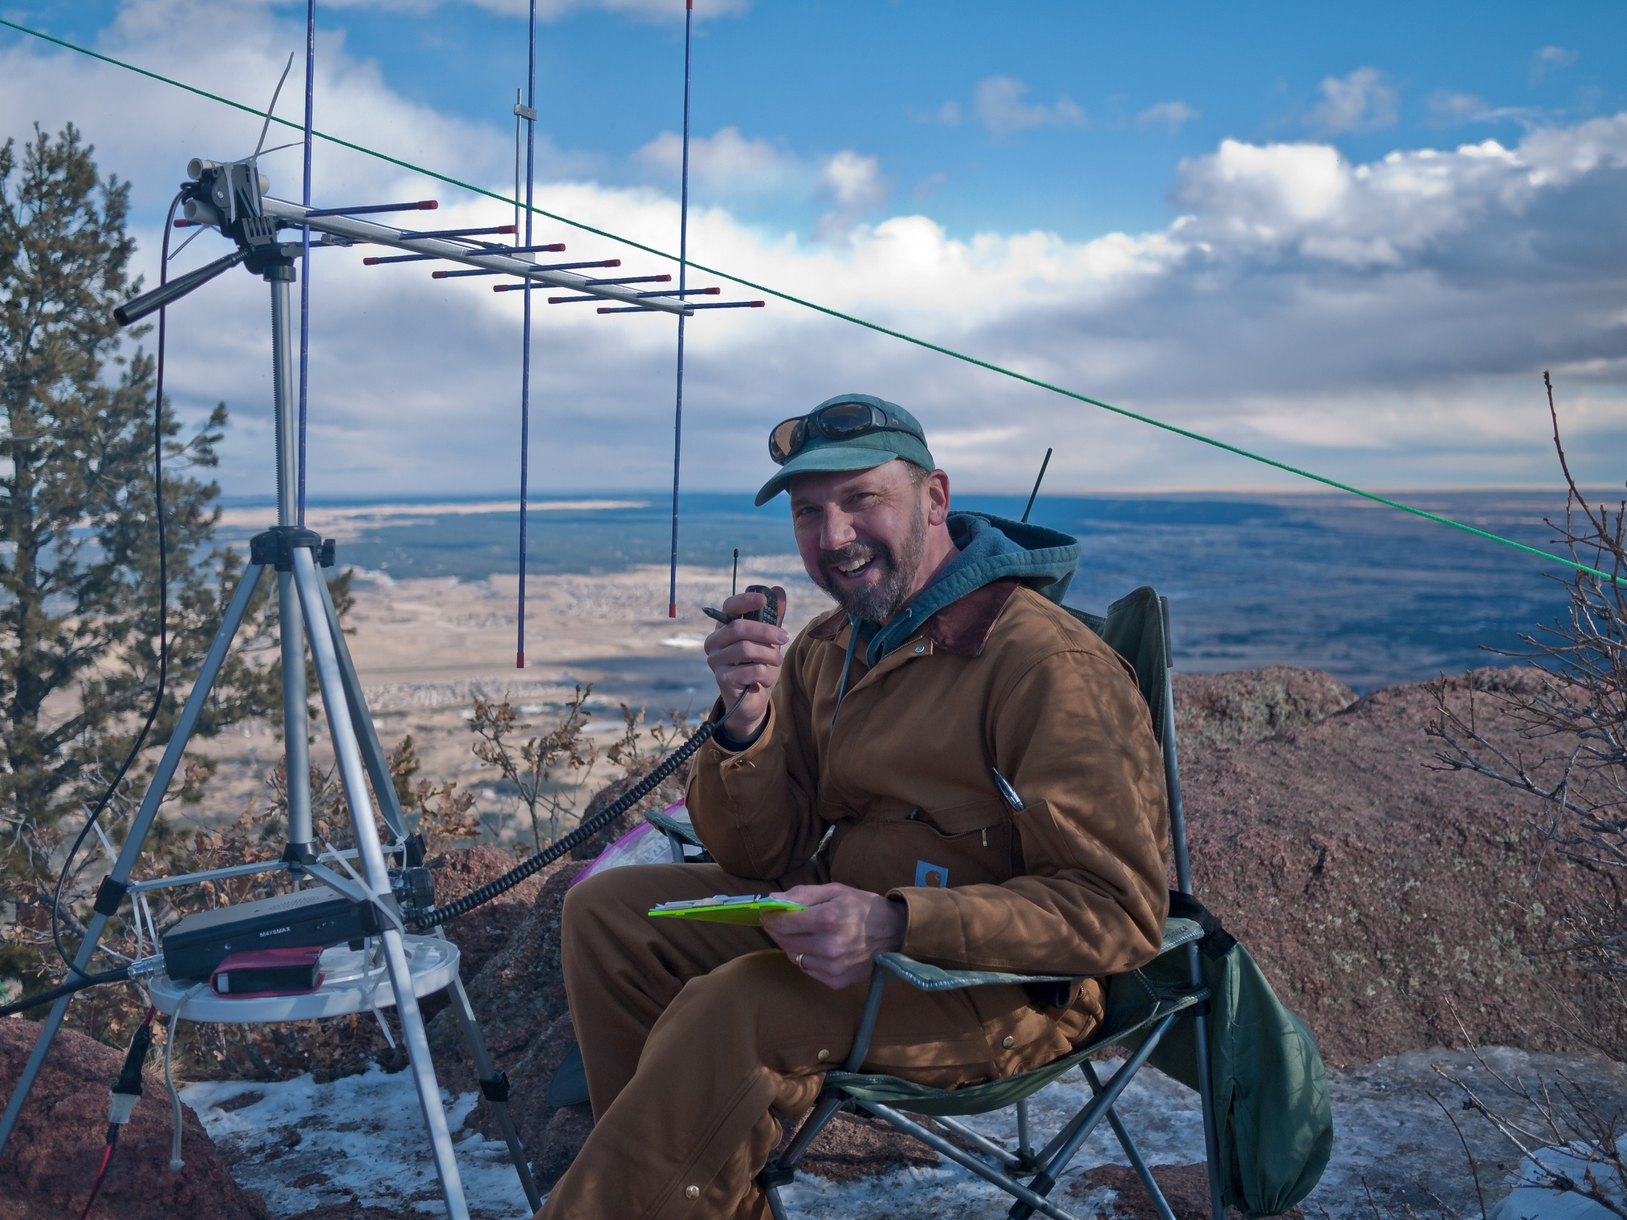
Stu WØSTU
Mt Herman January VHF 2011

Slide 42
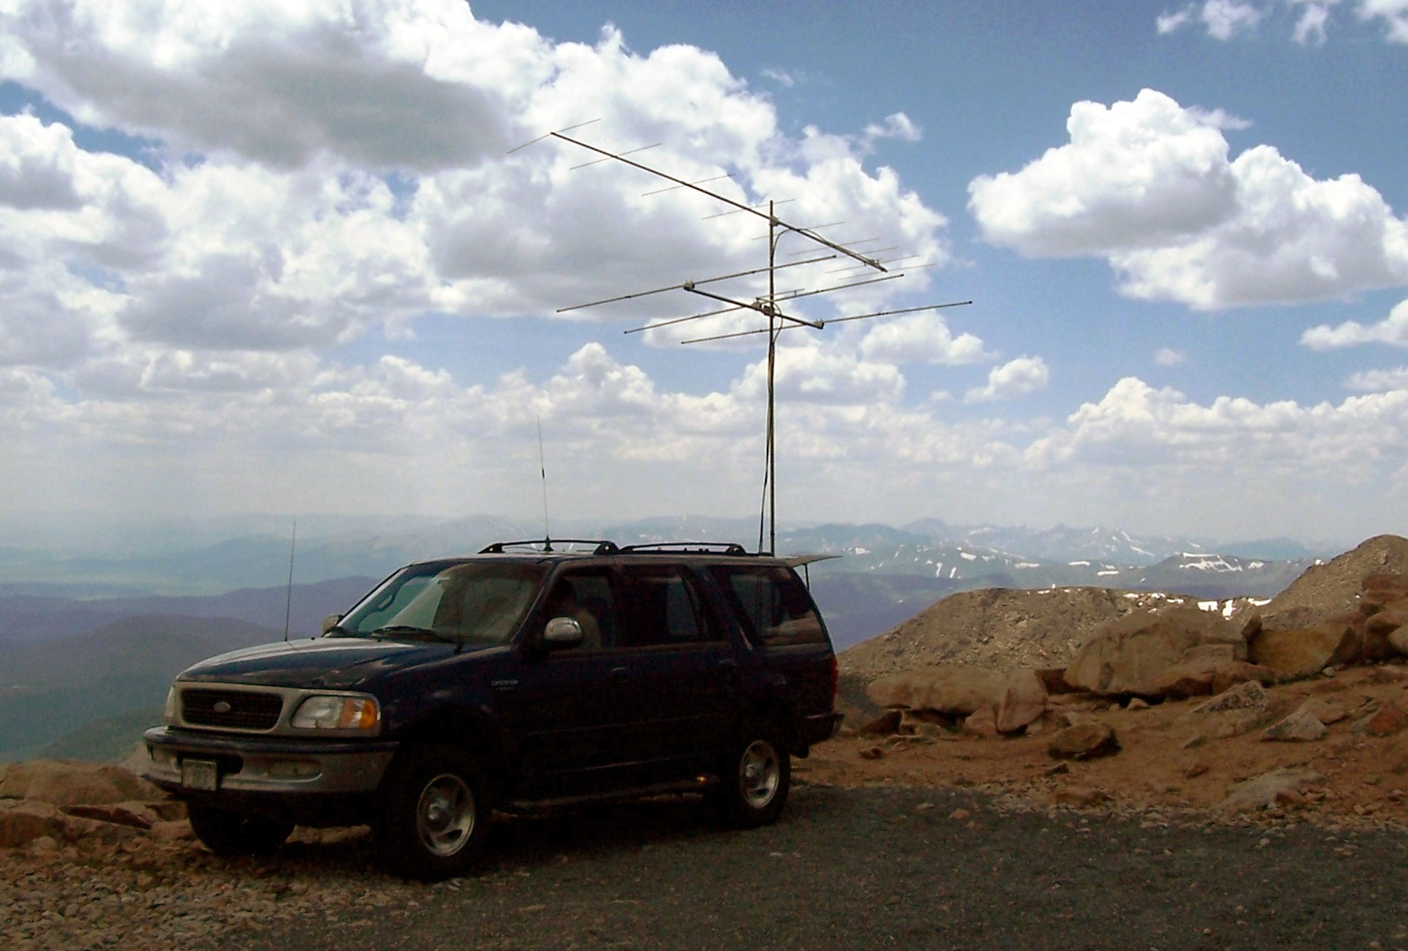
KØNR
CQ WW VHF 2006
Mount Evans

Slide 43
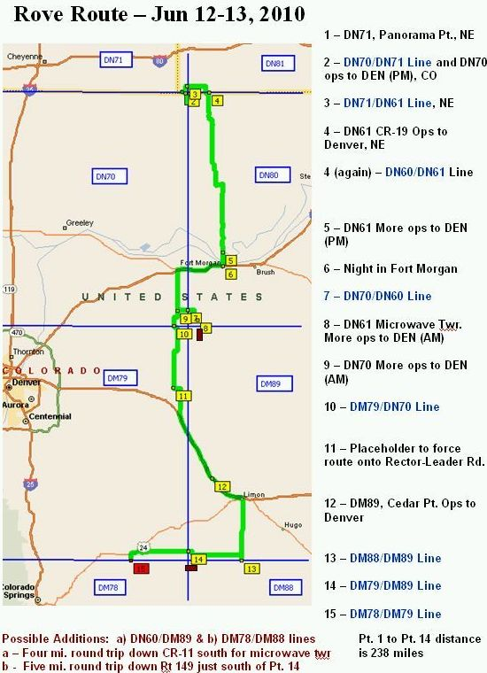
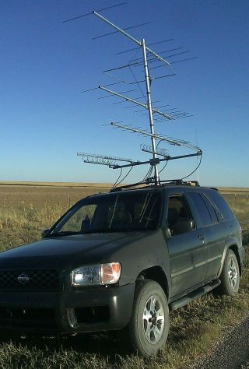
Rover Station
Eric KRØVER

Slide 44
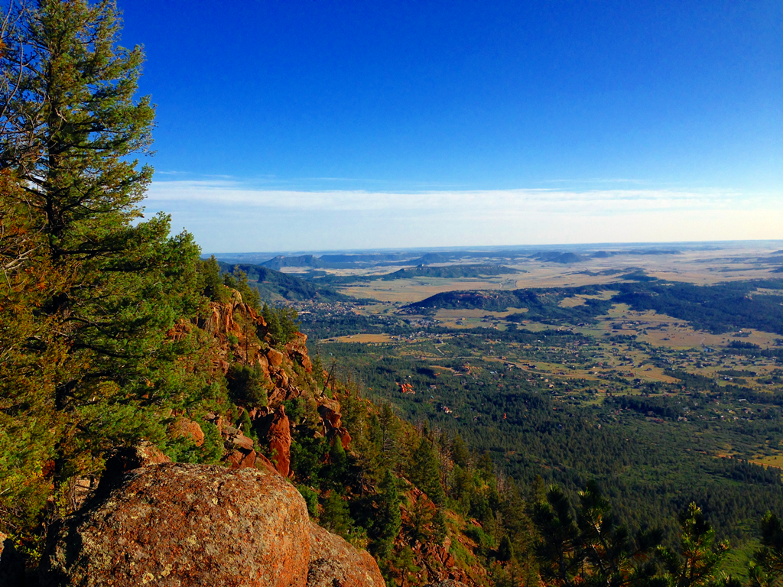
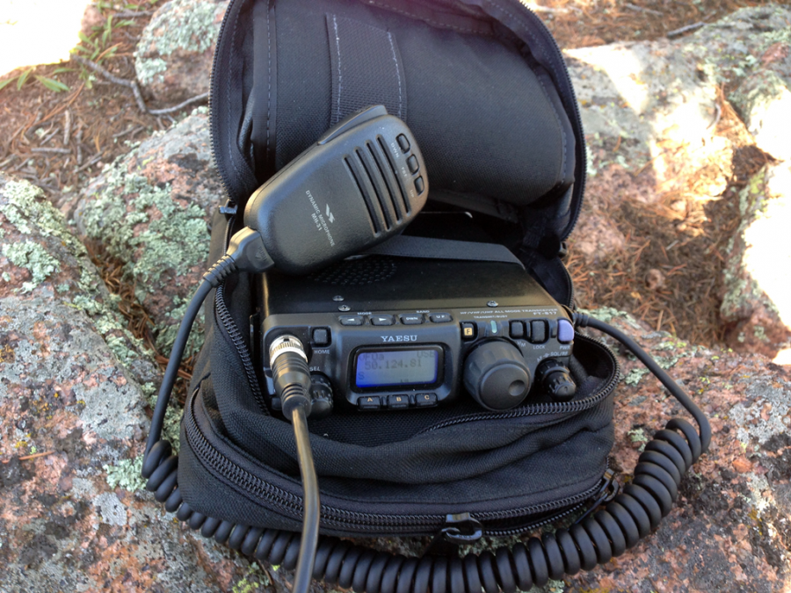
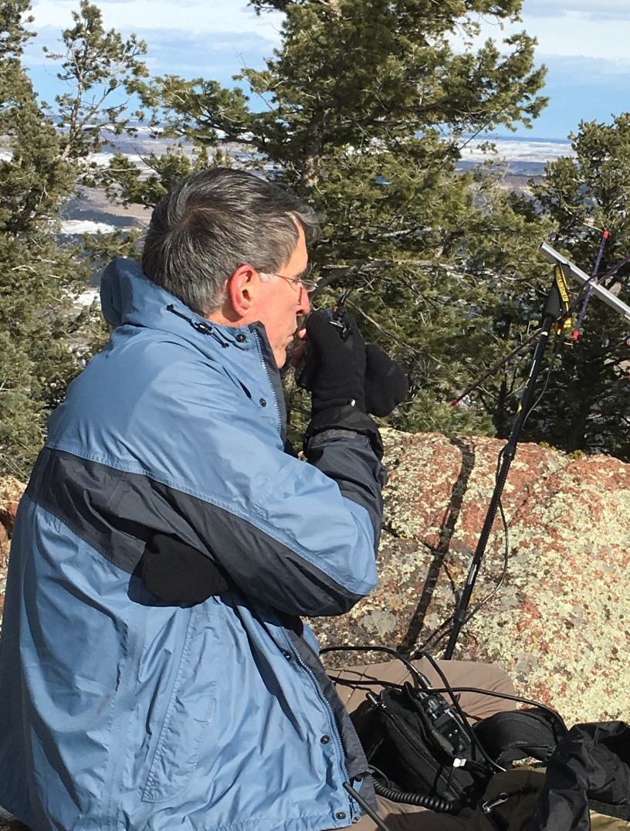
Mt Herman WØC/FR-063
9063 feet
Yaesu FT-817
VHF Contest plus SOTA
2016 January VHF Contest (KØNR)
2m & 70cm FM and SSB
17 QSOs in about one hour
Best DX: Wyoming DN71 (140 miles)

Slide 45
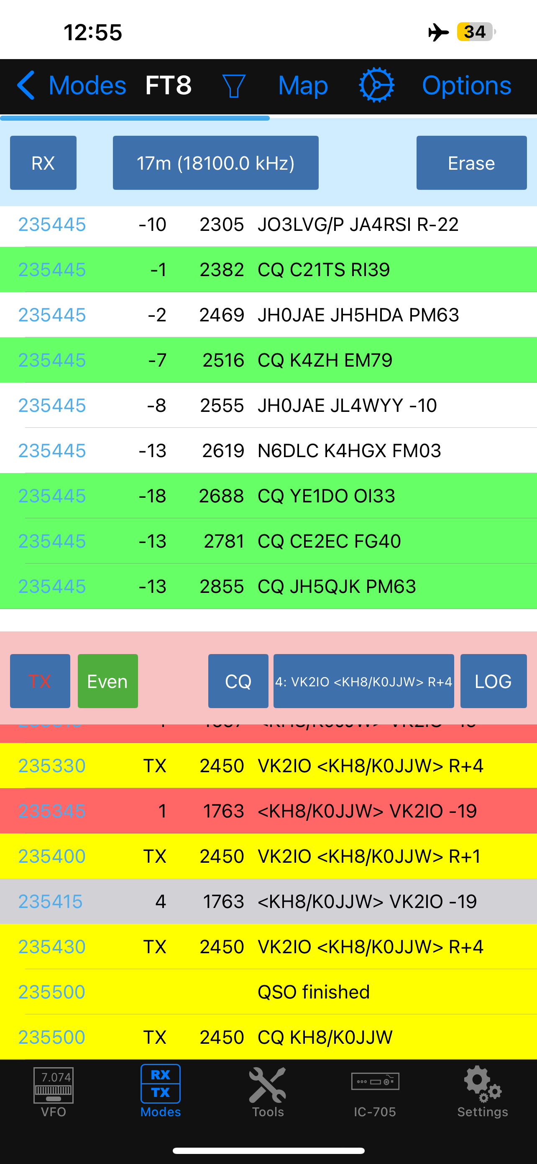
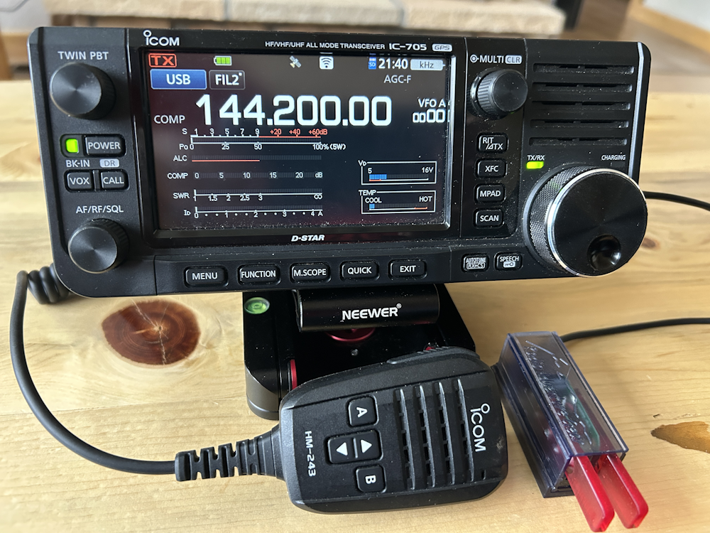
ICOM IC-705 Transceiver
160m to 70 cm, all mode 10 watts (external battery)
Great frequency coverage
Waterfall display
VHF/UHF:
6m, 2m, 70cm (all modes)
iOS App for FT8/FT4
SDR-Mobile
By Marcus, DL8MRE

Slide 46
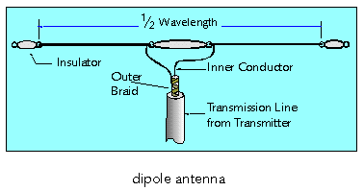
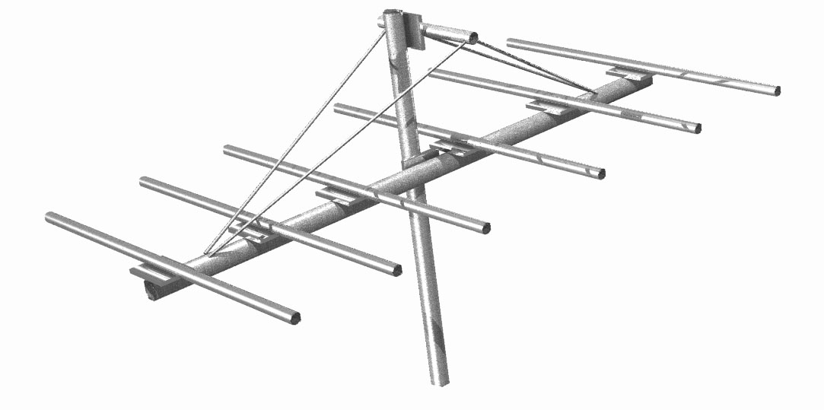
Mountaintop Antennas
6 Meters
Wire dipole antenna
End-fed halfwave antenna
Yagi antenna
2 Meters and up
Usually going to use a beam antenna Typically: Yagi
Horizontally polarized for SSB weak signal work

Slide 47
Antennas: Polarization is Important
Vertical polarization for FM, DMR, D-STAR
Naturally omnidirectional
Convenient for handheld, mobile and base
Horizontal polarization for SSB, CW, WSJT (weak signal)
Better performance with directional antennas
Omnidirectional antennas available, too.
Typical installation is a Yagi antenna, requires a method of pointing it

Slide 48

Logging
Keep a log of all contacts
Date/Time in UTC
Frequency (just the band)
Call sign and grid of each station worked
Paper log is OK
Electronic log is better
Shareware software: N1MM logger, W3KM VHF Logger For contests, logging programs track and prevent duplicate contacts

Slide 49
SOTA+VHF Contest Operating Tips
SOTA Chasers will expect your SOTA reference and a signal report
Contesters need your grid
Be prepared to assist casual operators with their grid locator
Spot yourself on SOTAwatch
More bands means more contacts, more contest points
Use SSB/CW/FT8 if you have the gear
For 2m FM, the calling frequency is 146.52 MHz
(Don’t be a calling frequency hog)
Also use North America Adventure Frequency 146.58 MHz (“the other simplex frequency”)
Also: 223.5 MHz, 446.0 MHz

Slide 50

Parks On
The Air

Slide 51
Parks On The Air Program
POTA is a program that encourages communications to and portable operations from state, provincial and nationally managed public lands.
POTA has a large set of references and a short set of rules. We welcome you to join us as an activator, chaser (hunter) or both!
Compared to SOTA, POTA has fewer restrictions: OK to use commercial power, generators, vehicles, etc.
This makes POTA more accessible and more universal (parks are everywhere and you don’t need summits nearby)

Slide 52

What Is A Park?
Federal level
National Parks, National Monuments, National Forests, National Recreation Areas, National Wildlife Refuges, Wilderness Areas, National Scenic Trails, …
State level
State Parks, State Forests, State Recreation Areas, State Wildlife Refuges, …
But not County or City parks
The park must be on the POTA list
Park designators in the USA are US-####

Slide 53

SOTA vs POTA
SOTA
Summits!
Hiking oriented (Non-motorized ascent)
No commercial power or fossil fuel generators
Not attached to a vehicle
4 QSOs to get activator points
POTA
Parks!
Hiking, vehicle, camping, very flexible
Any power source
Vehicle operation is OK
10 QSOs for a successful activation

Slide 54
So How
Far on VHF/UHF?
VHF/UHF

Slide 55
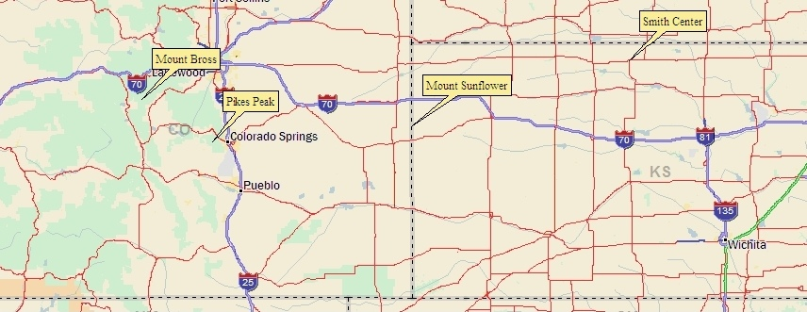
How Far Will My Signal Go on VHF?
Optical horizon from Pikes Peak: 120 miles, plus 15% for radio horizon = 138 miles
Mt Sunflower (highest spot in Kansas) is easily worked on 2m FM from Pikes Peak (160 miles)
Best 2m FM DX during Colorado 14er & Mountaintop Event: Phil NØKE on Mt Bross to Larry NØLL near Smith Center, KS (375 miles)

Slide 56
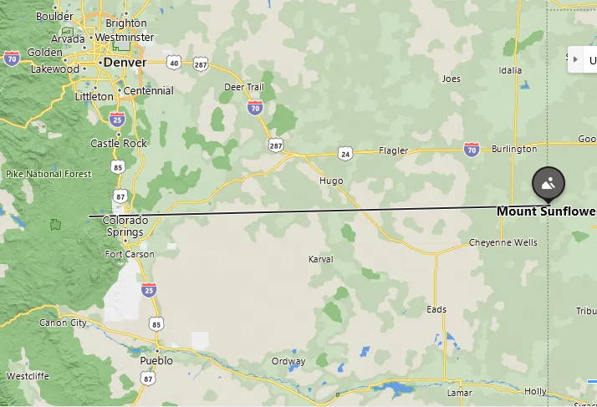


Pikes Peak to Mount Sunflower
Pikes
Peak
163 miles
Easily worked on 2m FM
(omni antenna with 30 watts)
Pikes Peak
W0C/FR-003
14,110 feet
Mount Sunflower
Highest Point in Kansas
4,039 feet

Slide 57



Capulin Mountain SOTA
W5N/SG-009
8182 feet
150 miles to major population area

Slide 58

Capulin Mountain SOTA
CW
Capulin
Mt
W5N/SG-009
8182 feet
150 miles to major population area
Best DX: N7KA 184 miles
2m CW
Also worked multiple
Denver & Col Springs stations
N7KA

Slide 59


Mt Scott (W5O/WI-002, 2464 feet)
Drive up summit in the Wichita Mountains of Oklahoma
2m FM using 3-element Yagi
Yaesu FT-90 transceiver 25W
146.52 MHz
Worked Bobby/K5RTN in Brownfield, TX
2m FM SOTA DX: 245 miles

Slide 60


Threemile Mountain (10,020 feet)
And then I heard Larry/NØLL calling me…
My Best 2-meter SOTA DX: 372 miles on SSB
Combination activation:
2021 January VHF Contest
Summits On The Air
Parks on the Air
(San Isabel National Forest)
Equipment:
Yaesu FT-991
3 element Yagi 2 meters

Slide 61

How about 1.2 GHz?
23 cm band
FM Calling Freq:
1294.5 MHz
Considered a microwave band for SOTA

Slide 62

Alinco DJ-G7T Handheld Transceiver 2m/70cm/23cm $270 1 watt on 23 cm Comet CYA-1216E Yagi Antenna 16 elements 16.6 dBi gain $155

Slide 63

2021 Colorado 14er Event
Mt Evans (W0C/FR-003) 14,264 feet
Sunshine Peak (W0C/RG-004) 14,001 feet

Slide 64


David/WØADC pointing
at the notch
1294.5 MHz
Alinco 1W FM handheld
Comet 16-element Yagi

Slide 65

Bob KØNR
Pikes Peak
Comet 16-el Yagi
Icom IC-9700
CW mode
CW

Slide 66

628 km, 392 miles
Pete, NØOY in Salina KS

Slide 67

NØOY Station

Slide 68

NØOY
Dish
For
23 cm
band

Slide 69

Wrap Up Q&A
Height Above Average Terrain
VHF Goes Beyond Line of Sight
Summits On The Air is a great option
Work 100’s of miles on VHF/UHF
VHF Contests, too!

