Slide 1
Good DX
Good Luck in the Contest! https://adxa.groups.io/
RMD Convention 2025

Slide 2

“Propagation Tools"
Bill Mader
K8TE@ARRL.net
https://www.dukecityhamfest.org/
Notes:
Continually increasing problem, but with more and more solutions.
Some of the solutions are drastic!
Overcoming at least some of your noise is possible.
We all need to get smarter about this, even when living off the grid!
Numerous references throughout the show.
E-mail me for a PDF copy

Slide 3

Proof of the Ionosphere
Edward V. Appleton Discovered the F-layer that
Had Been Postulated
Used Pulsed Radio Transmissions to Determine the Height of the Ionosphere by Timing the Echoes
Nobel Prize 1947
Notes:
Today, we know that solar Extreme Ultraviolet radiation is responsible for ionizing the air.
the ionospheric conductivity varies with the solar cycle [e.g. as expressed by the number of sunspots]
We know more about the ionosphere than every before.
And, we have great tools that can make us better DX’rs!

Slide 4
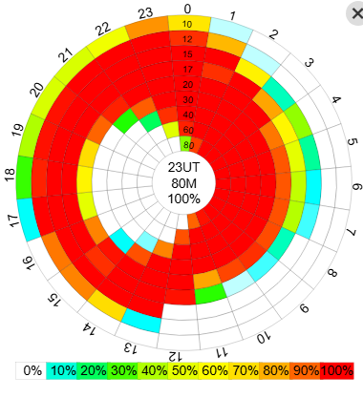
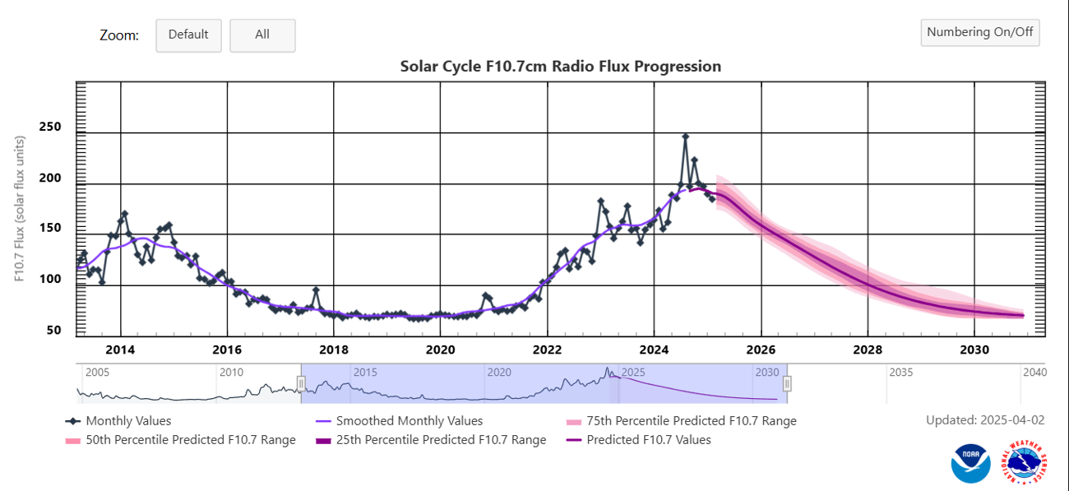
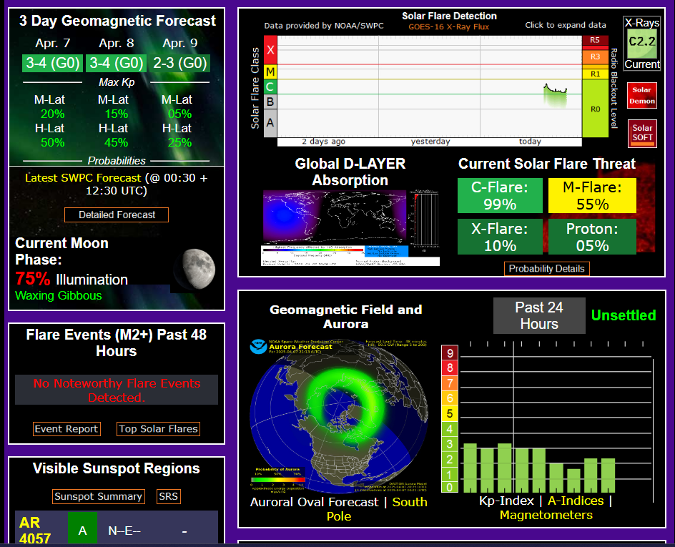
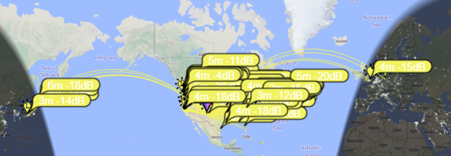
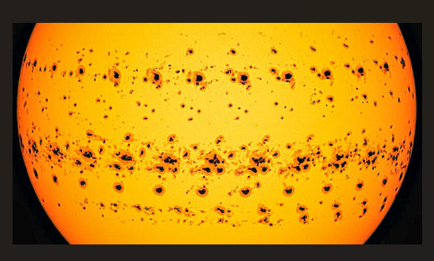
Today’s Topics
Why Propagation Tools?
VOACAP
SolarHam.com
Space WX Prediction Center
ClubLog
WSJT-X
www.SpaceWeather.com
Notes:
Perhaps you’ve heard noises like these?

Slide 5
Why Propagation Tools?
What Are/Will Be HF Conditions?
Be at the Right Place at the Right Time
Make Best Use of Your Time
Become More Effective DX’rs

Slide 6
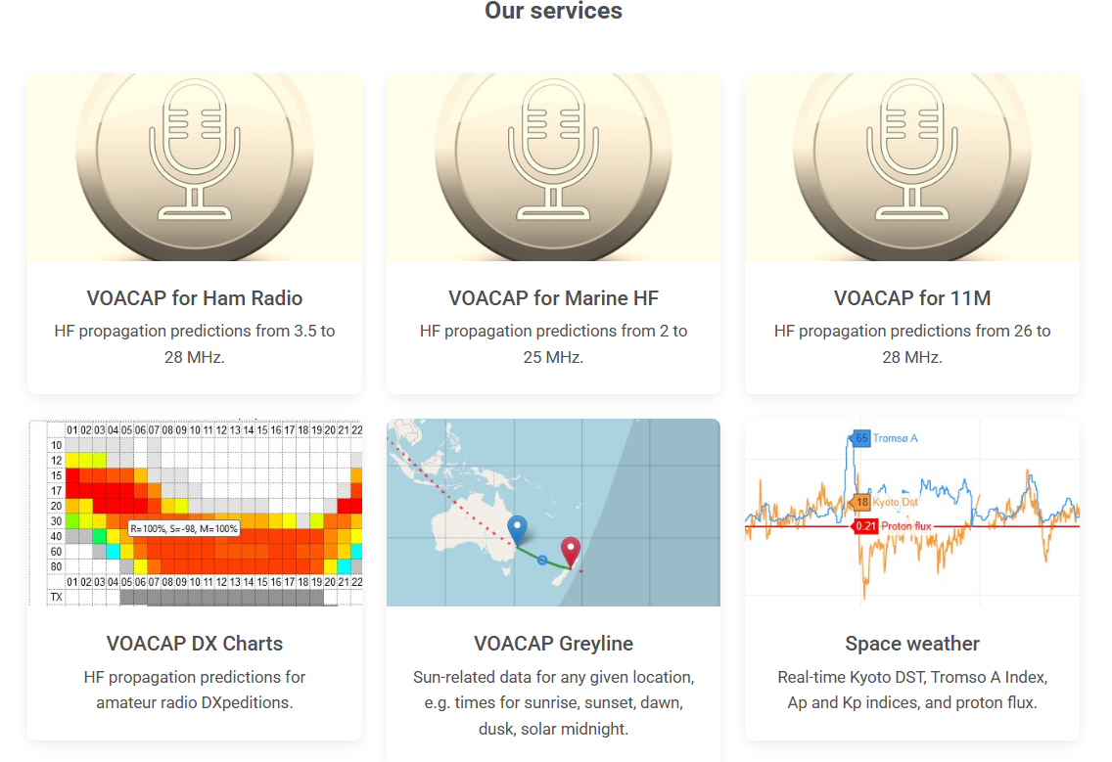
VOA Coverage Analysis Program
Free On-Line by Jari, OH6BG
Uses the VOA Propagation “Engine”
On-Line Guide & Manual
Point-to-Point Predictions
Current DXpedition Charts
Notes:
VOACAP is free professional high-frequency (3-30 MHz) propagation prediction software
from NTIA/ITS, originally developed for Voice of America (VOA).
online guide should get you well started with the software.
Donations Accepted!

Slide 7
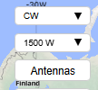

VOACAP Charts
Select VOACAP for Ham Radio
Insert DXCC Prefixes or Grid Squares
Select TX & RX Mode, Power, Antennas
Choose Data Display

Slide 8
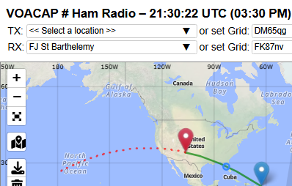
VOACAP Prop Charts

Slide 9
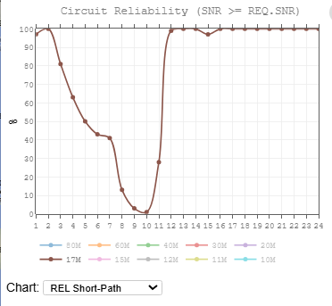
VOACAP Prop Charts
Notes:
Most importantly—RTFM!

Slide 10
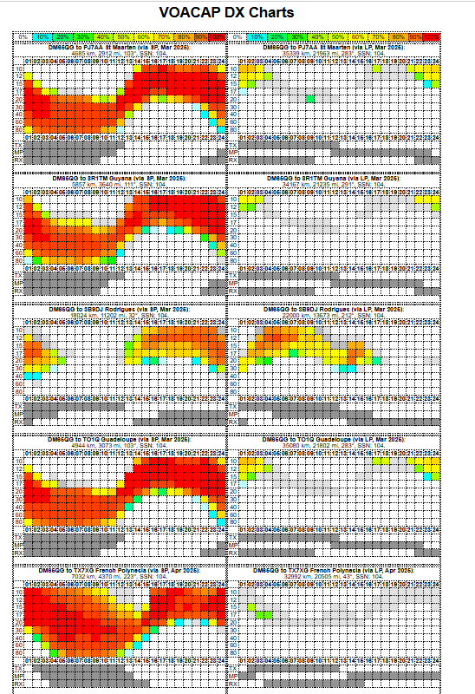
VOACAP Prop Charts
Notes:
Most importantly—RTFM!

Slide 11
SolarHam.com
Information Gathering Point by Andre, VE3IN
Up to the Minute/Hour Data
Free Service—Donations Accepted
Multiple Sources
Reality vs. Hype
vs. Blather
vs. Anecdotes
Notes:
What follows are some of the data as displayed on the home page

Slide 12
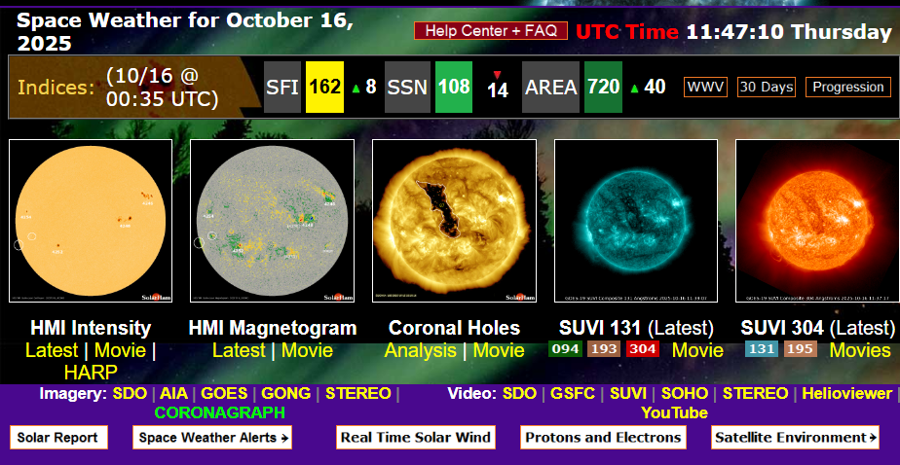
SolarHam.com

Slide 13
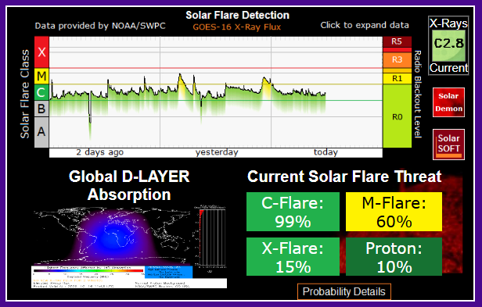
SolarHam.com

Slide 14
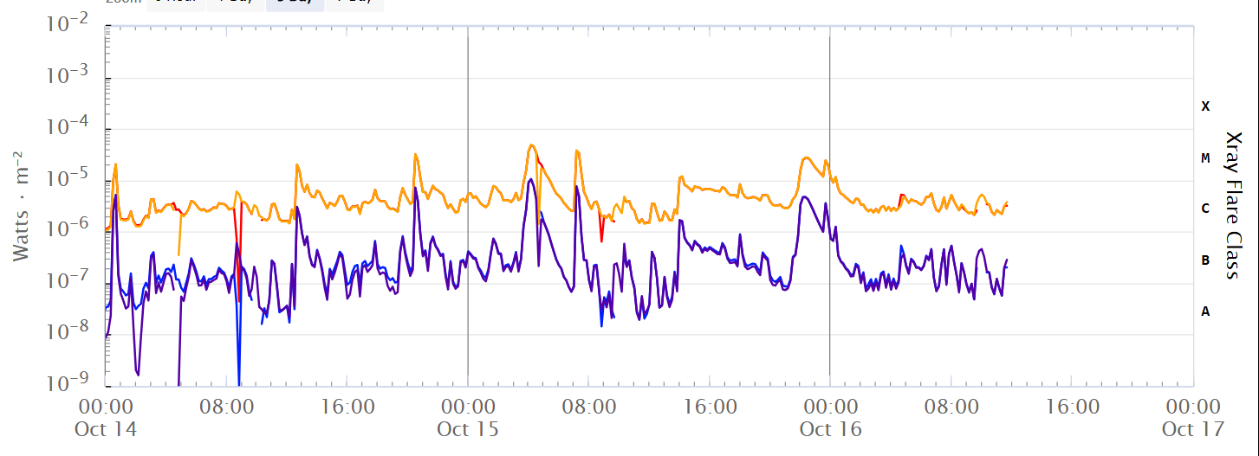
SWPC Source
Notes:
I clicked on the solarham graphic which was missing the 3-day data.

Slide 15
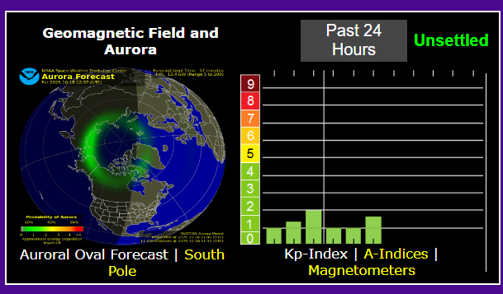
SolarHam.com

Slide 16
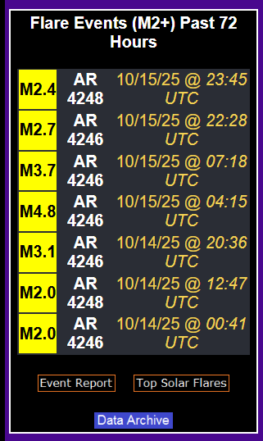
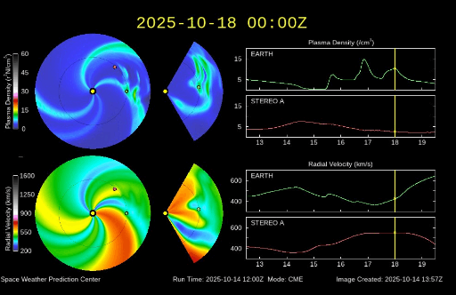
SolarHam.com

Slide 17
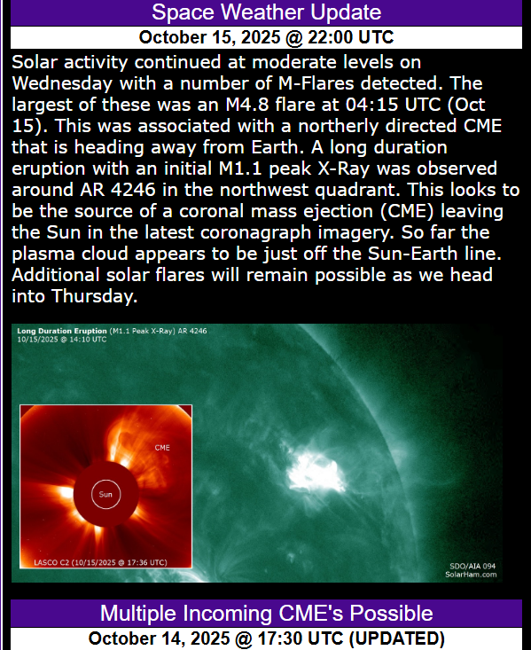
SolarHam.com

Slide 18
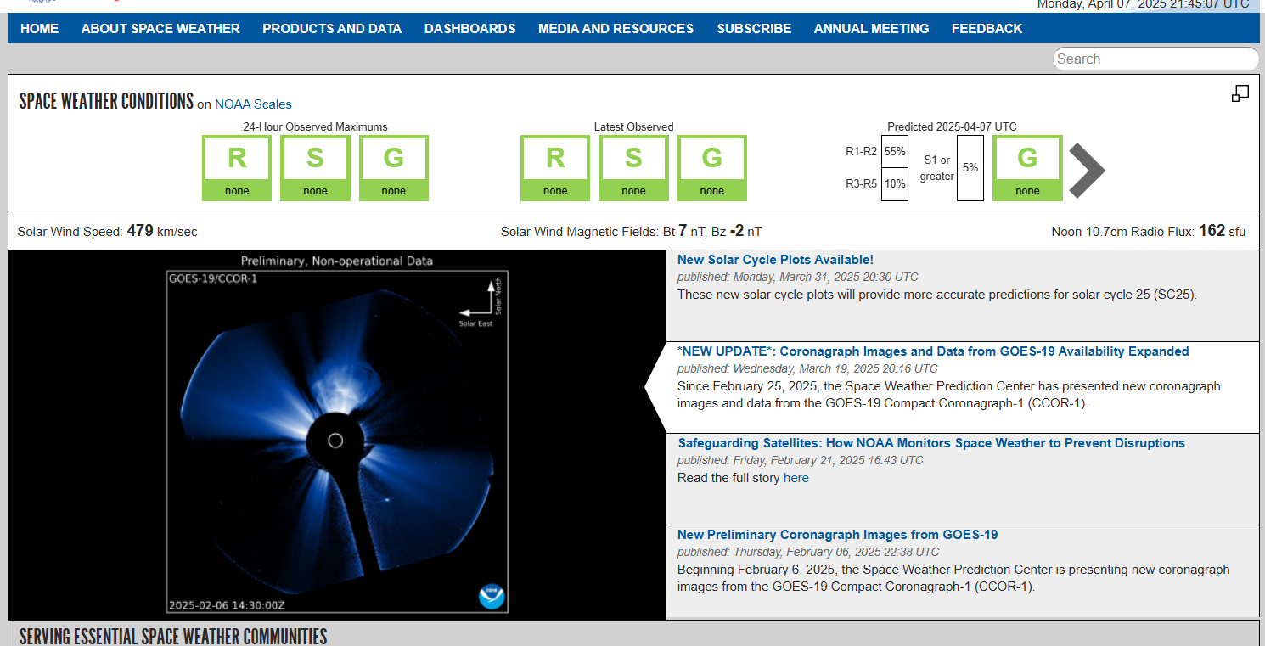
Space Weather Prediction Center
Part of NOAA
Provides Real Time, Archival, Prediction Data
Real Scientists Serving DoD, Hams, and Others
Solar Cycles
Current &
Next Cycle
Notes:
National Oceanic & Atmospheric Administration

Slide 19

Space Weather Prediction Center
Cycle 25’s Direction Since Fall 2025
Notes:
National Oceanic & Atmospheric Administration

Slide 20
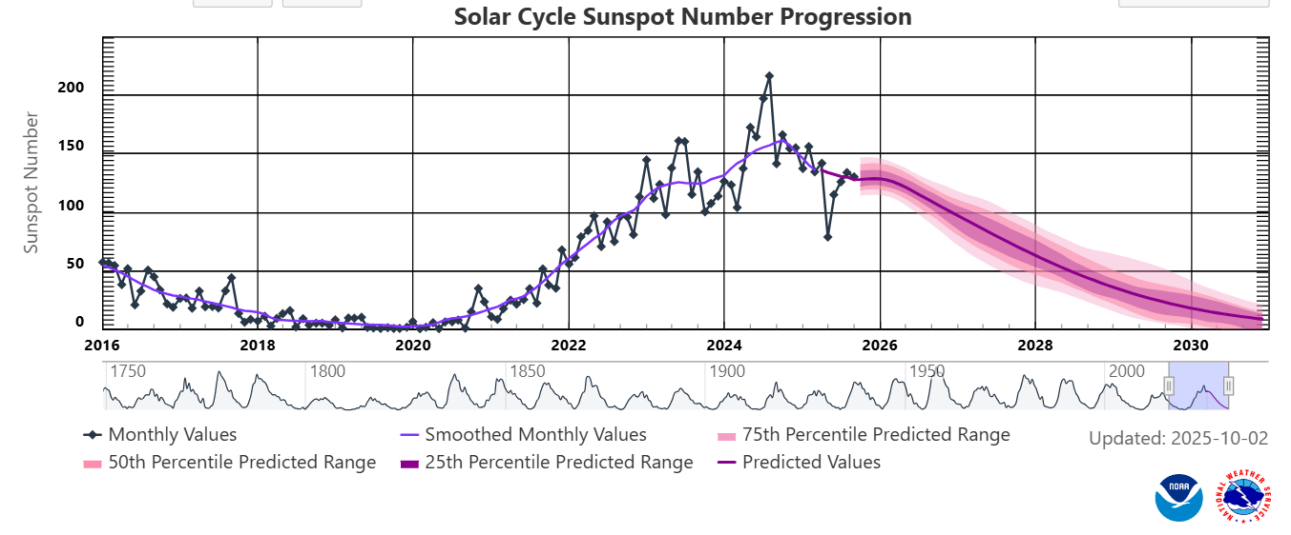
Space Weather Prediction Center
Cycle 25’s Direction Since Oct 2025—Sunspots
Notes:
National Oceanic & Atmospheric Administration

Slide 21
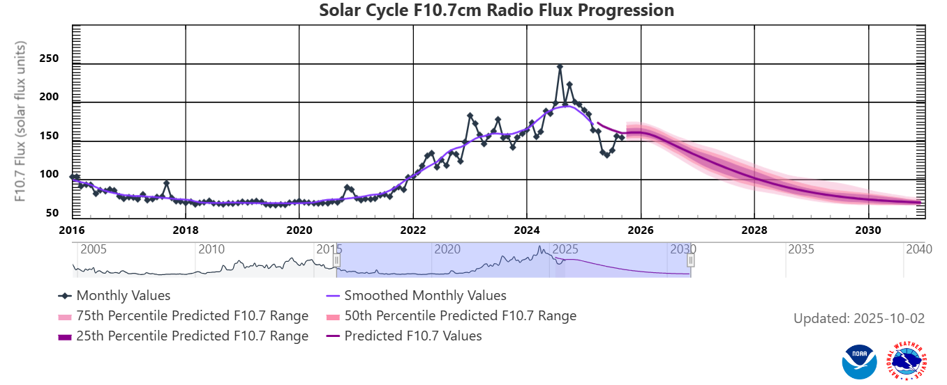
Space Weather Prediction Center
Cycle 25’s Direction Since Oct 2025—Flux
Notes:
National Oceanic & Atmospheric Administration

Slide 22
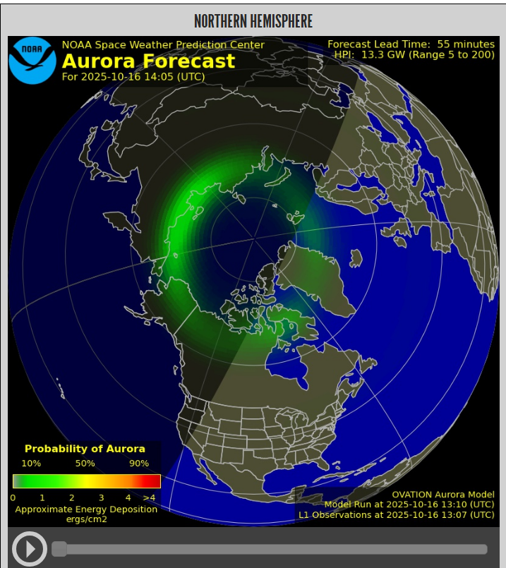
Space Weather Prediction Center
Auroa Display
Impact on
Over the Pole
Propagation
VHF Impact Too
Notes:
National Oceanic & Atmospheric Administration

Slide 23
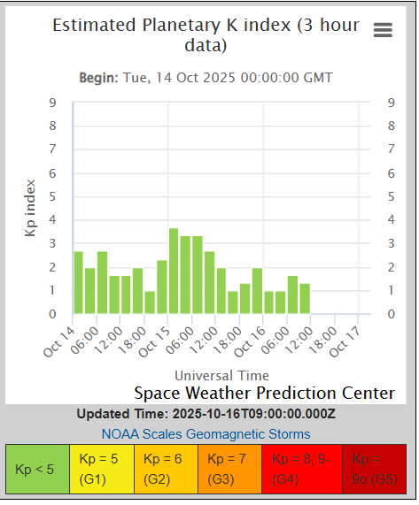
Space Weather Prediction Center
K-Index
Solar Wind, CME, Flare
All Impact
Ionospheric Absorption
and
Refraction
Green is Good (Go)
Enhancements Often
After Events
Notes:
I’ll show the impact of an event on HF in a later slide.

Slide 24
What Do the Data Mean?
http://bandconditions.com/PROP.htm for more
Solar Flux Index-10.7cm “Noise” Solar Activity Measure
50-Very Low 300-Very High
Relates to F2 Layer Intensity; Low Intensity=Low Bands
A & K Magnetometer Readings
K Measured 8x Daily 0=Inactive 9=Extreme Activity
Quasi-Logarithmic Higher is Worse for Propagation
A is Linear Average of 8 Previous K Values
0=Quiet (Good) 400=Severe Storm (Bad)
K ≤ 3 is Good A ≤ 15 is Good

Slide 25
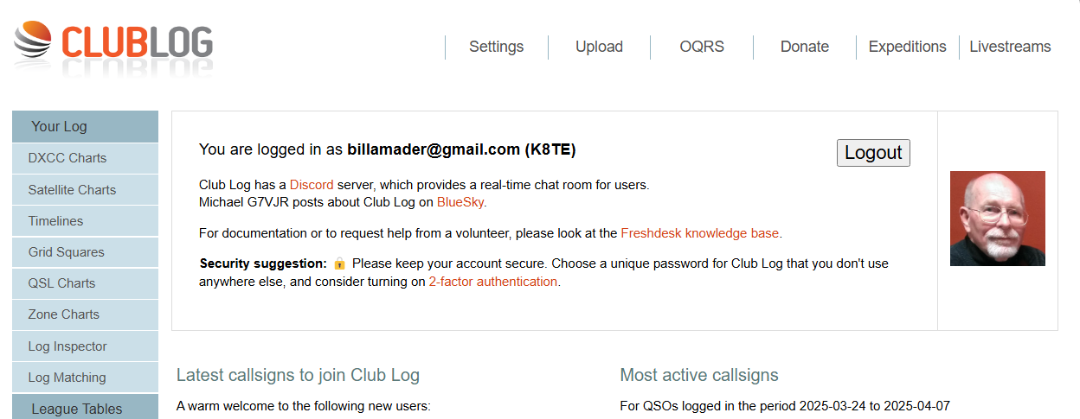
ClubLog
Source for Most Needed Listing
Relational Data Base Used for Personal Progress
Club Leagues for Intra-Club Competition
Propagation Reality for Current DXpeditions

Slide 26
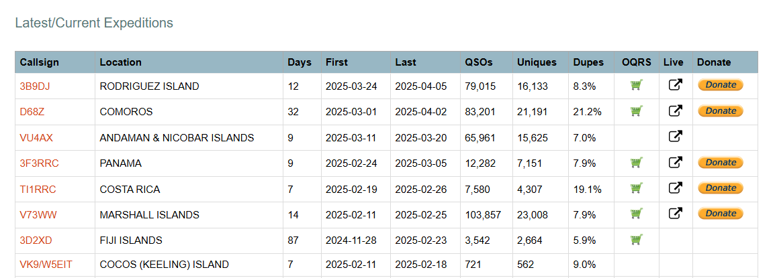
ClubLog
Propagation Reality for Current DXpeditions

Slide 27
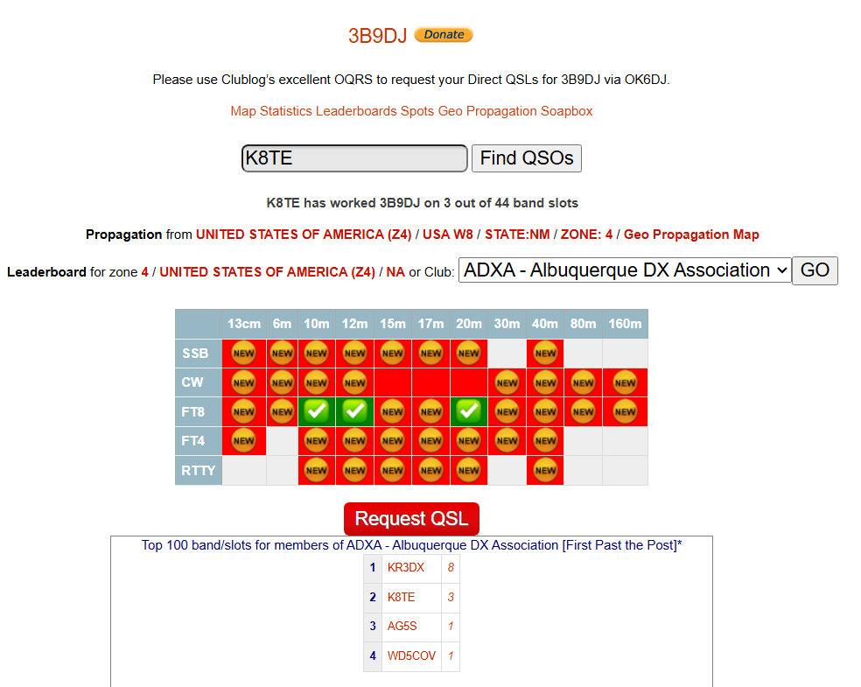
ClubLog
Propagation Reality for Current DXpeditions

Slide 28
ClubLog
Click on Your Choice for Propagation Display

Slide 29
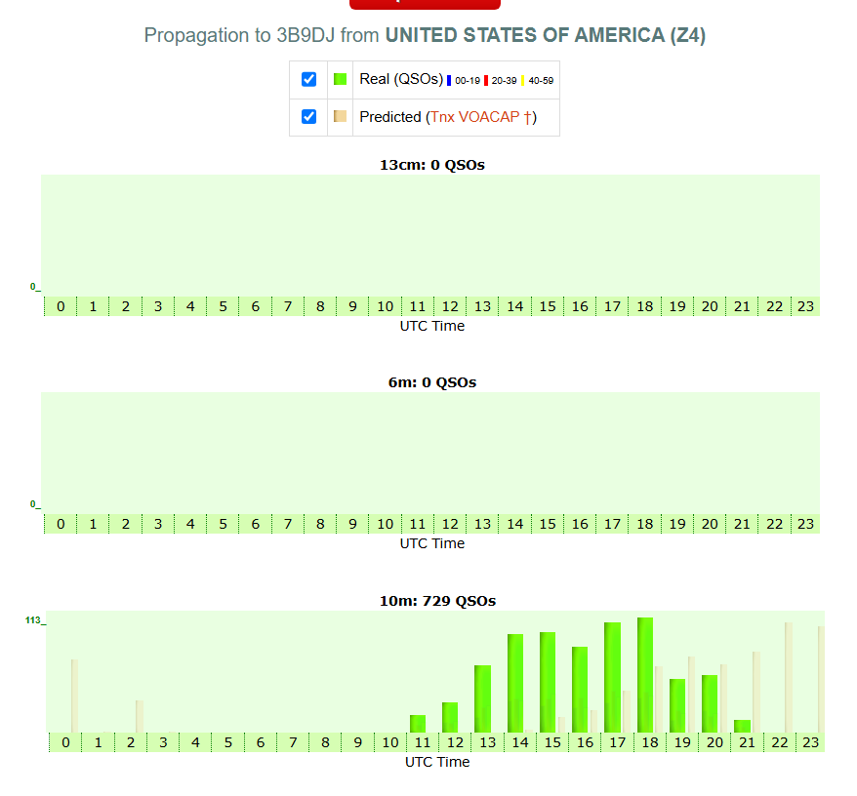
ClubLog
Band/Time Charts

Slide 30
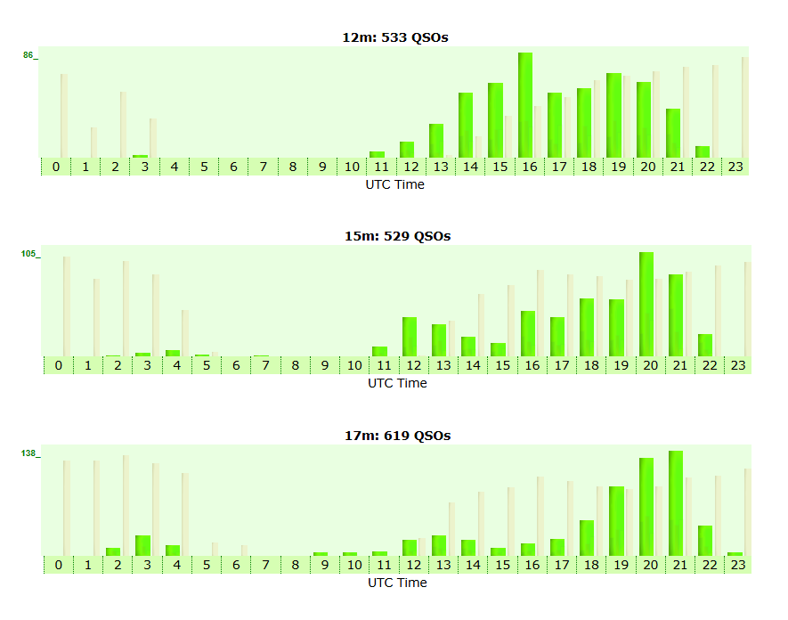
ClubLog
Band/Time Charts

Slide 31
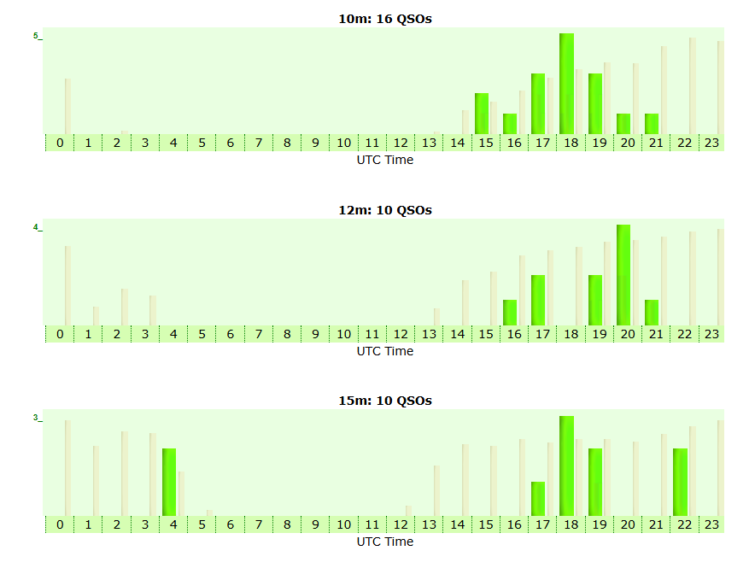
ClubLog
New Mexico

Slide 32
WSJT-X
Excellent for Testing Your
Station’s Effectiveness
Comparing Antenna
Checking Current Propagation
Use Your Sub-Mode of Choice
FT8/FT4
WSPR
FST4W
Notes:
17M 100 Watts 80m OCF at 35 ft. 14 Aug 2024

Slide 33
WSJT-X
Use Your Current/Spare Rig
Consider WSPR Using 250 mW TX
Rotate Among Your Choice of Bands
Run Prior to a DXpedition or Contest
Review the Results and
Be Prepared at the Start!
Notes:
17M 100 Watts 80m OCF at 35 ft. 14 Aug 2024

Slide 34
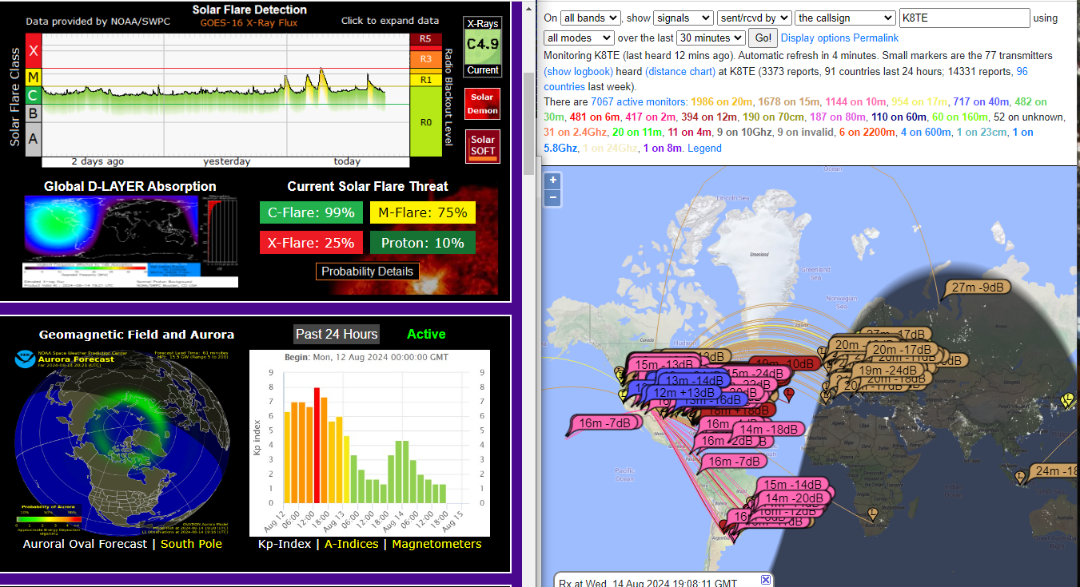
FT-8 at K8TE 14 Aug 2024
Words?
Notes:
30 minutes All Bands 1315 MDT as show on PSK Reporter

Slide 35
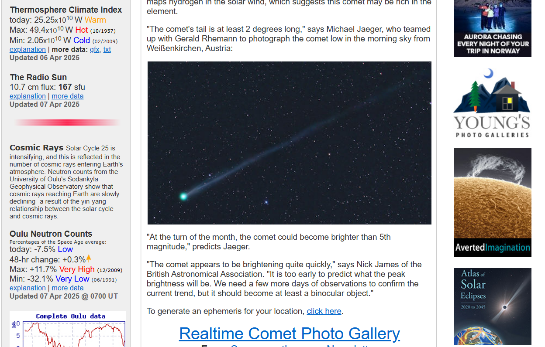
SpaceWeather.com
Beautiful Pictures
Focused on SELLING YOU STUFF!
Frequent Facts
More Frequent Hype
Lots of Stuff for Sale!
Even More Hype!
Notes:
Typical Media Hyperbole!
Now, a shameless plug:

Slide 36

Duke City Hamfest
A Real Convention
Many Presentations
Full Day Seminars
Vendors, Private Sellers, Plus Tailgate
Commercial Convention Center
Keynote Speaker
Many Prizes
“Best Hamfest in the Southwest U.S.”
www.dukecityhamfest.org
Notes:
Provide Handouts

Slide 37
Today’s Topics
Why Propagation Tools?
VOACAP
SolarHam.com
Space WX Prediction Center
ClubLog
WSJT-X
www.SpaceWeather.com
E-mail k8te@arrl.net for a PDF
or Go to: https://dxconvention.com/
Notes:
Perhaps you’ve heard noises like these?

Slide 38
References
http://k9la.us/May18_Solar_Minimum_and_Spotless_Days.pdf
https://k9la.us/Feb20_Cycle_25_Sunspots.pdf
http://www.reversebeacon.net/
http://www.sotabeams.co.uk/wsprlite-antenna-tester/
http://www.voacap.com/
http://www.grandhams.com/newsletters/2020%2001%20SCG%20January%202020%20newsletter.pdf
http://adsabs.harvard.edu/full/2012IAUS..286...27S
https://www.swpc.noaa.gov/products/geophysical-alert-wwv-text
http://arrl.org/propagation-of-rf-signals
https://www.spaceweatherlive.com/en/news/view/400/20191210-official-solar-cycle-25-forecast-update

Slide 39
References
https://www.spaceweatherlive.com/en/news/view/400/20191210-official-solar-cycle-25-forecast-update
http://dx.qsl.net/propagation/
https://www.dailydx.com/
https://www.swpc.noaa.gov/
https://www.zachtek.com/ for WSPR
www.solarham.net/ *
http://dx.qsl.net/propagation/ *
*Two of the Best for Current Propagation Conditions!
Frank Donovan, W3LPL

