Slide 1
Good DX Good Luck in the Contest! https://adxa.groups.io/
RMD Convention 2025

Slide 2

“How to Make 200 QSO’s per Hour" Bill Mader
K8TE@ARRL.net
https://www.dukecityhamfest.org/
Notes:
Continually increasing problem, but with more and more solutions.
Some of the solutions are drastic!
Overcoming at least some of your noise is possible.
We all need to get smarter about this, even when living off the grid!
Numerous references throughout the show.
E-mail me for a PDF copy

Slide 3
Is 200 QSO’s/Hour Realistic?
Operating Events vs. Just Operating
“How Many… Did You Work?”
Special Event Station Operating
Smart Operating Techniques
State QSO Party Challenge
Notes:
Perhaps you’ve heard noises like these?

Slide 4
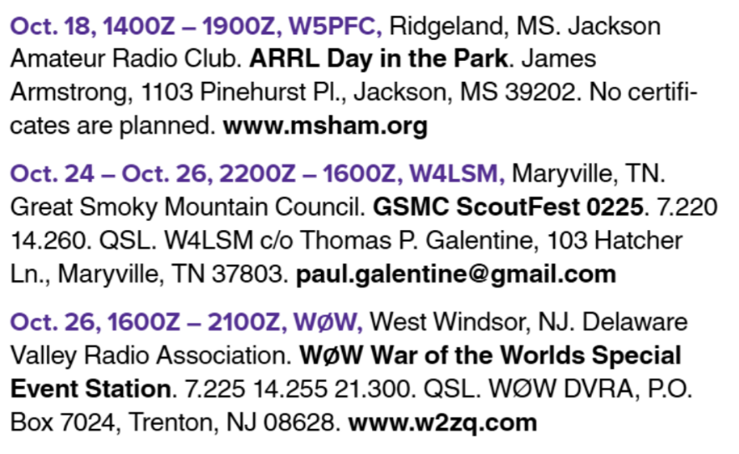
Operating Events
Concentrated Time Frames
You Become the “Wanted”
Demand Can Be Amazing!
POTA, SOTA, BOTA?
Field Day
Special Event Stations

Slide 5
Operating
CQ DX, New Mexico, Hex Beam Owners
“Casual” Operating
Small Group Nets
Propagation Nets
Friends who Gather on the Air
Enjoyable, Fun, Boring?
Notes:
VOACAP is free professional high-frequency (3-30 MHz) propagation prediction software
from NTIA/ITS, originally developed for Voice of America (VOA).
online guide should get you well started with the software.
Donations Accepted!

Slide 6
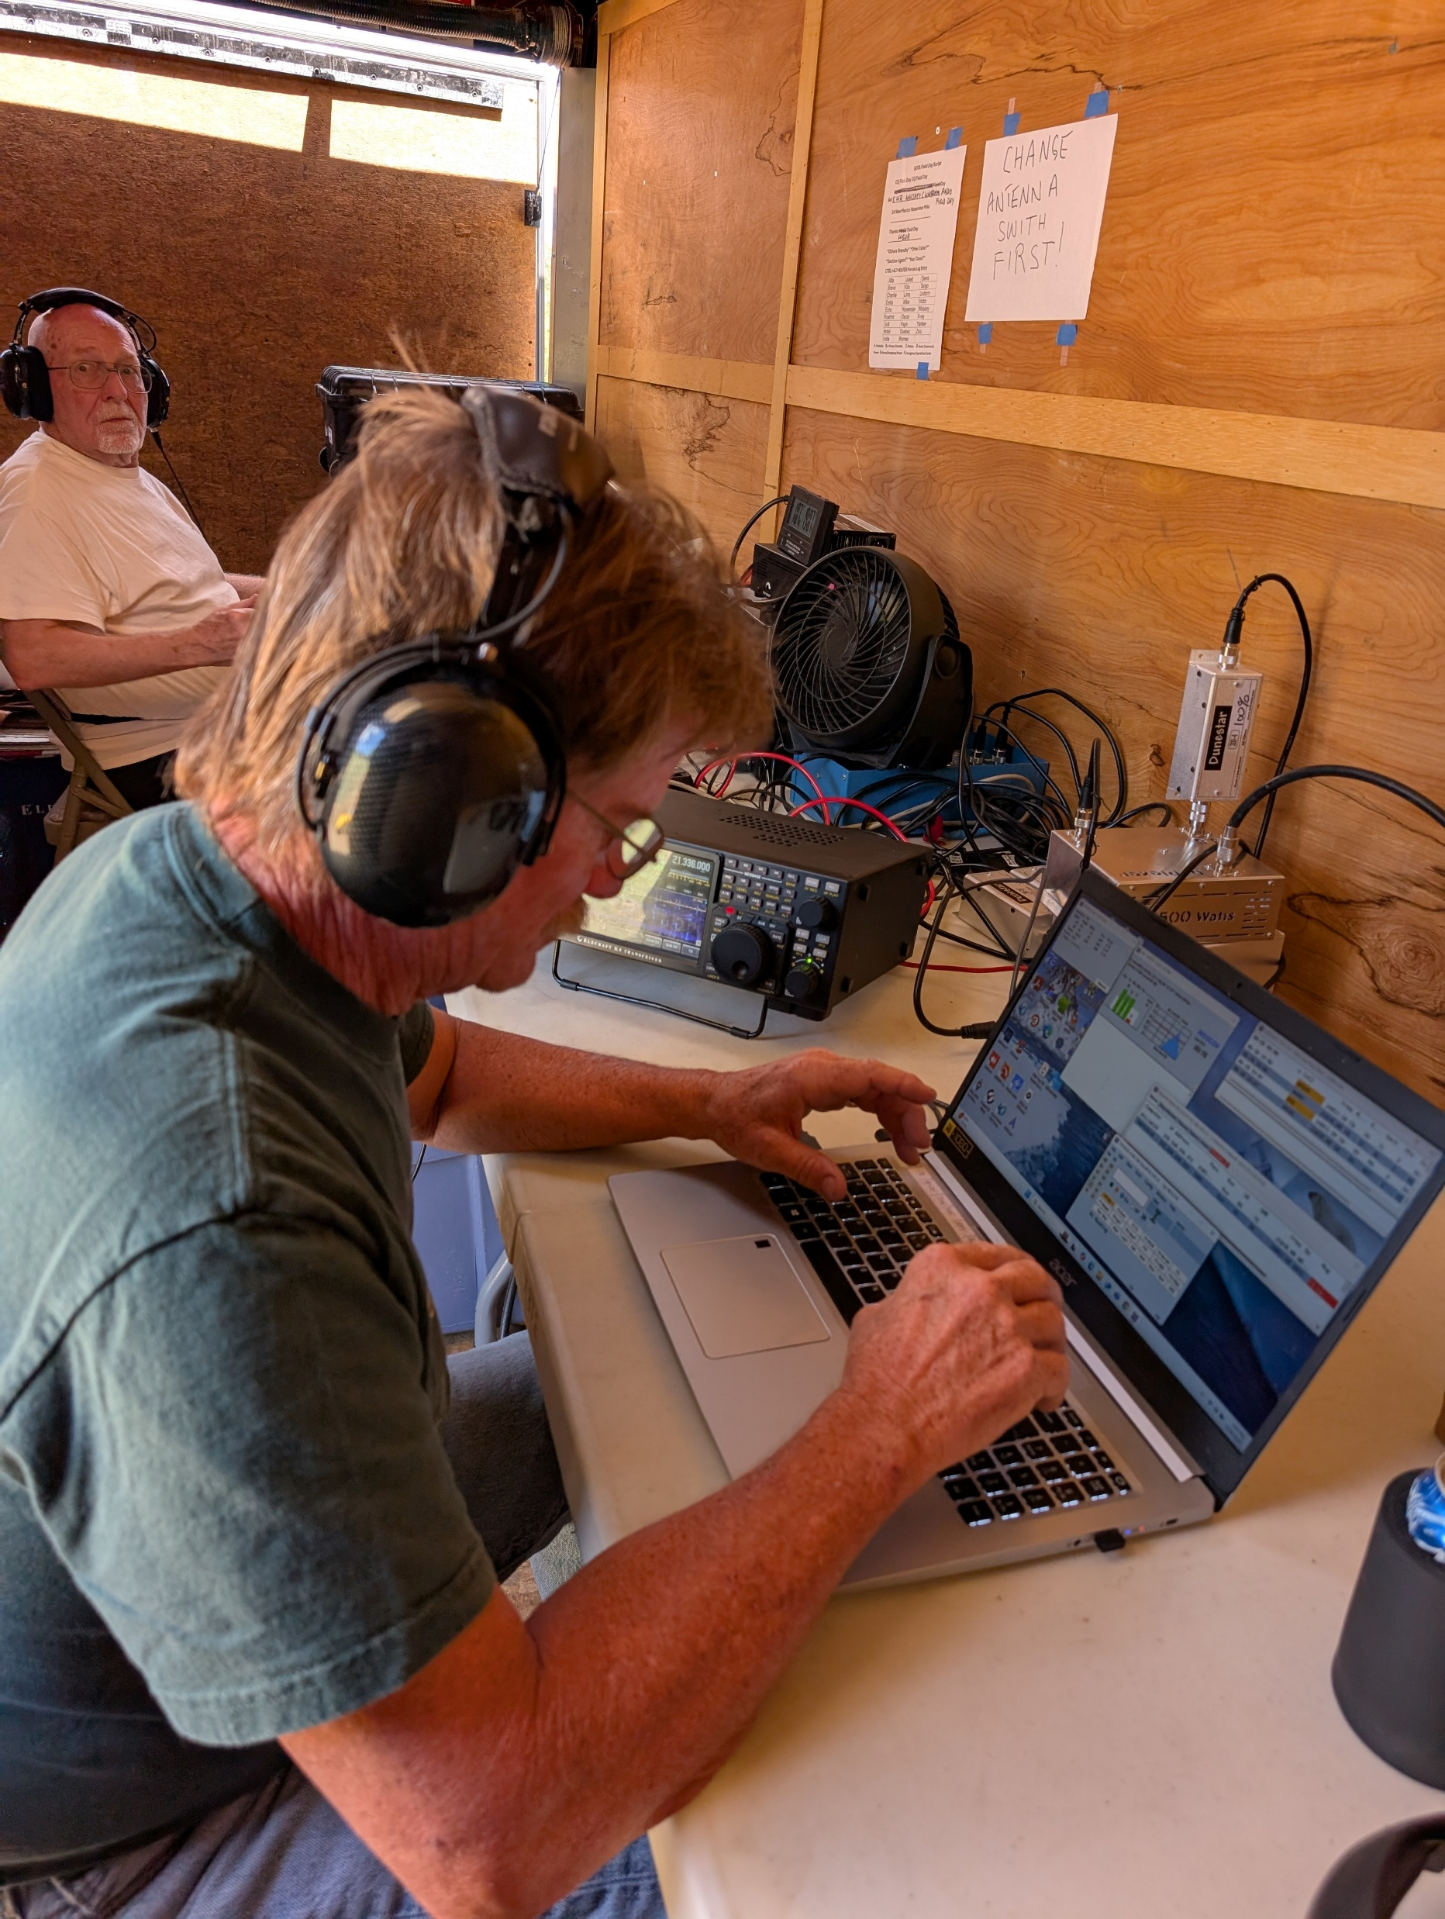
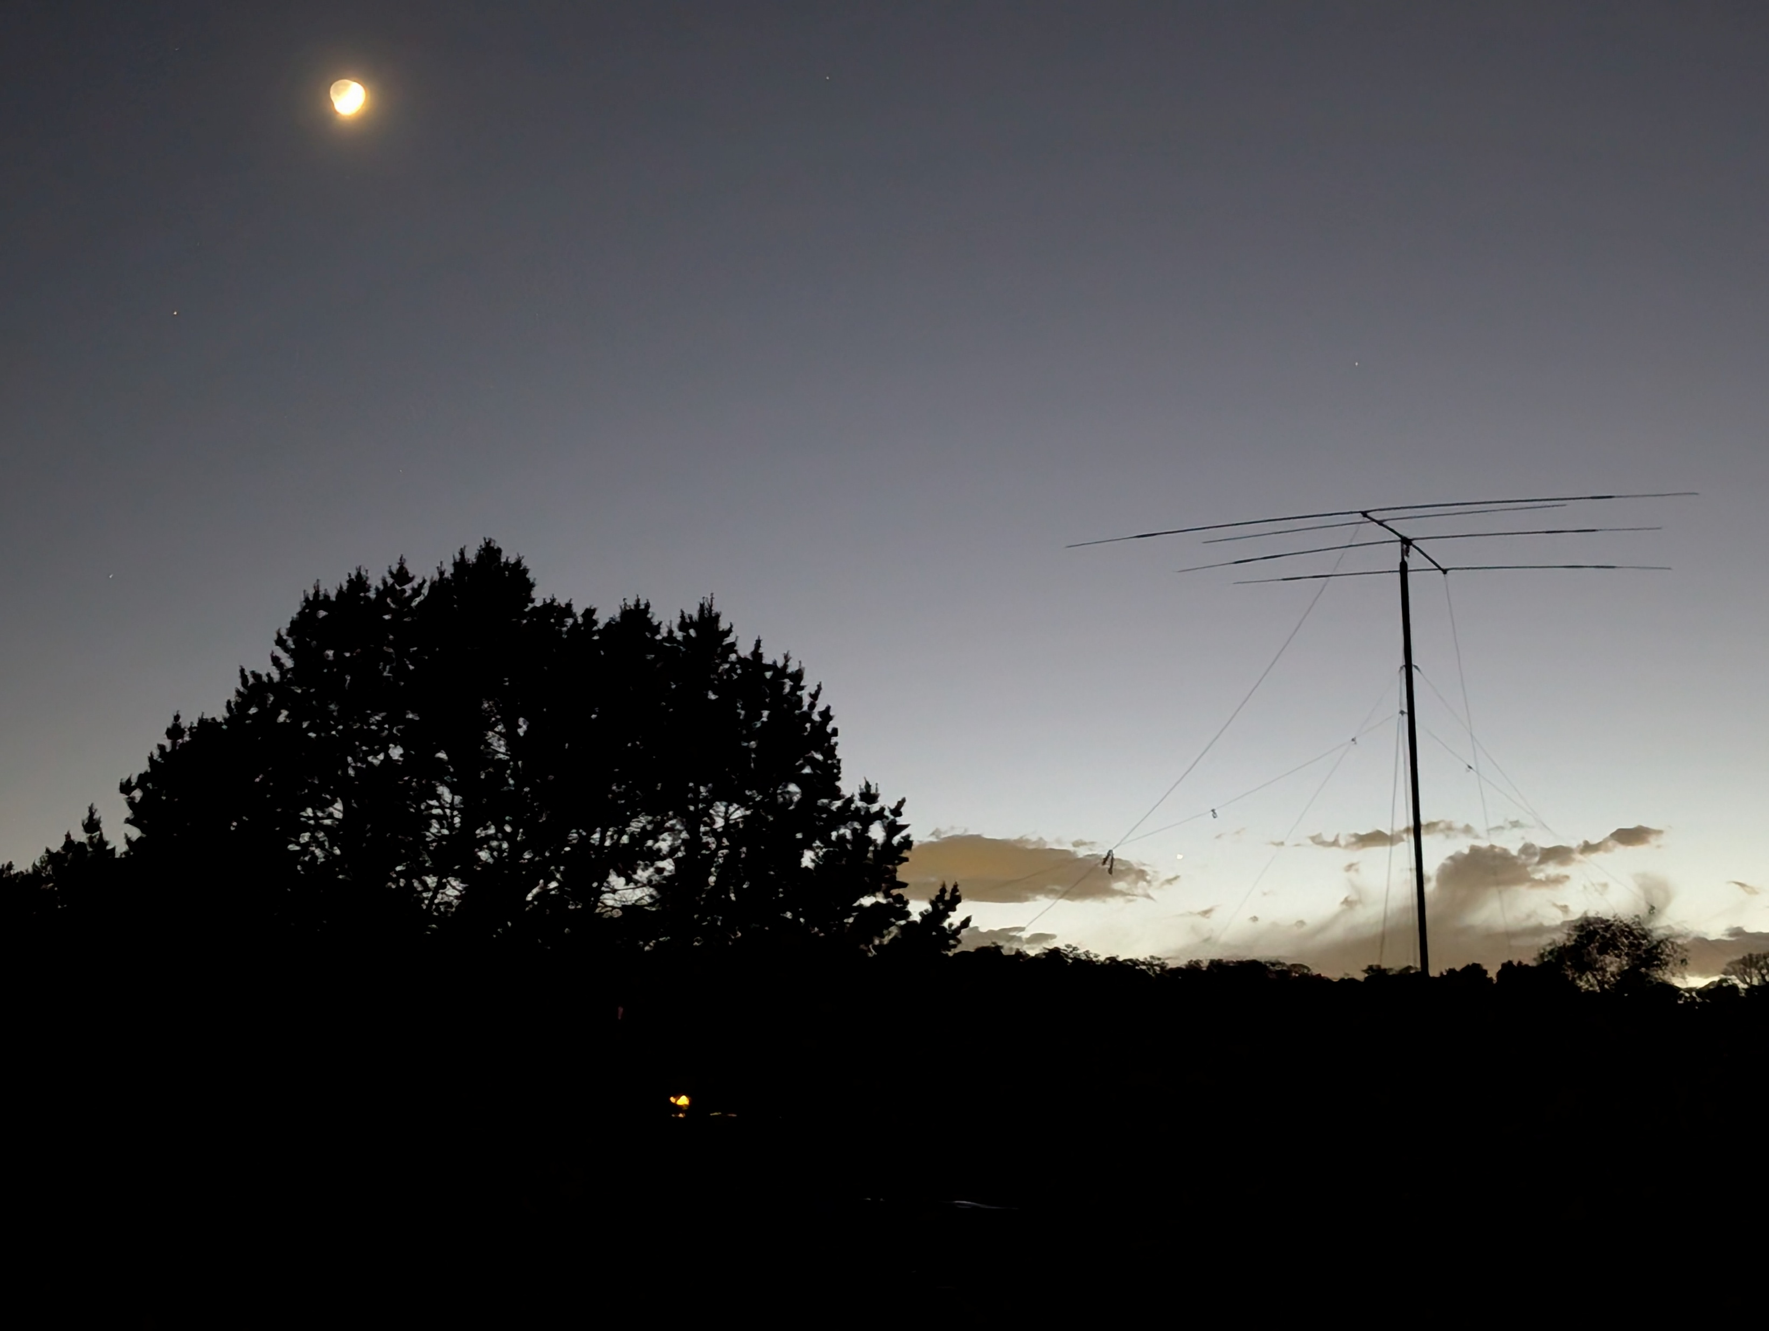
Field Day
Albuquerque DX Association 2A
2024: 2,931 QSO’s 5th in 2A
2025: 497 GOTA 3rd in 2A?
Primary Rigs 95% CW
GOTA FD “Play” in Advance
GOTA Coaches
10-15-20 Beam 40/80 Dipole 40 ft. AGL Operated 24 Hours

Slide 7
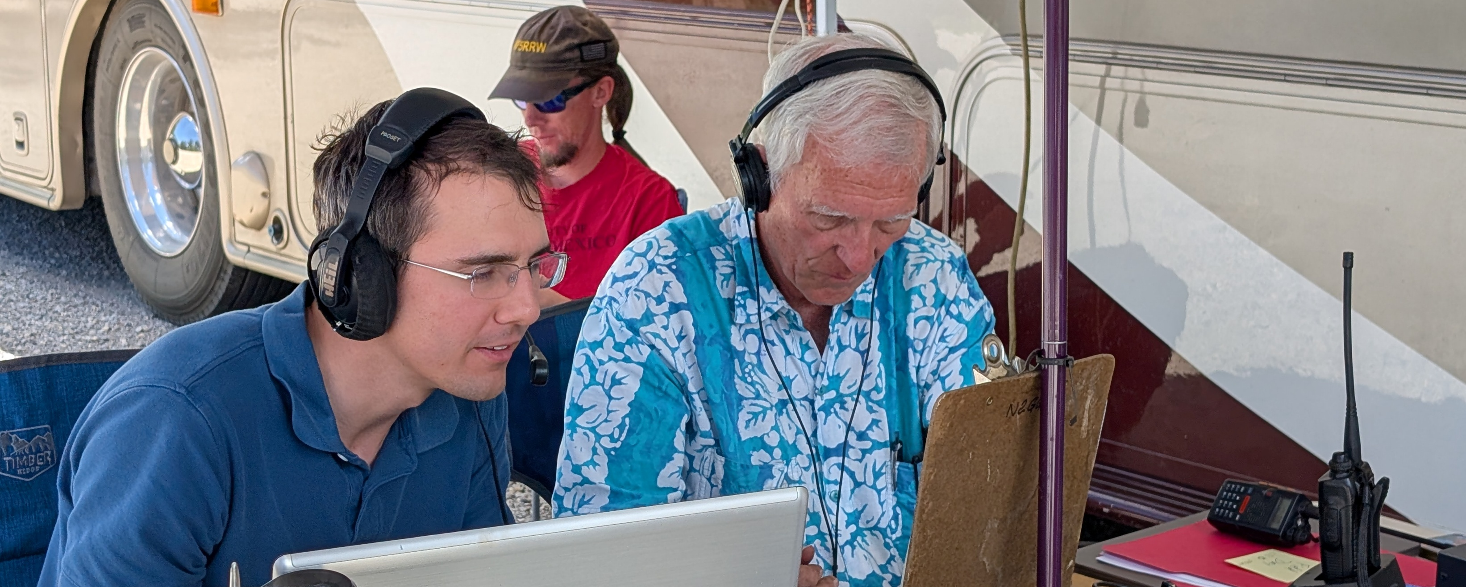
Field Day Rates
2025-06-28 1856Z - 6.0 per minute (1 minute(s)), 360 per hour by K8TE
2025-06-28 1933Z - 3.6 per minute (10 minute(s)), 216 per hour by WD5COV
2025-06-28 1954Z - 3.1 per minute (60 minute(s)), 188 per hour by WD5COV
GOTA Op & Coach

Slide 8
How Many did You Work?
Who Operates POTA?

Slide 9
How Many did You Work?
Who Operates POTA? What is Your Average QSO Total?

Slide 10
How Many did You Work?
Who Operates POTA? What is Your Average QSO Total?
Field Day 2024/5? Club/Group QSO Totals?

Slide 11
How Many Did You Work?
Who Operates POTA? What is Your Average QSO Total?
Field Day 2024/5? Club/Group QSO Totals?
Any SES Operations?

Slide 12
How Many did You Work?
Who Operates POTA? What is Your Average QSO Total?
Field Day 2024/5? Club/Group QSO Totals?
Any SES Operations?
Other Fun Events?

Slide 13
FD 2024 Results
4,219 Entries in U.S. & Canada
42 from New Mexico All But 9 Single TX
Average QSO’s 228 (158 without ADXA) Less Than Our GOTA Station (197)
Why Are These Results so Dismal?
How Can They Become Better??

Slide 14

Operating Special Event Stations
Route 66 On-the-Air W6H New Mexico
8,607 QSO’s over 9 Days in 2024
K8TE Made 6,504 of Them
Pair of Dipoles at 35 ft. (often 1,500 Watts)
If Sufficient Callers, Rates are High
High Rates = Adrenalin Rushes
And Smiling Faces

Slide 15
SES Operating
Promote Your Event in QST Listing
Use QRZ.com for Details
Build Team Momentum
Have Effective On-Line Scheduling
Share the Load
Have an Interesting Reason
Notes:
13 Colonies
Indianapolis Speedway
Revolutionary War Battles

Slide 16
SES Operating Guidelines
NEVER EVER Say “Please Copy!” Isn’t the Point to Copy?
Be Concise and Precise Say Nothing that Isn’t Needed
Use Recordings if at All Possible “CQ RTE 66 OTA W6H WISKEY SIX HOTEL” “59 New Mexico” “Thanks WISKEY SIX HOTEL”

Slide 17
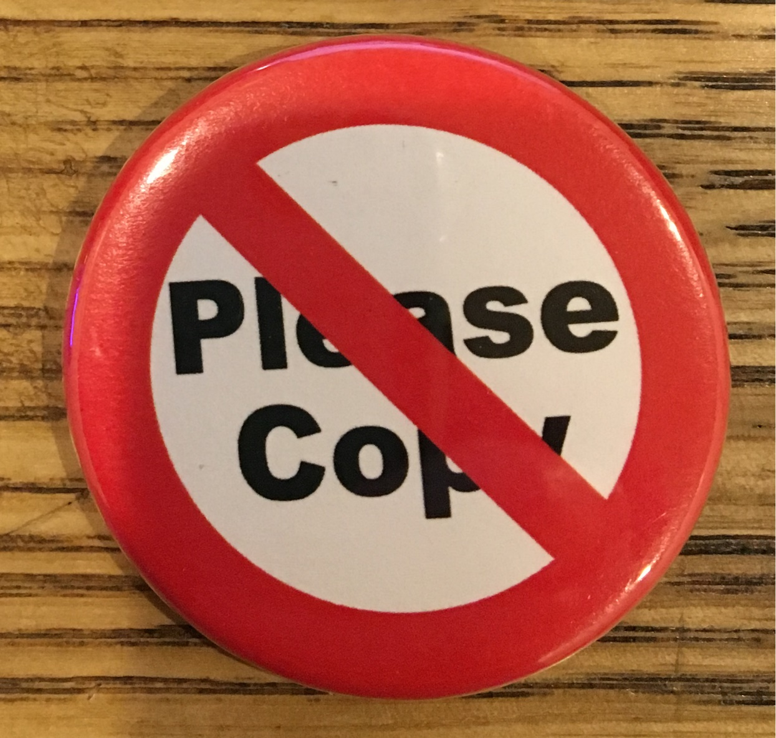
NEVER Say/Send This!

Slide 18
Smart Operating Guidelines
Be Concise and Precise

Slide 19
SES Operating Guidelines
Be Concise and Precise
QRZ Means “Who is Calling Me?”

Slide 20
SES Operating Guidelines
Be Concise and Precise
QRZ Means “Who is Calling Me?
NEVER Use QRZ in Place of CQ

Slide 21
SES Operating Guidelines
Be Concise and Precise
QRZ Means “Who is Calling Me?
NEVER Use QRZ in Place of CQ NEVER QRZ at the End of a Contact

Slide 22
SES Operating Guidelines
Be Concise and Precise
QRZ Means “Who is Calling Me?
NEVER Use QRZ in Place of CQ NEVER QRZ at the End of a Contact Unless Someone Was Calling

Slide 23
SES Operating Guidelines
Be Concise and Precise
QRZ Means “Who is Calling Me?
NEVER Use QRZ in Place of CQ NEVER at the End of a Contact Unless Someone Was Calling
DON’T USE: “OVER OVER”,

Slide 24
SES Operating Guidelines
Be Concise and Precise
QRZ Means “Who is Calling Me?
NEVER Use QRZ in Place of CQ NEVER at the End of a Contact Unless Someone Was Calling
DON’T USE: “OVER OVER”, “ROGER ROGER”

Slide 25
SES Operating Guidelines
Be Concise and Precise
QRZ Means “Who is Calling Me?
NEVER QRZ in Place of CQ NEVER at the End of a Contact Unless Someone Was Calling
DON’T USE: “OVER OVER”, “ROGER ROGER” “AGAIN AGAIN”

Slide 26
SES Operating Guidelines
Be Concise and Precise
QRZ Means “Who is Calling Me?
NEVER QRZ in Place of CQ NEVER at the End of a Contact Unless Someone Was Calling
DON’T USE: “OVER OVER”, “ROGER ROGER” “AGAIN AGAIN” etc. etc.

Slide 27
SES Operating Guidelines
Be Concise and Precise
QRZ Means “Who is Calling Me?
NEVER QRZ in Place of CQ NEVER at the End of a Contact Unless Someone Was Calling
DON’T USE: “OVER OVER”, “ROGER ROGER” “AGAIN AGAIN” etc. etc.
Why Say “Over”?

Slide 28
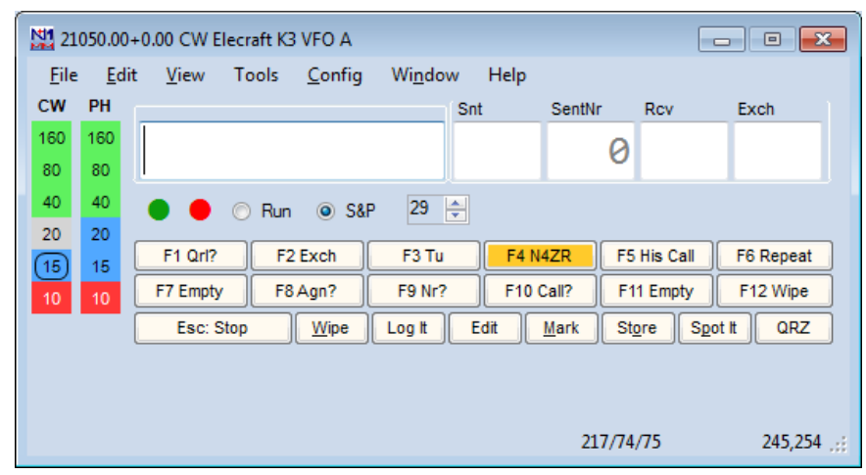
Smart Operating Guidelines
Logging Accurately and Quickly is Essential
N1MM+ is a Great Contest Logger #1 WW
Works Well with CW, SSB, & Digital
Use Function Key Macros for Messages
Type Callsigns and Maybe States
Just Hit ENTER for All Three Messages CQ, Exchange, Thanks
Log ‘Em Dano!

Slide 29
Smart Operating Guidelines
Operators Log—No Splitting Functions!
Coaching is OK and Recommended
Use a Script—for Everybody
Label Keyboard Function Keys Use Excel or Similar
F1 | F2 | F3 | F4
CQ | EXCH | TNX | W5UR

Slide 30
Smart Operating Guidelines
ALWAYS Use Phonetics
Answer Loudest Caller First
Big Pileups—Go By the Numbers
Control the Pileup “You Will Not Be Logged”
“W2ABC, you are not in the 6th Call Area. Wait your turn please.”
Ignore DQRM and Rude Remarks
Notes:
Speak and record with a sense of urgency

Slide 31
SES Operating Key
Teamwork!
Educate
Train (Practice)
Use State QSO Parties for Training
Make QSO’s Automatic
Copy Callsigns Correctly First Time
Keep Moving and Self-Spot {SPOTME}

Slide 32
SES Operating Teamwork
Evaluate Operating Techniques
Provide Improvement Feedback
Set Goals
Celebrate Success
Use Candid Pictures in Newsletters
Find/Do More Operating Events

Slide 33
SES Operating Skills
Use a Precise & Concise Rhythm Callers Know What to Expect
No More Than Two Seconds Between CQ’s
Avoid Voicing Live—Use Recordings
Have Clear Well-Formed SSB Articulation
Proper ALC (Never Smacking the Needle) Adjust Mic Gain per Manual Record Transmissions for Evaluation
Use TX Audio Equalizer: Cut Lows Add Highs

Slide 34
CW Operating Techniques
Send Everything Just ONCE!
Use Macros in Logger
Avoid Bugs!!!
Avoid Keyers!!
Use Logger for Plain Text
Run 20-25 wpm
Adjust TX Speed to Callers

Slide 35
State QSO Party Challenge
Plan on Operating YOUR State QSOP Run (CQ) 95% of the Time Self-Spot Use Spotting Sites
Operate Others for Practice
Check a Cluster for a Clear Frequency “Is the Frequency in Use?” Self-Spot
Spot Others if not Already Spotted

Slide 36
Summary
Operating Events vs. Just Operating
Special Event Station Operating
Smart Operating Techniques
State QSO Party Challenge
Have More Fun!
Notes:
Perhaps you’ve heard noises like these?

Slide 37
References
https://parksontheair.com/index.html
https://sotawatch.sota.org.uk/en/
http://www.arrl.org/field-day
http://www.arrl.org/special_events/search/page:5/model:Event
https://w6jbt.org/?page_id=15 (Route 66 On-the-Air)
https://n1mmwp.hamdocs.com/
https://www.google.com/url?q=https://youtu.be/G82Ko6vsxLQ&sa=D&source=calendar&usd=2&usg=AOvVaw2DAieBzBtoeDBoAaUZ2oSf (W4LT SSB Audio)
http://www.websdr.org/

