Slide 1
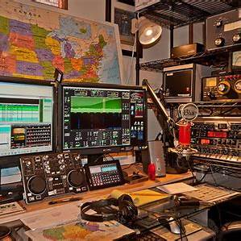
Being a Net Controller
Do's, Don'ts, and Benefits of Amateur Radio Net Control
Notes:
Timing: Spend approximately 2 minutes on this slide.
Image inserted for visual engagement.

Slide 2
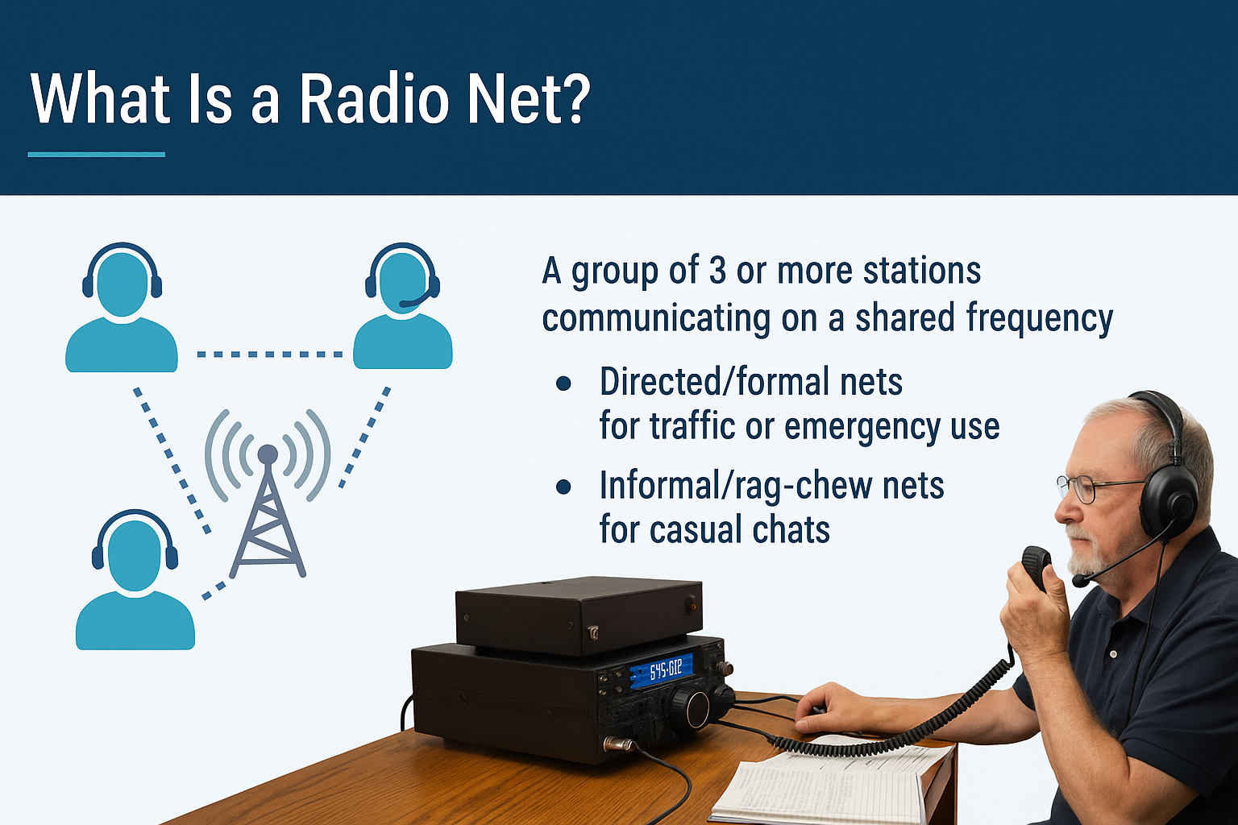
What is a Radio Net?
Definition: Group of 3+ stations on shared frequency
Types: Directed (formal) and Informal (casual)
Notes:
Timing: Spend approximately 5 minutes on this slide.
Image inserted for visual engagement.

Slide 3
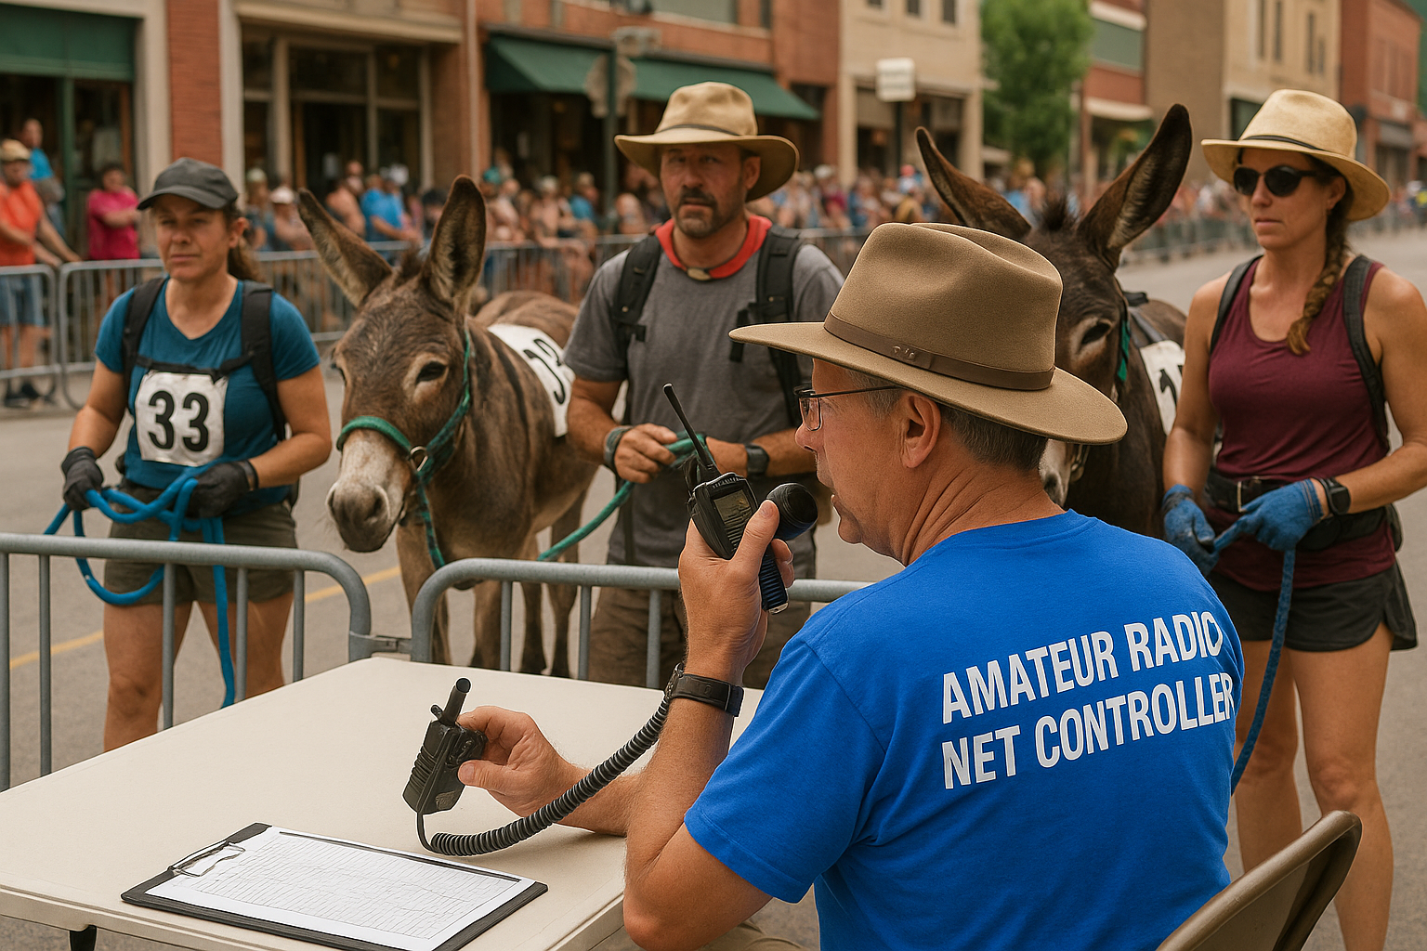
Role of a Net Control Operator
Moderates the net
Manages traffic and order
Logs communications and keeps the net efficient
Notes:
Timing: Spend approximately 5 minutes on this slide.
Image inserted for visual engagement.

Slide 4
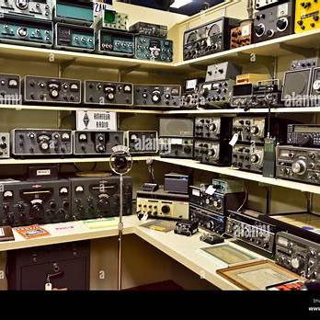
Why It Matters
Maintains clear, organized communications
Critical during emergencies
Builds technical and leadership skills
Notes:
Timing: Spend approximately 7 minutes on this slide.
Image inserted for visual engagement.

Slide 5
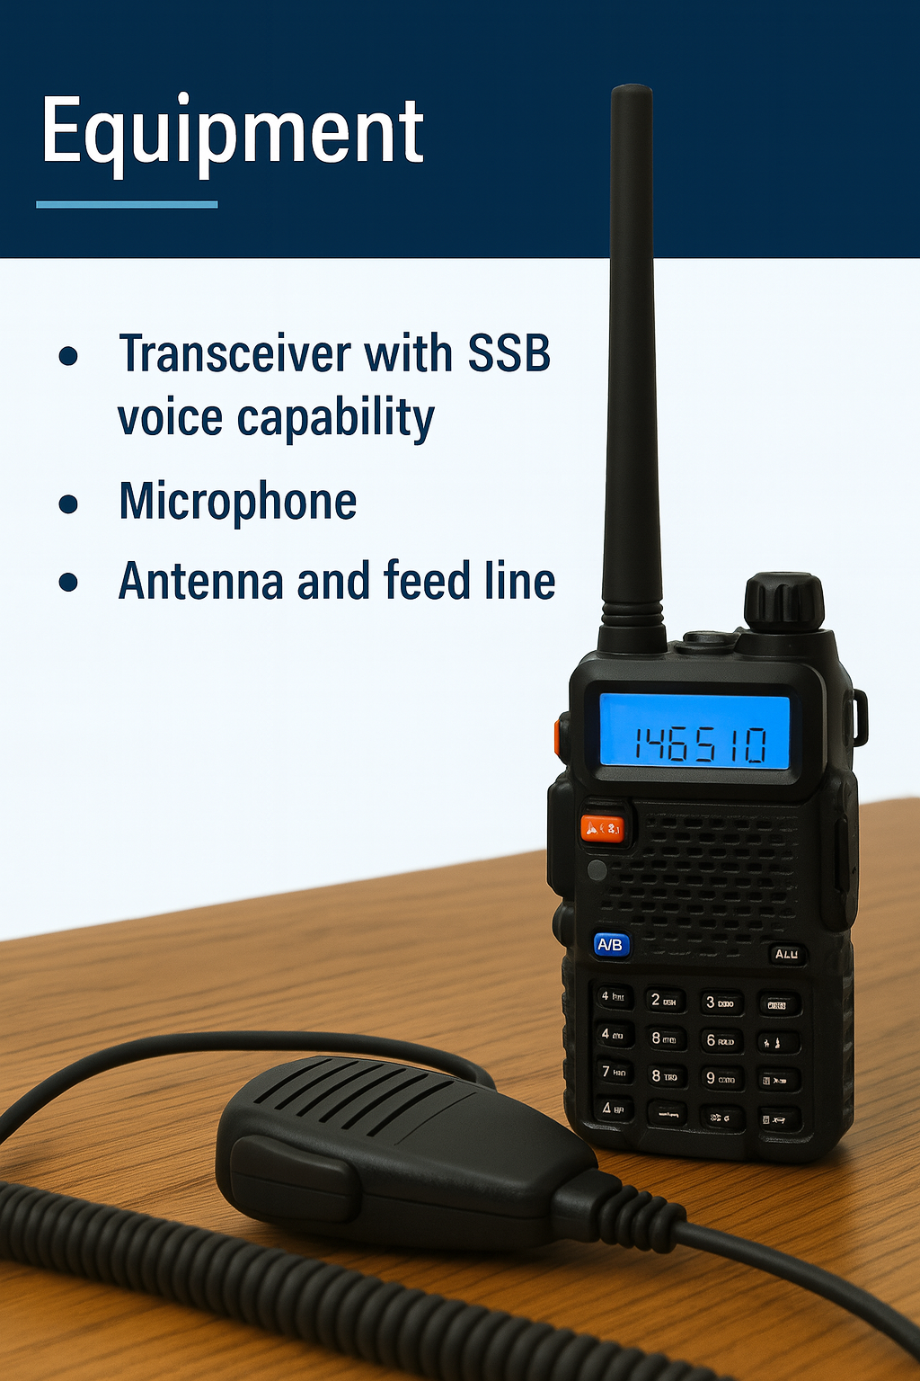
Getting Started – Equipment
Base or mobile station preferred over handhelds
Clear signal, good audio, reliable antenna
Notes:
Timing: Spend approximately 7 minutes on this slide.
Image inserted for visual engagement.

Slide 6
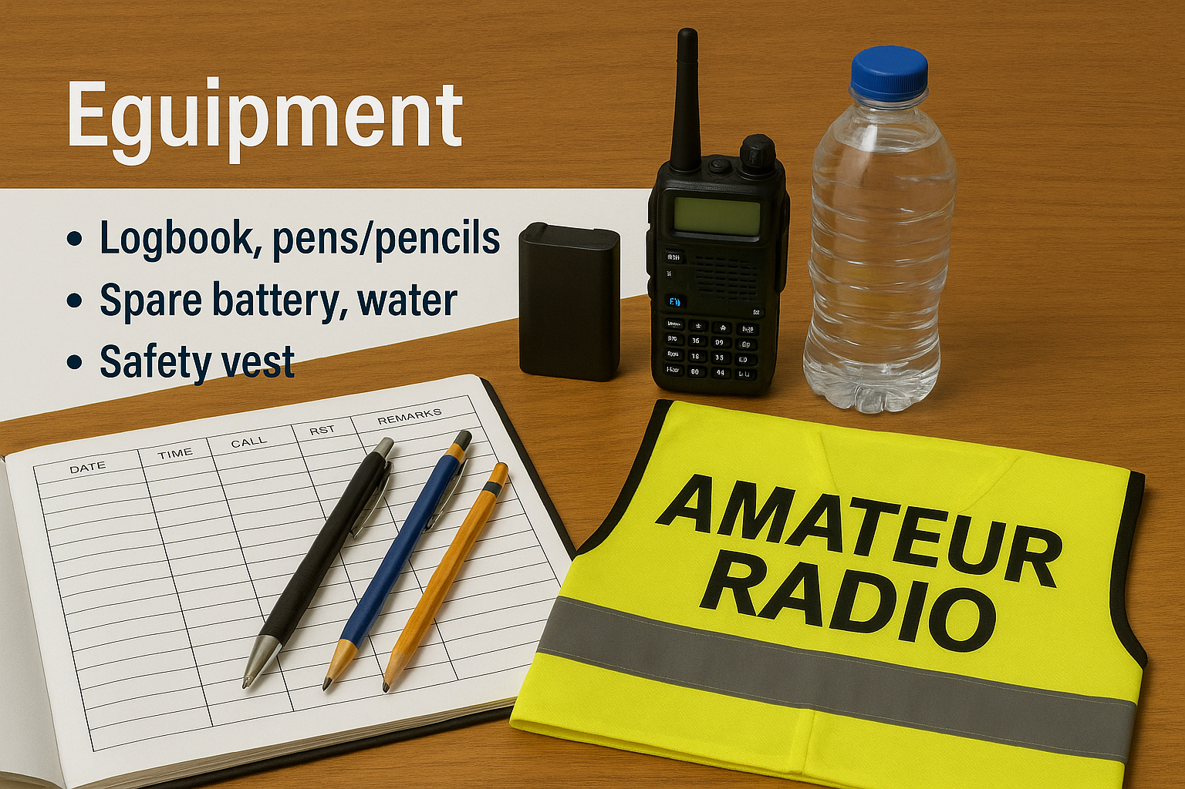
Tools You Need or may need
Logbook, pens/pencils, spare battery, water
Optional assistant for large nets
Safety Vest
Notes:
Timing: Spend approximately 5 minutes on this slide.
Image inserted for visual engagement.

Slide 7
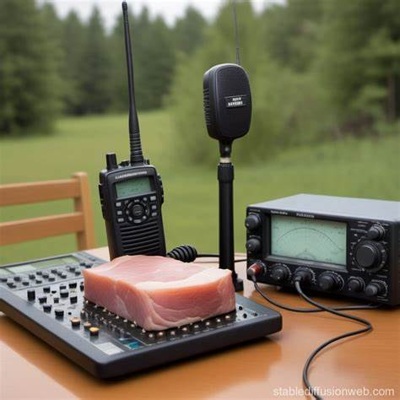
Net Script & Structure
Use a script for consistency
Includes preamble, check-ins, emergency traffic, and wrap-up
Notes:
Timing: Spend approximately 5 minutes on this slide.
Image inserted for visual engagement.

Slide 8
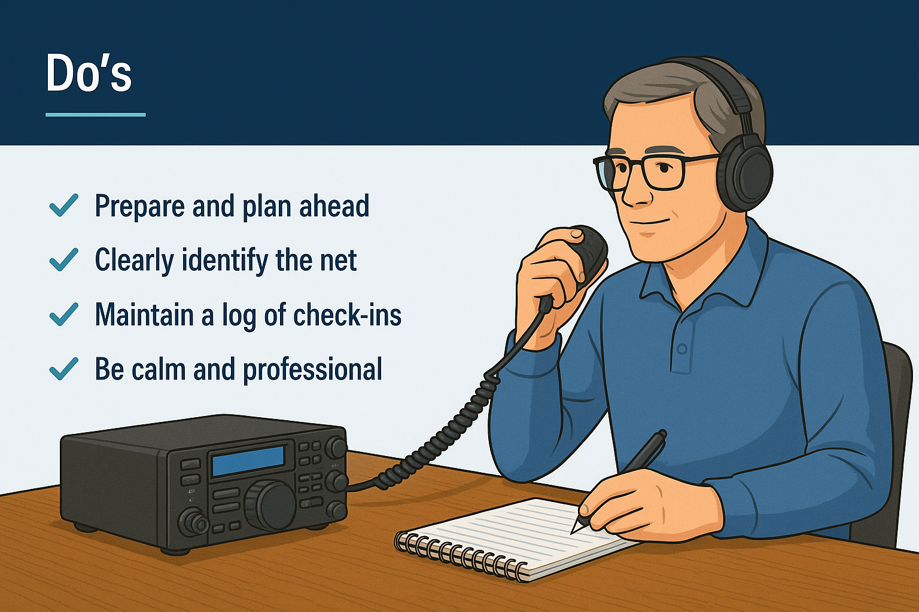
Do's
Speak clearly and calmly
Use standard phonetics and plain language
Log concisely and accurately
Notes:
Timing: Spend approximately 5 minutes on this slide.
Image inserted for visual engagement.

Slide 9
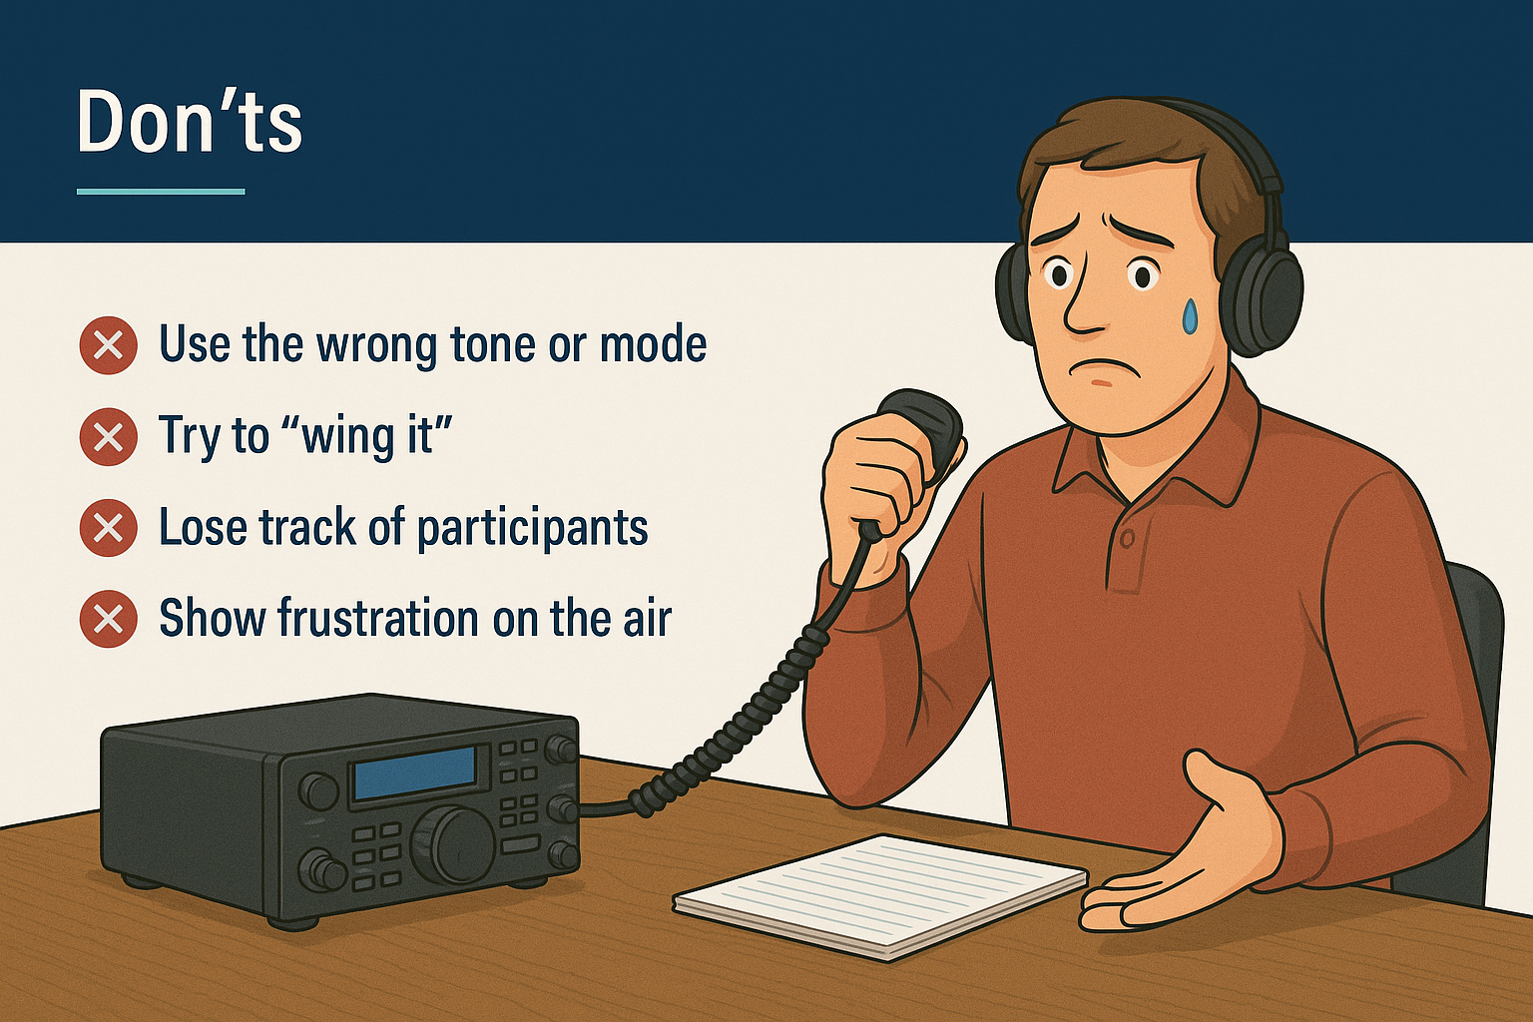
Don'ts
Don't rely on memory for logging
Don't start late or be disorganized
Don't allow off-topic chatter
Notes:
Timing: Spend approximately 3 minutes on this slide.
Image inserted for visual engagement.

Slide 10
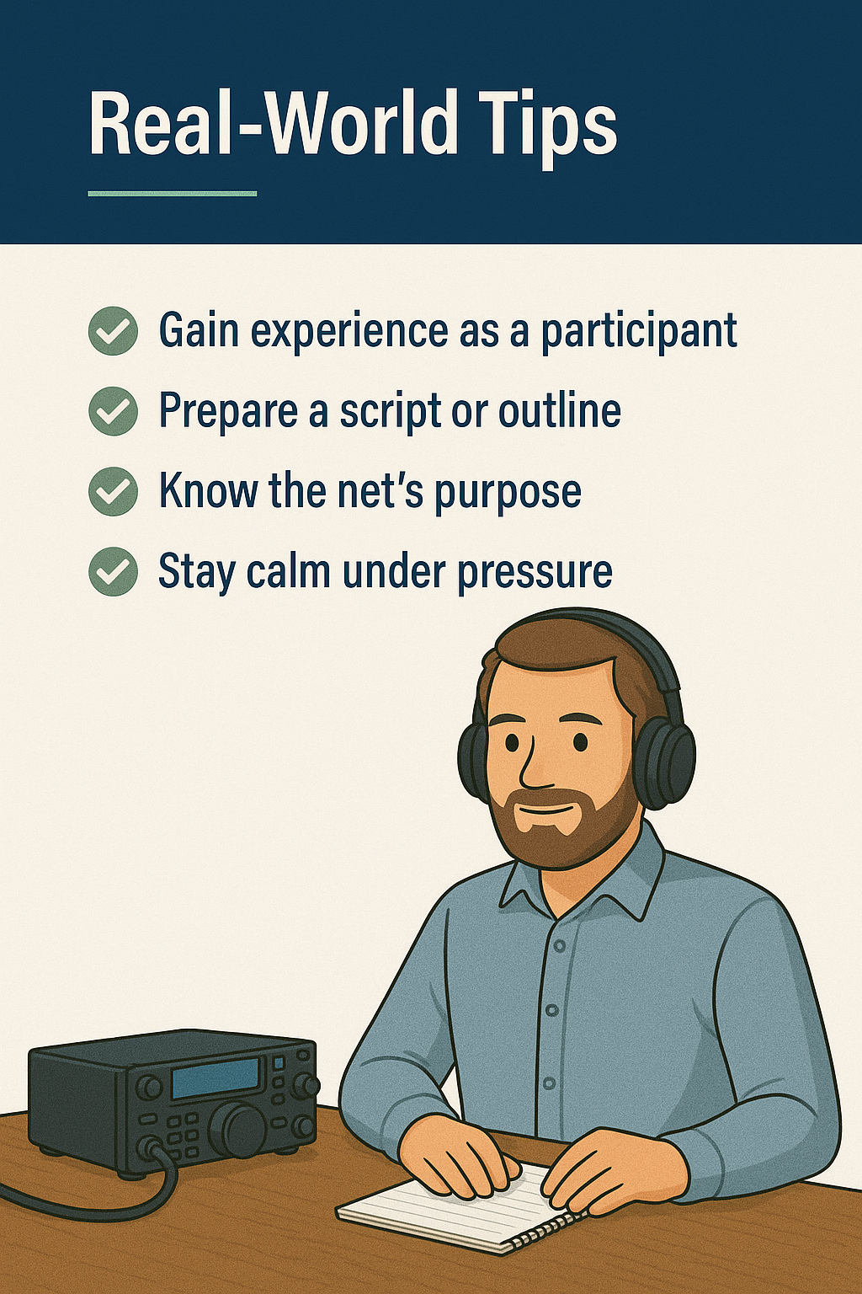
Real-World Tips
Prepare with script and supplies
Start nets on time
Use relief operators for long nets
Practice and gain confidence
Notes:
Timing: Spend approximately 3 minutes on this slide.
Image inserted for visual engagement.

Slide 11
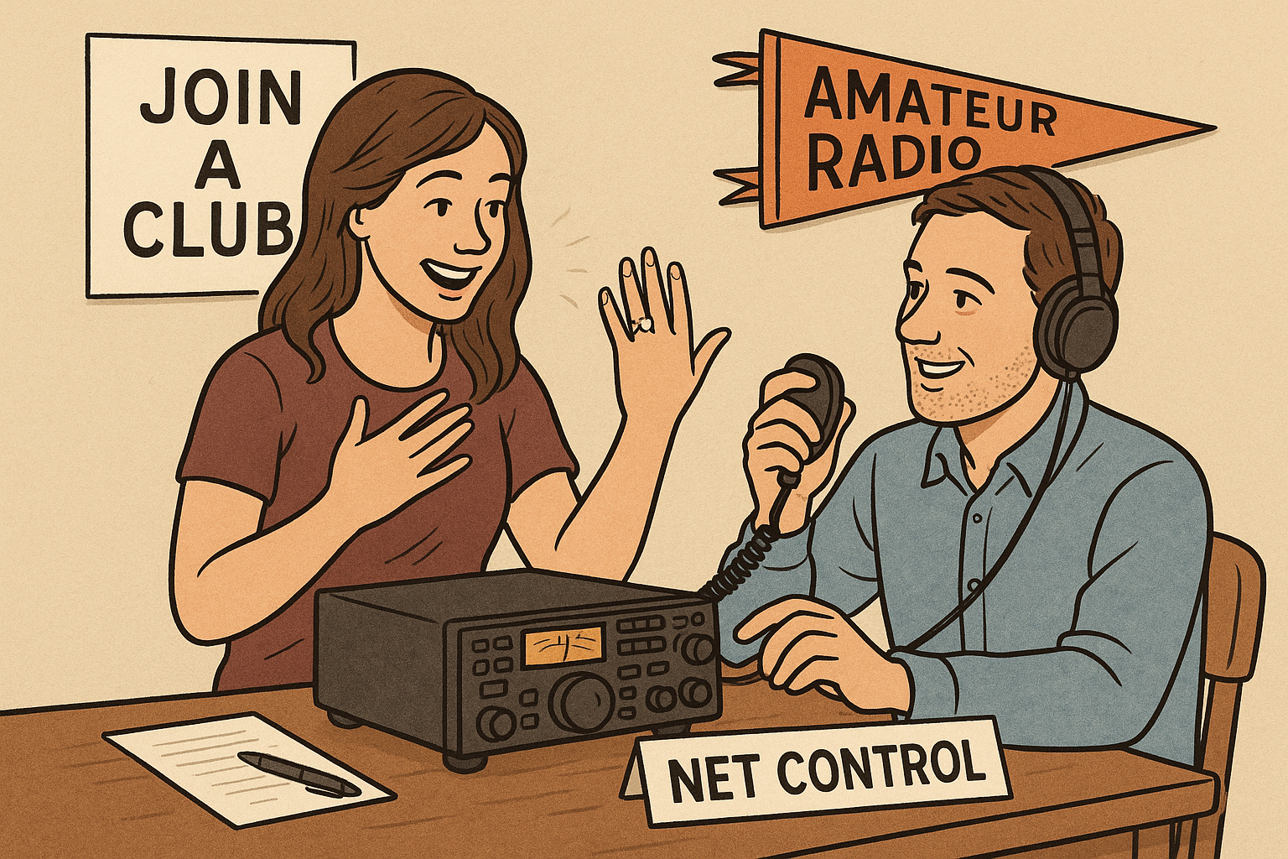
Get Engaged
Reach out to local clubs for mentorship
Start as alternate NCO and build experience
Notes:
Timing: Spend approximately 3 minutes on this slide.
Image inserted for visual engagement.

Slide 12
Summary
Key Benefits: Service, Skills, Community
Start small and grow steadily
Step out of your comfort zone
leadership Skills
Notes:
Timing: Spend approximately 3 minutes on this slide.
Image inserted for visual engagement.

Slide 13
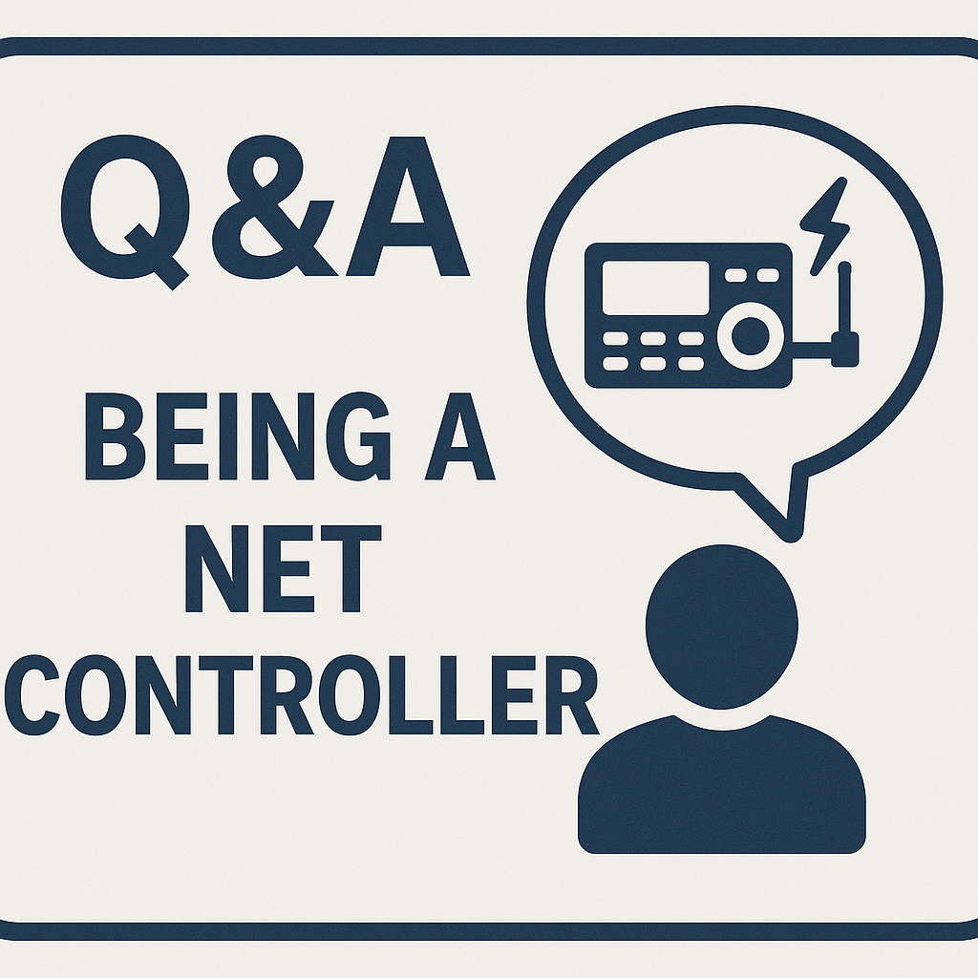
Q&A / Closing
Ask questions, share resources, and keep learning
Notes:
Timing: Spend approximately 2 minutes on this slide.
Image inserted for visual engagement.

