Slide 1
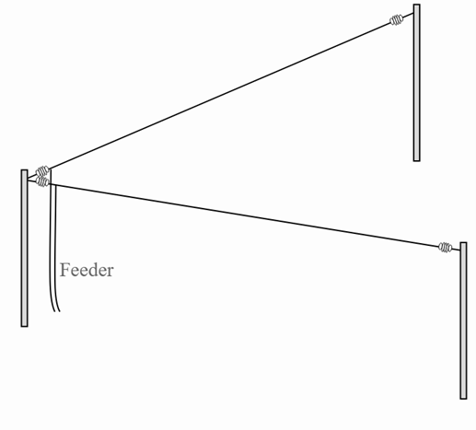
The VEE BEAM Antenna a wire alternative to the multi-band yagi for General, Portable, and Field Day use
Mike Ferguson K0MF
HAMCON 2025

Slide 2
Presentation Overview:
Vee Beam description, theory of operation
Overview of modeling a Vee Beam in EZNEC
Using EZNEC to explore design variations
A compact Vee Beam design for Field Day
Some hybrid Vee – Yagi designs, the “YagVEE”
Observations

Slide 3
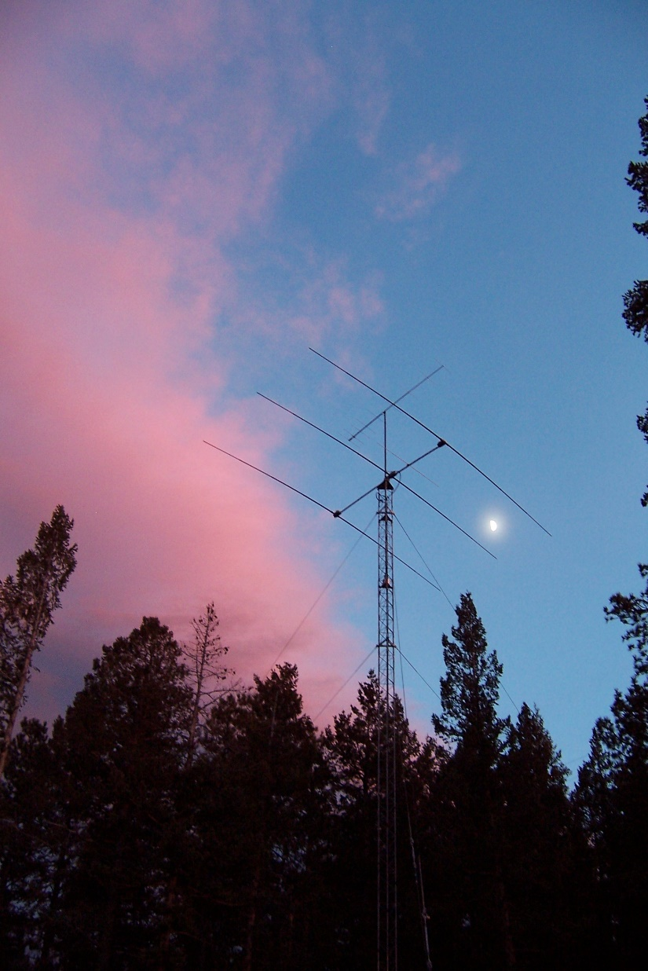
Yagis are Great, but what about..
HOA and/or Gov’t restrictions?
Neighbor or family objections?
They cost a lot of $$$....
If you want 1 all - band antenna
If you have room to consider wire options?

Slide 4
How about a VEE BEAM?
Two end-fed long wires (usually 2 ^ or more) in a horizontal “V” pattern
It’s a ½ rhombic
OR, a center-fed doublet with legs folded toward each other

Slide 5
VEE Beam Advantages:
Wire based, light weight
Support with rigid masts, towers not required
All bands with dipole or better performance
Useful gain - tri-bander to 5 el yagi equivalent
Low radiation angles from relatively low height
Can be uni-directional with terminating resistors
Multiple side lobes for multi-directional coverage

Slide 6
VEE Beam Downsides:
Need acre(s) of space
Bi-directional – no useful F/B ratio
Hard to rotate!
Narrow main lobe beamwidth vs Yagi
Needs 3 supports or trees
Uses balanced feed line and antenna tuner
Smaller versions have no gain on lower bands

Slide 7
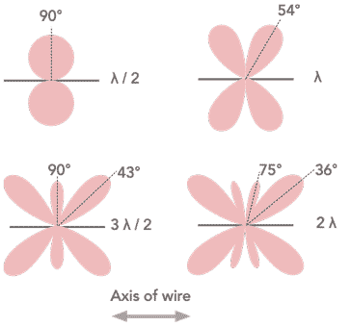
Long Wires – the longer they are:
The primary lobes get stronger, more narrow, and closer to the wire axis
More and more side lobes appear

Slide 8
Long Wire Primary Lobe Gain and Angles
Length (λ) | Angle of main lobe | Gain (DBd)
1 | 54° | 0.4
1½ | 42 | 1.0
2 | 36° | 1.5
2½ | 33° | 1.8
3 | 30° | 1.8
4 | 26° | 3.3
5 | 22° | 4.2
6 | 20° | 5.0
8 | 18° | 6.4
10 | 16° | 7.4

Slide 9
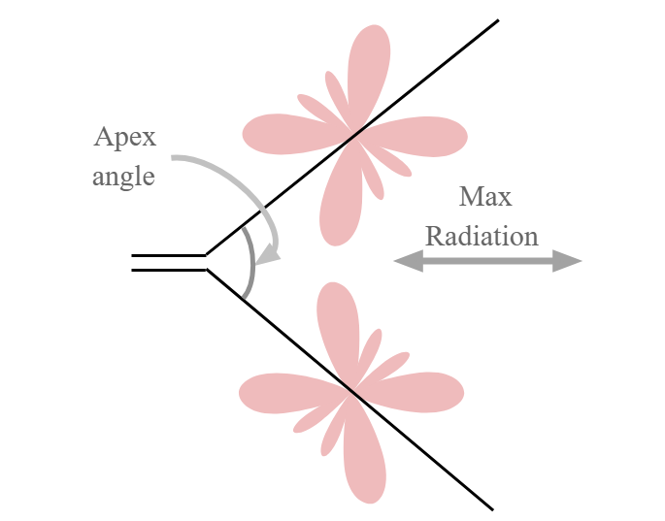
Feed 2 Long Wires in a “V” configuration
Enhance gain with an Apex angle that aligns primary lobes for band(s) of interest
How the VEE BEAM Works:

Slide 10
77K+ lines of code free, but no longer supported
GIGO – be precise
Results not always as dramatic as the plots - some real world fill – in effects
I’m NO expert…
EZ-NEC app, manual download – EZNEC.com
YouTube instructional video – G-QRP Club 12/4/21
EZ-NEC (Numerical Electromagnetics Code)
Pro2+ v7.0 s/ware by Roy Lewallen W7EL

Slide 11
EZ-NEC Modeling
File – open or add description
Use or modify saved descriptions
Set options / parameters (gnd type, units, etc)
Build wires / elements
Define source
Verify antenna view for accuracy
View peak gain on elevation plot, then azimuth plot at peak elevation angle - varies with frequency
Adjust parasitic element length / spacing for peak gain
Generate plots – print, scan, save as jpeg
Overlay two plots for comparison

Slide 12
Building elements tips:
Use odd # of wire segments with X/Y/Z coordinates.
5- 11 segments to 20M, lower bands need more
Define short first element equidistant across center, then build a side at a time off each end
Build V’s or sloping elements horizontal first, then modify wire table with ^X and ^Y based on length
For balanced antennas, place source at 50% of first element - i.e. 50% from end of wire #1
If desired, it will re-scale dimensions when you change design frequency
Verify build in “View Ant”

Slide 13
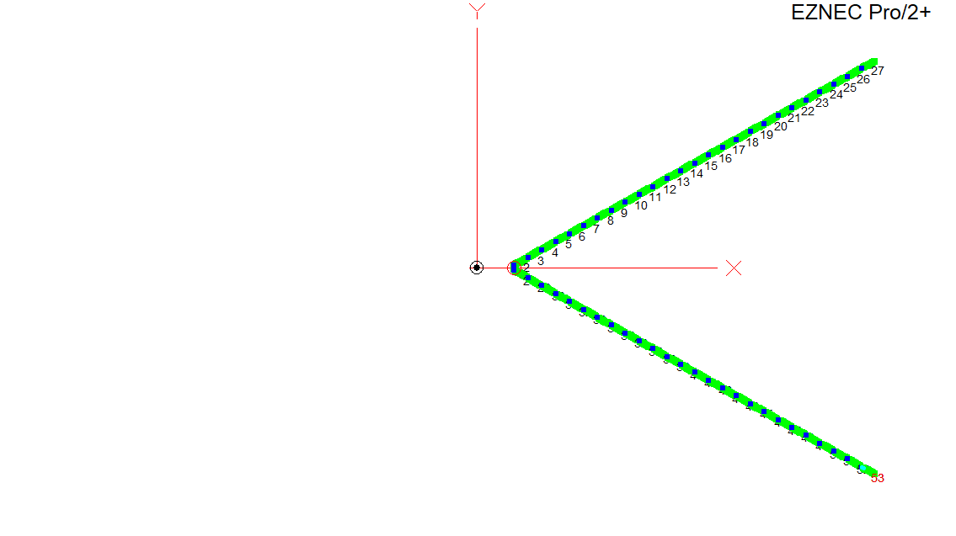
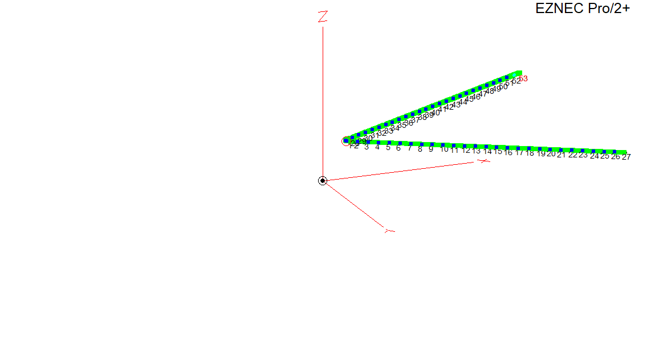
Example VEE Beam in EZNEC:
180’ legs
2.5 ^ @ 20M
60 deg Apex – best for 20M
53 wire segments
158’deep
180’ wide
40’ up

Slide 14
VEE Beam vs Dipole – Gain and Launch Angle
1.7 dBd gain 40 and 30M
Tri-bander / LP like gain 20 – 10M including WARC
Better launch angles
* @50 deg
BAND | DIPOLE dBi | LAUNCH ANGLE | VEE BEAM dBi | LAUNCH ANGLE | VEE BEAM dBd
160 | 6.1 | 90 | 4.4 | 90 | -1.7
80 | 7.4 | 90 | 6.0 | 50 | .1*
40 | 6.6 | 55 | 8.4 | 33 | 1.8
30 | 8.8 | 25 | 10.5 | 25 | 1.7
20 | 8.4 | 25 | 12.5 | 19 | 4.1
17 | 7.6 | 19 | 13.2 | 15 | 5.6
15 | 7.3 | 16 | 13.1 | 13 | 5.8
12 | 8.0 | 14 | 12.7 | 11 | 4.7
10 | 8.1 | 12 | 13.9 | 12 | 5.8

Slide 15
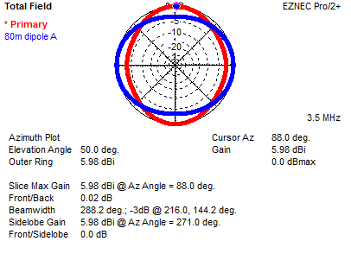
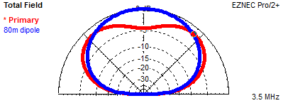
80M Plots
VEE favors sides by 3 dB
50 vs 90 deg launch angle

Slide 16
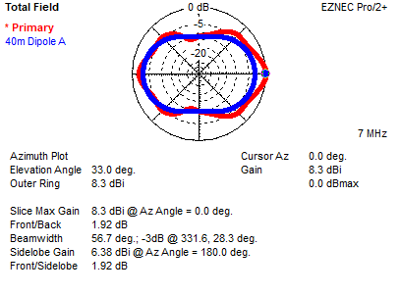
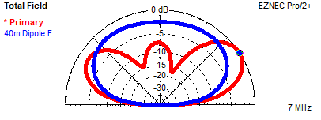
40M Plots
VEE - 1.7 dBd gain
33 vs 55 degree launch angle

Slide 17
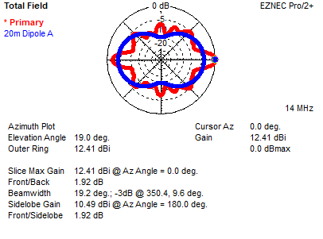
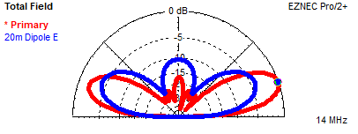
20M Plots
VEE – 4.1 dBd gain
~8 dB better off the sides
Lower launch angle

Slide 18
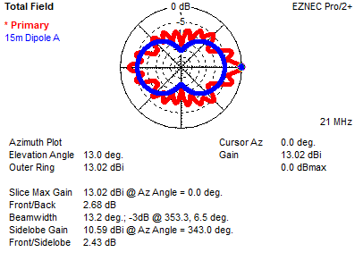
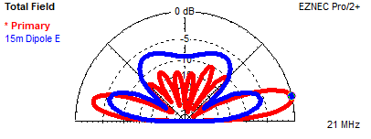
15M Plots
VEE – 5.8 dBd gain
Some gain almost all directions

Slide 19
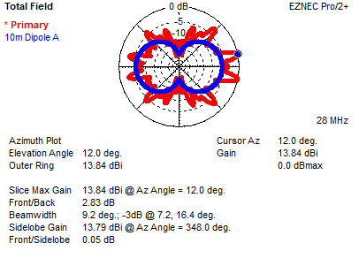
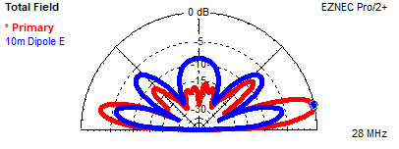
10M Plots
VEE – 5.8 dBd gain
Double-peak main + back lobes. Why?
Some gain almost all directions

Slide 20
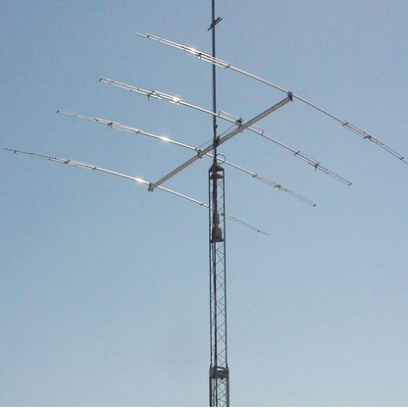
VEE BEAM vs Tri-bander Gain, dBd
BAND GAIN dBd VEE
20M 4.5 -.4
15M 4.9 +.9
10M 5.3 +.5

Slide 21
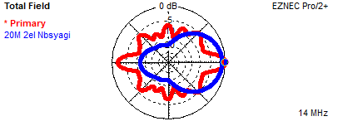
VEE Beam vs 2 el 20M Monoband Yagi @ 40’

Slide 22
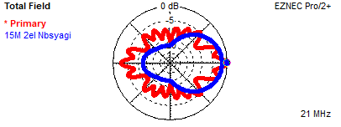
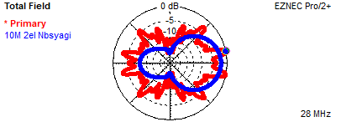
VEE Beam vs 2 el 15M Monoband Yagi @ 40’
VEE Beam vs 2 el 10M Monoband Yagi @ 40’

Slide 23
VEE aimed North – South for DX, 40’ high
180’
60 deg
Major lobes N – S
Also has gain > dipole E & W
N
Feedline

Slide 24
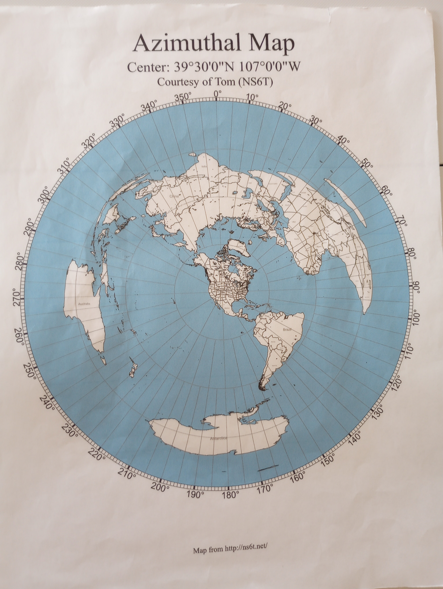
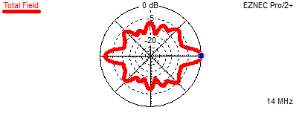
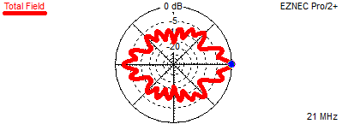
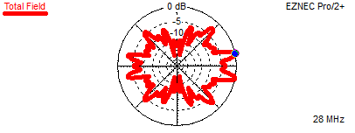
N – S VEE 20m 15m 10m

Slide 25
Multi-Directional Deployment
Fits on ~ 1 acre
180’
60 deg
Relay / Switch Box*
* “Multiple V-Beams,” DL4ZC
QST, Aug 1956,
Reprinted “ARRL’s Wire Antenna Classics”
ARRL Pub #242, 1999 - 2000
Feedline

Slide 26
2 DPDT Relays near Apex select Northeast and Northwest Wires
N
S

Slide 27
Northeast and East wires selected
NE
SW

Slide 28
Northwest and West Wires selected
NW
SE

Slide 29
East and West Wires selected
360’ Doublet:
Mainly for 160 & 80M but usable on any band
Extended Double Zepp on 80M (~3 dBd gain)
N
S

Slide 30
East and West Wires selected
360’ Doublet:
Mainly for 160 & 80M but usable on any band
Extended Double Zepp on 80M (~3 dBd gain)
N
S
4 unique antennas with 4 wires!

Slide 31
A VEE Beam as a Field Day Alternative?
Tower / tri-bander assembly, setup, and teardown is cumbersome and time consuming
Requires several people
Painful if you drop it (new KT34A is $3400!)
Don’t need another antenna for low bands
Most wire alternatives provide less performance

Slide 32
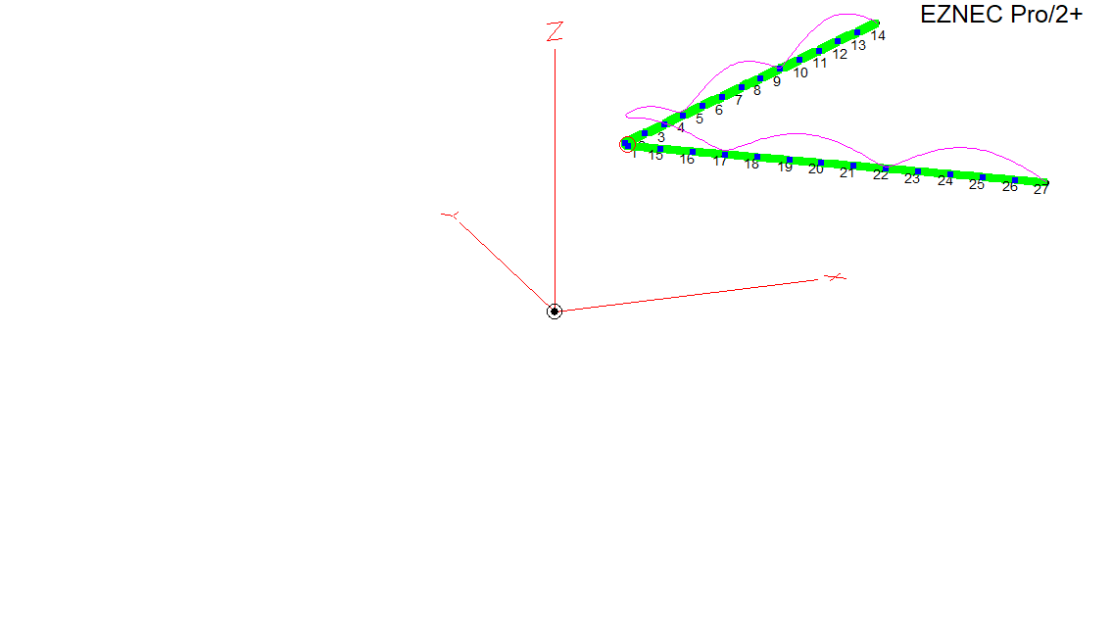
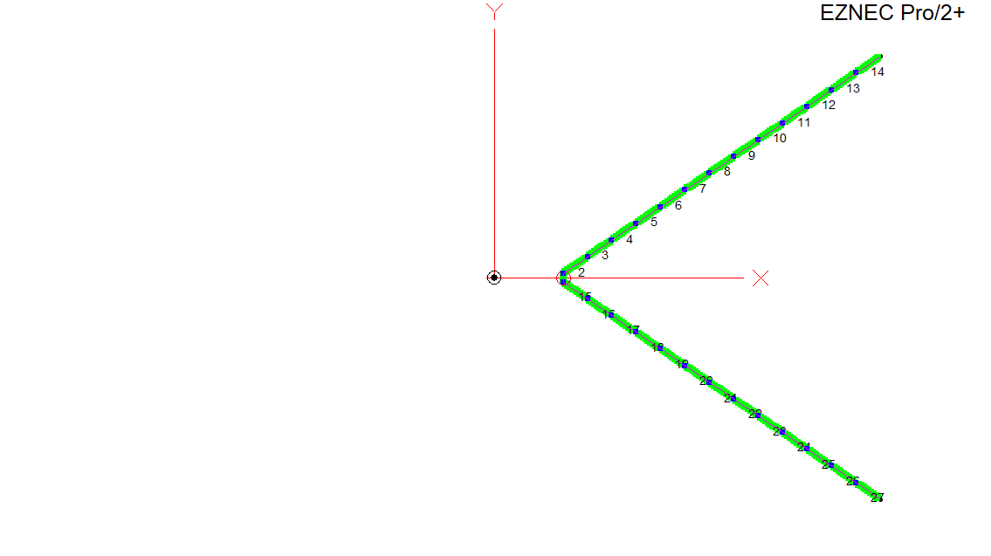
Compact VEE BEAM: 70 Degree Apex
90’ legs (~2 waves on 15M), 30’ high in EZNEC:
Apex Angle = 70 deg
Height (Z) = 30’
Spacing = 103.4’
BAND | DIPOLE | ANGLE | 70 VEE GAIN | ANGLE
20M | 0 (8.2 dBi) | 33 | 1.9 dBd | 27
15M | 0 (8.1 dBi) | 22 | 4.2 dBd | 19
10M | 0 (7.3 dBi) | 16 | 5.6 dBd | 14

Slide 33
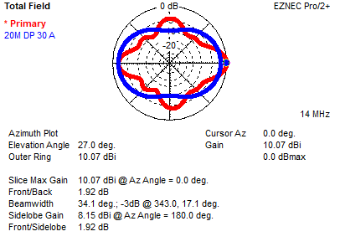
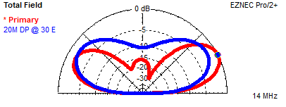
20M Plots
VEE – 1.9 dBd gain East
+5 dBd N and S

Slide 34
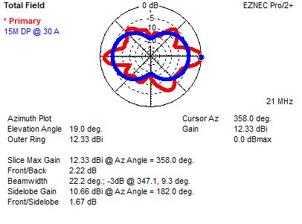
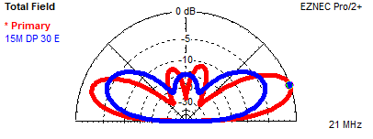
15M Plots
VEE – 4.2 dBd gain East
+1 to 5 dBd other directions

Slide 35
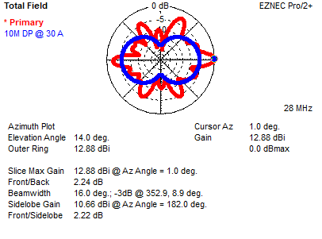
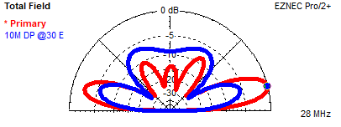
10M Plots
VEE – 5.6 dBd gain East
gain almost everywhere else

Slide 36
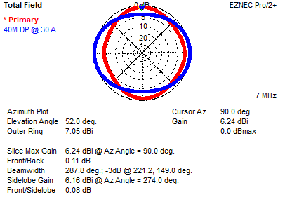
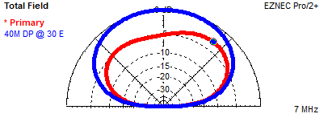
And 40M?
VEE: Dipole pattern
Favors N-S, -2 dB East
+3 dBd N-S,
-5 dB straight up

Slide 37
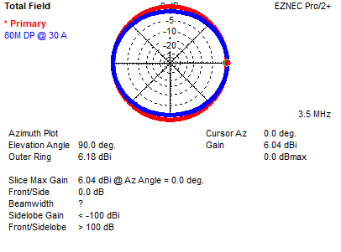
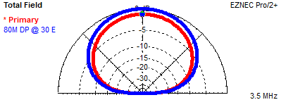
And 80M?
VEE: Dipole – like pattern, +1 dBd N and S
-1 dBd straight up

Slide 38
Finding Extra OOMPH Eastward for FD
Could use wires twice as long - 2 ½ waves (180’) for ~ 4dBd gain on 20M
But cumbersome / unwieldy, and 15 / 10M beamwidth is further reduced
OR, would yagi – type parasitic elements
help?

Slide 39
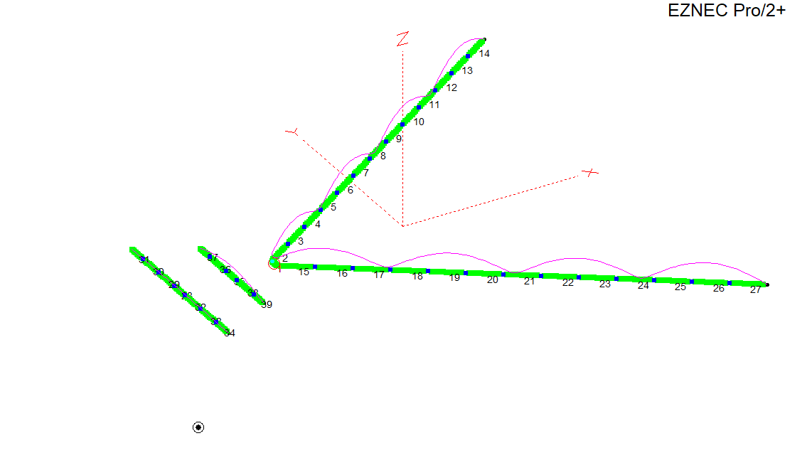
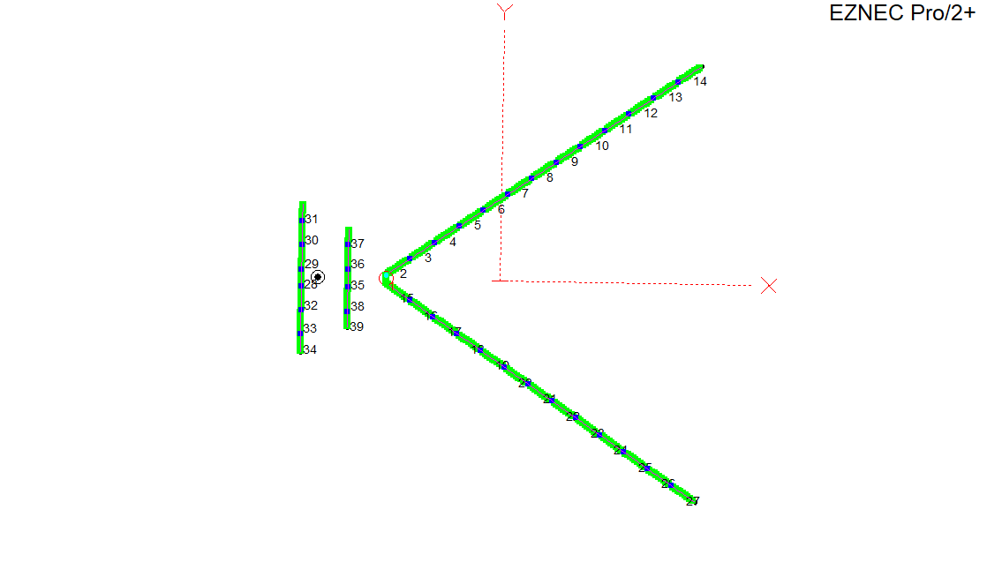
VEE BEAM + 20 & 15M Yagi – Type Reflectors - (a YagVEE?)
20M Reflector, 35’ 5”, 20’ behind Apex
15M Reflector, 23’ 5”, 9’ behind Apex
10M – not used

Slide 40
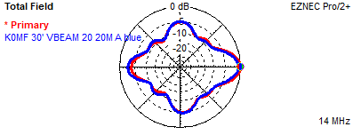
Reflectors add .9 dB on 20M,
1dB on 15M, .3 dB on 10M (?)
There’s some, but far less parasitic - driven element coupling with the VEE vs a yagi, and it varies by frequency
VEE Good on 10M, reflector not needed
Total gain = 2.8 dBd on 20M,
5.2 dBd on 15M
Not a lot, but not bad for 60’ more wire!
BAND | DIPOLE | ANGLE | YAGVEE GAIN | ANGLE
20M | 0 | 33 | 2.8 dBd | 26
15M | 0 | 22 | 5.2 dBd | 18
10M | 0 | 16 | 5.9 dBd | 14

Slide 41
YagVEE vs Tribander Gain, dBd
BAND GAIN YAGVEE
20M 4.5 -1.7
15M 4.9 +.3
10M 5.3 +.6

Slide 42
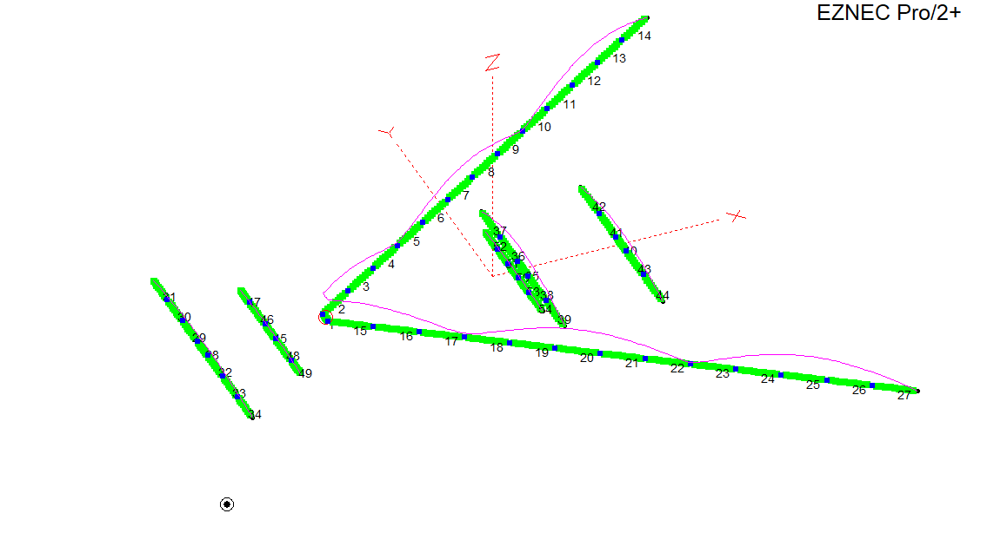
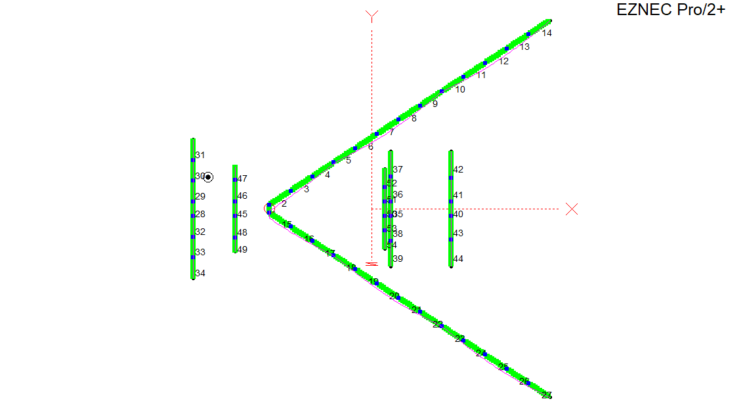
A YagVEE with Directors too
20M Director 2: 31’ 10”, 16’ from Dir 1
15M Director 1- 22’, 30’ 6” from Apex
20M Director 1- 31’ 10”, 32’ from Apex

Slide 43
YagVEE with Two 20M, One 15M Director
Director(s) fit in existing antenna envelope - supported by wire legs
Same limited parasitic coupling observed
Two 20M directors alone add another .9 dBd gain, but cost .7 dB gain on 15M, .5 dB on 10M
One 15M director restores lost gain
More directors added little
80 and 40M unaffected
BAND | DIPOLE | ANGLE | 4 el YAGVEE GAIN | ANGLE
20M | 0 | 33 | 3.7 dBd | 27
15M | 0 | 22 | 5.3 dBd | 18
10M | 0 | 16 | 5.4 dBd | 14

Slide 44
YagVEE +D’s vs Tribander Gain, dBd
BAND GAIN YAGVEE
20M 4.5 -.8
15M 4.9 +.4
10M 5.3 +.1

Slide 45
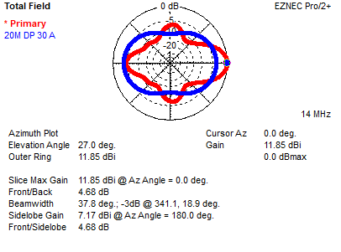
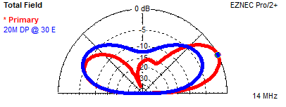
20M Plots
YagVEE -
3.7 dBd gain East
+3 dBd N + S

Slide 46
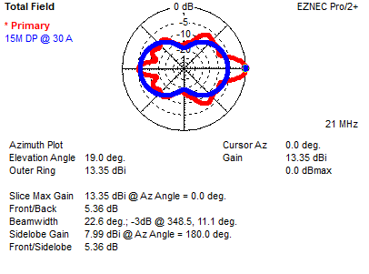
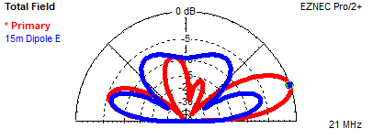
15M Plots
YagVEE -
5.3 dBd gain East
+1-4 dBd other directions

Slide 47
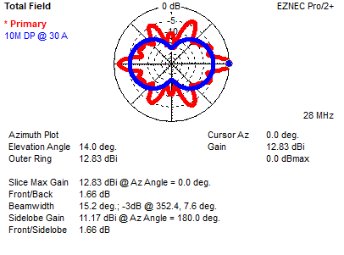
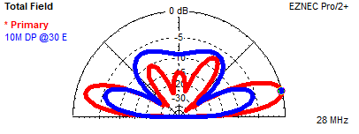
10M Plots
YagVEE -
5.4 dBd gain East
Good gain in many directions

Slide 48
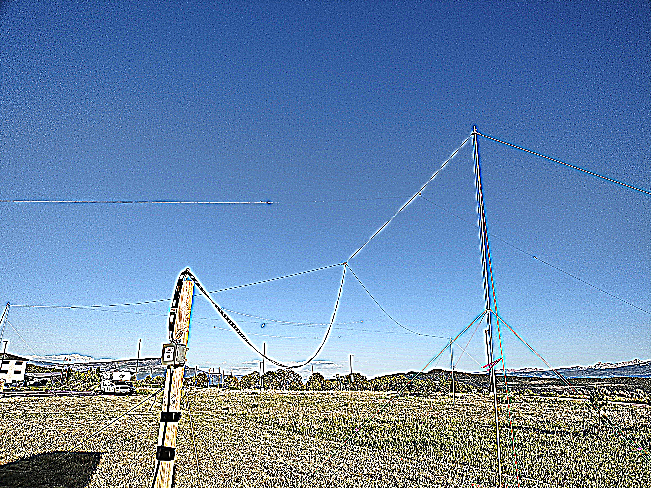
The YagVEE

Slide 49
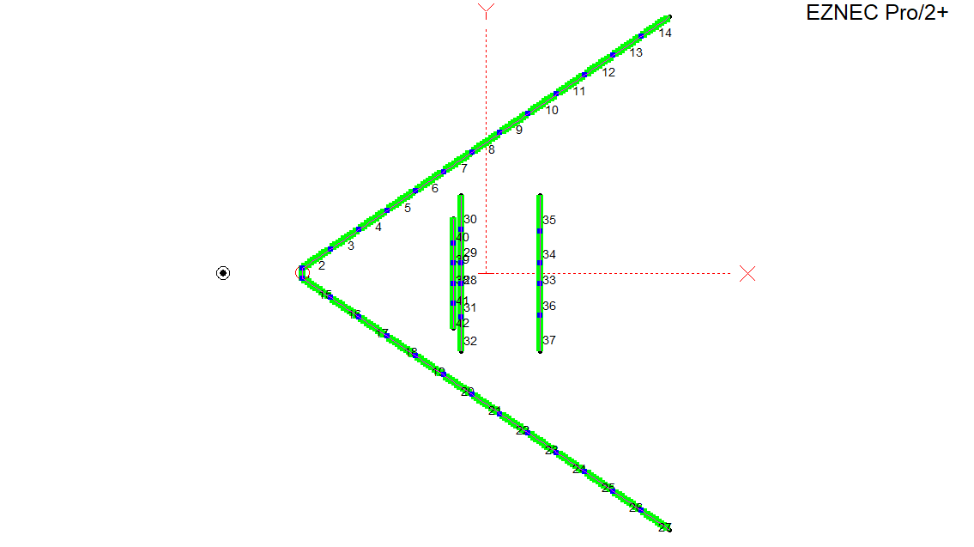
YagVEE, 2 Directors, no Reflector
BAND | DIPOLE | ANGLE | YAGVEE GAIN | ANGLE
20M | 0 | 33 | 2.8 dBd | 27
15M | 0 | 22 | 4.8 dBd | 19
10M | 0 | 16 | 5.4 dBd | 14
Antenna is 20’ shorter without Reflectors
Easier to erect and support VEE and embedded directors with less sag
No reflectors cost .9 dBd on 20M, .5 dBd on 15M vs YagVEE

Slide 50
YagVee, no R vs Tribander Gain, dBd
BAND GAIN YAGVEE
20M 4.5 -1.7
15M 4.9 - .1
10M 5.3 +.1

Slide 51
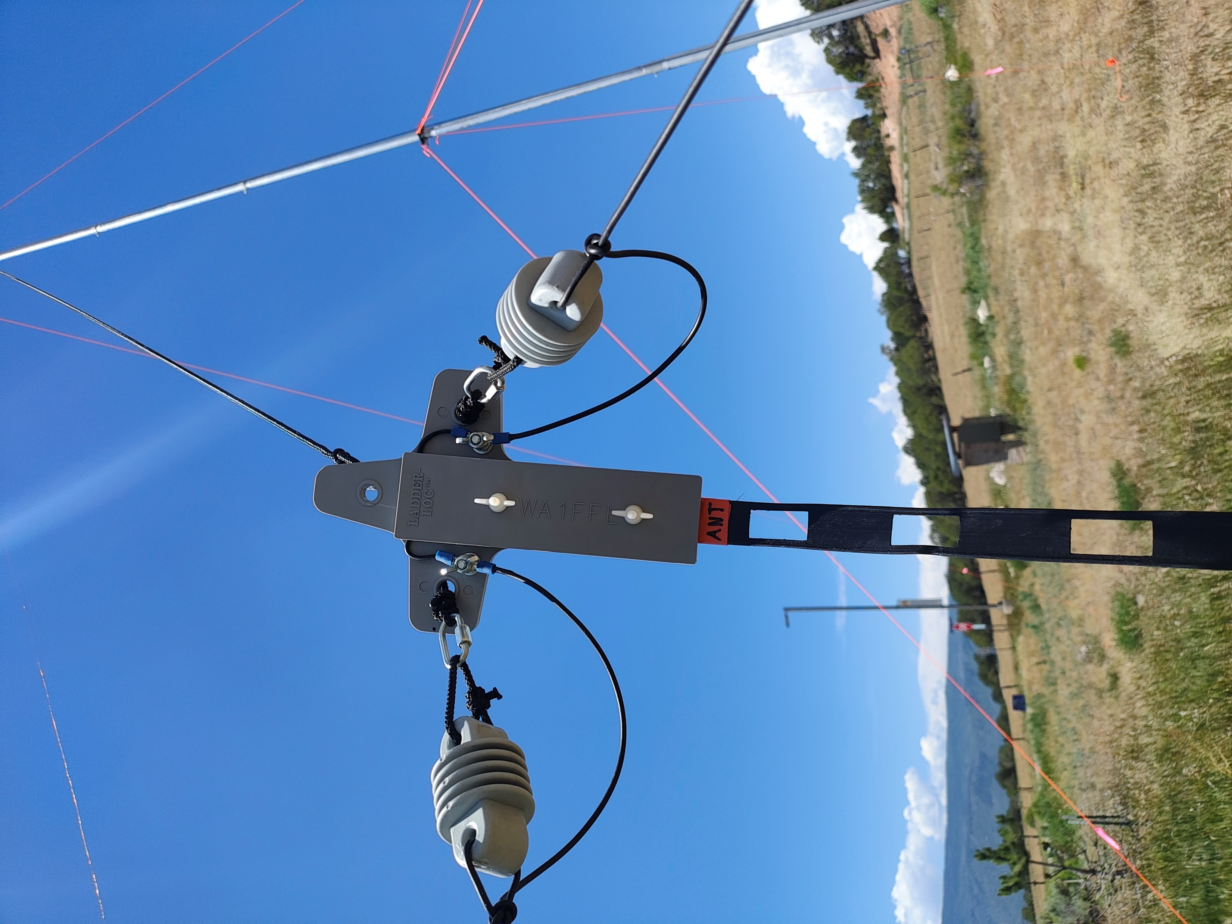
VEE BEAM / YagVEE Construction Notes
VEE legs of #12 or #14 wire, parasitic elements of #18
String end spreader to hold apex angle
30 – 35’ supports – mast / tower / tree
YagVEE reflector ends can slope some but need support
Ladderline / balun - coax feed – non resonant length (95’ here)

Slide 52
Observations: Cautious optimism…
YagVEE on 30’ masts at Ski Country ARC (K0RV) FD ’25
YagVEE version with 20M reflector and 2 directors
Poor post - solar flare band conditions, but still 740 CW Q’s
428 Q’s on 20M, extended runs, 200+ Q’s on 40M
Poor condx on 15M (90 Q’s), and 10M was dead (0 Q’s) – so who knows??? It sounded good otherwise…
Good on back/side lobes – CA, NW, FL, TX.
Easier to erect than a tribander, but took longer to raise masts

Slide 53
VEE BEAM Summary:
All bands, multiple side lobes for wide azimuth coverage
Gain comparable to tribander but narrower beamwidth
Low launch angles at relatively low height
Need long wires and acreage for good gain
Compact versions suitable for Field Day / portable deployment
Lightweight and easy to erect
Lot’s of dB’s / $

Slide 54
YagVEE Summary:
Compact design provides gain comparable to a tribander
Parasitic elements compensate for shorter leg lengths within .5 dB
Lower launch angles but narrower beamwidth than Yagi
Side lobes provide good all – around coverage for Field Day
Configurable with / without parasitic elements
All – band coverage, lightweight and easy to erect
YagVEE is a better FD option with more gain on 20 and 15M
LOT’s of dB’s / $

Slide 55
EZNEC Modeling made the YagVEE possible
Building, measuring, and adjusting all of the various configurations would be a nightmare
EZNEC is a useful tool for creating, mixing, modifying, and comparing various design elements
Easy way to determine optimal dimensions, configurations, and tradeoffs
Real – world results seem to track EZNEC quite well

Slide 56
I will email EZNEC wire tables for these antennas if you wish – send request to
K0MF@ARRL.net
Thank You!

