Slide 1

Remote Station Operation Using Wfview
Ed James KA8JMW
John Maxwell W0VG

Slide 2
Todays Presentation on Wfview
This quick explanation of the Wfview implementations and not intended to be a comprehensive how-to.
There are quite a few how-to videos out.
Significant functionality is being “glossed over” in this quick talk.

Slide 3

What is
A free, open source, program that allows many modern Icom and Kenwood ham radio transceivers to be controlled via a computer.
Displays the spectrum display on whatever display is connected, including projectors, touch screens, and TVs.
Allows for full radio control from a computer keyboard and basic control from a numeric keypad.
Runs on hardware ranging from the Raspberry Pi to laptops to desktops.
Runs on Linux, macOS, and Windows.
Supports rig control over ethernet as well as over USB & serial CIV bus.
Allows older radios to be accessed over the internet, for full control and low-latency audio streaming

Slide 4
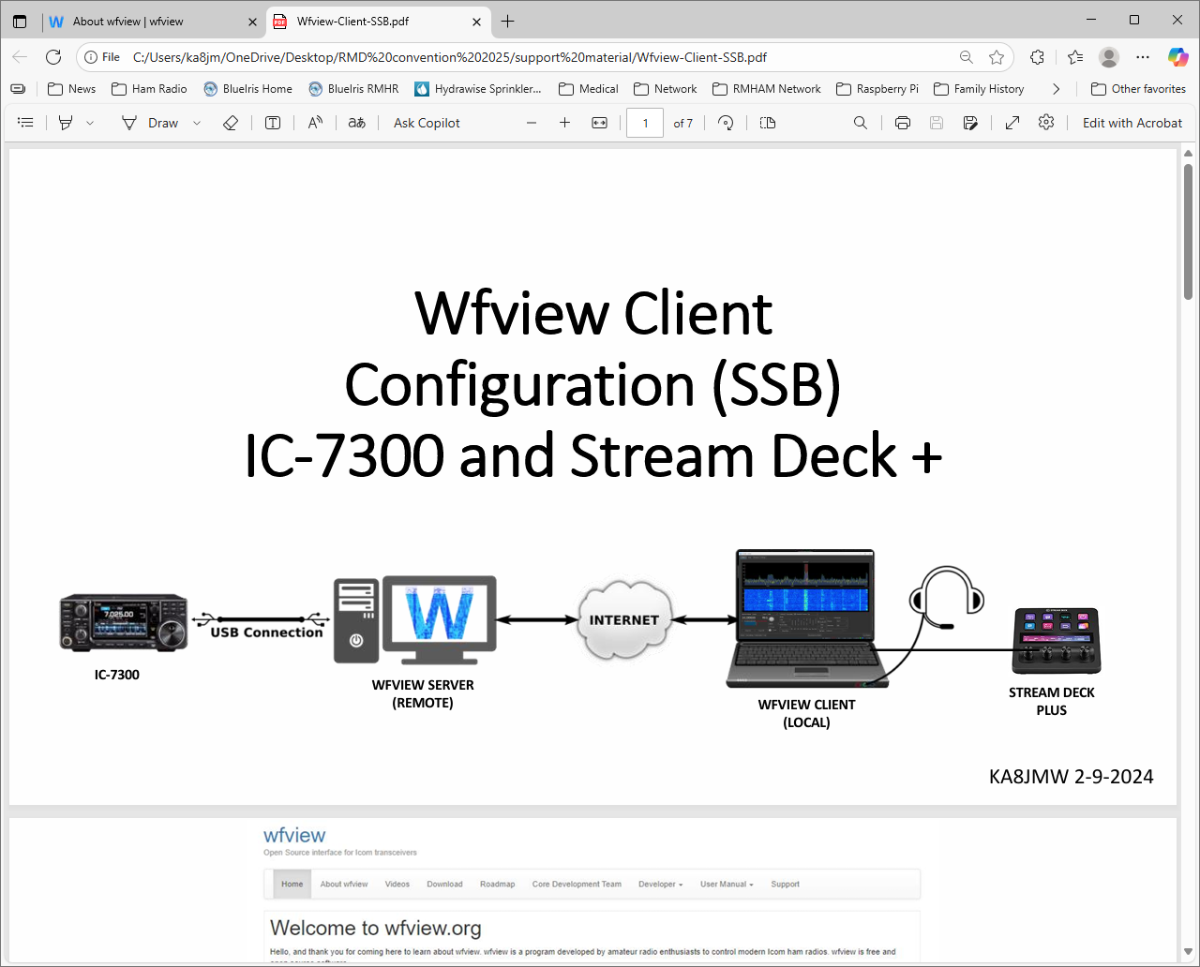
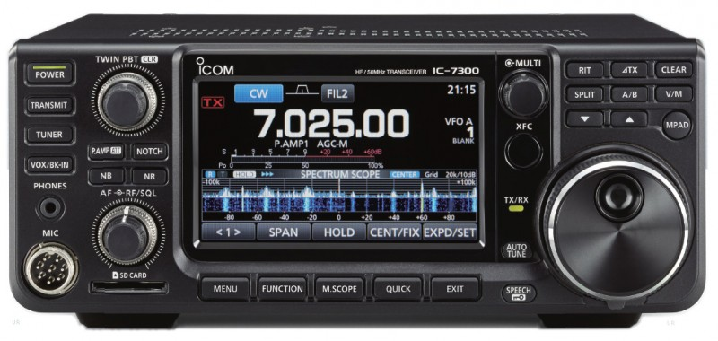
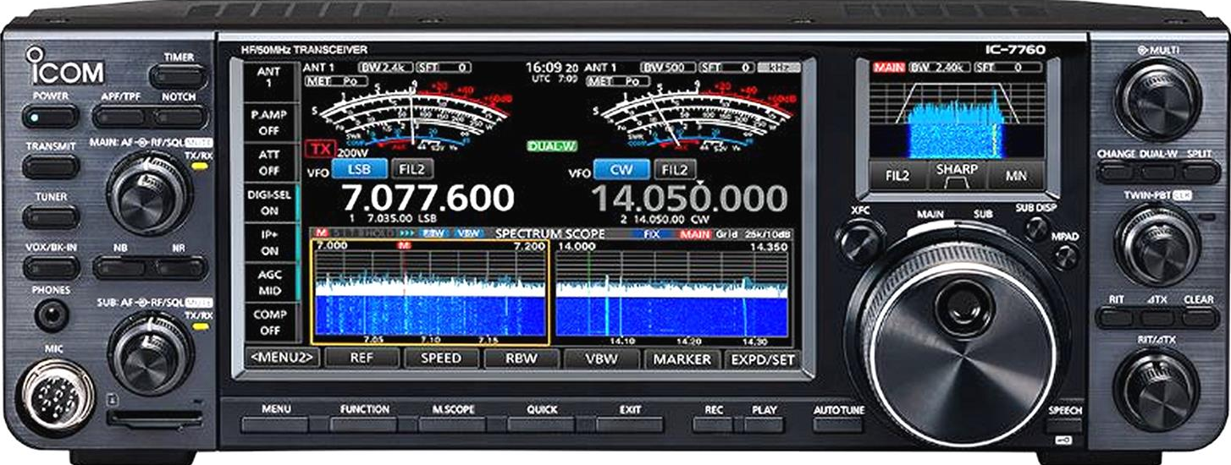
Typical Wfview Configurations
Radio with USB or Serial Interface
Radio with an Ethernet Interface
KA8JMW 1-31-2024

Slide 5
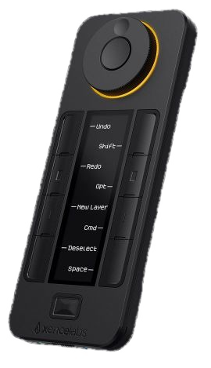
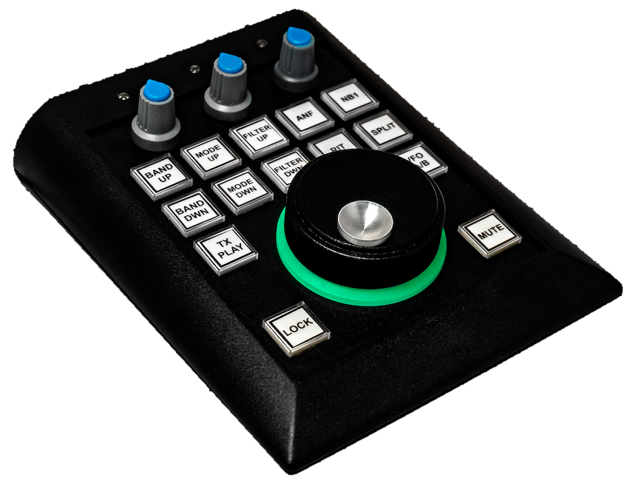
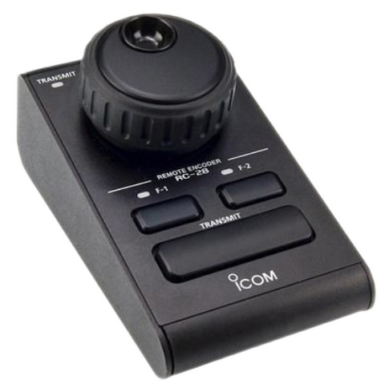
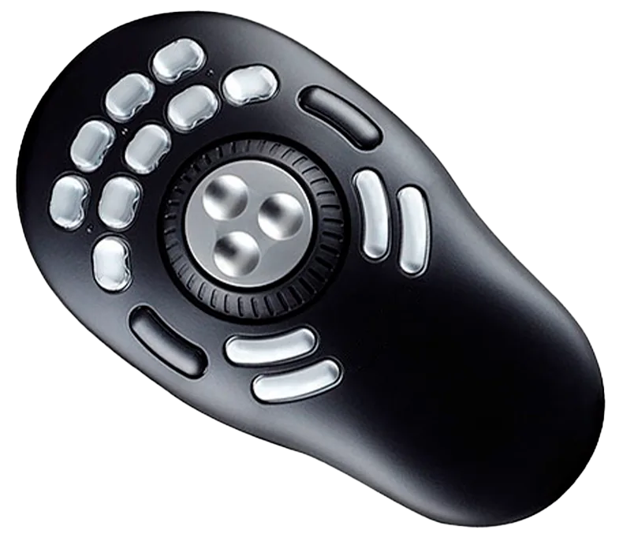
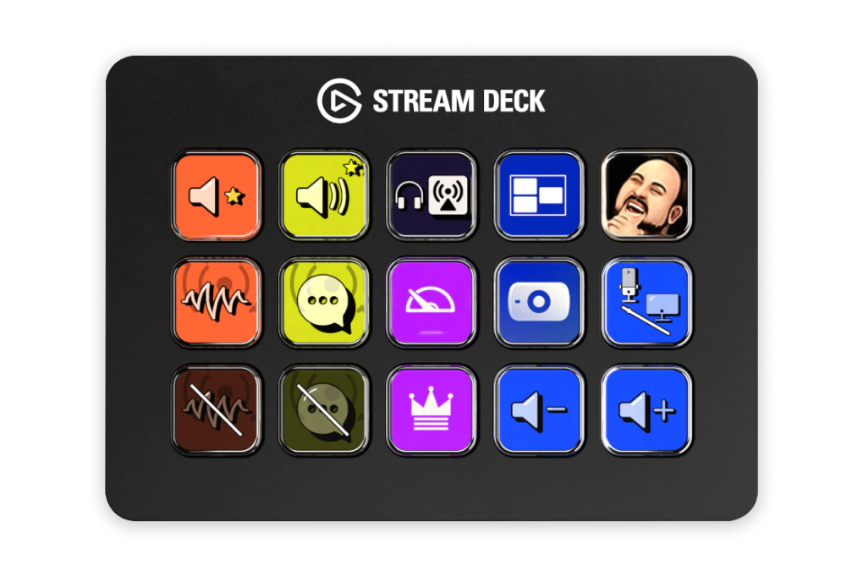

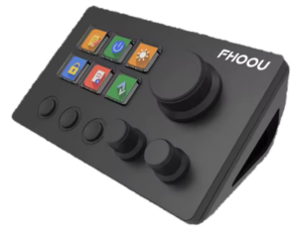
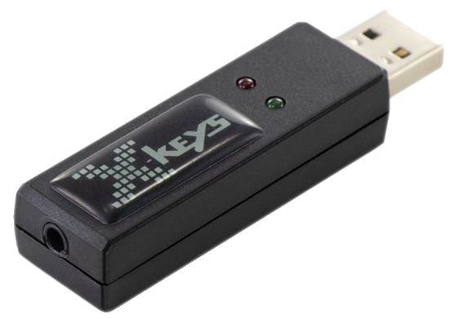
Supports many USB Controllers
RC-28, Shuttle, Stream Deck, sunSDR, …

Slide 6
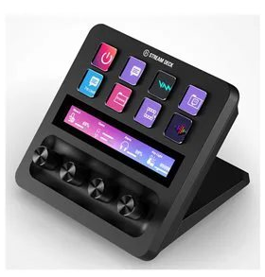
Stream Deck+ and Wfview
• Can be used for all radio functions in Wfview
• VFOA/VFOB
• Waterfall/Spectrum
• Volume
• RF Gain
• TX Power
And more
• Multiple “pages” of options can be addressed
• Commonly used function on front page
• Less common on second page

Slide 7
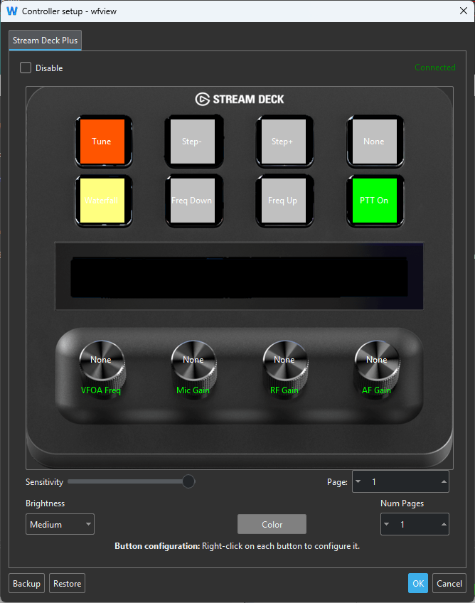
Stream Deck+ Device Configuration
You do not need to load any drivers
Wfview software polls and operates the device directly
Simply Right Click on the button and select its function

Slide 8
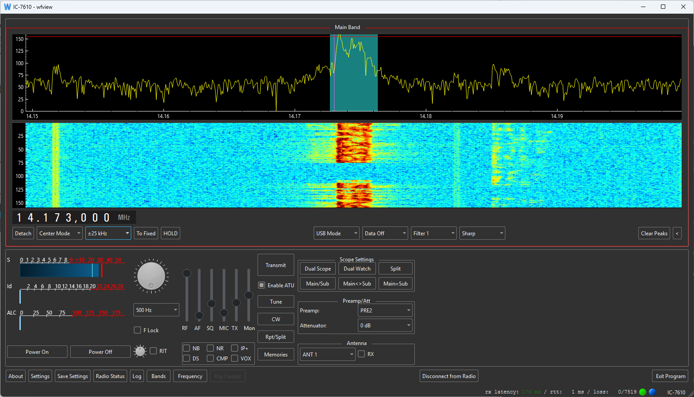

Slide 9
Demonstration
Using a Remote IC-7760 Located in RMHAM trailer

Slide 10
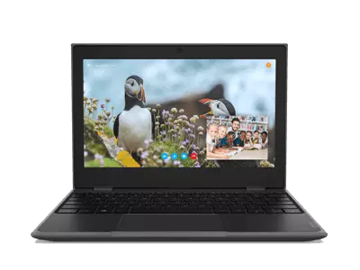
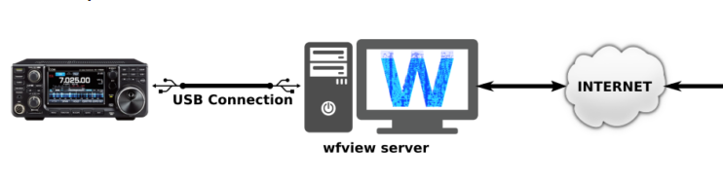
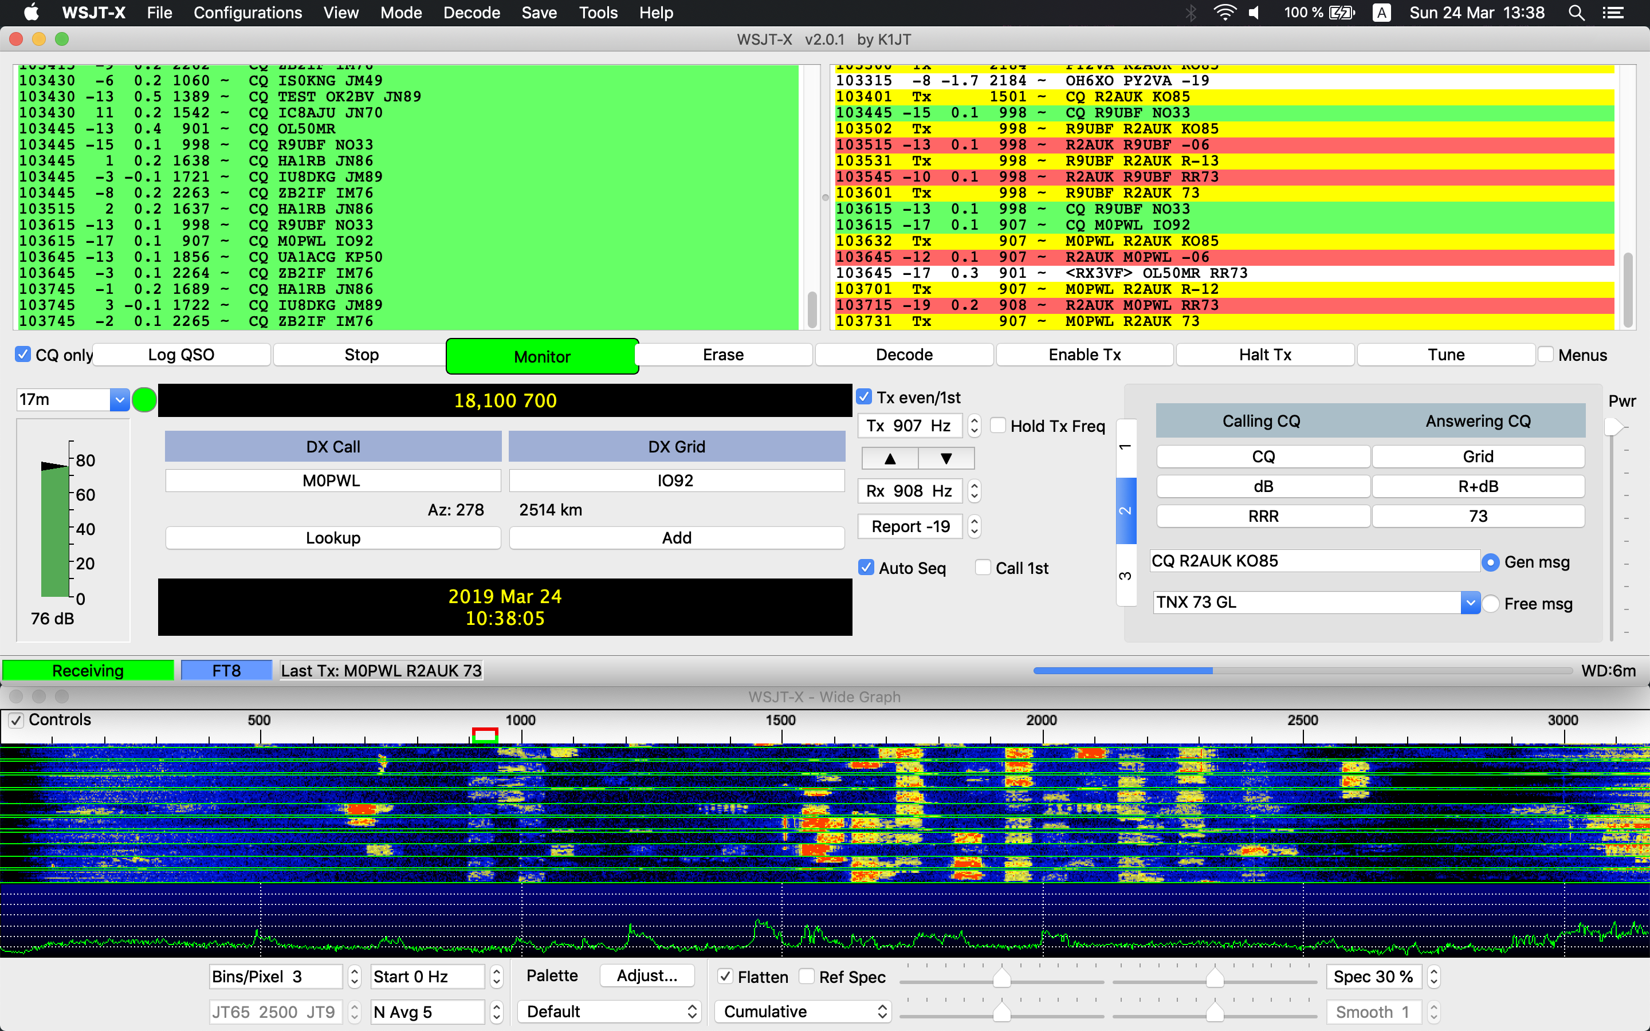
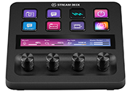
Digital Modes
When operating digital modes you will need a Virtual Audio Cable to provide the audio to both Wfview & the digital mode program.
Excessive latency can be an issue.
IC-7300
WFVIEW SERVER
(REMOTE)
WFVIEW CLIENT
(LOCAL)
STREAM DECK PLUS

Slide 11
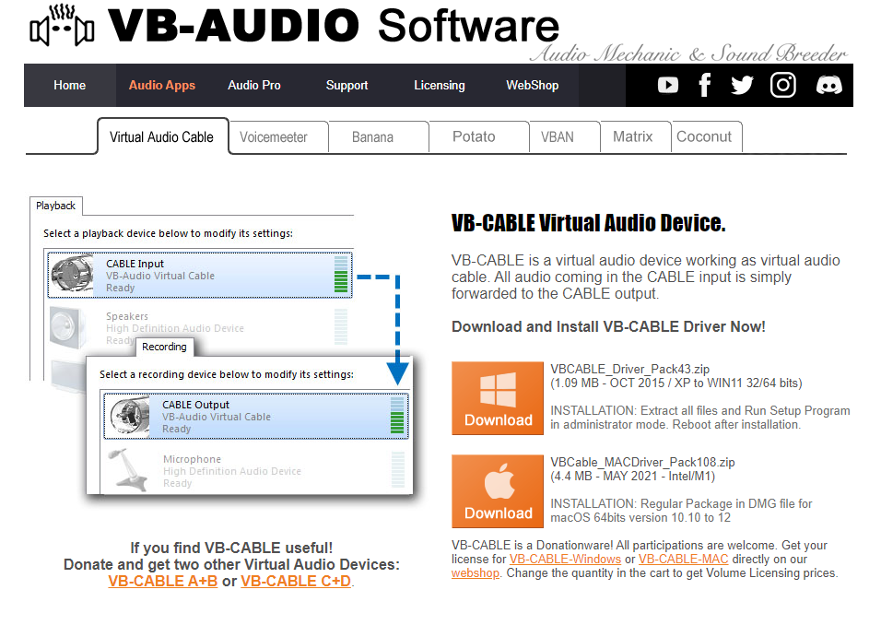
FREE for both Windows & Mac
VB-Audio Virtual Apps

Slide 12


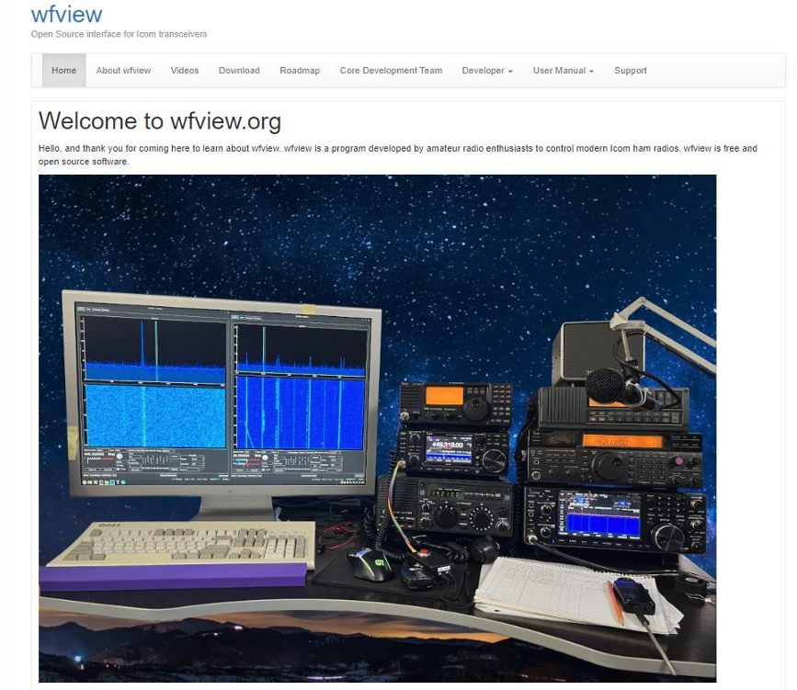
(Questions?)

Slide 13
Thank You
Ed James KA8JMW, ka8jmw@arrl.net
John Maxwell, W0VG johnm@johnmaxwell.net
http://www.rmham.org

