Slide 1

Using ChatGPT AI and OpenSCAD
to generate
3D Printer stl files
Ed James KA8JMW

Slide 2
OpenSCAD: wikipedia
OpenSCAD is a free software application for creating solid 3D computer-aided design (CAD) objects. It is a script-only based modeller that uses its own description language; the 3D preview can be manipulated interactively, but cannot be interactively modified in 3D. Instead, an OpenSCAD script specifies geometric primitives (such as spheres, boxes, cylinders, etc.) and defines how they are modified and combined (for instance by intersection, difference, envelope combination, or Minkowski sums) to render a 3D model. As such, the program performs constructive solid geometry (CSG). OpenSCAD is available for Windows, Linux, and macOS.

Slide 3
Chat GPT: wikipedia
ChatGPT is a generative artificial intelligence chatbot developed by OpenAI and released in 2022. It currently uses GPT-5, a generative pre-trained transformer (GPT), to generate text, speech, and images in response to user prompts.^{[3][4]} It is credited with accelerating the AI boom, an ongoing period marked by rapid investment and public attention toward the field of artificial intelligence (AI).^{[5]} OpenAI operates the service on a freemium model. Users can interact with ChatGPT through text, audio, and image prompts.

Slide 4
3D print: wikipedia
3D printing, also called additive manufacturing, is the construction of a three-dimensional object from a CAD model or a digital 3D model.^{[1][2][3]} It can be done in a variety of processes in which material is deposited, joined or solidified under computer control,^{[4]} with the material being added together (e.g. plastics, liquids, or powder grains being fused), typically layer by layer.

Slide 5
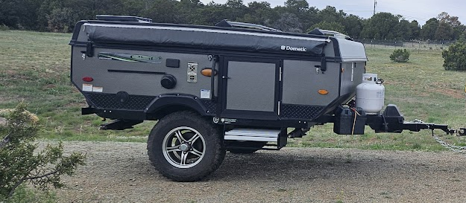
Project Inspiration: popup camper mods.
Furnace Inlet/Outlet
Speaker

Slide 6
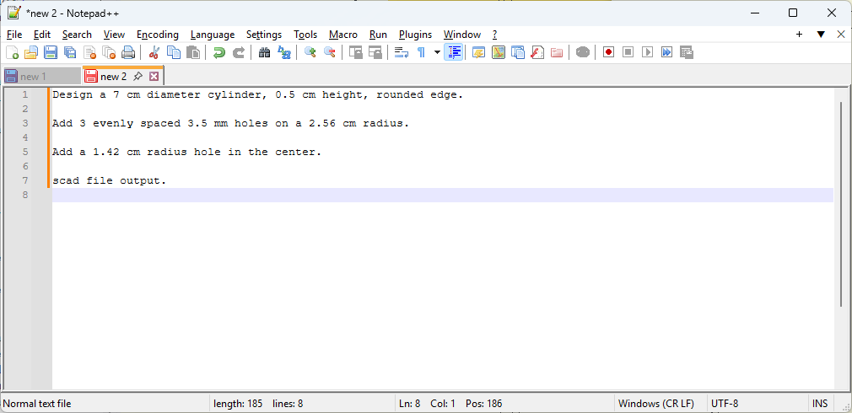
1. Describe the part: An iterative process…

Slide 7
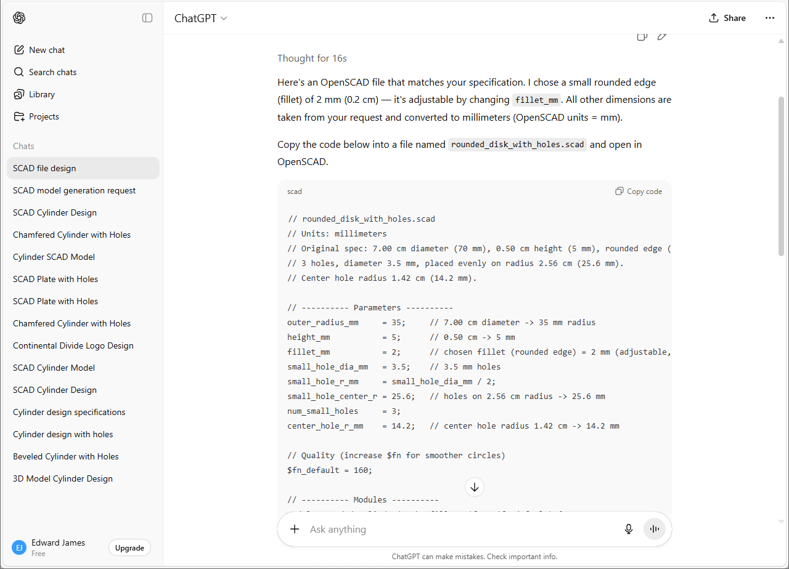
2. Paste the part description into ChatGPT.

Slide 8
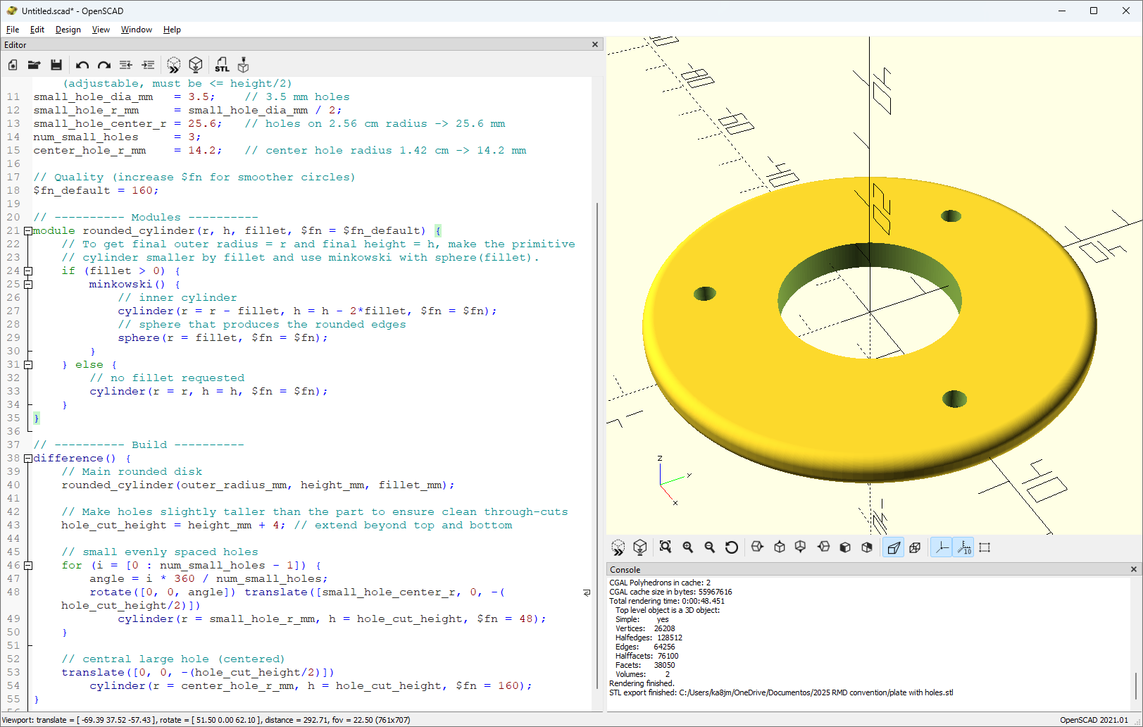
3. Paste the output into OpenSCAD and render.

Slide 9
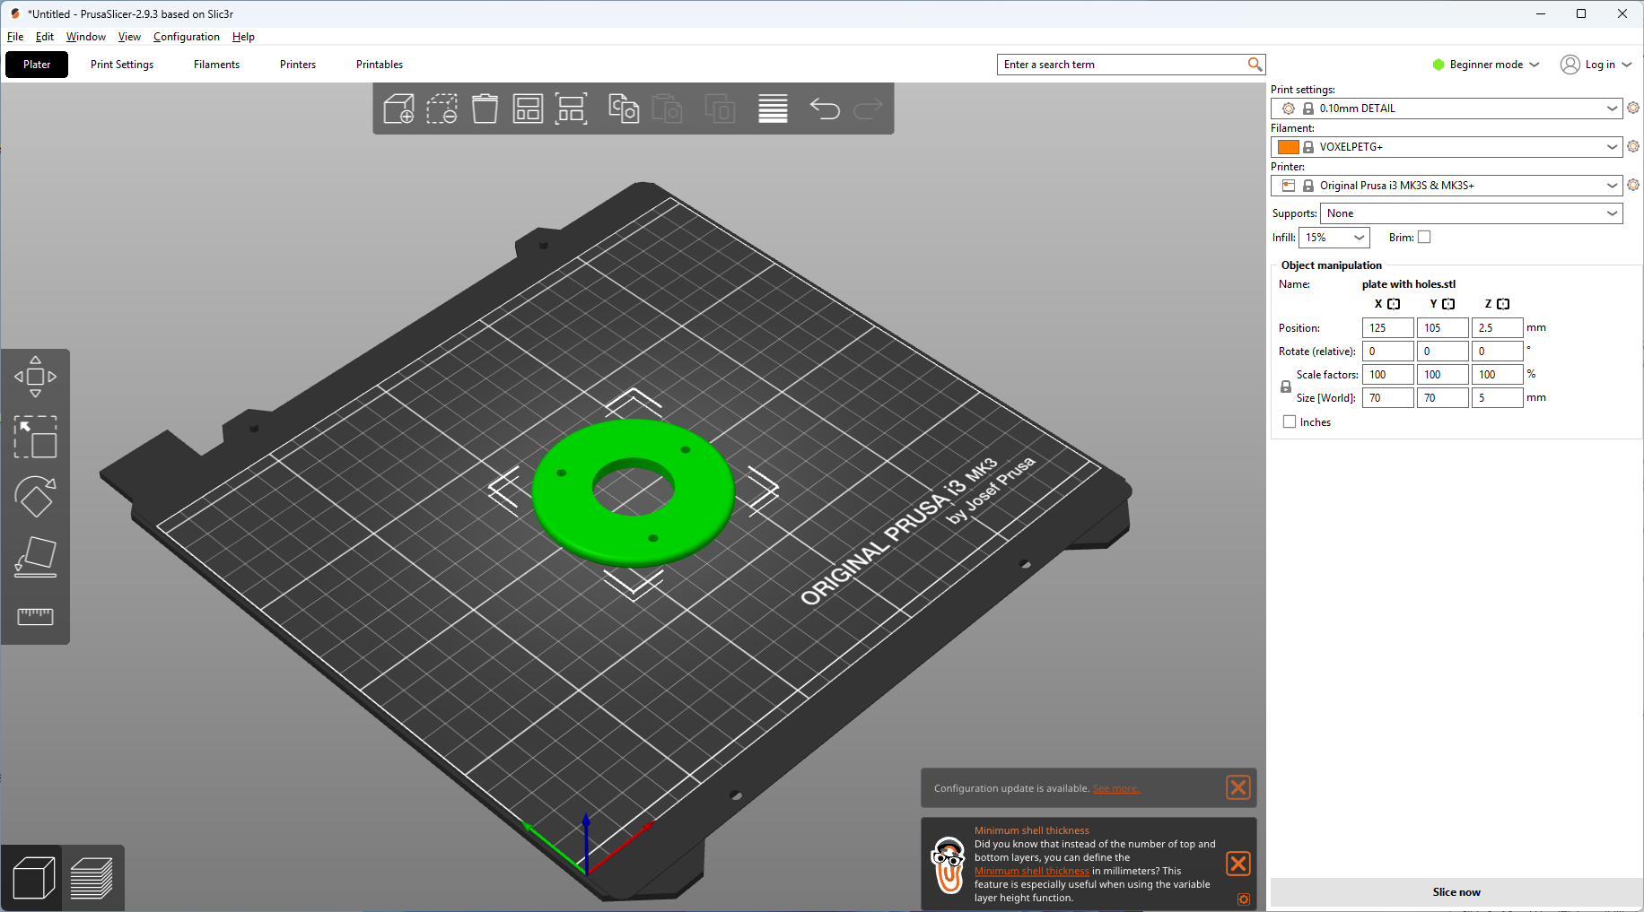
4. Load the STL file into the 3D printer slicer.

Slide 10
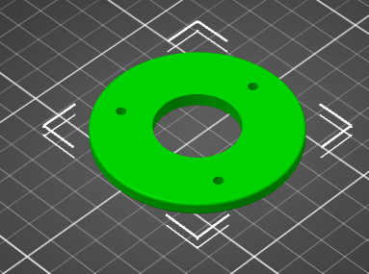
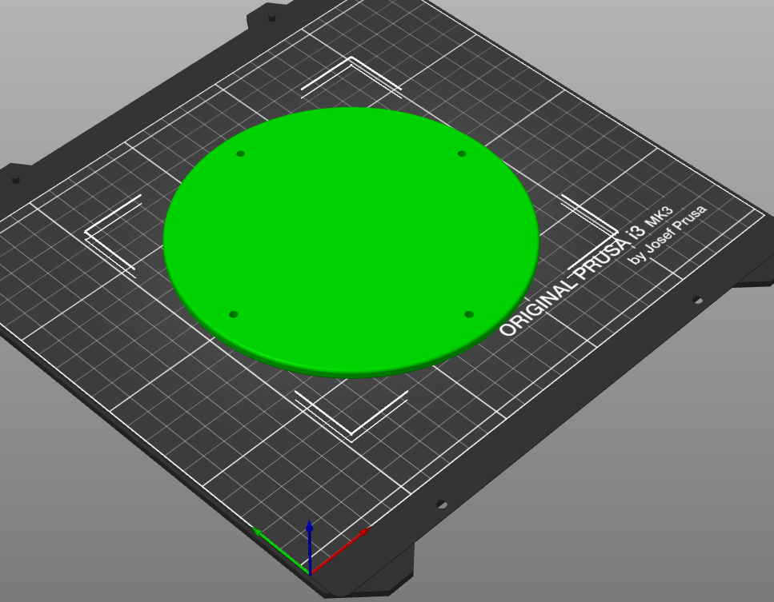
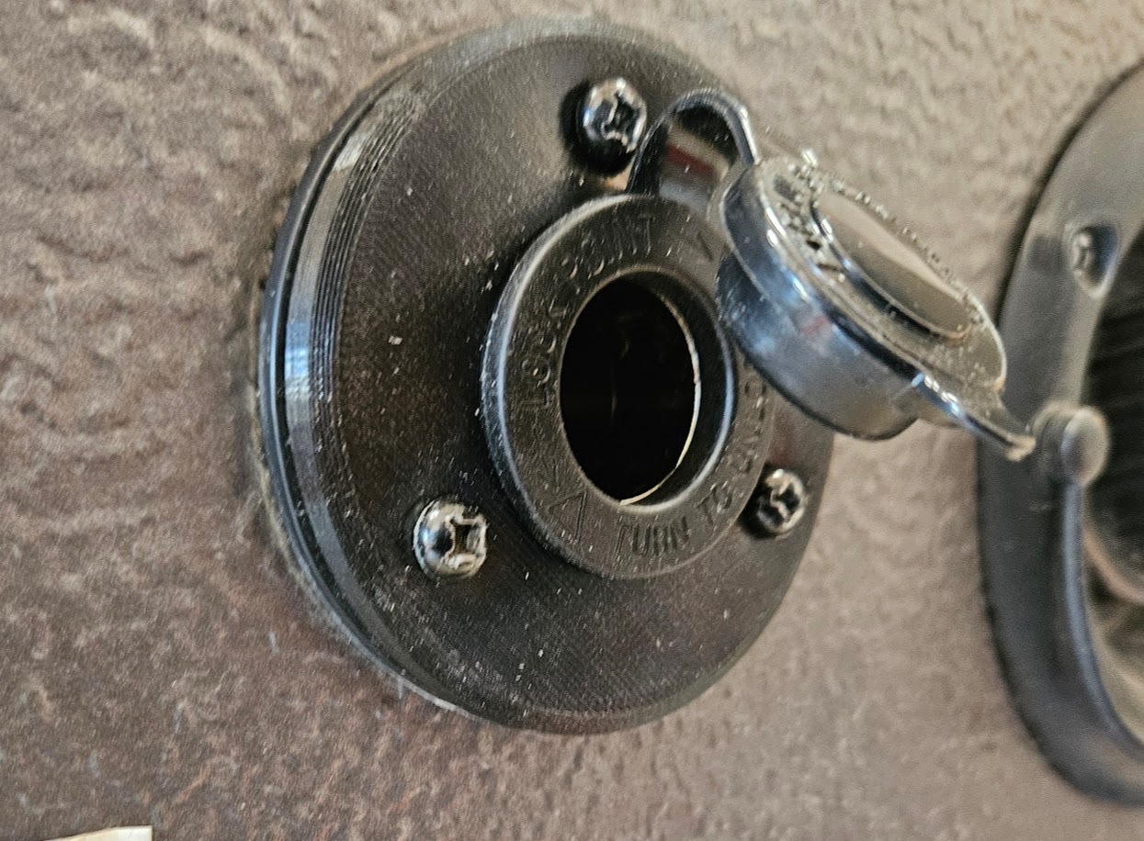
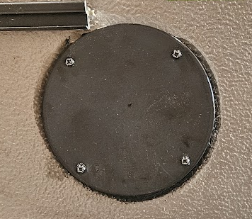

Slide 11
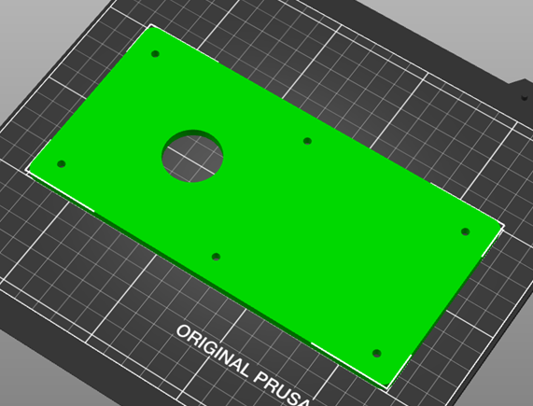
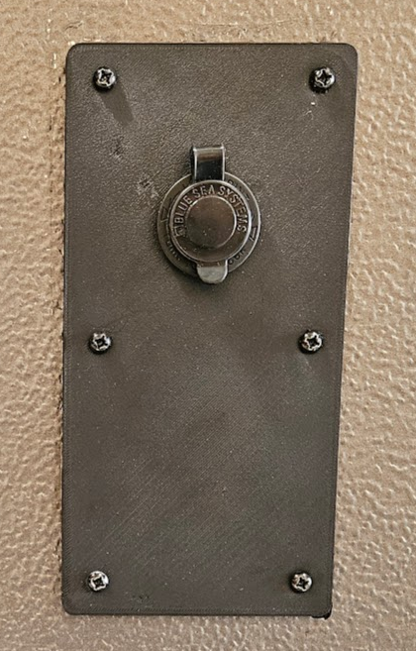
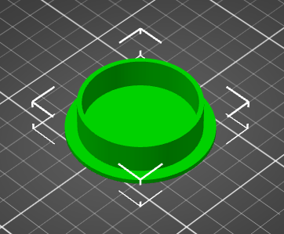
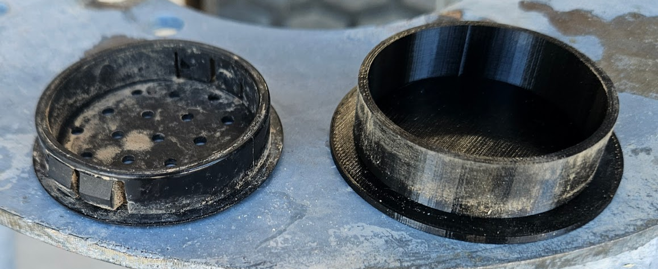

Slide 12
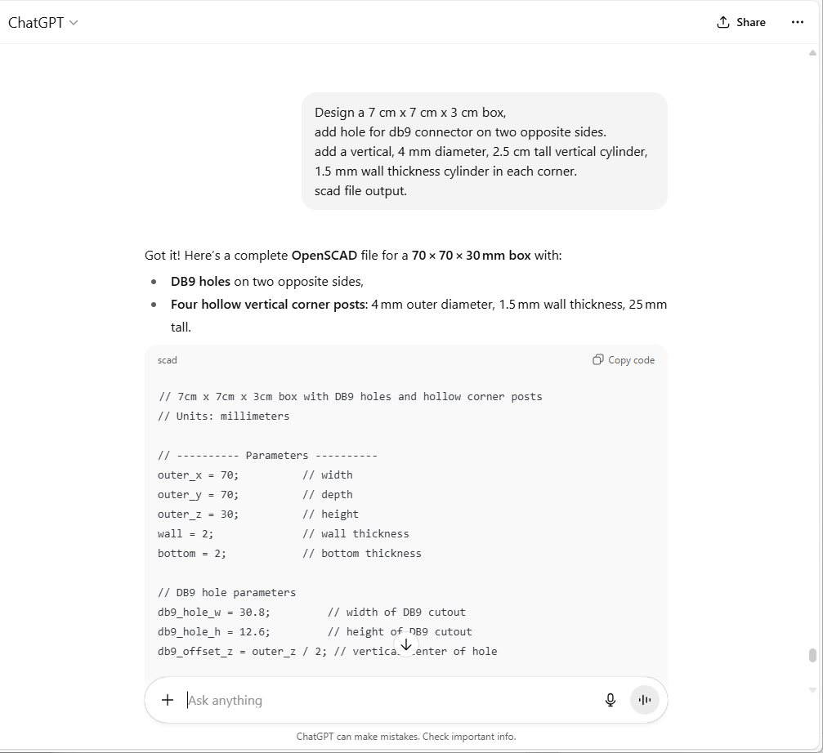
Lets make a box:

Slide 13
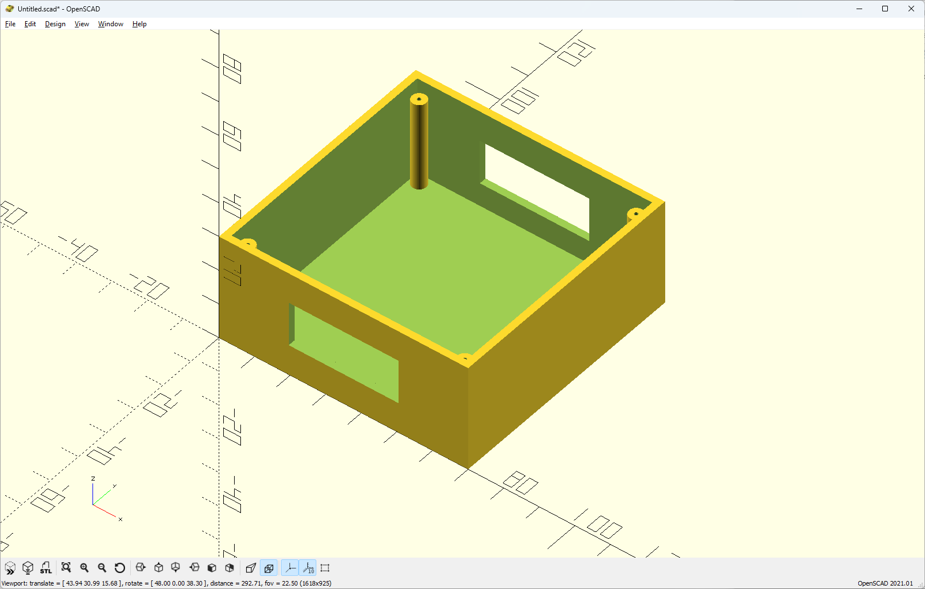

Slide 14
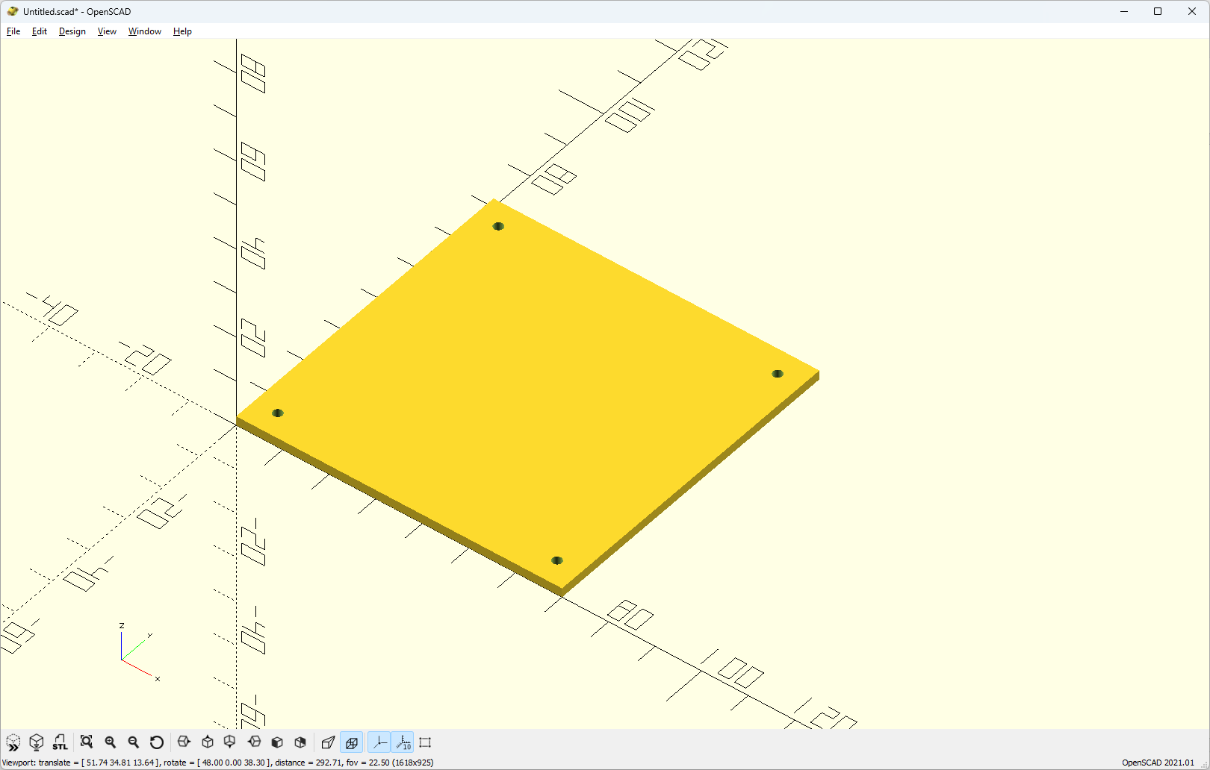

Slide 15
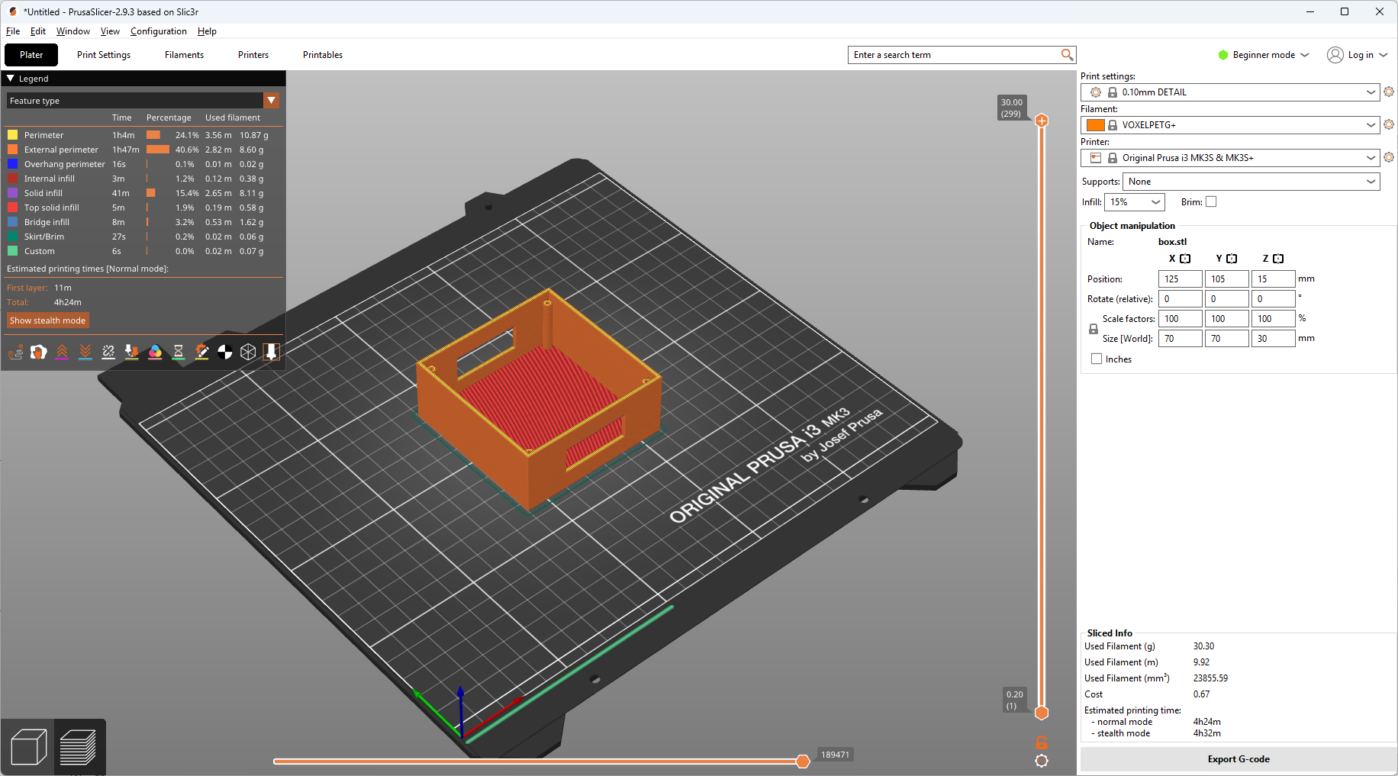

Slide 16
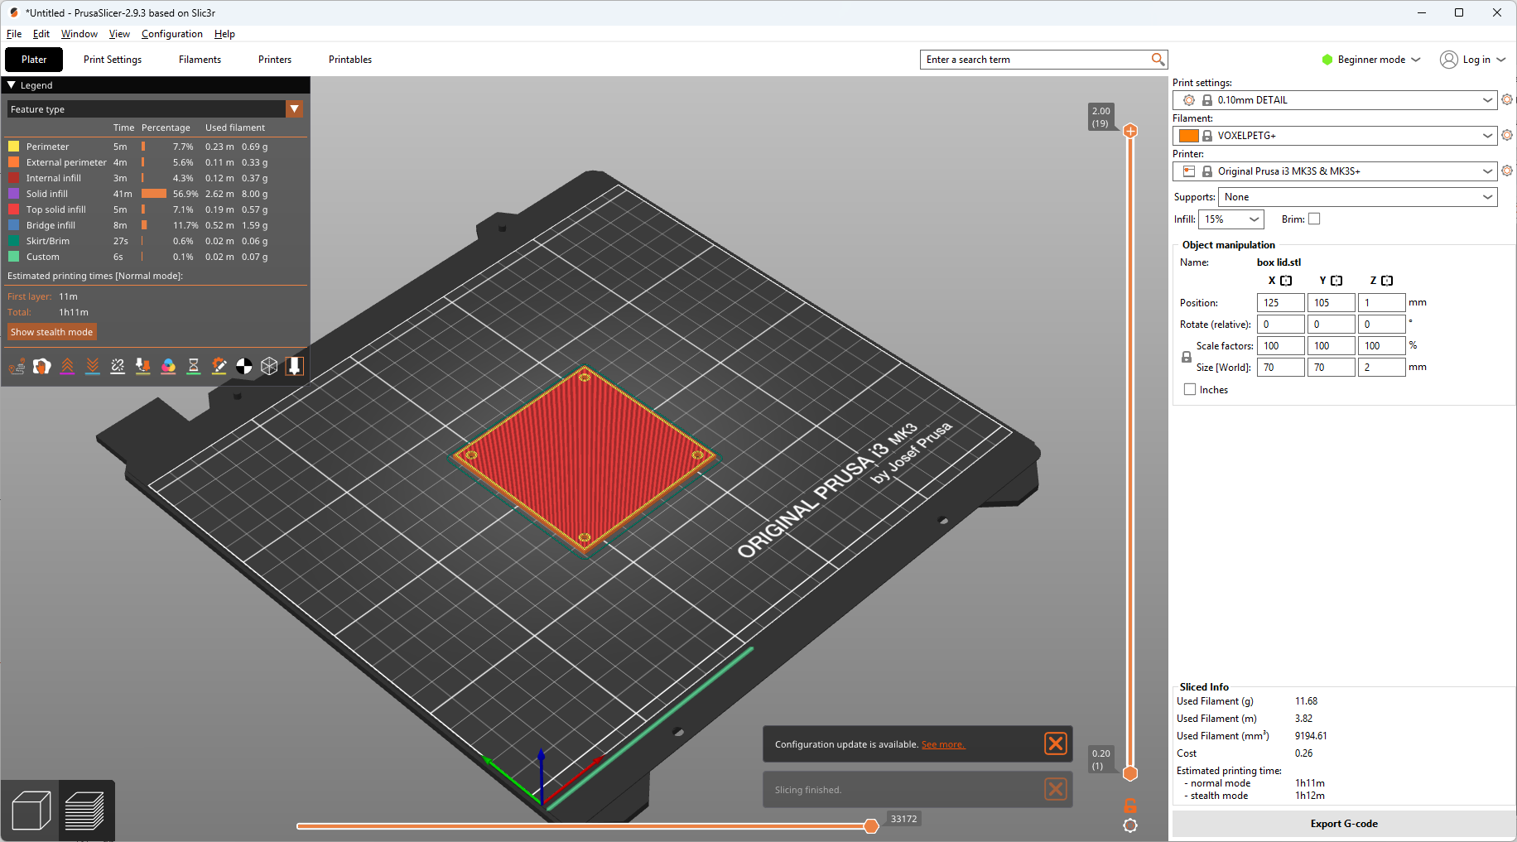

Slide 17

(Questions?)

Slide 18
Thank You
Ed James KA8JMW, ka8jmw@arrl.net
http://www.rmham.org

