Slide 1


RMHAM Multi-State 5 GHz Microwave Network:
A Realtime Demonstration of its Functionality and Capabilities
Ed James KA8JMW

Slide 2

Who We Are
RMHAM develops capabilities.
RMHAM facilitates technical education.

Slide 3
Who We Are
We provide microwave IP and/or network connectivity to partnering clubs and repeater organizations across New Mexico and Colorado to enable or expand their capabilities
We own and operate 45 DMR, D-STAR, and AllStar repeaters and APRS i-Gates available for use by any amateur radio operator
We get involved with many things RF, electrical, mechanical, and networking
RMHAM develops capabilities.

Slide 4
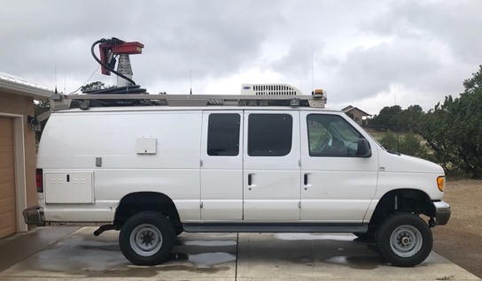
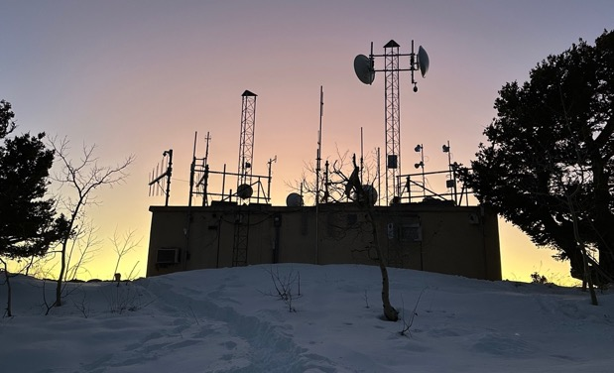
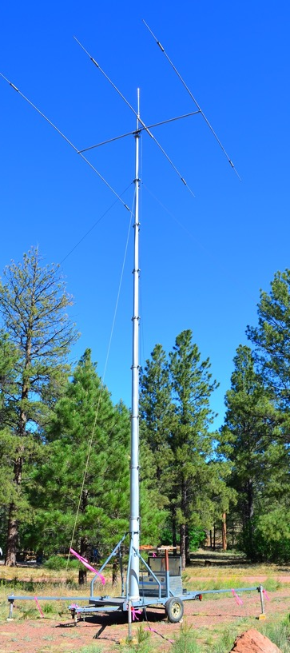
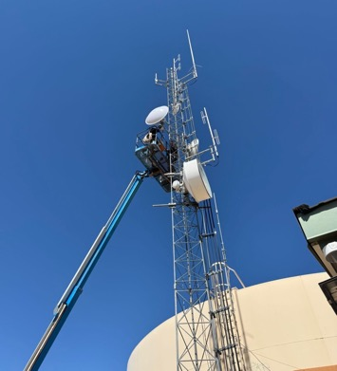
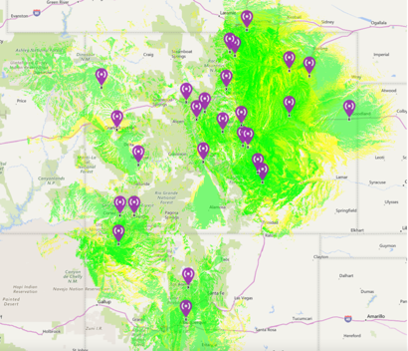
Who We Are
RMHAM develops capabilities.

Slide 5
Who We Are
We organize three annual events to teach amateur radio operators about a variety of technical topics:
New Mexico TechFest (each February in New Mexico)
NerdFest (each January in Colorado)
RMHAM University (weekend short courses throughout the winter months)
RMHAM facilitates technical education.

Slide 6
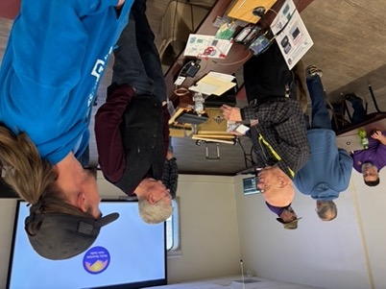
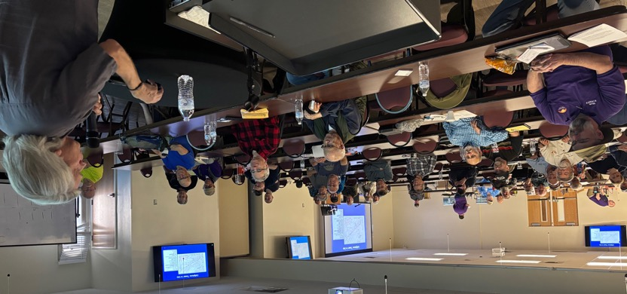
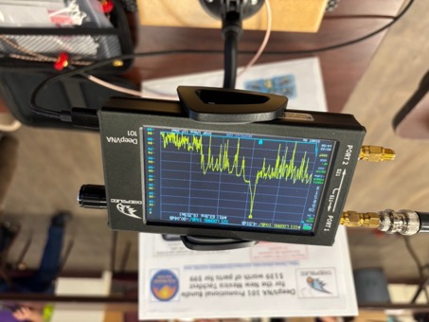
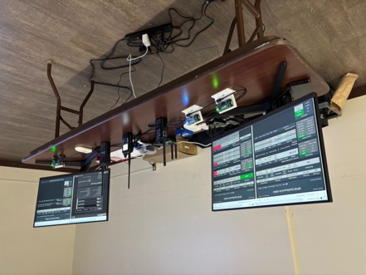
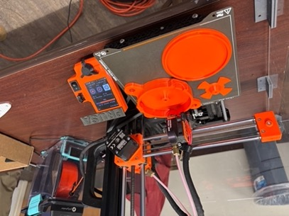
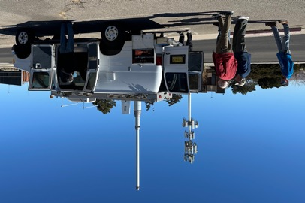
Who We Are
RMHAM facilitates technical education.

Slide 7
RMHAM 5-GHz Microwave Network

Slide 8
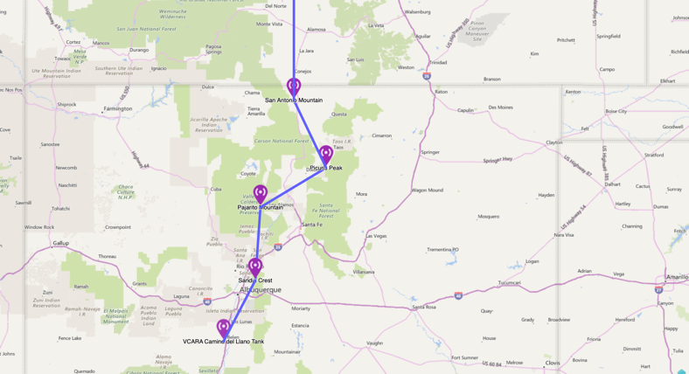
RMHAM’s 5-GHz Microwave Network
WYOMING
RMHAM has designed a fully-managed IP-based microwave backbone network
Spans Cheyenne, Wyoming down to Belen, New Mexico and across Colorado’s western slope (soon: down to El Paso, Texas)
An infrastructure for partnering clubs and repeater organizations to expand their capabilities (repeater linking, repeater troubleshooting and administration, any IP-based application that is Part 97 compliant, etc.)
RMHAM’s network is comprised of (as of TODAY):
950+ miles of combined microwave shots
106 point-to-point and 14 point-to-multipoint microwave links across New Mexico and Colorado
923 registered devices (routers, repeaters, RTCMs, power controllers, PTZ cameras, VoIP phones, etc.)
COLORADO
NEW MEXICO

Slide 9
RMHAM’s 5-GHz Microwave Network
WYOMING
It is secure*, firewalled, and accessible only through RADIUS authorization and authentication
It is managed and monitored 24x7x365 by a dedicated network operations team and a suite of tools/protocols
DevDB, Observium, Smokeping, OSPF, and automated email/text alerts
Throughput averages 150-Mbit/sec across the network
It is built from reliable COTS 5-GHz networking and microwave equipment configured to operate on Part 97 amateur radio spectrum
It does not rely on the internet to function…however we do have several internet taps for automatic fail-over if an RF link goes down temporarily
COLORADO
NEW MEXICO
* = a relative term

Slide 10
Why it Matters for Clubs and Repeater Organizations
Use Case: San Antonio Mountain (on the Colorado-New Mexico border) now hosts several linked repeater systems for different organizations, enabled by a single RMHAM microwave link. Repeater owners also now have the the ability to troubleshoot, reconfigure, power-cycle, and restore equipment without needing to travel up to 3 hours (one-way) to the mountaintop site.
Provides high-bandwidth IP connectivity to remote RF sites
Helps turn standalone analog repeaters into systems that can link across New Mexico, the United States, and world
Allows for the expansion of digital repeaters (DMR, D-STAR) and APRS I-Gates
Enables remote troubleshooting and system management (power-cycling, configuration, performance monitoring, site security, etc.) without needing to travel to the site

Slide 11
Why it Matters for Hams
Use Case: Pajarito Mountain (above Los Alamos) historically had just one 2-meter analog repeater. Using the IP connectivity provided by RMHAM’s microwave network, the site also now offers DMR, Yaesu System Fusion, and APRS iGate service for amateur radio operators to use and enjoy.
New capabilities to enjoy → Because of the high-bandwidth IP provided by RMHAM’s microwave network, isolated standalone RF sites can now offer additional capabilities such as DMR, D-STAR, AllStar, Echolink, APRS, even the ability to operate an HF station remotely
More coverage → Standalone repeater systems can expand their coverage footprint because they can now easily link to other sites around the New Mexico, the United States, and world
More reliability → Downtime, due to technical issues, is reduced because site owners can troubleshoot and resolve certain problems without having to travel to far-away, remote RF sites

Slide 12
Why it Matters for Emergency Communications
Use Case: In 2013, devastating flash floods destroyed commercial and government communications infrastructure and isolated remote communities around Estes Park, Colorado. RMHAM’s microwave network was used to temporarily restore high-bandwidth connectivity for ARES teams, first responders, and disaster response organizations.
Provides a high bandwidth backbone that is independent of commercial internet
Allows ARES to transmit large amounts of data, including video, photos, and logistical information
Can tie strategic locations (within line of sight of each other and RMHAM microwave sites) such as EOCs, shelters, etc. together for seamless communications
Preserves common methods of communication (Microsoft Outlook, Word, PowerPoint, conversations by VoIP telephone, etc.)

Slide 13
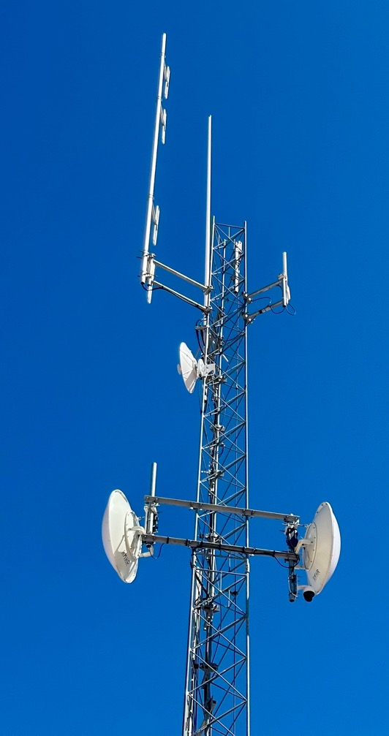
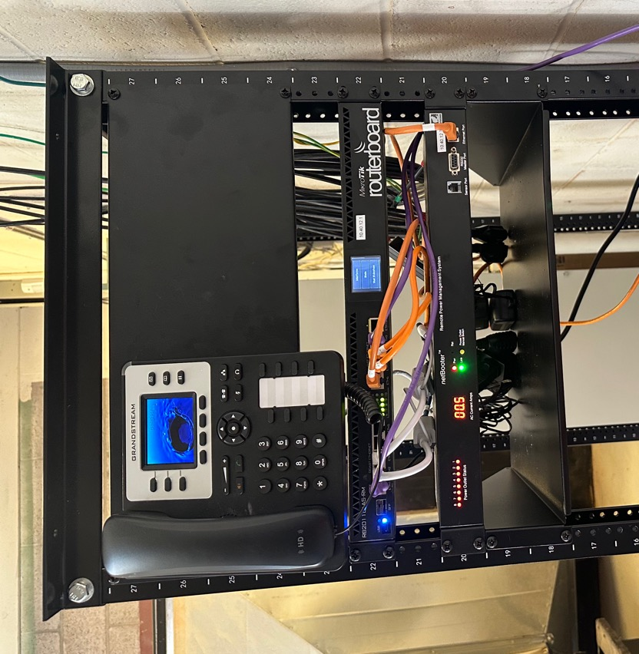
What a Typical Link Looks Like
VoIP phone
5-GHz microwave dish and radio
Router
PTZ video
camera
Remote IP power
management unit
13

Slide 14

Configuration Management.
RMHAM Network Operations Webpage
Netops
DevDB RMHAM Device Database
DevDB
Network Device setup and configuration utility
Winbox

Slide 15
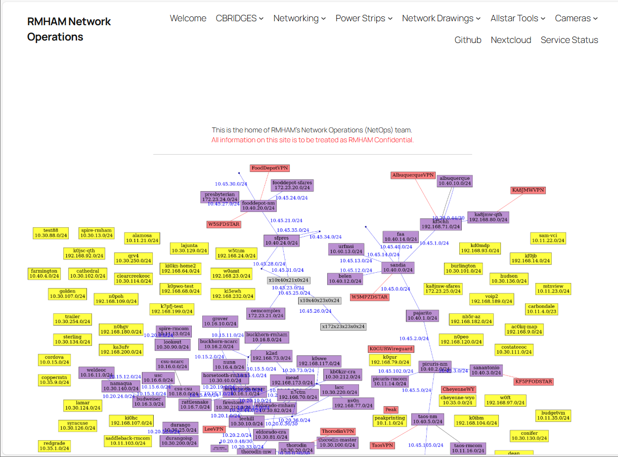
RMHAM Network Operations webpage

Slide 16
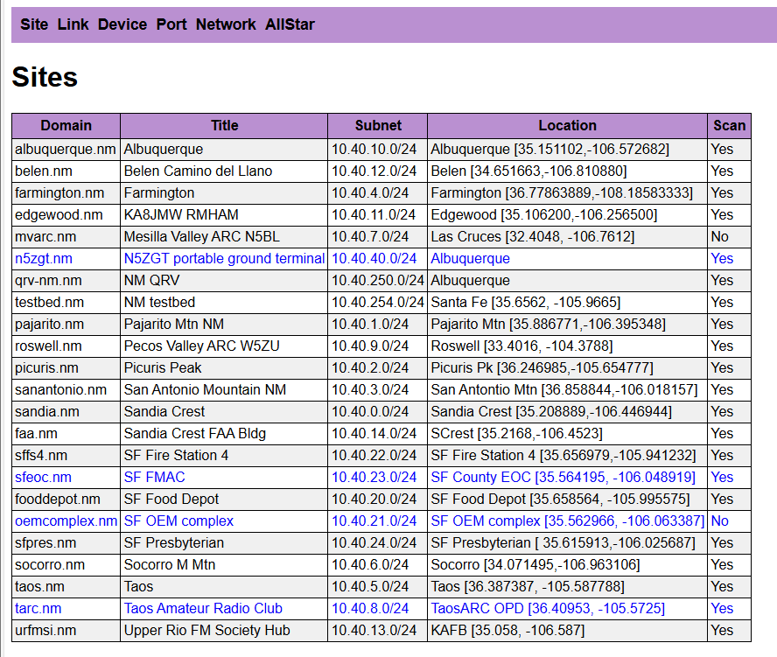
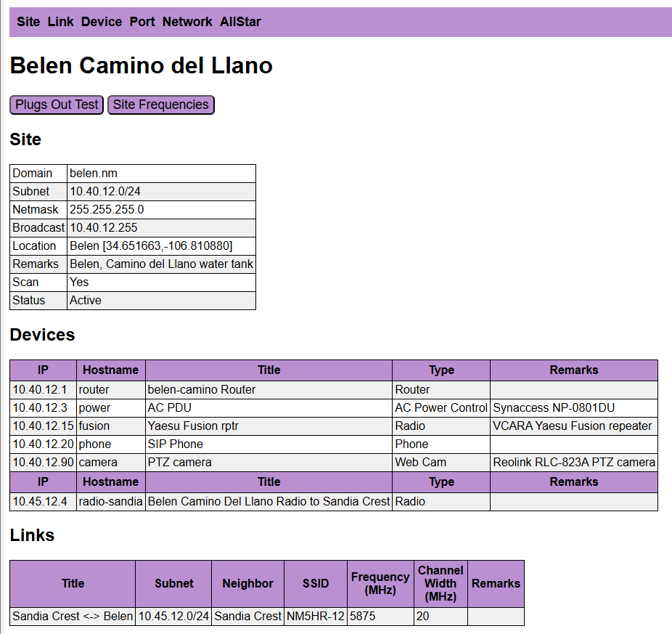
DevDB “One app to rule them all”

Slide 17
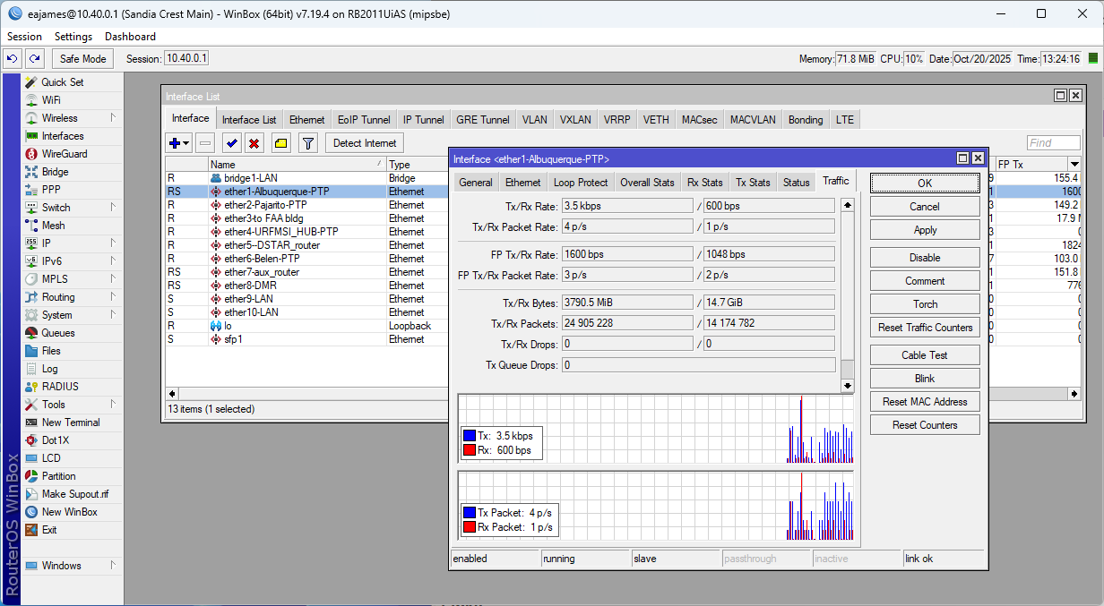
Mikrotik WinBox

Slide 18


Network Monitoring.
Observium SNMP monitoring.
Observium
SmokePing
SmokePing Latency
Cping
Putty 10.40.0.70

Slide 19
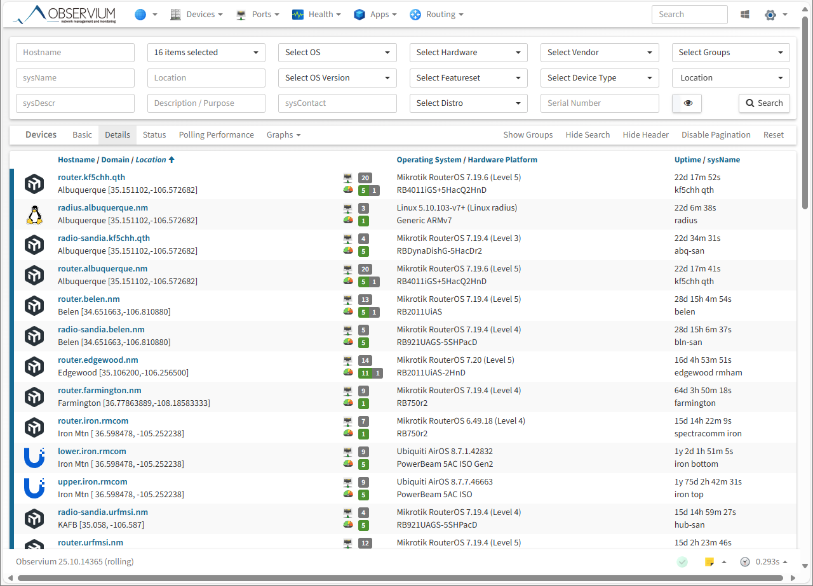
Observium

Slide 20
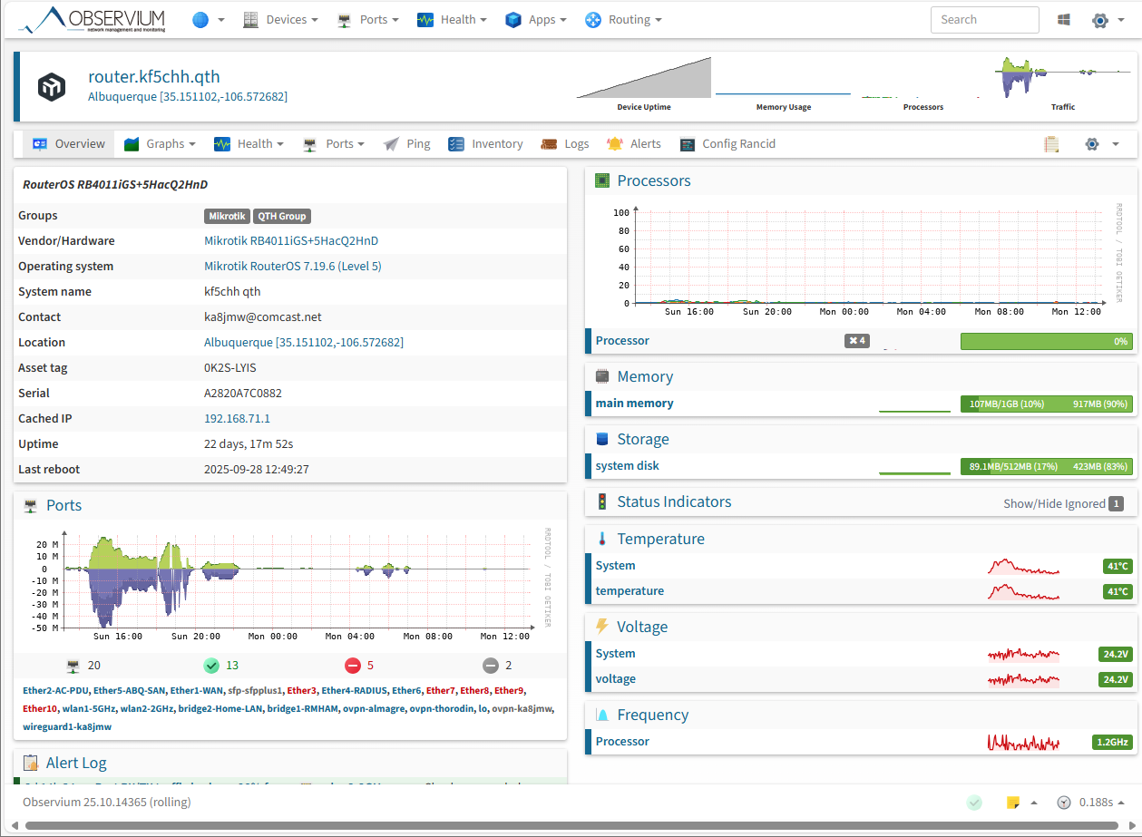
Observium (cont.)

Slide 21
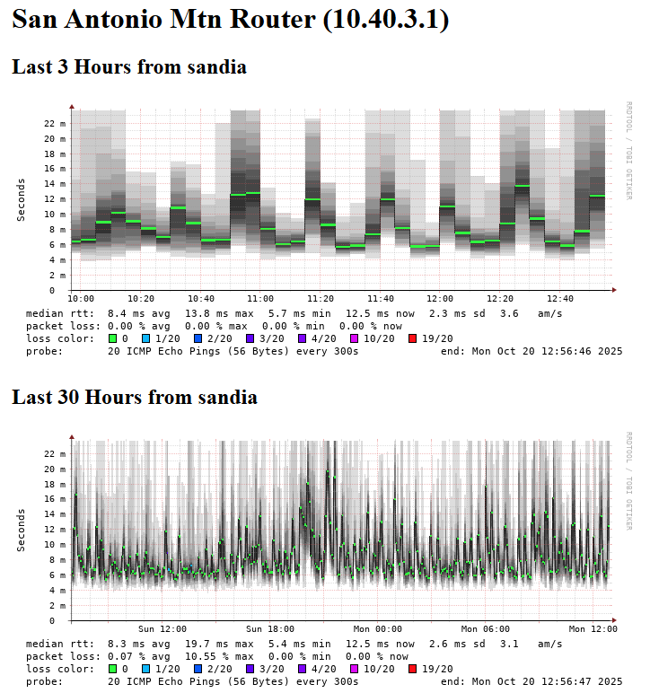
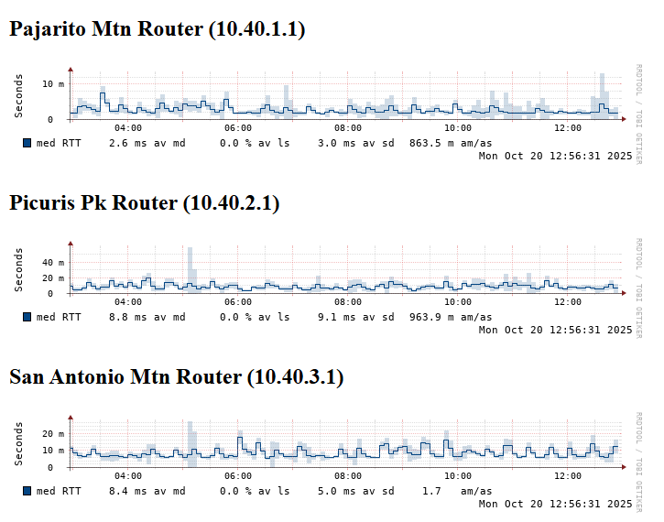
SmokePing

Slide 22
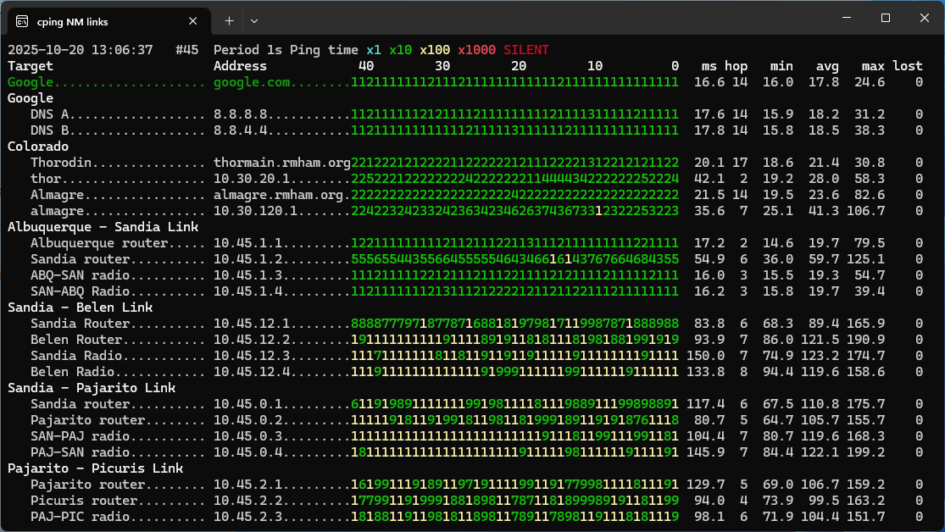
Cping (continuous ping)

Slide 23
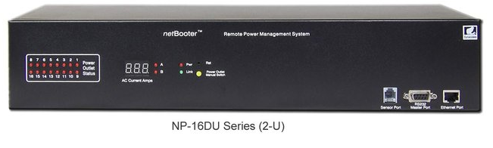
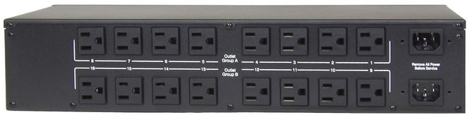
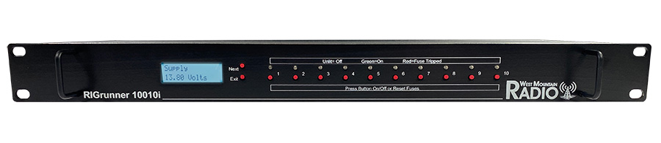
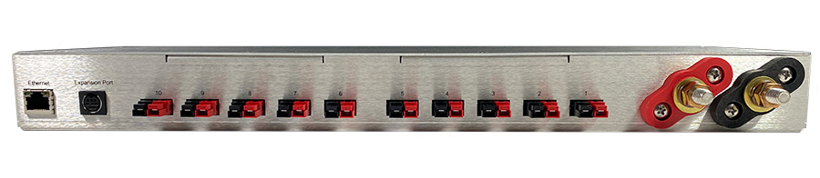
Power Monitoring & Control.
AC Power Control
Synaccess netBooter
DC Power Control
RIGRunner Sandia Crest
Auto load shedding at a Solar site
RIGRunner Picuris

Slide 24
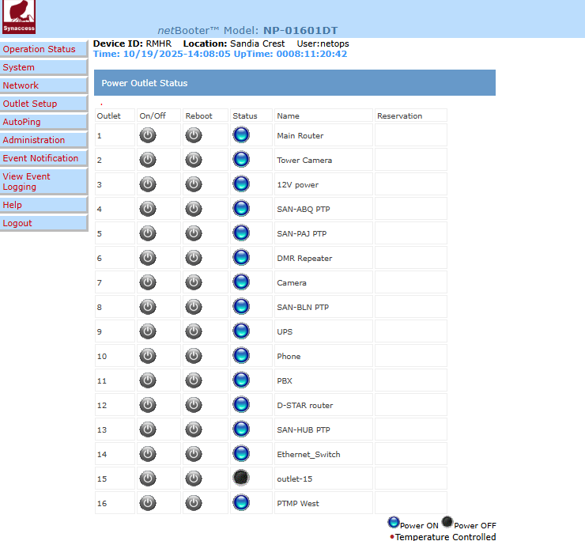
DC Power
monitoring & Control.
Synaccess netBooter
Control power to attached devices
Automatically turn off or cycle power to devices based upon their ping response
Automatically turn on/off devices dependent of temperature

Slide 25
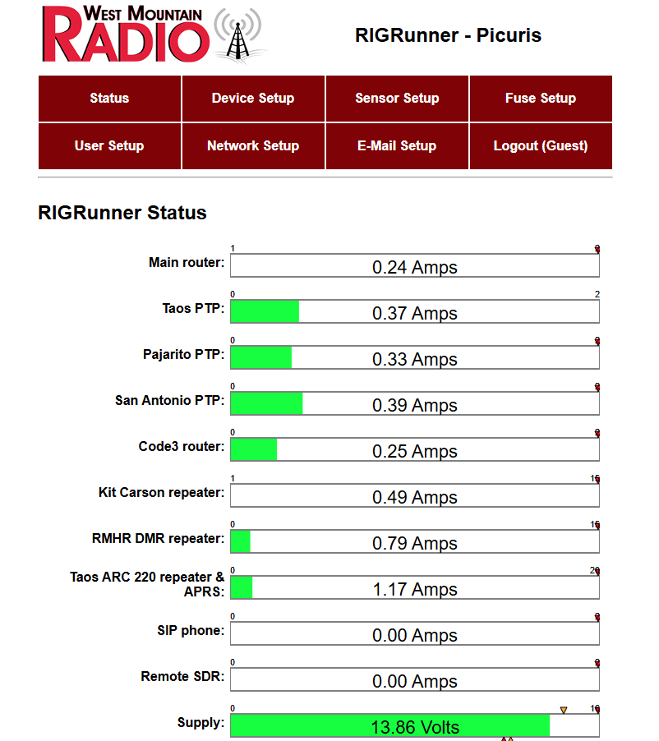
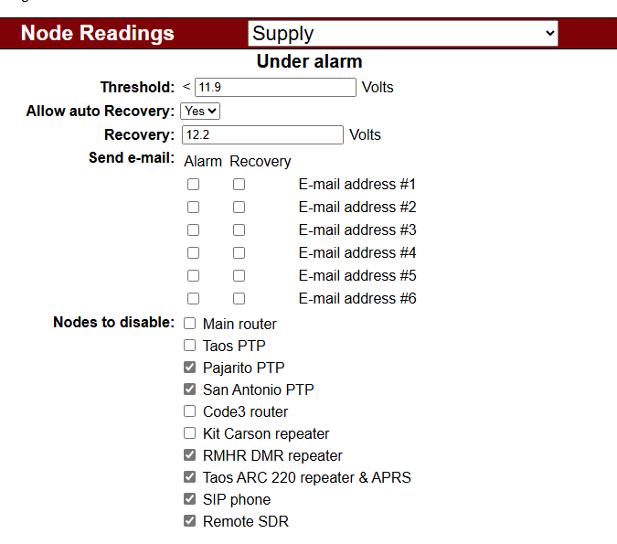
DC Power
monitoring & Control

Slide 26
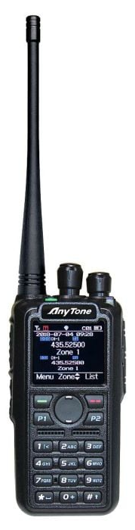


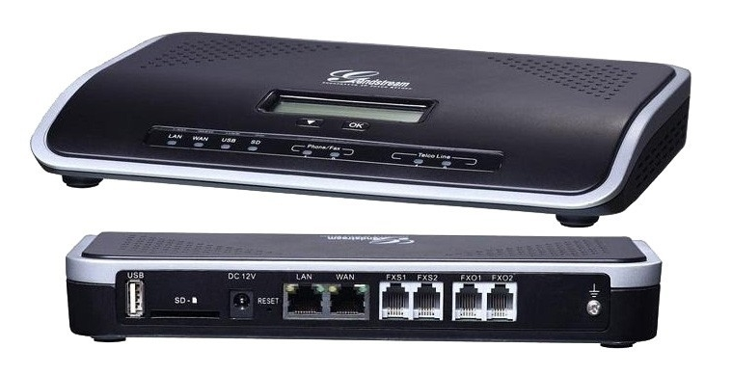

Network Infrastructure Resources.
DMR C-bridge VM
CO-RMHR
RMHAM Blueiris VM
RMHAM NM Blue Iris
NM PBX
UCM6202 | Dashboard

Slide 27
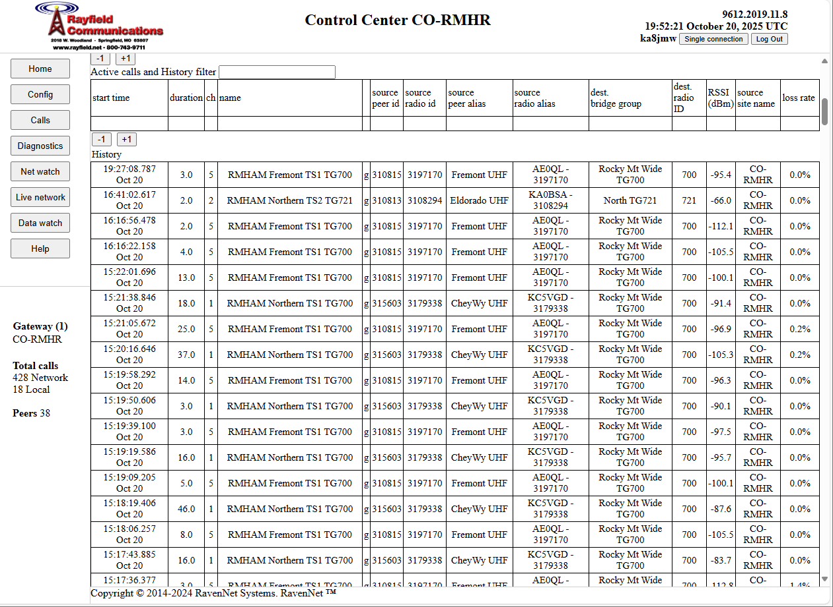
DMR c-Bridge, where talkgroups come together

Slide 28
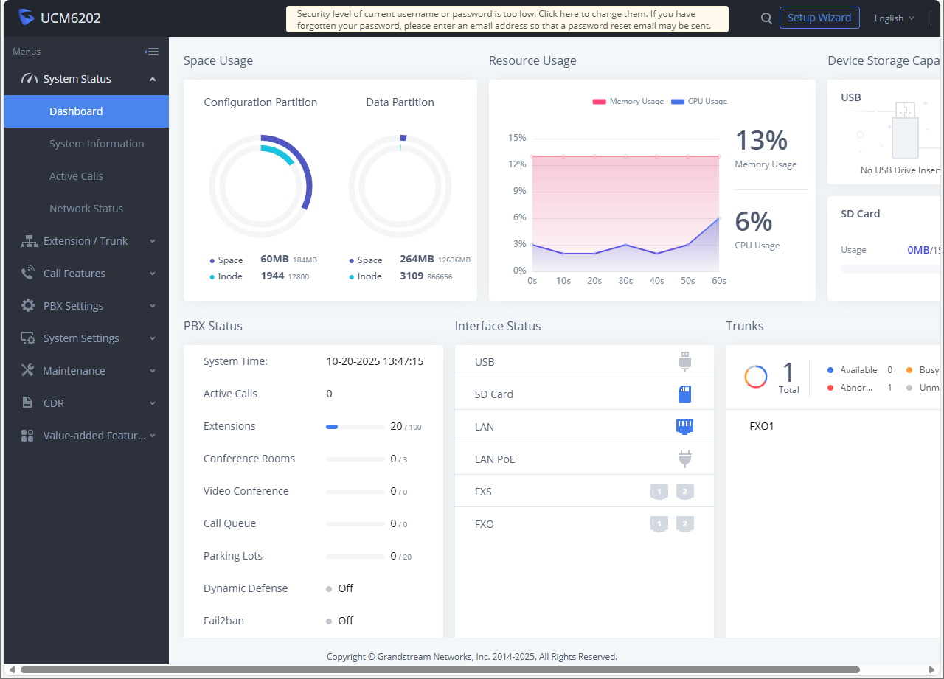
Grandstream UCM6202 SIP Phone PBX

Slide 29
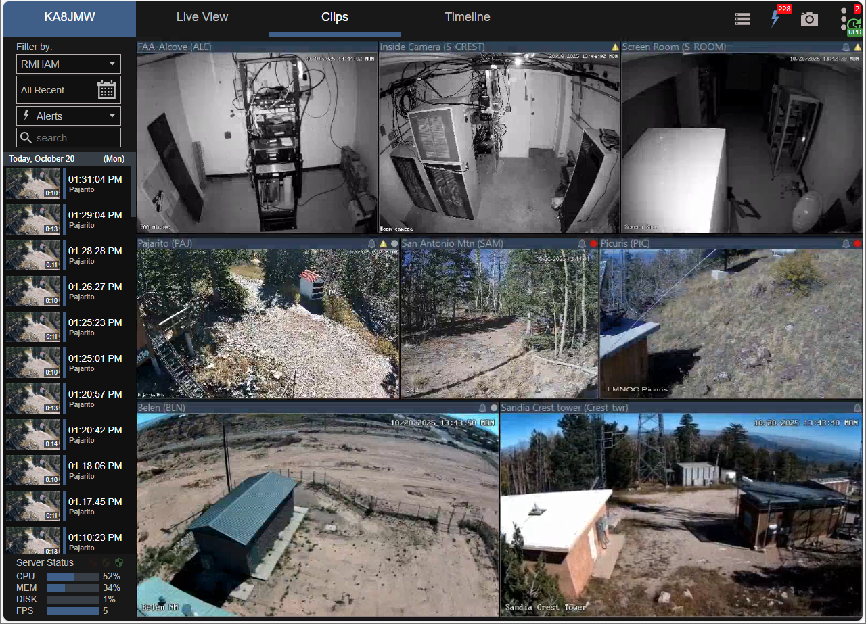
Blue Iris Webcam software.

Slide 30
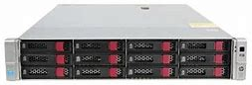

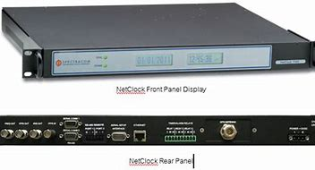
Network Infrastructure Resources (cont).
VMware server
Hosts much of out software
Blue Iris
C-Bridge
File Server
Email
…
VMware ESXi
NTP server
Spectracom NetClock/GPS 9383

Slide 31



Network Community Resources.
New Mexico Site Cameras
Rocky Mountain Ham Radio Webcams
Site Temperatures
FAA Building Alcove, Room Temperature
PAJ APRS iGate
aprs.fi – live APRS map
With more coming…

Slide 32
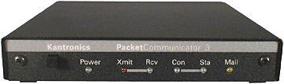
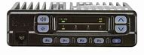

Network RMHAM User Resources.
Virtual machines that host our network applications
Linux, various flavors
Windows
Remote packet, Sandia Crest
Putty into 10.40.0.70 run minicom
Remote HF station operation
Wfview demo

Slide 33
Questions

Slide 34
Thank You
Ed James KA8JMW, ka8jmw@arrl.net
http://www.rmham.org

