Slide 1

Microcontrollers for Amateur Radio
A Practical Introduction
Dean Mertz, K0MKT eme432@gmail.com
Glenn Reker, KE0UWC ke0uwc@arrl.net

Slide 2
Who This Talk Is For
Many hams use Raspberry Pi for hotspots and digital modes.
But for hardware projects, microcontrollers are simpler:
No operating system to manage
Instant boot, instant results
Just connect and code
You can already solder. We'll show you the programming part.

Slide 3
What's the Difference?
Microcontroller
Raspberry Pi
Dedicated chip
Runs one program
Bare metal
Instant boot (milliseconds)
Complete computer
Runs Linux
Multiple programs
20-40 second boot

Slide 4
Comparison Table
Feature | Microcontroller | Raspberry Pi
Boot time | Instant | 20-40 seconds
Power draw | 20-50mA | 600-1200mA
Power loss | Instant restart | File corruption risk
Real-time control | Precise µs timing | OS interrupts
Cost | $5-$35 | $80+
Complexity | Simple, focused | Full computer

Slide 5
When to Choose Each
Raspberry Pi
Microcontroller
SDR applications
Web interfaces
Complex signal processing
Network services
Keyers, controllers, interfaces
Portable/battery operations
Precise timing needs

Slide 6
Understanding Project Requirements
Key questions to ask:
How many I/O pins? Digital/analog inputs/outputs, serial interfaces
Communication protocols? UART/Serial (CAT), I2C (displays), SPI (SD cards)
Processing power? Simple tasks work on any board, timing-critical needs vary
Power requirements? Fixed vs. battery/portable operation
Display needs? OLED, LCD, or none

Slide 7
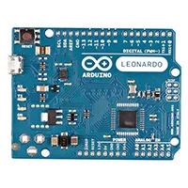

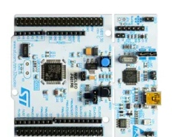
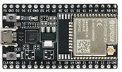
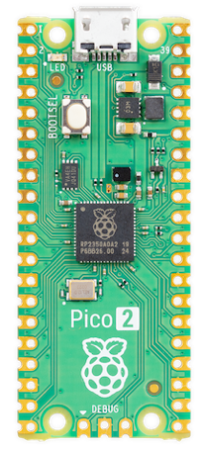
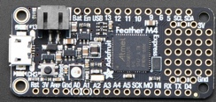
Popular Microcontroller Boards
Arduino Family (C++) - $10-$40 • Most tutorials available
Teensy (C++) - $20-$30 • Very fast, excellent audio
STM32 Nucleo (C++) - $10-$25 • Professional development
ESP32 (C++/MicroPython) - $5-$15 • Built-in WiFi/Bluetooth
CircuitPython Boards (Python) - Adafruit, Raspberry Pi Pico
Today: Using CircuitPython for ease of learning

Slide 8
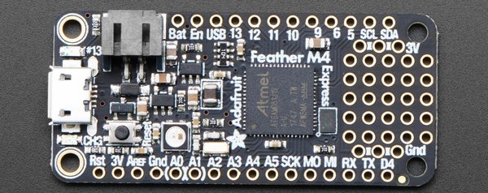
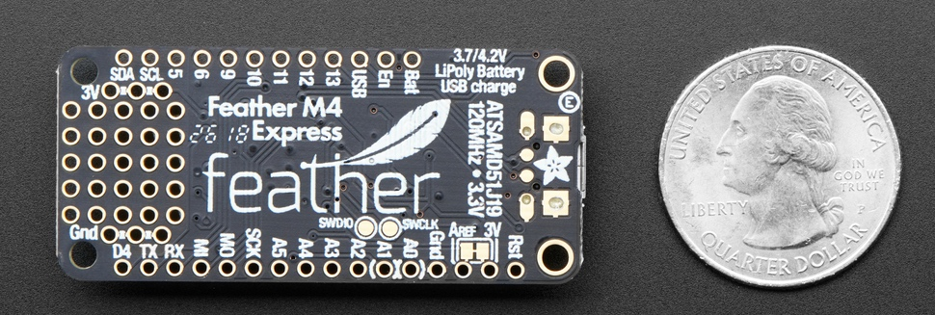
Today's Featured Board: Adafruit Feather M4 Express
Top
21 GPIO pins: Digital and Analog I/O
Built-in battery charging
Many stacking accessory boards available
Displays, Ethernet, GPS, and more
Bottom

Slide 9
Python: Easy to Start, Great Resources
Why CircuitPython for this talk:
Python syntax - if you know Python, you're ready
No compile step - edit, save, runs immediately
Interactive REPL (Read-Eval-Print Loop) - test commands live
Clear error messages (mostly)
Excellent library support
Active community - Adafruit Discord always responsive
Perfect for rapid prototyping and learning

Slide 10
Getting Started with CircuitPython
3 Easy Steps:
Edit code: Board appears as USB drive CIRCUITPY. Open code.py in text editor, save, runs in 1 second
Use the REPL (Read-Eval-Print Loop): Press Ctrl-C for Python prompt, test live, Ctrl-D to reload
Add libraries: Copy to lib/ folder, import in code
Total cost: $0 • No IDE required!

Slide 11
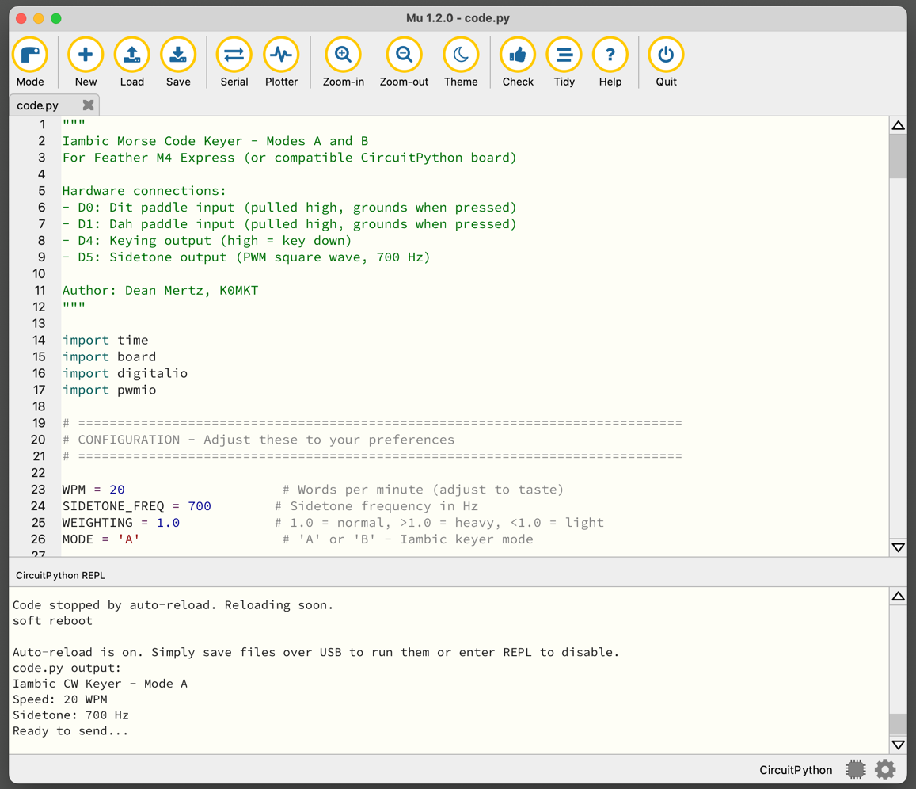
Recommended Editor: Mu
Free and simple Python editor
Works great with CircuitPython
Built-in serial console for REPL access
Uploads/downloads code.py file
Important: Does not auto-save (prevents board restarts)
Download: codewith.mu
Or use any text editor -just disable auto-save!

Slide 12
Today's Project: Morse Code Keyer
Create compact keyer for dual-paddle
Why this project?
Demonstrates timing-critical programming
Runs perfectly on Feather M4
Practical tool hams can use
Shows capability of compact boards

Slide 13
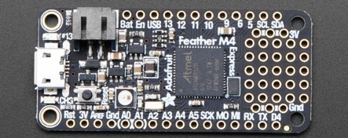
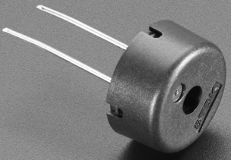
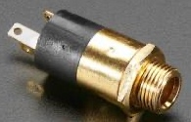
Project Hardware
Microcontroller: Feather M4 Express ($25)
120 MHz - fast enough for precise CW timing
Compact - perfect for portable use
21 GPIO pins
Additional Components: Piezo speaker, 3.5mm jack, enclosure, wire ($4-9)
Total: ~$29-34

Slide 14
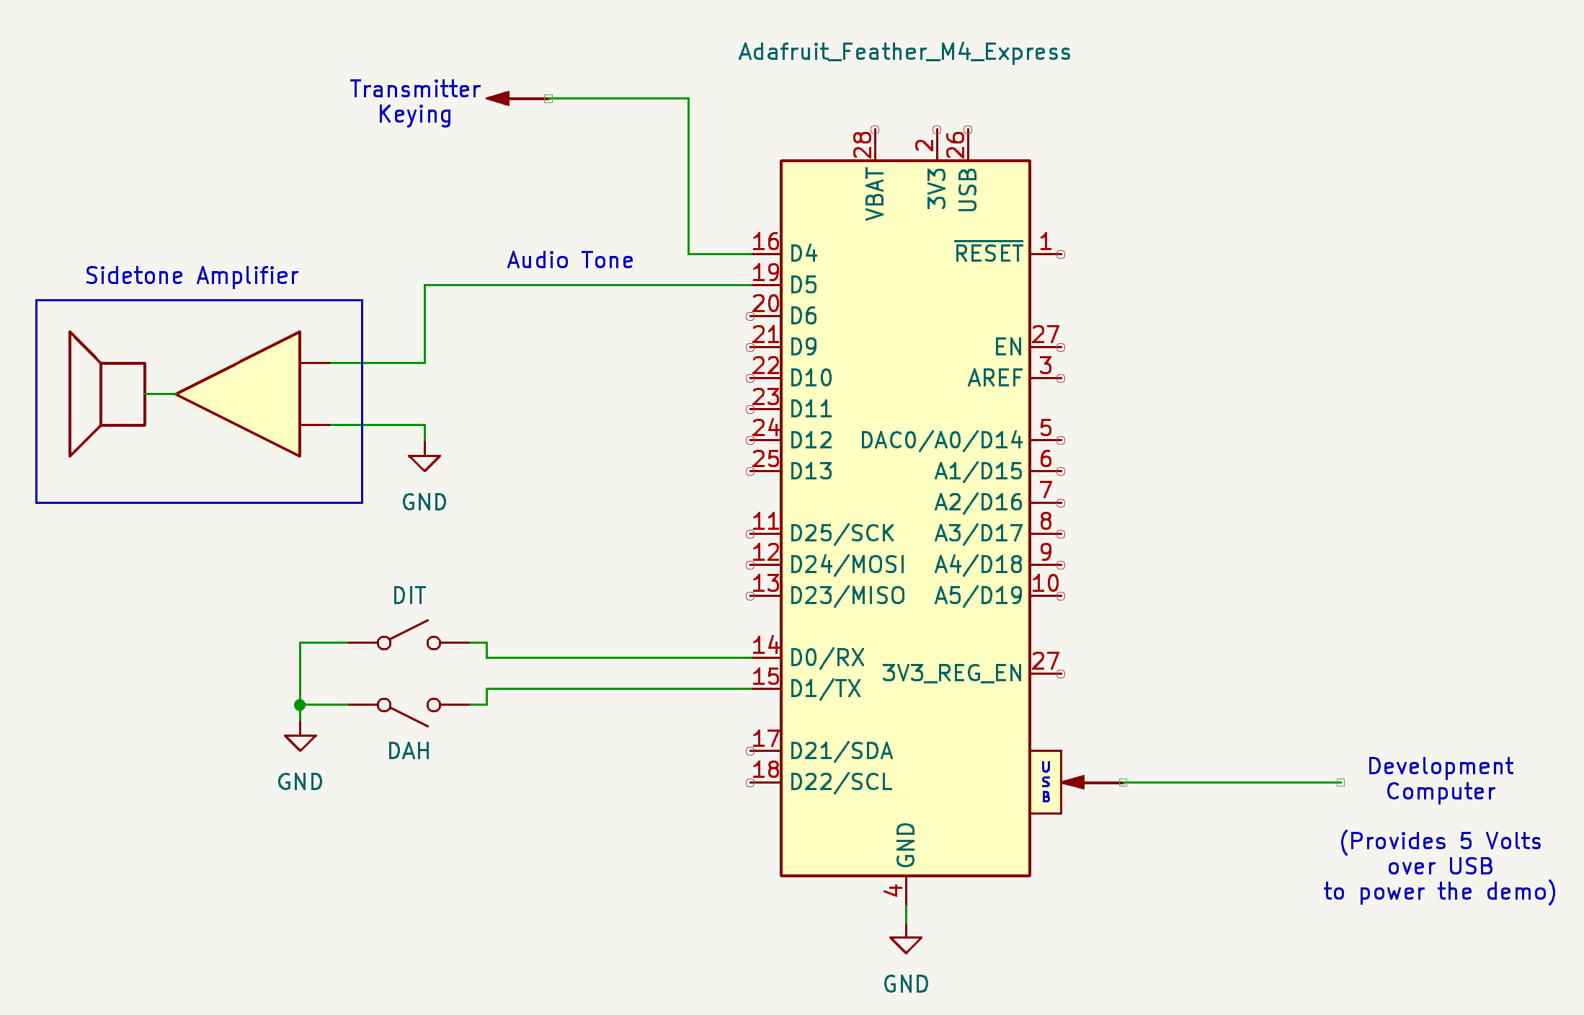
Wiring Diagram
Simple 5-wire connection!

Slide 15
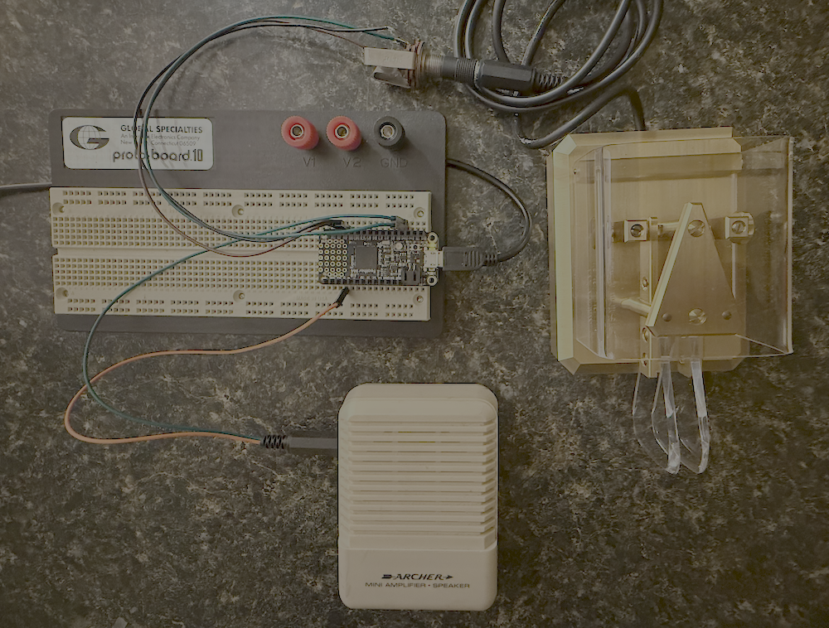
CW Keyer Breadboard

Slide 16
Step 1: Configuration
# Configuration
WPM = 20
SIDETONE_FREQ = 700
dit_time = (1.2 / WPM) # PARIS standard: 50 dit units = 1 word

Slide 17
Step 2: Initialize Hardware
# Paddle inputs
dit_paddle = digitalio.DigitalInOut(board.D0)
dit_paddle.direction = INPUT
dit_paddle.pull = Pull.UP
dah_paddle = digitalio.DigitalInOut(board.D1)
dah_paddle.direction = INPUT
dah_paddle.pull = Pull.UP
# Keying output
key_out = digitalio.DigitalInOut(board.D4)
key_out.direction = OUTPUT

Slide 18
Step 3: Key Control Functions
def key_down():
global sidetone
key_out.value = True
sidetone = pwmio.PWMOut(board.D5,
frequency=700, duty_cycle=32768)
def key_up():
global sidetone
key_out.value = False
if sidetone:
sidetone.deinit()
sidetone = None

Slide 19
Step 4: Element Timing Functions
def send_dit():
key_down()
time.sleep(dit_time)
key_up()
time.sleep(dit_time)
def send_dah():
key_down()
time.sleep(dit_time * 3)
key_up()
time.sleep(dit_time)

Slide 20
Step 5: Main Loop
def iambic_keyer_mode_a():
last_element = None
while True:
dit_pressed = not dit_paddle.value
dah_pressed = not dah_paddle.value
if dit_pressed and dah_pressed:
if last_element == 'dit':
send_dah()
else:
send_dit()

Slide 21
Step 5: Main Loop (continued)
elif dit_pressed:
send_dit()
last_element = 'dit'
elif dah_pressed:
send_dah()
last_element = 'dah'
else:
last_element = None
iambic_keyer_mode_a() # Start!

Slide 22
Project Enhancements
Easy additions:
Potentiometer for speed adjustment
Button to switch modes A/B
Store settings in memory
Advanced:
USB/CAT control for logging
Weight adjustment
Multiple speed memories

Slide 23
Troubleshooting: Board Issues
Won't enter bootloader?
Try double-click rhythm
Try different USB cable
Check connection
Drive corruption?
ALWAYS eject before unplugging
Never unplug while LED blinking
Backup files regularly

Slide 24
Troubleshooting: Serial Console
Don't see the serial console?
Put board in Safe Mode:
Click reset button
Wait for LED to flash yellow
Press reset again
Note: Drive corruption usually shows as CIRCUITPY folder being read-only

Slide 25
Pro Tips
Test in REPL first - Interactive is faster
Keep backups - Of working code
Properly eject drives - Prevent corruption
Read error messages - They’re (mostly) helpful!
Protect from static discharge - Touch grounded metal first
Watch logic voltage – Some boards can tolerate 5-Volt logic, but not all
When stuck:
Adafruit Discord: #help-with-circuitpython
Post: board type, version, error, code

Slide 26
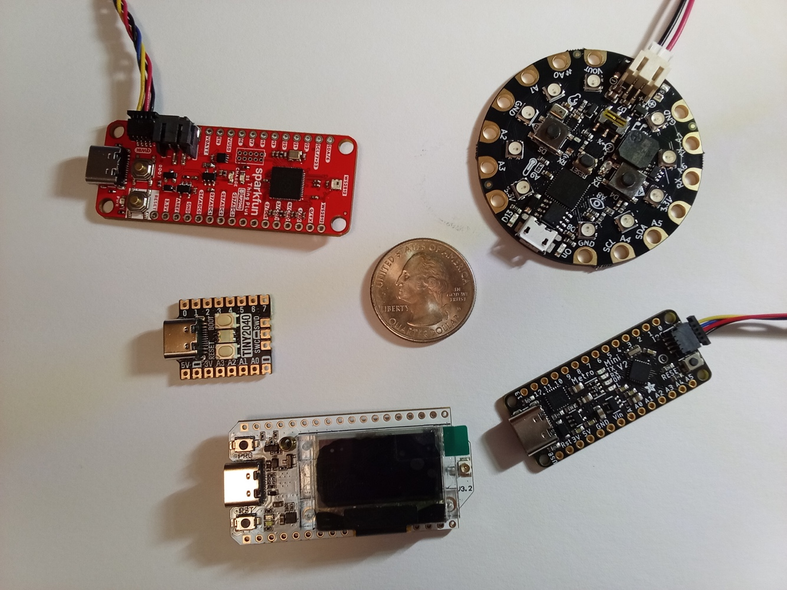
Getting Started: Your Path
Sparkfun Things_ 2040
Adafruit Circuit Playground Express
1. First board:
Circuit Playground Express, Trinket M0, or Feather M4
2. First projects:
Blink LED
Read a button
This CW keyer
Add OLED display
Pimoroni Tiny 2040
Heltec L0Ra V3
Adafruit MetroMiini

Slide 27
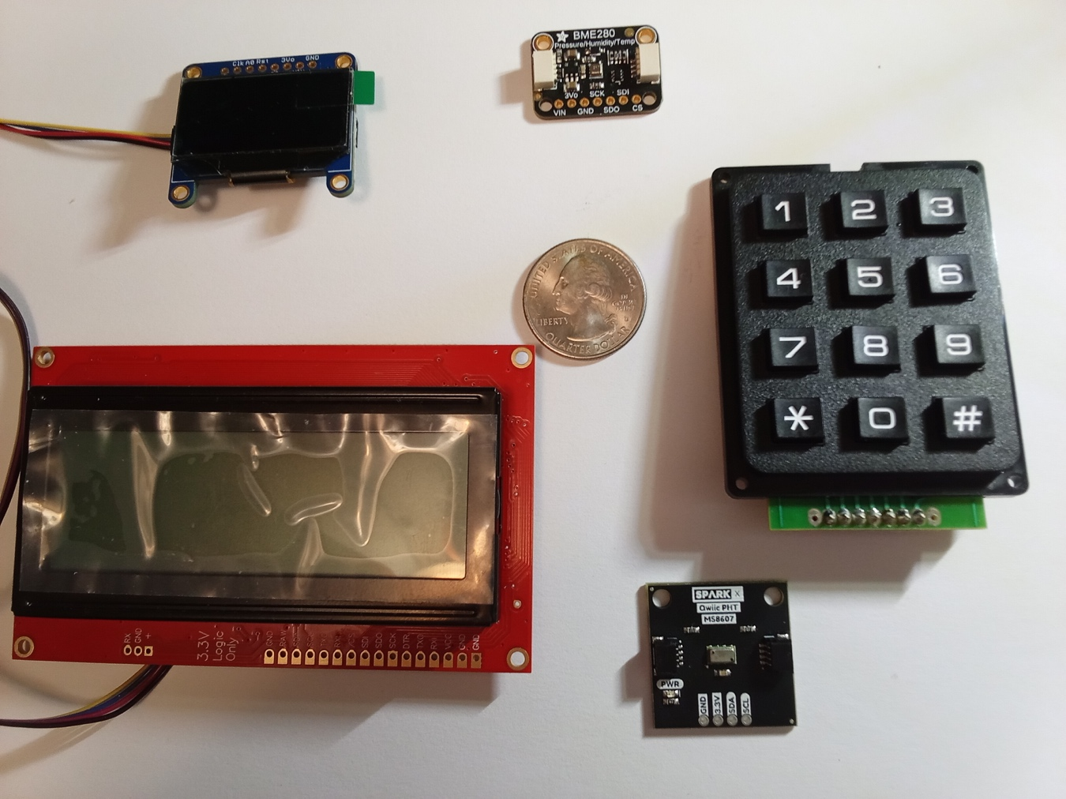
Getting Started: Your Path
OLED Display
Temperature, pressure, humidity Sensor
Temperature, pressure, humidity Sensor
LCD text-only Display

