Slide 1

Operating multiple HF stations in close proximity such as Field Day
Doug Sharp, K2AD

Slide 2


Do you ever wonder …
Why can I not hear those weak stations?
Will the annoying ”CW Guy” ever take a break so I can work people on SSB? (You just can’t trust those CW operators.)
Maybe they will switch to another band?
Why do I have a headache after operating?
We are losing QSOs!

Slide 3

A Balance of three major items
Radio Performance
Filtering
Separation

Slide 4
How do I operate multiple HF radios in close proximity?
Let’s talk about
Receiver Overload
Transmitter Noise
Bandpass Filters
Multi-Band Combiners (diplexers and triplexers)
Non hardware solutions

Slide 5
HF Radio Performance
Receiver Performance
Rob Sherwood’s measurements are a must!
http://www.sherweng.com/table.html
Transmitter Performance
A clean transmitter is critical
Power
Does it have a clean power source or AC Power Supply?
Environmentals
Does the radio become “dirty” when warm?
Find his Hamcon Colo DX University talk online
You can not filter on-frequency noise with your RX filters

Slide 6

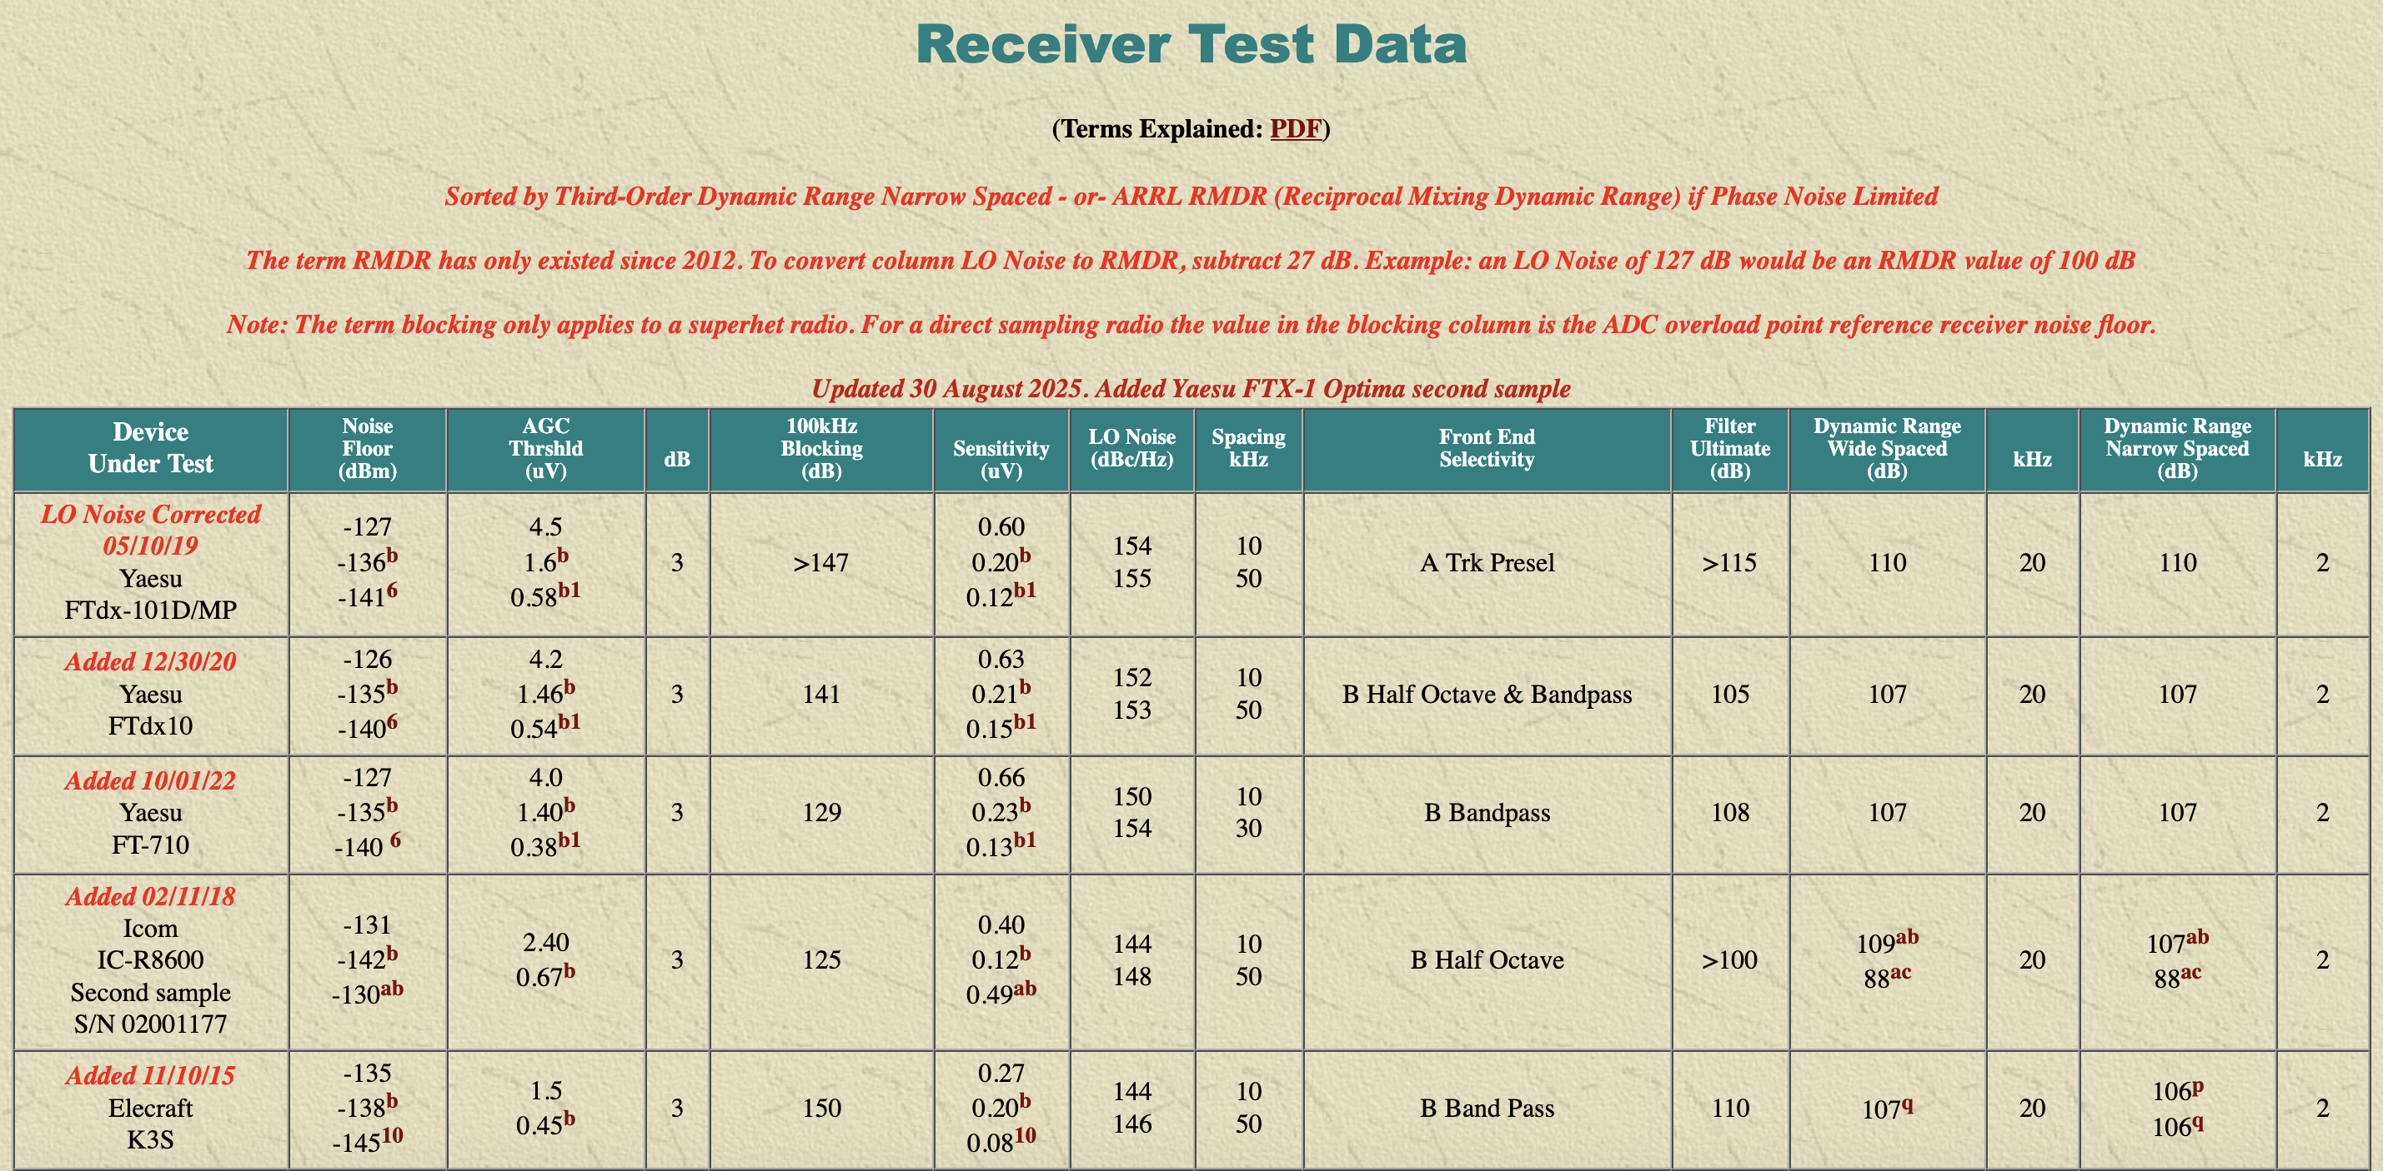
From Rob Sherwood’s (NC0B) web site – The Top 30 http://www.sherweng.com/table.html Page 1 of 4
Position
#1
#2
#3
#4
#5

Slide 7
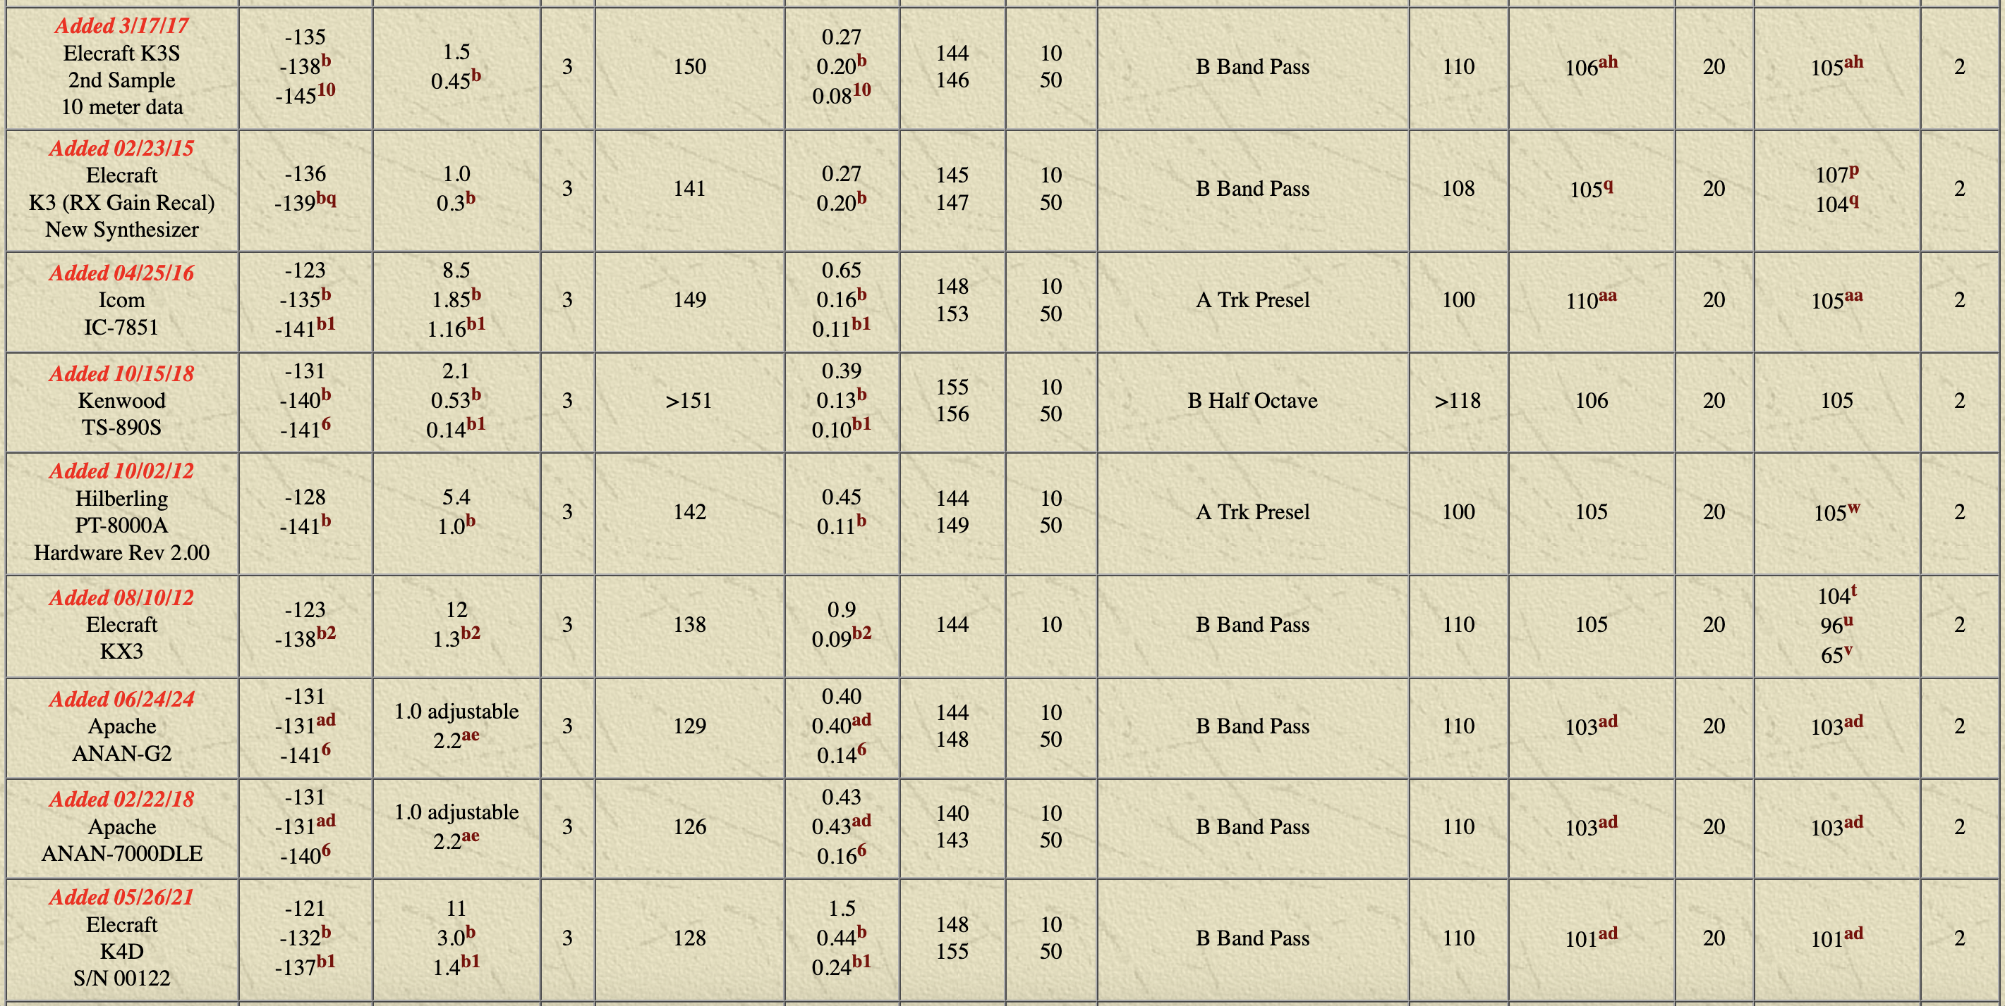
Cut and Paste from Rob Sherwood’s web site http://www.sherweng.com/table.html Page 2 of 4
Position
#6
#7
#8
#9
#10
#11
#12
#13
#14

Slide 8
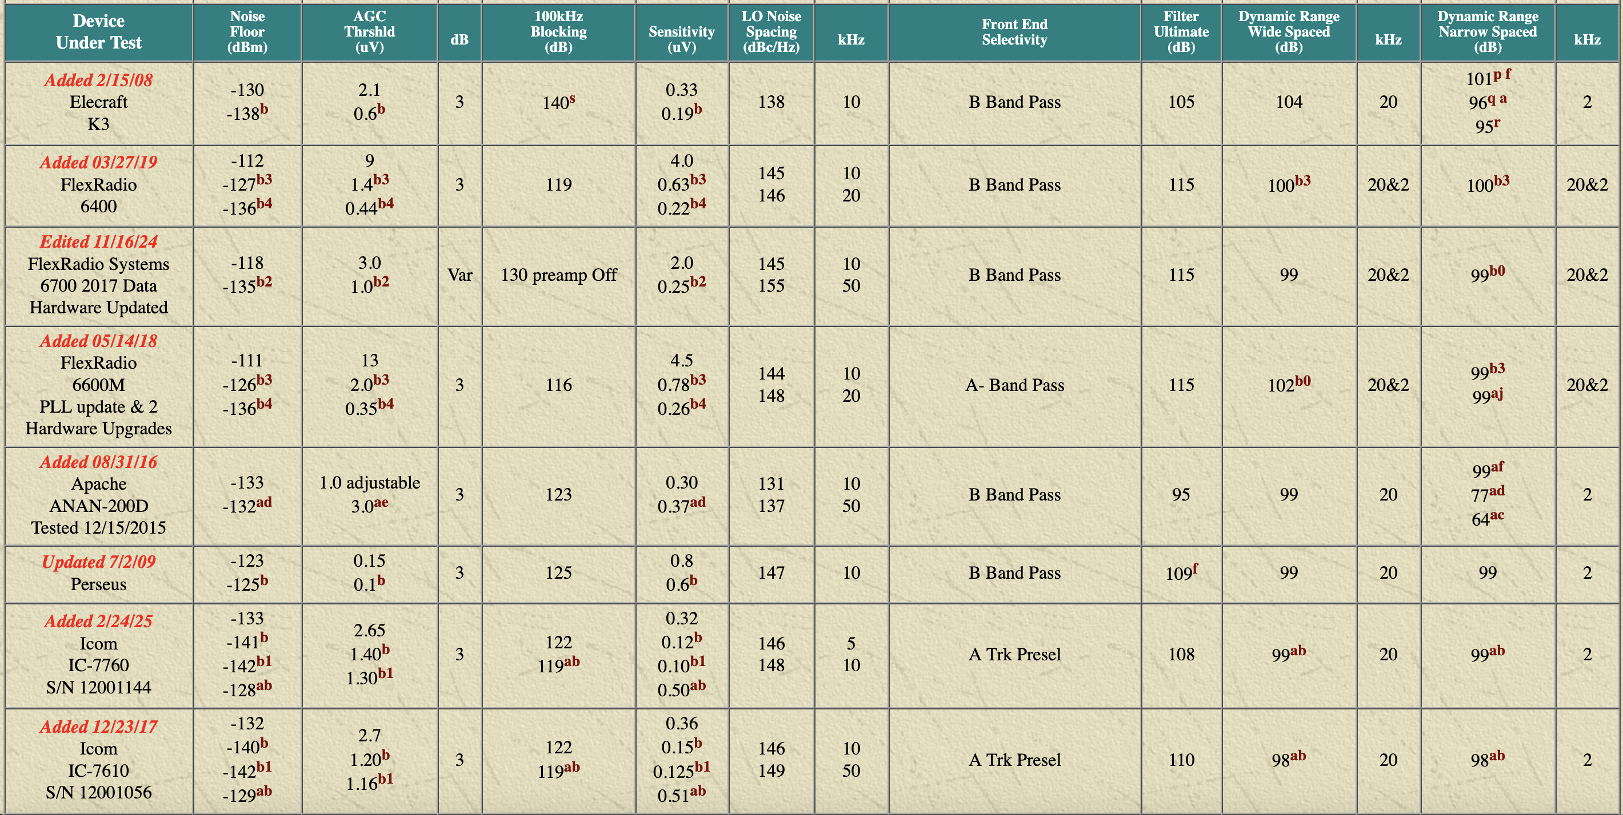
Cut and Paste from Rob Sherwood’s web site http://www.sherweng.com/table.html Page 3 of 4
#15
#16
#17
#18
#19
#20
#21
#22

Slide 9
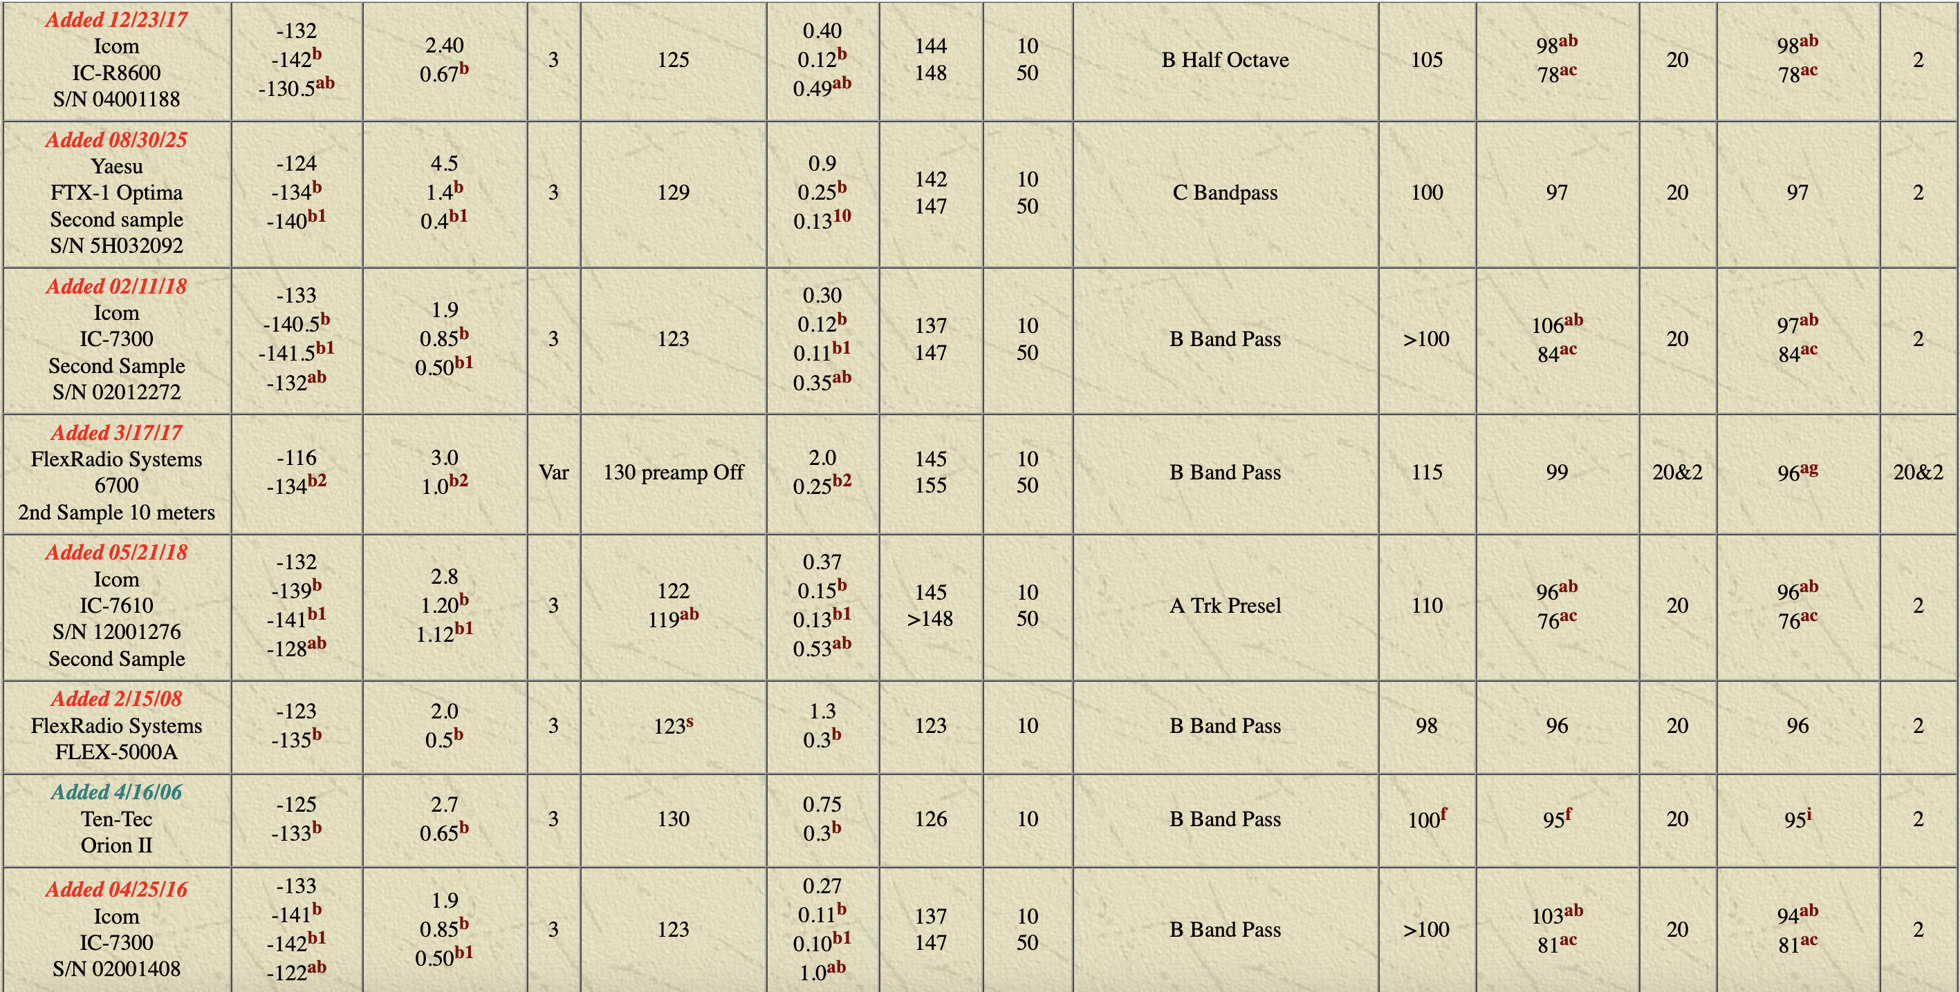
Cut and Paste from Rob Sherwood’s web site http://www.sherweng.com/table.html Page 4 of 4
#23
#24
#25
#26
#27
#28
#29
#30

Slide 10
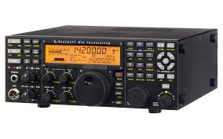
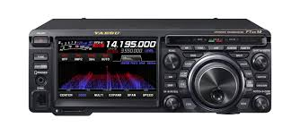
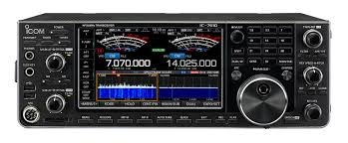
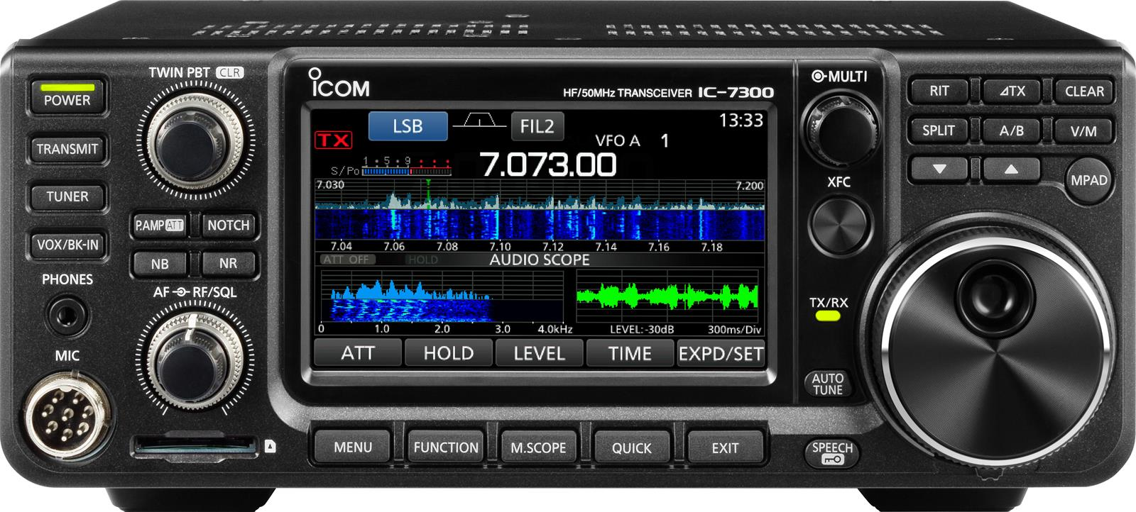
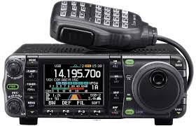
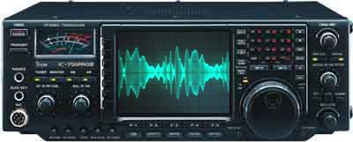
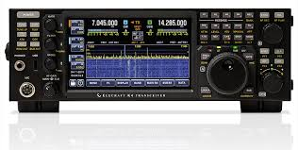
HF Radios used by RMHAM at Field Day (This is not an endorsement. Just a list of radios used by RMHAM at Field Day.)
Yaesu FT-DX10 (not listed)
Elecraft K3S (#5)
Icom IC-7300 (#30)
Icom IC-7610 (#27)
IC-7000 (not listed)
Icom IC-756PROiii (#71)
Elecraft K4D (#14)
Good
Better
Best

Slide 11
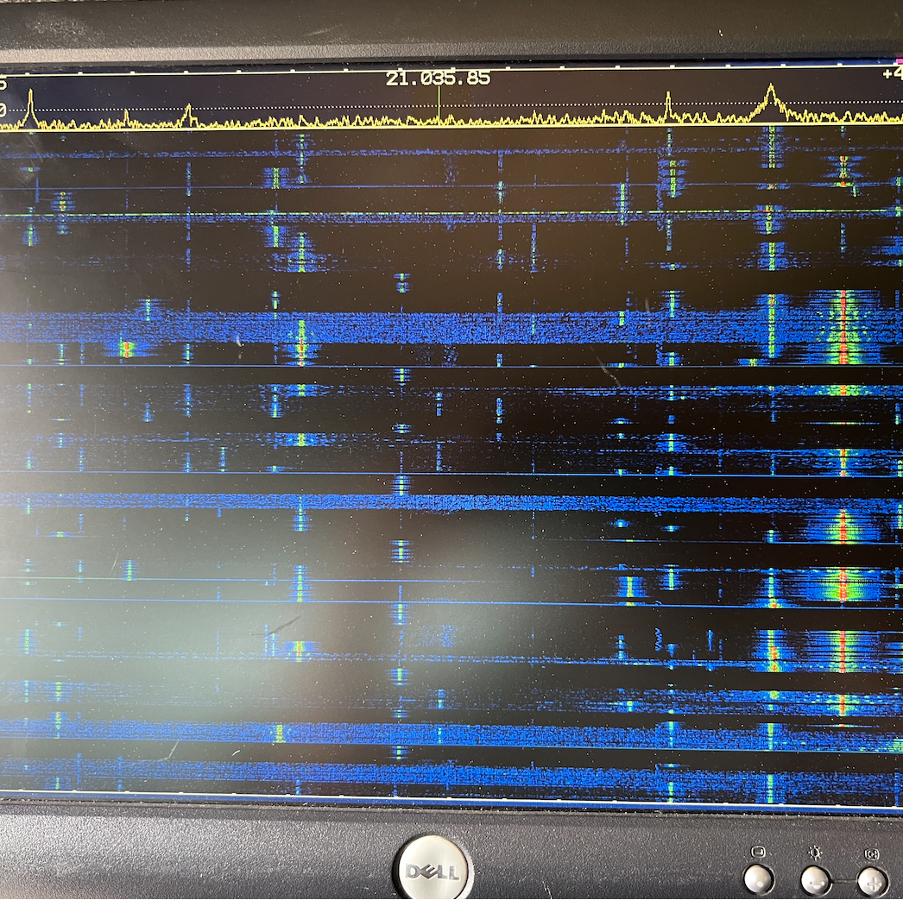
Dirty Pictures - Icom IC-7000 and IC-7300
Not all transmitters and receivers are alike
The high-end Yaesu and Elecraft radios have the cleanest transmitters and best receivers (see Rob Sherwood’s performance tests)
Icom IC-7000 and IC-7300 are fine radios … for HOME USE
The IC-7000 transmitter gets “dirty” when warm or hot
The IC-7300 receiver easily overloads when operating in close proximity to other HF radios (I own one! It is a nice home station radio … but not multi-TX at Field Day)
These radios are excellent radios for those operating from home (and do not have another ham living next door.)
Field Day 2024 – Elecraft K3 Pan Adapter on CW when IC-7000 operating on FT8

Slide 12
Filters
In-Band filtering
Adjacent Band FIltering

Slide 13
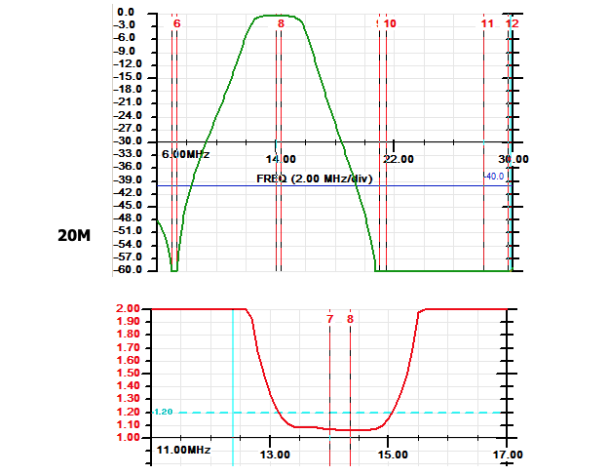
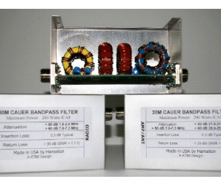
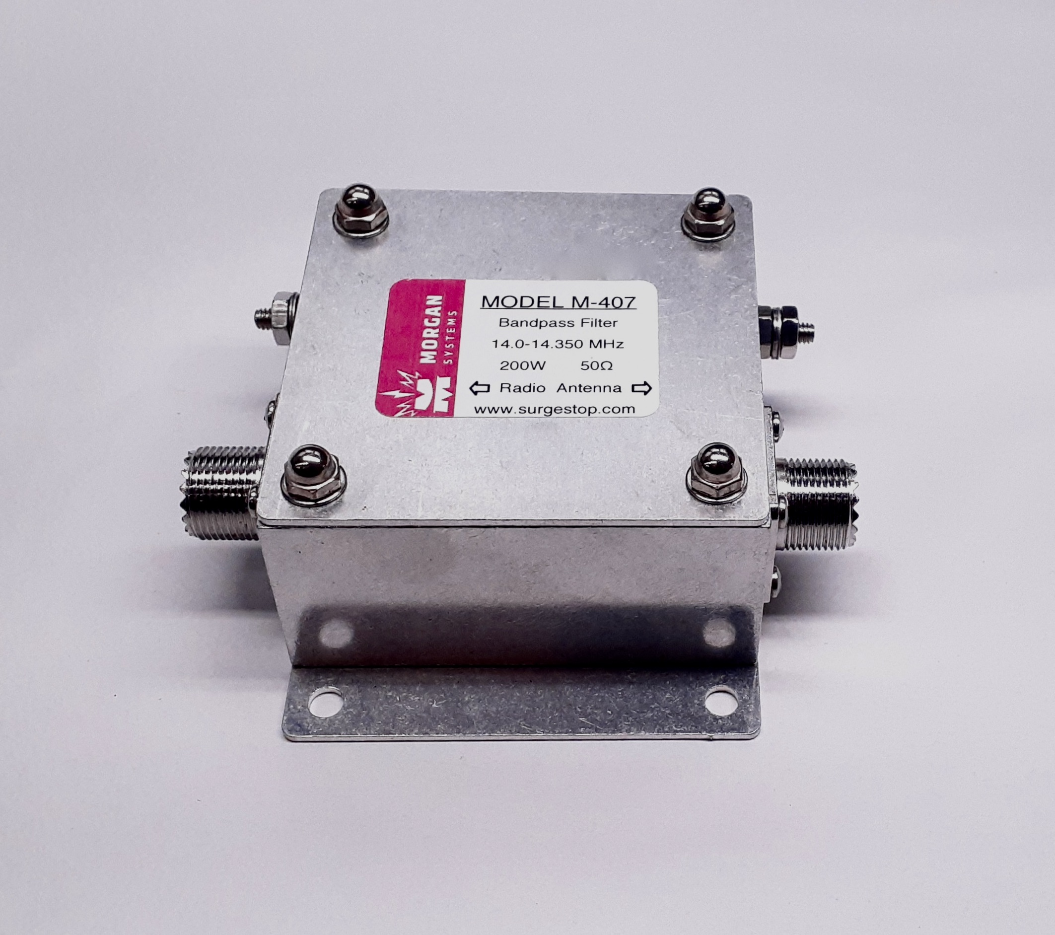
Will Filters help?
Interference BETWEEN bands
Yes, adding a bandpass filter will help!
Example: Bandpass filter on 40 meters (7 MHz) and 20 meters (14 MHz)
Bandpass filters are effective at reducing or eliminating interference between different bands
7 MHz
14 MHz
21 MHz
Hamation EF Series ~ $120 each
Hamation EF / CF
Morgan Systems

Slide 14
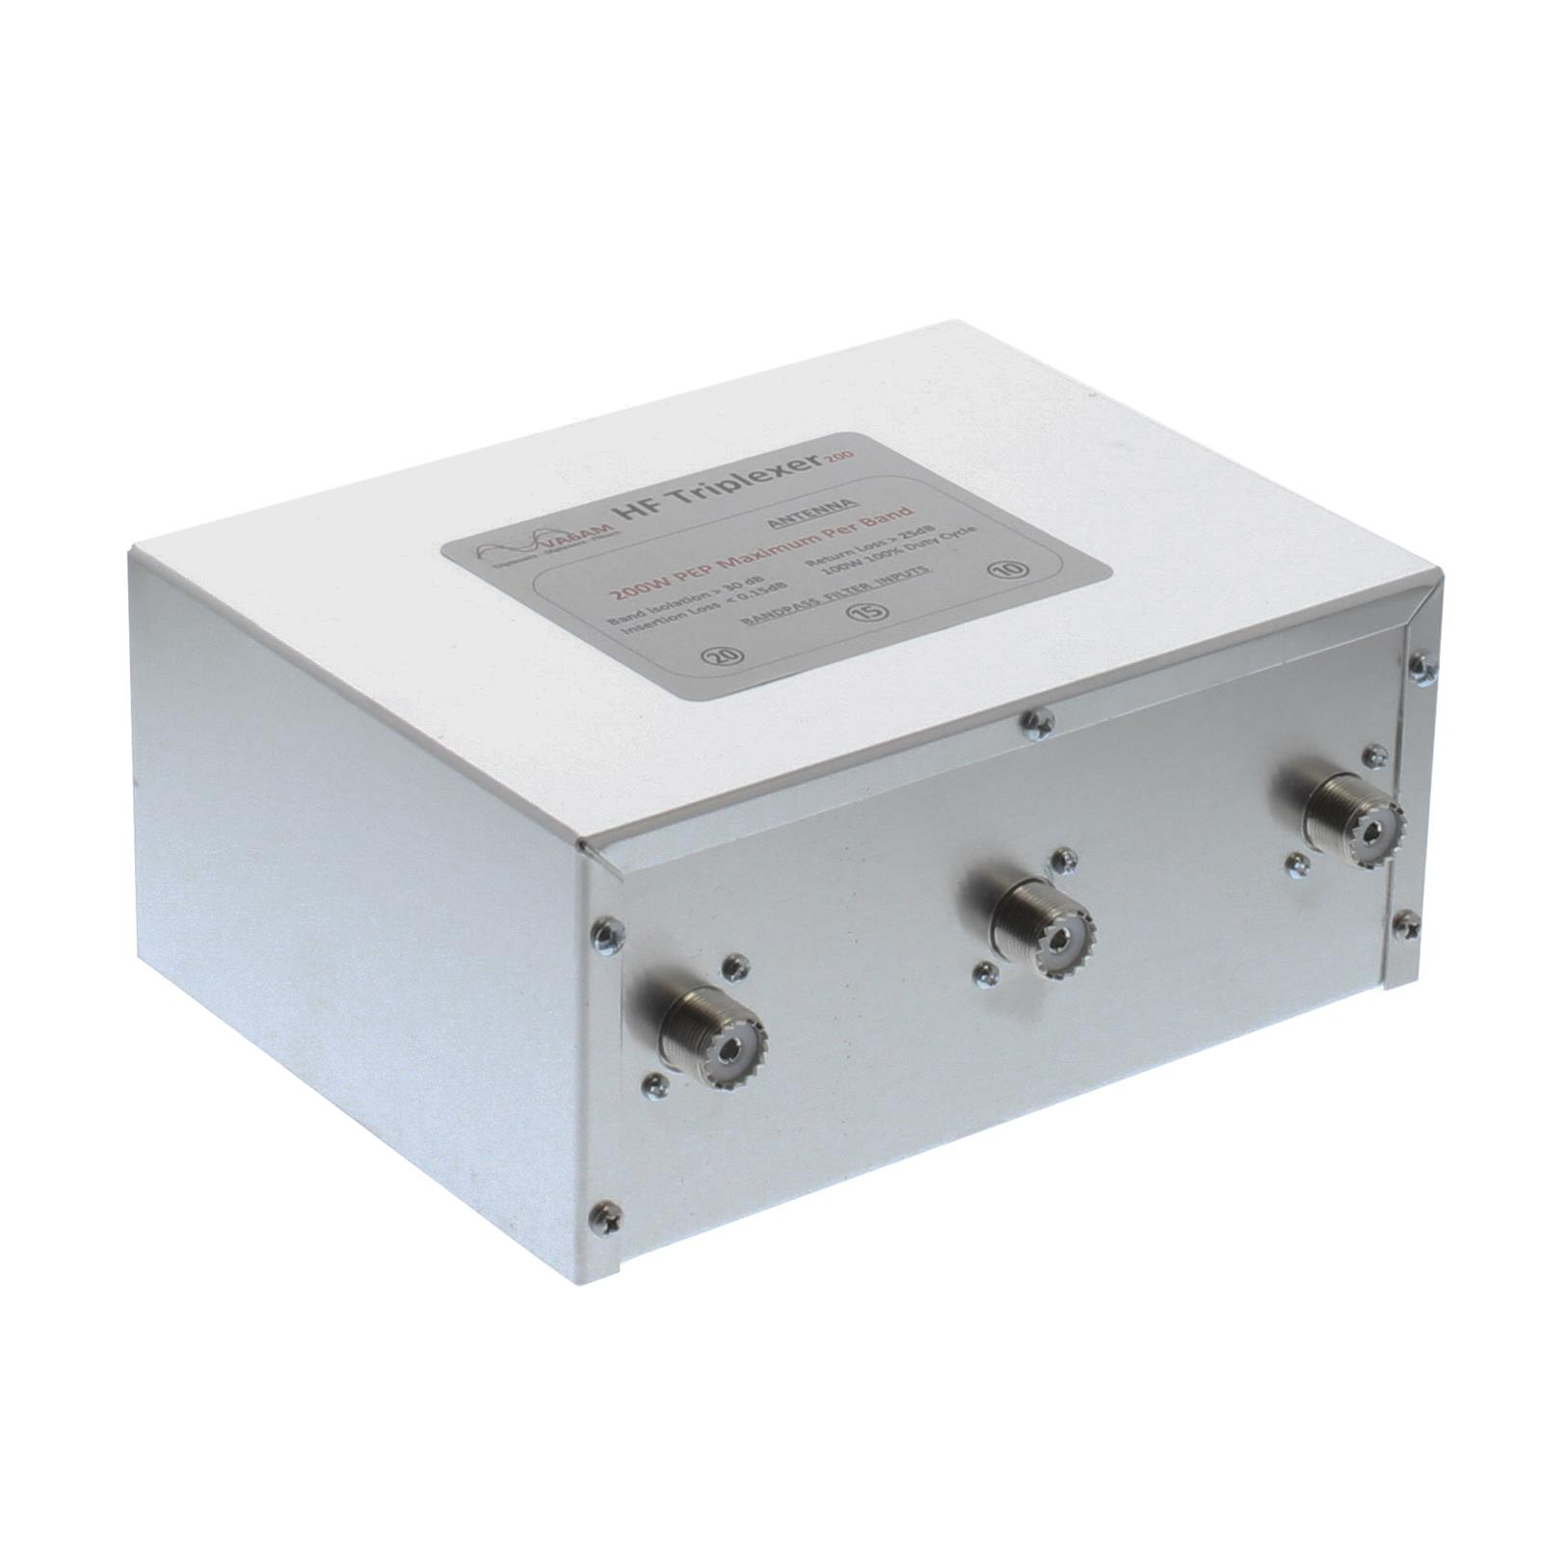
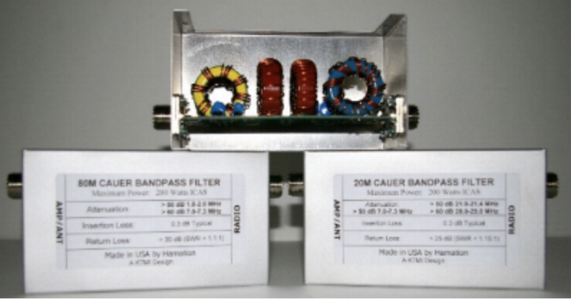
HF Radio Performance
Diplexer and Triplexer
Can be homebrew built but requires some additional knowledge
Commercial models available
Allows multiple HF Radios to share one antenna
One radio per band
Requires additional bandpass filters per band
Field Day 2025 RMHAM used
Two Elecraft K4D radios
VA6AM Triplexer (20/15/10)
VA6AM Diplexer (80/40)
Hamation Bandpass Filters
Cushcraft A3S tri-band yagi + 40meter kit
We are using these filters in the W1AW/0 station
Come check them out!

Slide 15
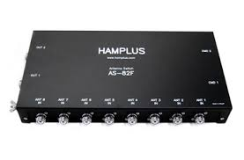
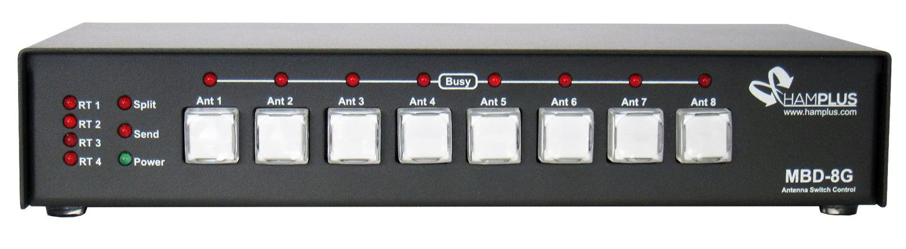
HF Radio Performance
Evolution of the solution
Is there a way to easier switch between bands?
I need to switch two radios between up to eight antennas
Yes, the Hamplus AS-82F with MBD8G controllers
We are using this switch in the W1AW/0 station
Come check it out!

Slide 16
Back of the napkin separation suggestions
Good Radios
Greater than 1000 ft separation
Better Radios
About 500 to 700 feet separation
Best Radios
About 300 feet separation

Slide 17
Use Cases
RMHAM Field Day 2024
RMHAM Field Day 2025
Mount Greylock Expeditionary Force W2SZ/1 VHF Contest (50 MHz)

Slide 18
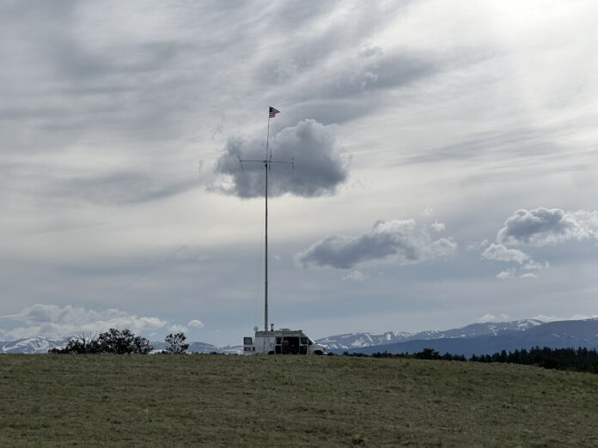
RMHAM uses the Cushcraft A3S Tri-Band Yagi with 40 meter add-on kit
Why this antenna?
Surplus or donated antennas
40 meter kit adds a rotatable dipole
Minimal Front to Back Ratio allows contacts “off the back of the beam”
Easy to assemble
Great for Field Day

Slide 19
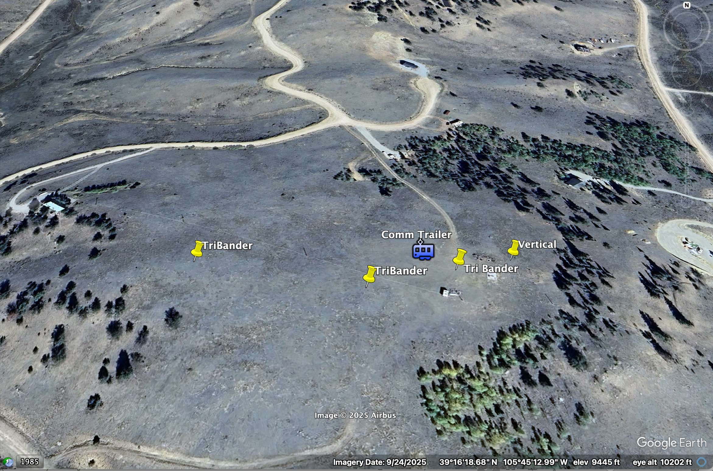
RMHAM Field Day 2024 – 3 Transmitters + GOTA
Site Layout
Varied physical separation
Directional antennas aimed at each other
Vertical antennas (omni) too close to other antennas
Used lesser grade TX and RX radios
Result
It worked, but lots of interference
CW
SSB
FT8
~ 500 feet
WEST
EAST

Slide 20
RMHAM Field Day 2024 – 3 Transmitters + GOTA
Site Layout
Varied physical separation
Directional antennas aimed at each other
Vertical antennas (omni) too close to other antennas
Used lesser grade TX and RX radios
Result
It worked, but lots of interference
CW
SSB
X
FT8
X
~ 500 feet
WEST
EAST

Slide 21
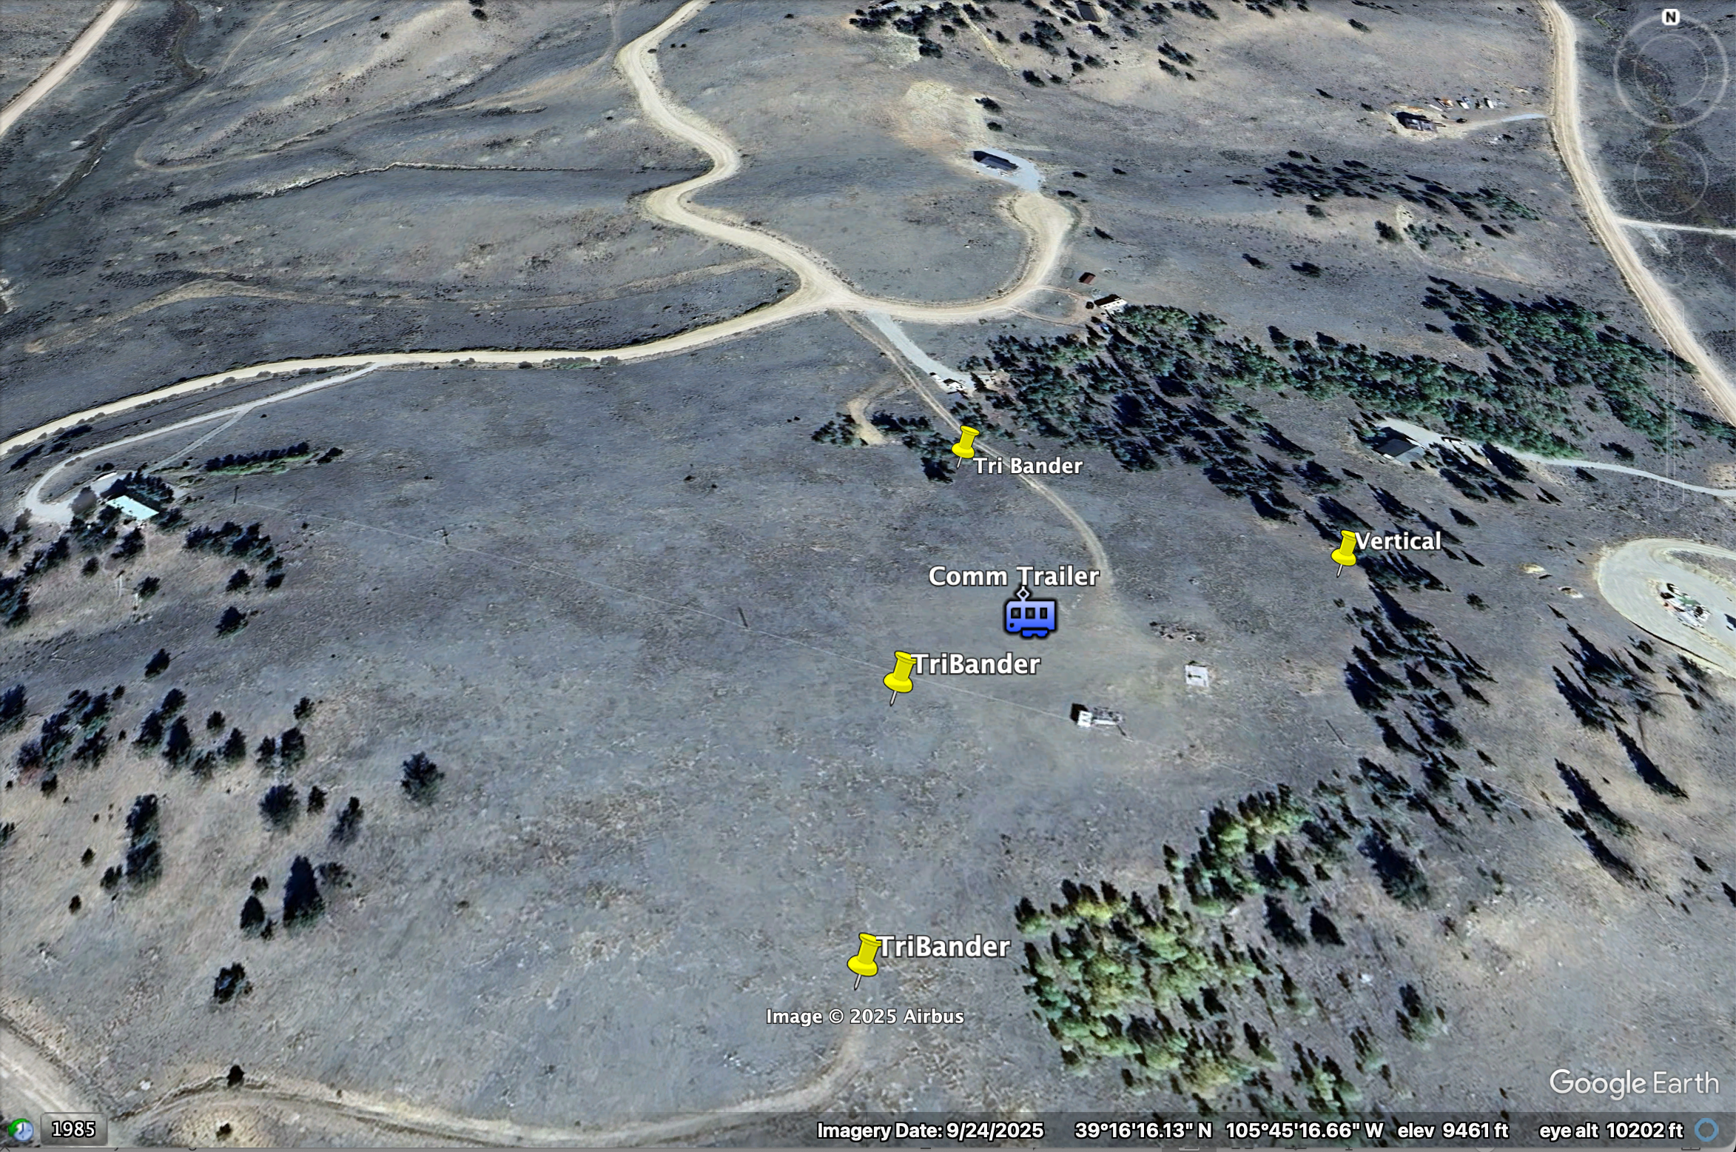
RMHAM Field Day 2025 - 4 Transmitters + GOTA
Site Layout
Increased physical separation
Directional antennas NOT aimed at each other
Vertical antennas have physical separation
Only used “high end” radios
Added Quad Plexer
Multiple radios combined into a single antenna
Result
Nearly interference free
~ 600 feet
~ 500 feet
WEST
EAST

Slide 22
RMHAM Field Day 2025 - 4 Transmitters + GOTA
Site Layout
Increased physical separation
Directional antennas NOT aimed at each other
Vertical antennas have physical separation
Only used “high end” radios
Added Quad Plexer
Multiple radios combined into a single antenna
Result
Nearly interference free
~ 600 feet
~ 500 feet
WEST
EAST

Slide 23
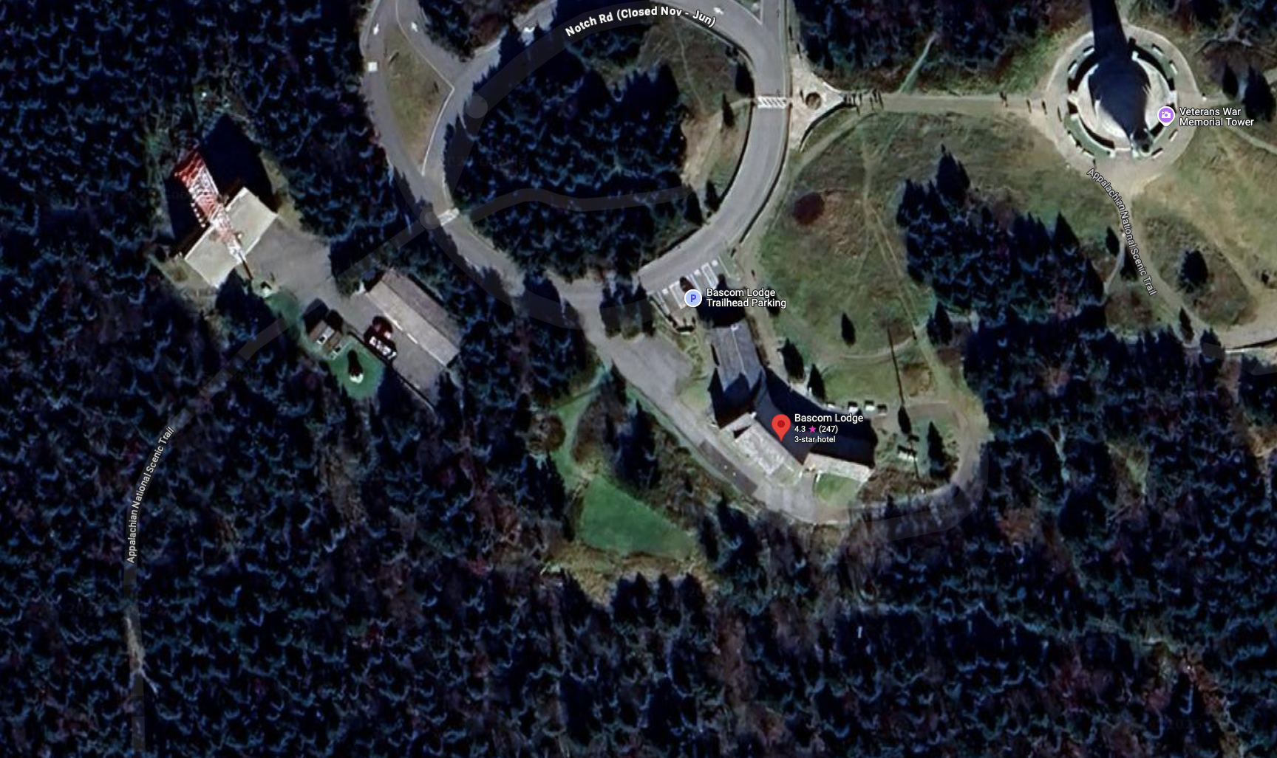
The six meter station at W2SZ/1 – Mt Greylock, MA. (grid FN32)
WHY ???
The Main Station (SSB/CW/FT8) uses a Elecraft K4D with 6/6 yagi stack
The remote station (FT8) uses a pair of Electraft K3S radios with a pair of 3/3 yagi stacks (with K3/0 remote heads at the main station)
We can call CQ on SSB/CW (main station) while listening on FT8 (remote station)
3/3 Stack
Remote Station x2
3/3 Stack
850 feet with 60GC IP link
Local Station
Primary
6 / 6 ele

Slide 24
Questions?
TNX de Doug Sharp, K2AD

