Slide 1

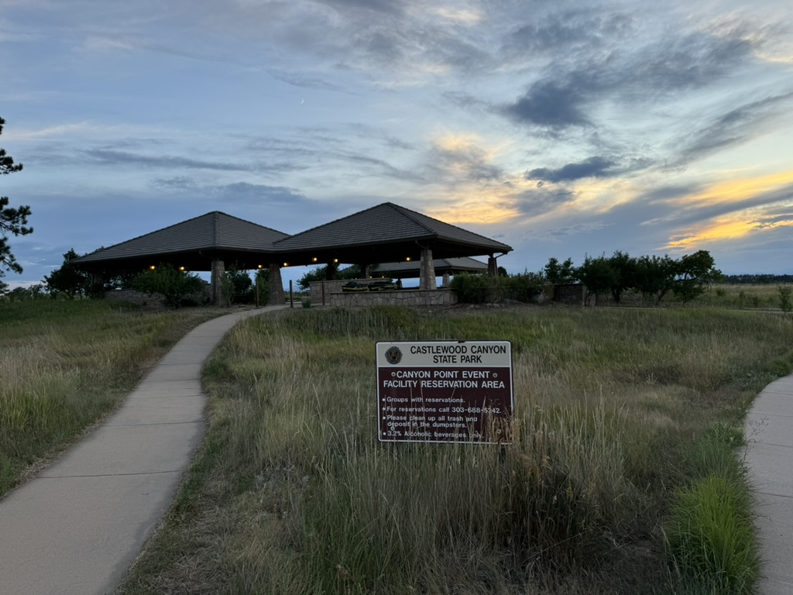
POTA Lessons Learned from the Field
By Perry Lundquist (W6AUN) & Brad Tombaugh (W0BDT)

Slide 2
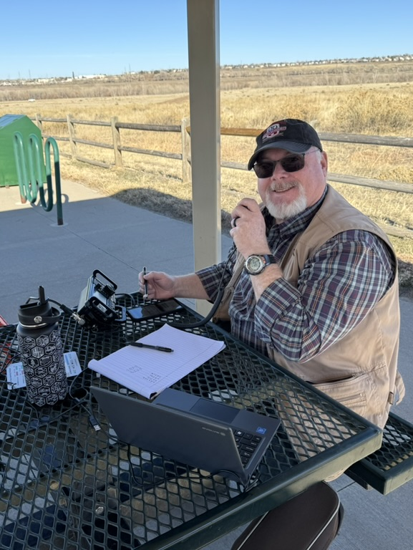
Presenters
Perry Lundquist, W6AUN
First licensed in 1978, Perry enjoys many amateur radio activities including POTA activating and hunting. He also serves his local ARES District as a Plans Section Chief and is the Liaison to the Douglas County Sheriff's Office in Colorado. Perry is a Reserve Deputy Sheriff with Douglas County, and is the manager of the 911 Communications Authority for Elbert County. Additionally, Perry is a Colorado AuxComm member. Professionally, he is a Senior Project Manager for a national telecom company.

Slide 3
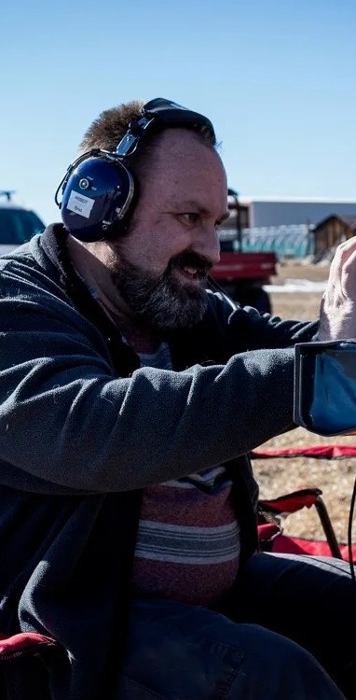
Presenters
Brad Tombaugh, W0BDT
After building a crystal radio set as a kid, Brad has had a lifelong interest in radio and electronics. After doing CB, FRS and GMRS, was licensed as an amateur in 2019. Brad is active with several area radio clubs and serves as IT staff and PIO for the local ARES district. Brad is an Advisory Consultant for a global IT firm.

Slide 4
Introduction
We’re not experts—just POTA enthusiasts!
Purpose: Share lessons learned and encourage others to try POTA.
Motto: 'Every day doing POTA is Field Day!'
Notes:
We are not experts in anything, but are portable operations and Parks on the Air enthusiasts. I’m sure that there are people here today that have been licensed longer, done more activations, and made more contacts. Our purpose here is to share what we have learned, and to encourage others to try Parks on the Air.

Slide 5
Organizing Your Gear
Keep a checklist
  Add anything that you’re missing
Have a bag/box/bin for your POTA gear to keep everything together
Folding wagon is very handy for moving gear
Notes:
Can use a to do list/reminder app like Google Keep, Todoist

Slide 6
Trial Run
Set up in your backyard or at a local park to make sure that you have everything you need
Add what's missing to your checklist
There is always a mission glitch, expect it
You learn something new with each activation

Slide 7
On-Air Tips
Expect pileups – be ready
Common bands: 40m & 20m, plus WARC bands, 10m, 6m
Can work VHF/UHF Simplex 146.52/146.58
Modes: CW, SSB, FT8/FT4, FM simplex, satellites
Pro Tip: Add 'POTA' to CQ call for digital modes
Notes:
POTA is NOT a contest, so you can use any band, including the WARC bands, 17m, 15m, 12m
Can work 2m and 70cm Simplex, but you can announce that you are working POTA on a repeater.
If you use the calling frequency like 146.52, move to another frequency to complete your contact, like the Adventure frequency 146.58MHz

Slide 8
Spotting
Spot yourself at POTA.app in advance
Spot yourself on the POTA.app website from your phone if you have cell coverage
Ask someone to spot you when you make an on air contact
Use APRS
Use SOTAmat and FT8
Notes:
Need notes from Perry on using SOTAmat

Slide 9
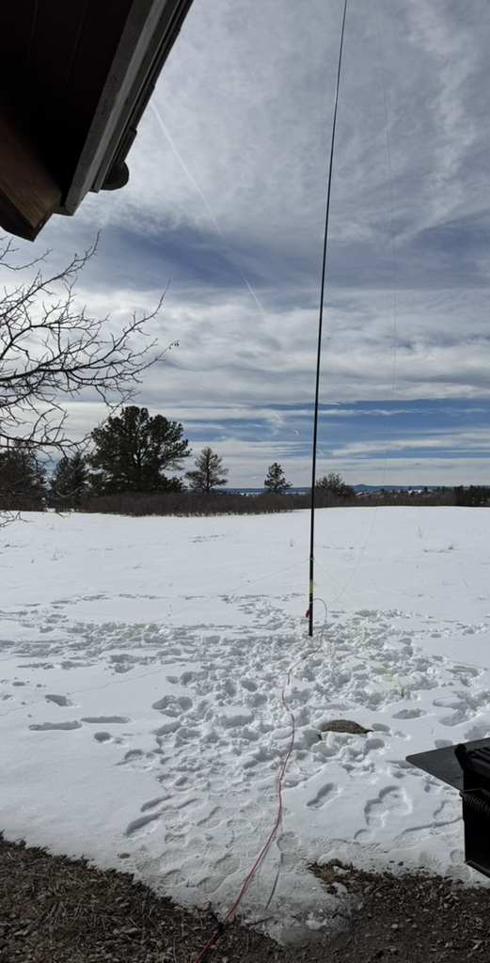
Weather
Plan for (changing) weather conditions
Conditions at the park may be very different than when you left home
Bring a jacket, hat, etc. even if you don’t think you will need it.
Plan for wind, you may need to secure tripods and other gear
Add sun screen and bug repellent to your POTA kit
Always bring water and stay hydrated

Slide 10
Public Interaction & Safety
Be polite with rangers/LEO, calmly explain about POTA
Expect curiosity from the public, be an ambassador for amateur radio
Safety checklist: buddy system, trip plan, first aid gear
Use bright paracord for guy lines and tie downs. Mark items with reflective tape
Avoid RF and shock hazards
Maintain good situational awarness. Always consider your personal safety
Notes:
It is possible that you will be approached by the public, a park ranger, or even a law enforcement officer to ask what you are doing or tell you that you have broken a rule or policy. Stay calm, and don’t argue. Try to accommodate the request. Ask where you can find the rules.
Take a buddy, they can help setup, assist with logging, or work as a second operator
Let someone know where you are going, when you plan to return
Have emergency supplies just in case
Be prepared for spotty or no cellular coverage
Don’t expect to have internet access in all areas
Watch for overhead power lines!
If using a dipole, be perpendicular to the power lines if possible

Slide 11
Potential Issues
RFI can interfere with your computer, use ferrite beads on USB cable
Always use common mode chokes (CMC) like an “ugly balun”
Increase distance from antenna and power leads
Use ferrite beads on coax cables
A CMC needs to be at the antenna feed point for vertical, but at the radio for an EFHW
May need a CMC at both ends
Notes:
Some radios like the ICOM IC-705 are susceptible to RFI on the USB port, which can make the radio lose its connection to the computer.
Use a good quality USB cable with ferrite beads on both ends
Use a longer coax cable to increase the distance between the antenna and radio/computer
Use WiFi or Bluetooth to connect the computer to the radio if available
Might need to add a common mode choke with ferrite beads or a coil of coax.
For a vertical antenna, place the choke at the antenna feed point
For an EFHW, place the choke at the radio, as the coax acts as the counterpoise

Slide 12
Barrel Connectors
When you coil up your coax cable, join the ends with a barrel connector.
This helps hold the cable together and protects the connectors from dirt and damage.
You’ll also have a barrel connector handy if you need to extend your coax.
Put can put a nylon wire with an eyelet around the middle of the barrel and a piece of Paracord to attach it to something so that you don’t lose the barrel.
Pack extra barrel connectors and assorted adapters

Slide 13
POTA
Antennas
The perfect POTA antenna is easy to setup, works well, is easy to tear down, and packs compactly
There are hundreds of antenna options
Have more than one type of antenna with you
Depending on conditions, verticals can work as well or better than EFHW antennas
The amount of RF power you plan to run may determine the particular antenna you need to use
Consider using antenna supports that don't depend on trees or stakes in the ground
Notes:
POTA activations are great for experimenting with building your own antenna
Wire antenna are easy to make, using a BNC-Binding Post “Cobra Head” adapter
Determine the length using the formula or find a design you like in the ARRL Antenna Handbook, Portable Operations, or Salty Walt’s book, or search in QST archives
Cut your wires long so that you can tune as necessary. Feed through the holes in a plastic S-biner to adjust the length before trimming, wrap around the end of the wire.
Can use crimp-on ring terminals to connect to the binding post for durability
Use an antenna analyzer to measure SWR, resonant frequency, etc. and tune as needed

Slide 14
Making Your Own Antenna
Construct simple wire antennas using a BNC-Binding Post adapter
Silicone jacketed wire doesn’t tangle as much
Plastic “S-biners” work great to hang antenna or attach the ends
Have plenty of paracord to hang in trees or use as antenna supports, but make sure that you take it all with you
Can use an arborist’s throw line to hang antenna in trees
Notes:
POTA activations are great for experimenting with building your own antenna
Wire antenna are easy to make, using a BNC-Binding Post “Cobra Head” adapter
Determine the length using the formula or find a design you like in the ARRL Antenna Handbook, Portable Operations, or Salty Walt’s book, or search in QST archives
Cut your wires long so that you can tune as necessary. Feed through the holes in a plastic S-biner to adjust the length before trimming, wrap around the end of the wire.
Can use crimp-on ring terminals to connect to the binding post for durability
Use an antenna analyzer to measure SWR, resonant frequency, etc. and tune as needed

Slide 15
Basic Tools
Have some basic tools with you
Pocket knife
Swiss Army Knife or Leatherman
Small pliers or crescent wrench
Electrical tape
Nylon wire ties
Paracord or #36 bank line
Flashlight and headlamp in case you need to tear down in the dark
Notes:
Be prepared with some basic tools in case you need to make a repair or adjustment

Slide 16
Fishing Vest
Extra pockets can be helpful
Quickly stow connector caps, covers, adapters, twist ties, cable ties, Velcro tape, etc.

Slide 17
Getting Help
Parks on the Air help desk provides support for uploading logs, and answering questions
Slack Channel
Facebook Group

Slide 18
Final Tips
Practice your setup in the backyard first
Make a checklist of all essential gear
Plan for weather, weak cell coverage, long pileups
Above all else...
Get outdoors, get on the air, and have fun!

Slide 19
Q&A
Questions about getting started, gear, or activation planning?

