Slide 1


Considerations for a remotely controlled and operated station
Doug Sharp, K2AD

Slide 2
Physical Separation
In my last NerdFest talk we discussed physical separation to minimize or eliminate interference between HF stations
We can separate using long RF cables
  Have the radio close to the people
  Install the antenna far away
But long RF feedline cables are expensive … and have some loss
  Expensive is the major factor
  Loss of LMR600 (like we use at RMHAM Field Day) only has about 0.2 dB loss / 100 feet - thus our 500 foot cable is only 1dB loss on 20 meters. Not bad!
Another solution is to remote the radio … placing it 300-500 feet away

Slide 3


What do we need to remote?
Remote Computer (for logging and FT8 operation)
Remote control Antenna Rotor (to move a directional yagi)
Remote Antenna Switch (to select one of multiple antennas)
Power system (run everything possible on 12VDC)
Remote monitoring or metering

Slide 4
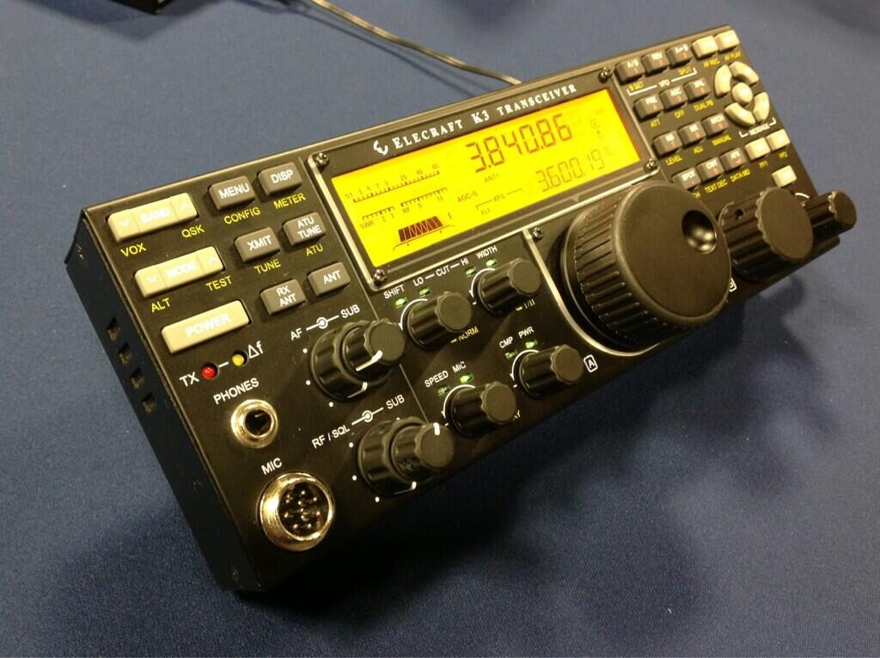
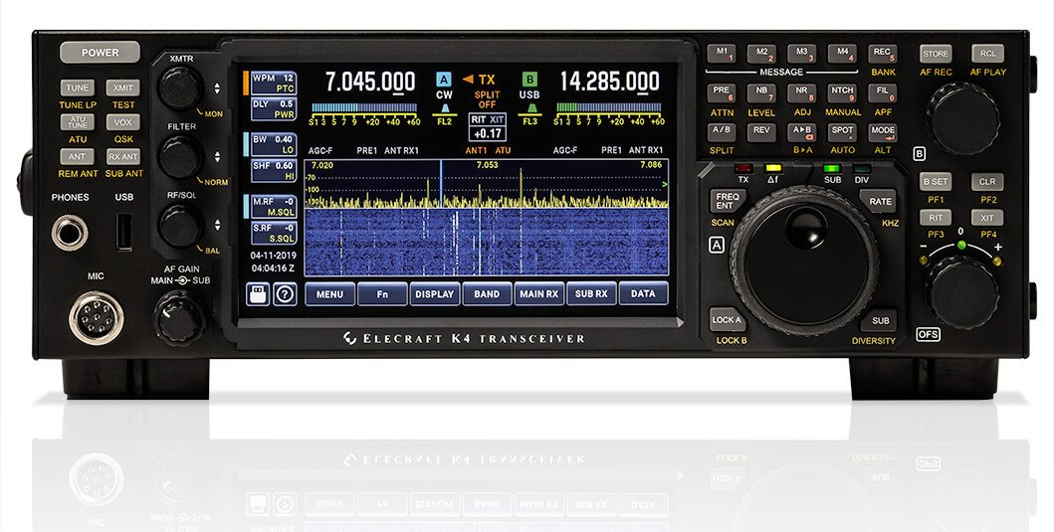
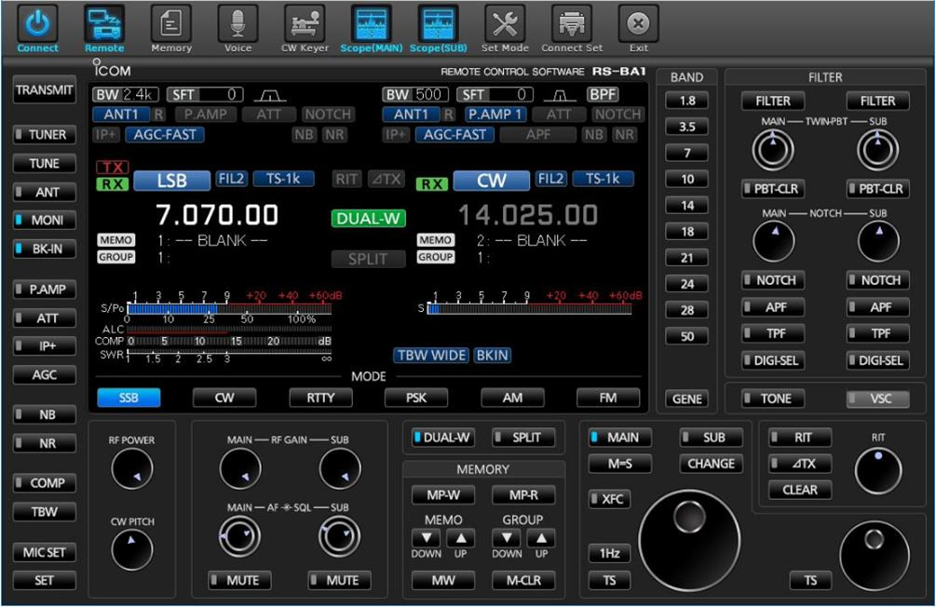
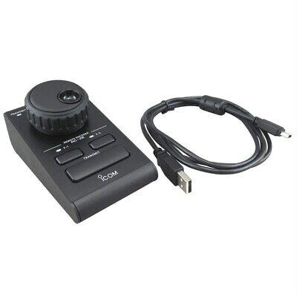
CW and SSB on a remote radio
A good human interface is a must
Hard to operate SSB and CW with a “click based” control panel
Try to use a real remote control head
  Elecraft K3/0 remote head
  Elecraft K4D is fully remote control from another K4D
  If a “partial head” consider a “Pod Controller” for the VFO and some functions

Slide 5
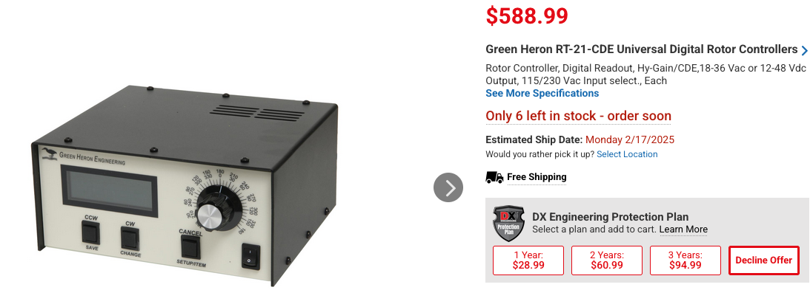
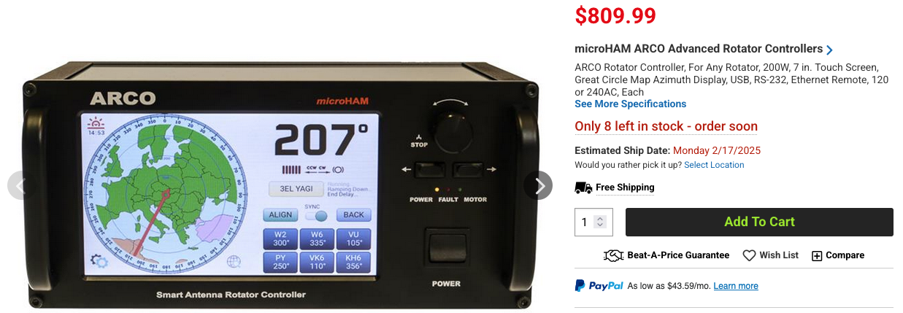
Antenna Rotor
Several nice rotor controllers available with remote IP control
Green Heron
  RMHAM has several of these
  IP remote control possible – but slightly complicated
Arco
  Very nice controller
  LCD screen shows where you are pointing
  Direct IP connection – easy to remote control

Slide 6
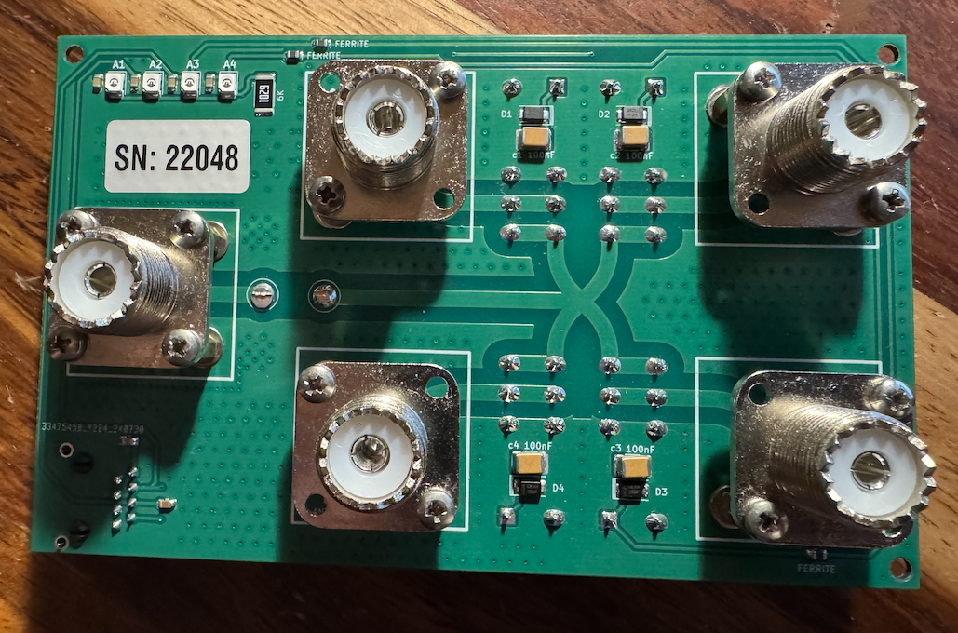
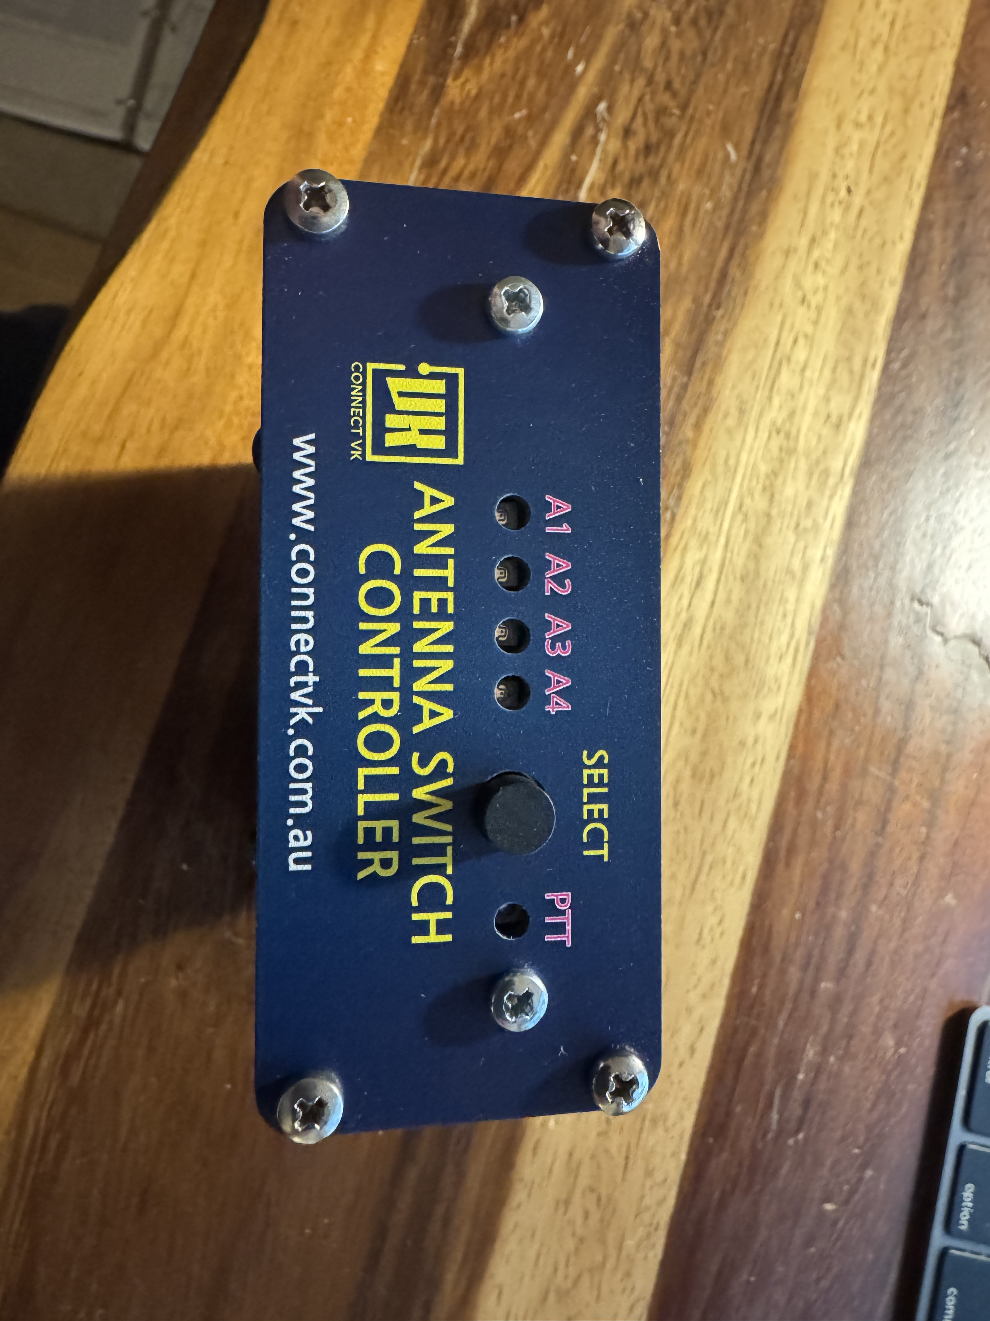
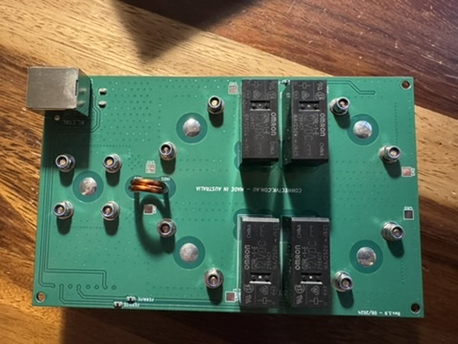
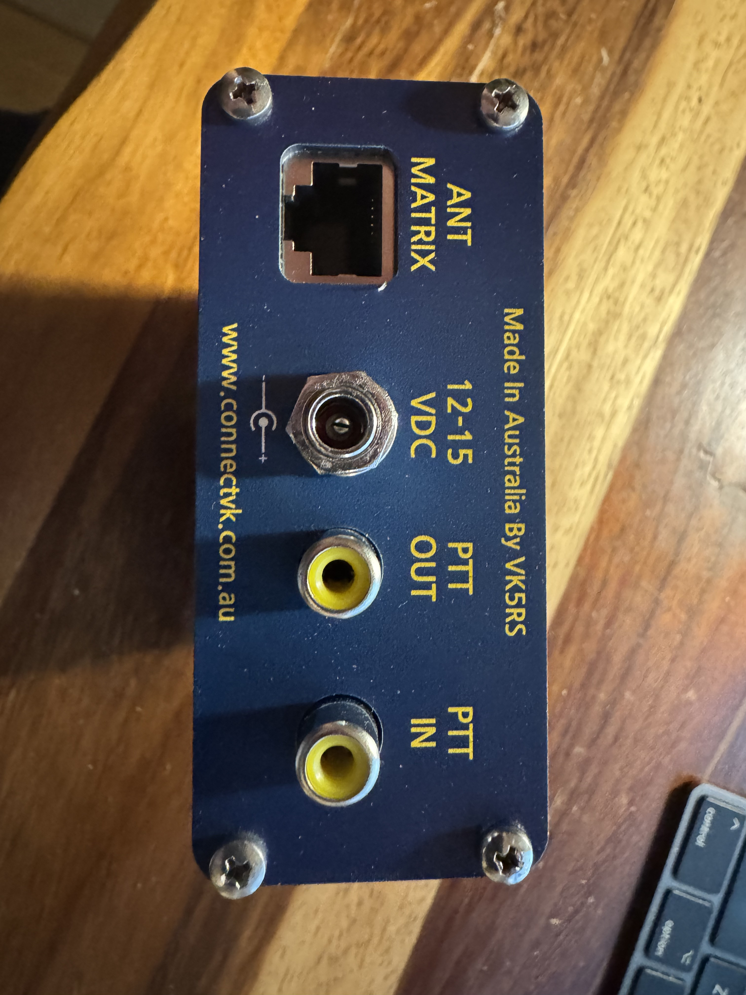
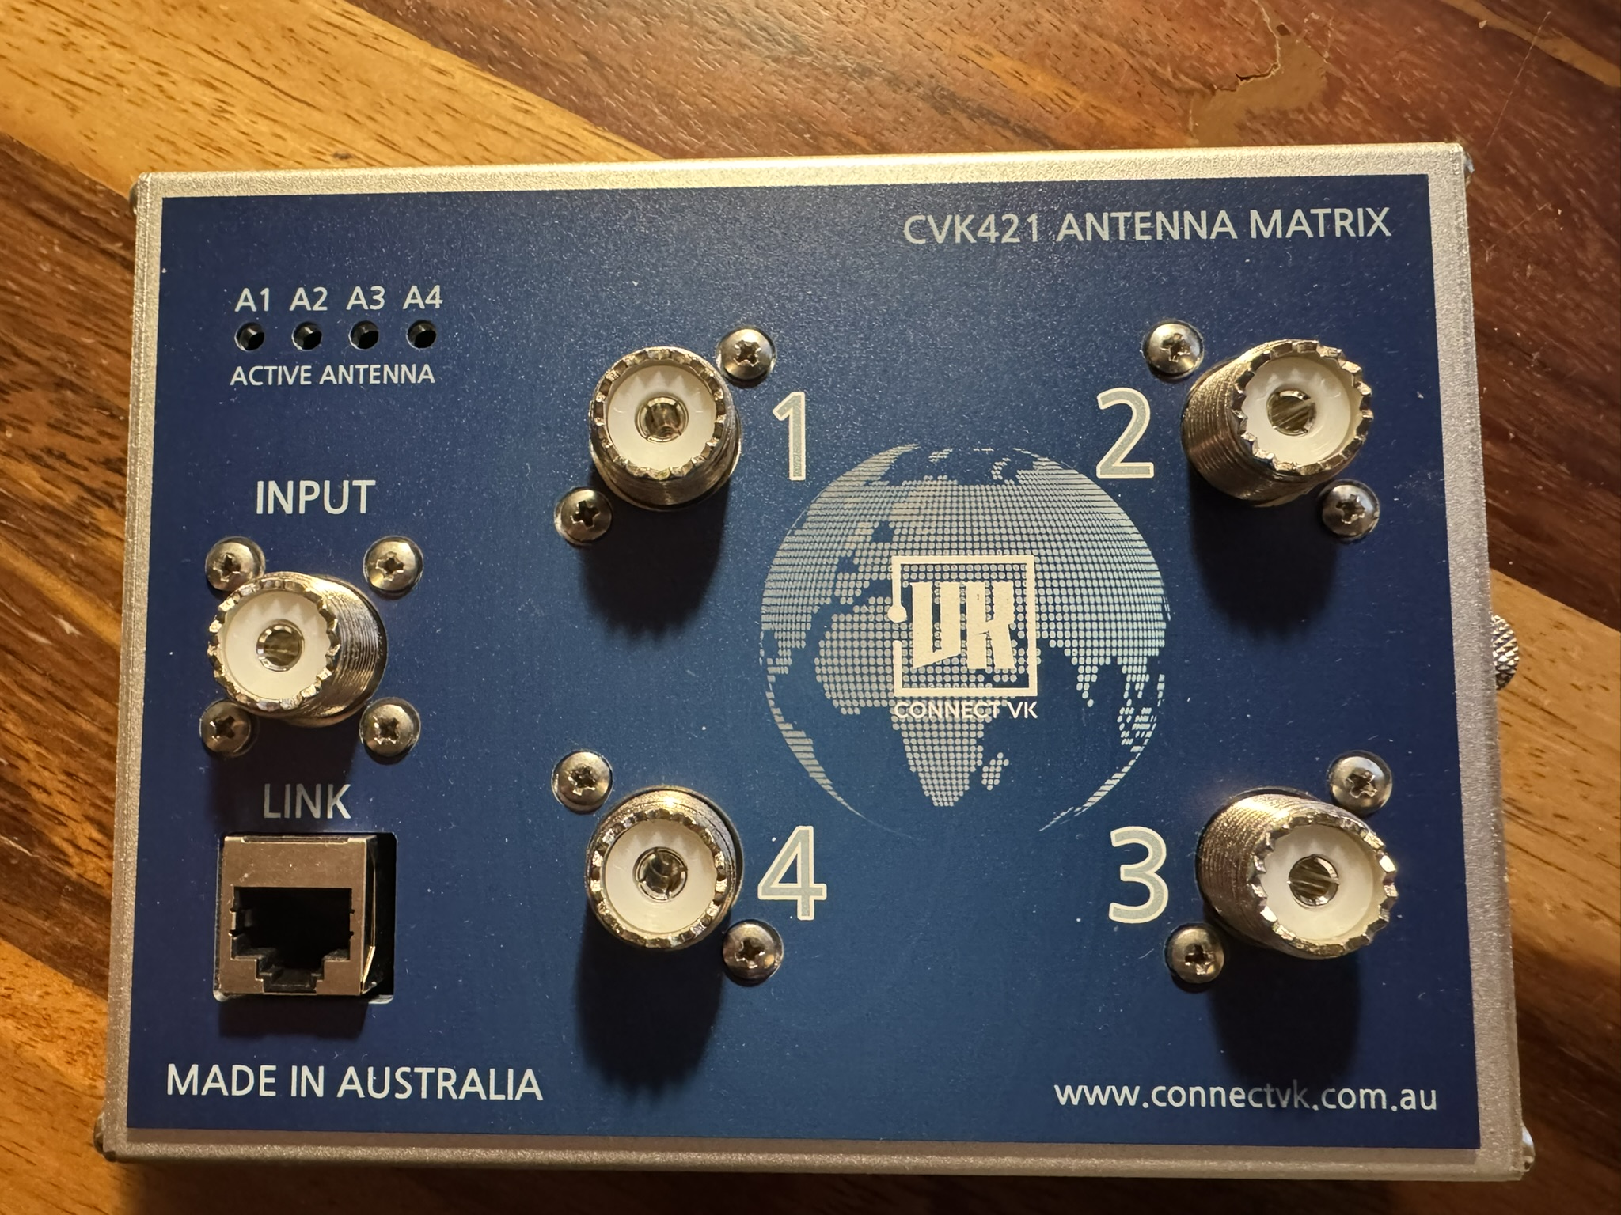
Antenna Switch
I’ve found a nice remote (relay) antenna switch
We can build one if needed, but as one of my Elmers used to say, “Buy what you can afford. Build what you can not.”
I found this nice relay switch built by a ham in Australia
He even sells a local control box
  Note the PTT IN and PTT OUT connections
  Why does the antenna switch need a PTT connection?
    You need it to avoid hot switching the relays!
But no remote control
  Can we build one?
  Anyone up for a homebrew project with an Arduino or equivalent?

Slide 7
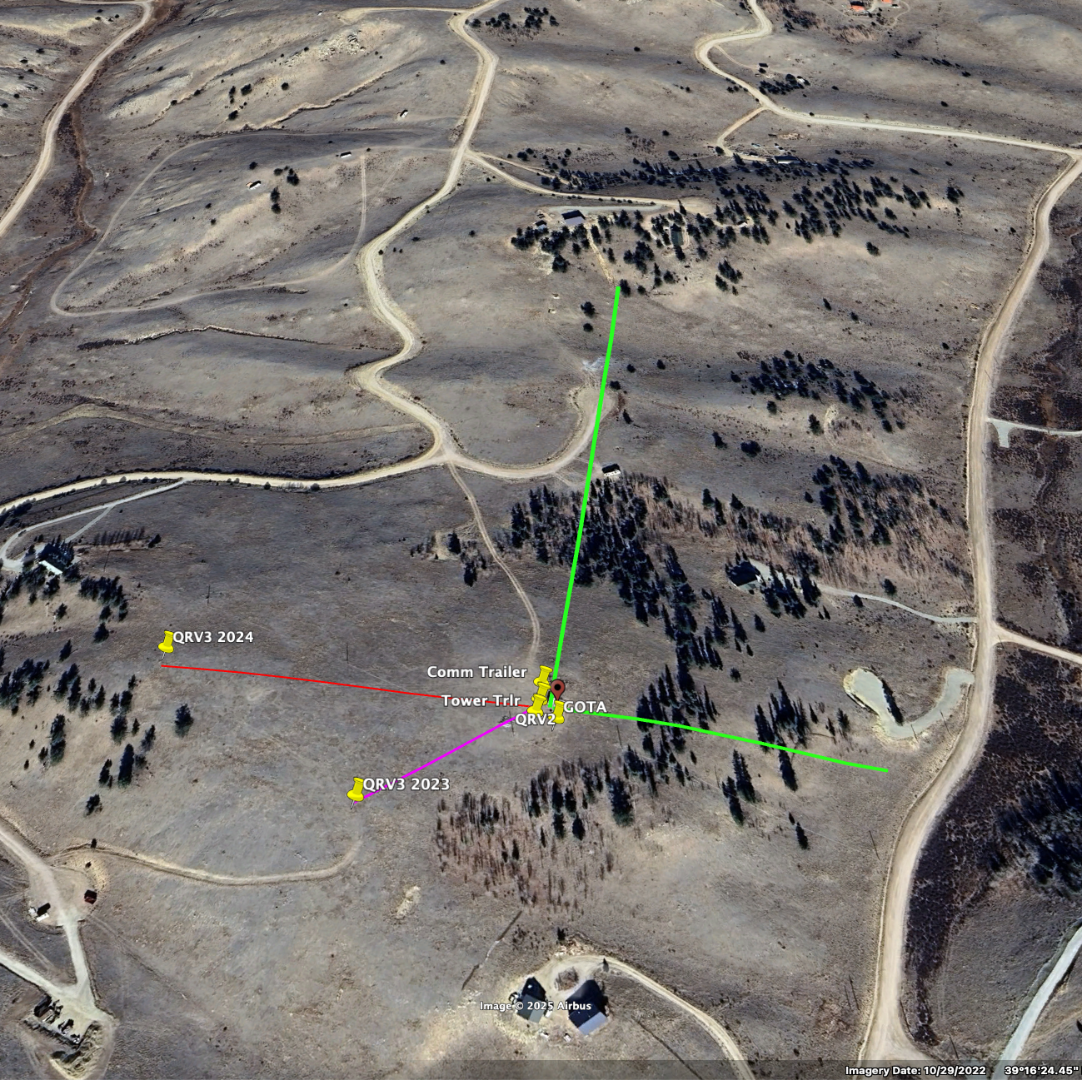
RMHAM Field Day 2025
A new possible layout?
Operator positions in the Comm Trailer
One station “local” with antennas near the trailer
Two stations with antennas “remote” at least 300 feet away
Use Tri-plexer with filters to operate multiple radios on a single tri-band yagi
NORTH
Station 3
Remote
Spare
Antenna
QRV3 2022
WEST
Station 1&2
Local
GOTA
Antenna
EAST
Station 4
Remote

