Slide 1
Lessons learned while operating multiple 100 watt HF stations in close proximity
Doug Sharp, K2AD

Slide 2
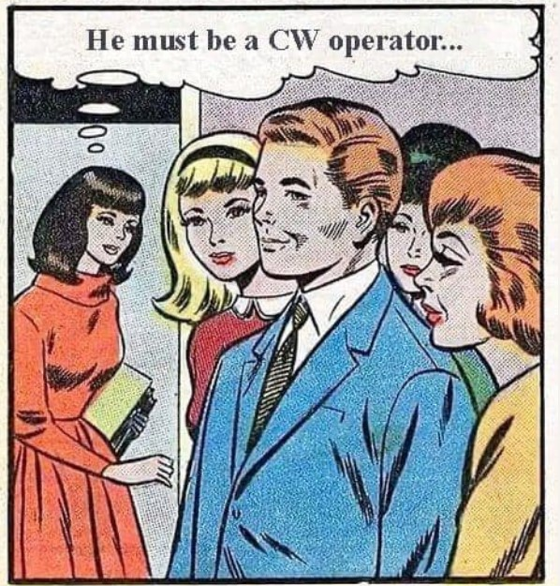
D0 you ever wonder …
Why can I not hear those weak stations?
Will our annoying ”CW Guy” ever take a break so I can work people on SSB? (You just can’t trust those CW people.)
Maybe he will switch to another band?
Why do I have a headache after operating?
We are losing QSOs!

Slide 3
RMHAM Field Day
2020ish
Radios and Antennas located close to the Comm Trailer
Significant inter-station interference
2022
QRV3 moved to ”top of hill” at “Stonehenge”
Due West of the Comm Trailer @ 500ft
Some minor interference between SSB and CW when antennas were aimed at each other
2023
QRV3 moved to the Southwest
Southwest of the Comm Trailer @ 350ft
Much less interference
But it was a long walk over uneven terrain
2024
QRV3 moved back to ”top of hill” at “Stonehenge”
Due West of the Comm Trailer @ 500ft
Added second Tri-bander for Digital near Comm Trlr
Major issues when CW aimed East and FT8 station aimed west
NORTH
QRV3 2022
WEST
EAST

Slide 4
Icom IC-7000 and IC-7300 “Spooge master”
Dirty Pictures
Not all transmitters and receivers are alike
The high-end Yaesu and Elecraft radios have the cleanest transmitters and best receivers (see Rob Sherwood’s performance tests)
Icom IC-7000 and IC-7300 are fine radios … for HOME USE
The IC-7000 transmitter gets “dirty” when warm or hot
The IC-7300 receiver easily overloads when operating in close proximity to other HF radios (I own one! It is a good radio … except at Field Day)
These radios are excellent radios for those operating from home (and do not have another ham living next door.)
Field Day 2024 – Elecraft K3 Pan Adapter on CW when IC-7000 operating on FT8

Slide 5
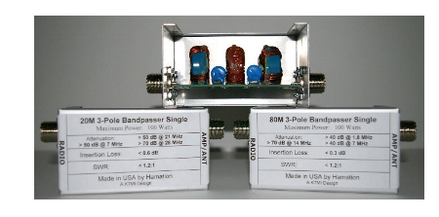
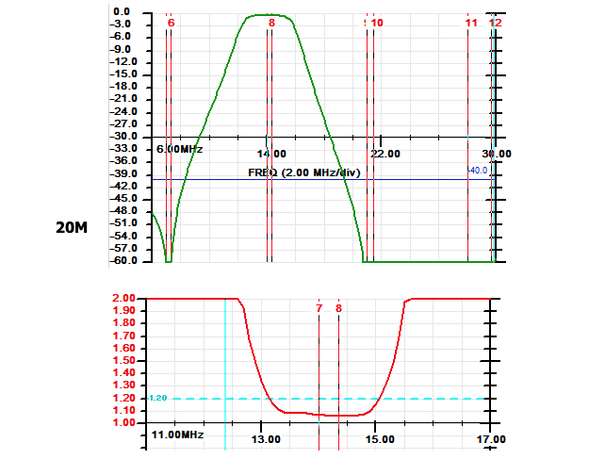
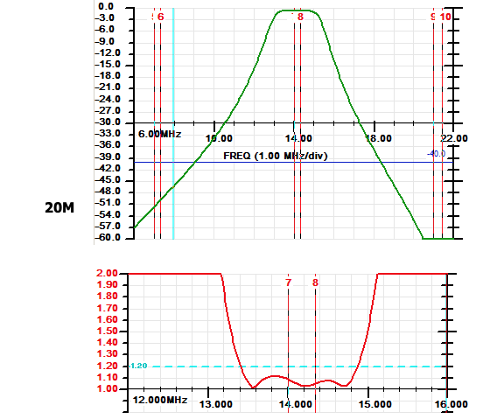
Will Filters help?
I like the filters by Hamation
Hamation EF Series
~ $120 each
Hamation CF Series
~ $90 each
Interference BETWEEN bands
Yes, adding a bandpass filter will help!
Example 1: Bandpass filter on 40 meters (7 MHz) and 20 meters (14 MHz)
Example 2: 40 meters (7 MHz) and 15 meters (21 MHz)
Where do I find filters?
Homebrew
Several off-the-shelf filters available at reasonable cost
Bandpass filters are effective at reducing or eliminating interference between bands
7 MHz
21 MHz
14 MHz

Slide 6
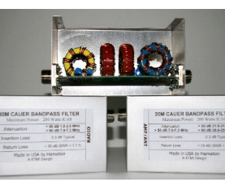
Will Filters help?
What about interference within the same band?
Let’s look at a use case
CW operating at 14.025 MHz
SSB operating at 14.300 MHz
Adding a bandpass filter will NOT help!
So what do we do?
Physical separation
Antenna pattern / antenna nulls
Antennas should be placed at least 300 feet apart ”a.k.a. One Spinelli”
This is the entire 20 meter band
Hamation EF Series
~ $120 each

Slide 7
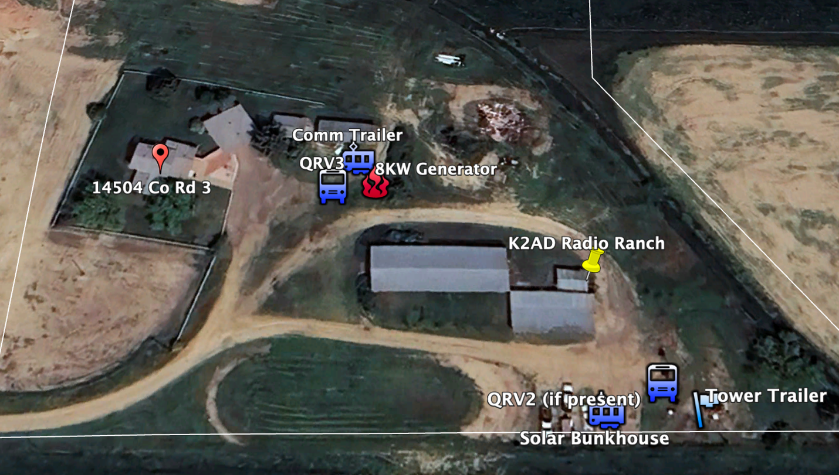
Winter Field Day (WFD) 2025
One of our goals for WFD Winter Field Day was to learn about inter station interference
CW Station (QRV3 antenna) had Elecraft K4D with Cushcraft A3S + 40 meters
SSB Station (QRV2 antenna) had Elecraft K3 with Cushcraft A3S + 40 meters
Digital Station (spare antenna) had Icom IC-7300 with 80 meter dipole
We tested CW on K4D+QRV3 tri-bander and SSB on K3+QRV2 tri-bander both operating on 20 meters
No inter station interference!
North
Yagi aimed NE / SW
300 ft
Yagi aimed NE / SW
The K2AD Radio Ranch

Slide 8
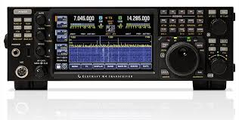
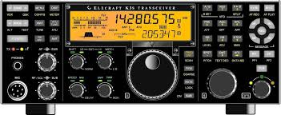
HF Tri-Plex Filters
Off-the-shelf HF Triplexer filters are available
Allows multiple HF radios to operate using the same antenna
HF radios must be on different bands!
Must add additional bandpass filters per band (Don’t use additional filters = HF radio dead. Big $$$)
Tri-plexers and Bandpass filters limited to 100 or 200 watts depending upon construction
Tested with Elecraft K4D on 20 meters and Elecraft K3 on 15 meters
No interference between bands
John Maxwell told me about these a few years back.
I was skeptical. I thought John was a crazy fool.
I hate to admit it, but John was right! (But don’t tell him I said that)

Slide 9
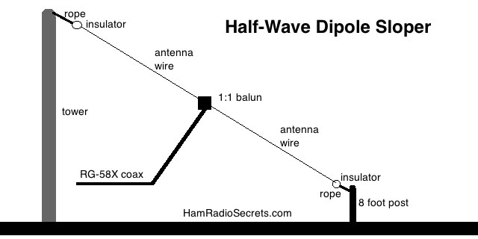
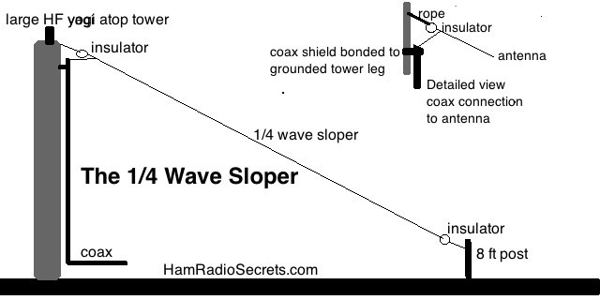
What about 80 / 75 meters?
The ARRL Handbook (not the ARRL Antenna Book) has a nice article about 80 meter quarter wave Sloper antennas
A sloper is essentially a dipole mounted at a 45 degree angle
Directional antenna
ARRL Handbook suggests that some “top hat” capacitance will improve performance
So let’s use our Tri-Band yagi as a top hat
We can install multiple sloper antennas (NE and SW) to obtain directivity
Or possibly two sloper antennas (NE and SW) with an Inverted Vee at 90 degrees?
Graphics stolen from HamRadioSecrets.com

